Slide 1



Title Prosposal Presentation
By : Ian Padilla

Slide 2

Titles:
Inventory System of Purok Narra (SLP) Convenience Store
OJT Monitoring System
Online Faculty Consultation System

Slide 3
Title:1
Inventory System of Purok Narra (SLP) Convenience Store

Slide 4
Background
Current Situation
• Inventory recorded in notebooks
• Products counted one by one
• Sales computed using calculator
• Reports prepared manually

Slide 5
Background
Resulting Problems
• Time-consuming inventory process
• Prone to human errors
• Difficulty monitoring stock levels
• Slow preparation of sales reports

Slide 6
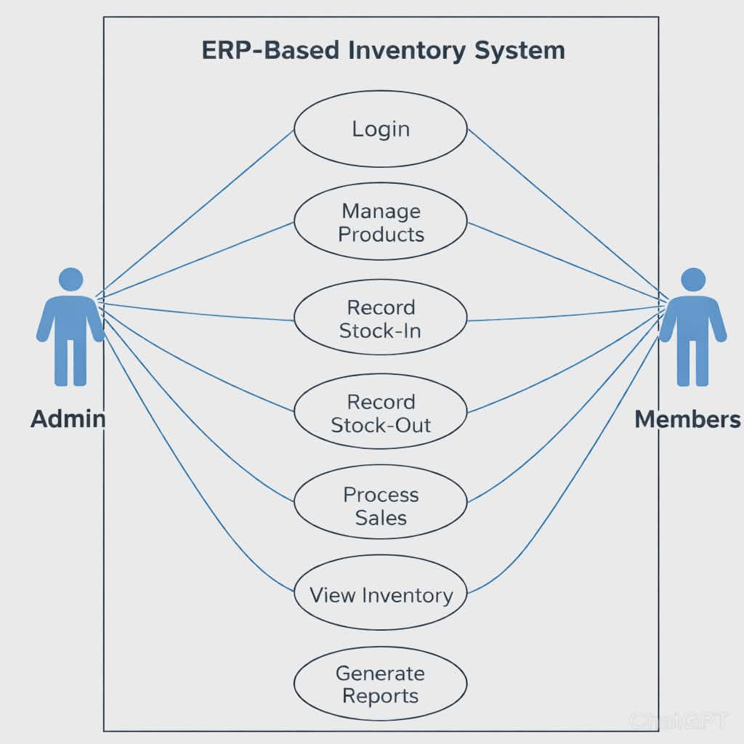
Background

Slide 7
Background
Benefits of the System
• Faster inventory monitoring
• Accurate stock records
• Automatic report generation
• Improved store management

Slide 8
Statement of the Problem
Purok Narra (SLP) Convenience Store uses a manual system where inventory is recorded in notebooks and sales are calculated using calculators. This process is time-consuming, prone to errors, and makes stock monitoring difficult.

Slide 9
Statement of the Problem
What are the challenges encountered in the current manual inventory system used by Purok Narra (SLP) Convenience Store?
How can an ERP-Based Inventory System be designed to improve the inventory management of the store?
How can the system generate accurate and timely inventory and sales reports for the store?

Slide 10
Objectives
General Objective:
Develop an ERP-Based Inventory System for
Purok Narra (SLP) Convenience Store

Slide 11
Objectives
Key Objective:
1.To make a streamline inventory management.
2. To speed up sales transactions.
3. To provide faster business reports.

Slide 12
Theoretical Framework
This study is anchored on the theory proposed by Rajeev K. K. (2008), which identifies financial limitations, human factors, technology, and organizational concerns as key variables affecting inventory management effectiveness. The framework highlights the challenges small-scale convenience stores face such as limited resources and staff constraints. By integrating affordable technology and simplifying workflows the proposed system aims to create a practical and sustainable inventory management solution for local businesses.

Slide 13
Methods
Research Design: The study used a Descriptive Developmental Research Design
Respondents: The respondents were the store President and Members
Research Environment: The research was conducted at the Purok Narra SLP Convenience Store.
Statistical Tool: Data were analyzed using Frequency, Percentage, and Weighted Mean.
Project Management: The system was developed using the Waterfall Model

Slide 14
Reference
Rajeev, N. (2008). Inventory management in small and medium enterprises: A study of machine tool enterprises in Bangalore. Management Research News, 31(9), 659–669. https://doi.org/10.1108/01409170810898554 (doi.org in Bing)

Slide 15
Title:2
OJT Monitoring System

Slide 16
Background
Current Situation
• Students submit paper-based logs
• Professors review manual records
• Reports prepared manually
• Progress tracking is time-consuming

Slide 17
Background
Resulting Problems
• Delayed evaluation of student performance
• Prone to errors and missing data
• Difficulty monitoring multiple students simultaneously
• Hard to generate accurate reports

Slide 18
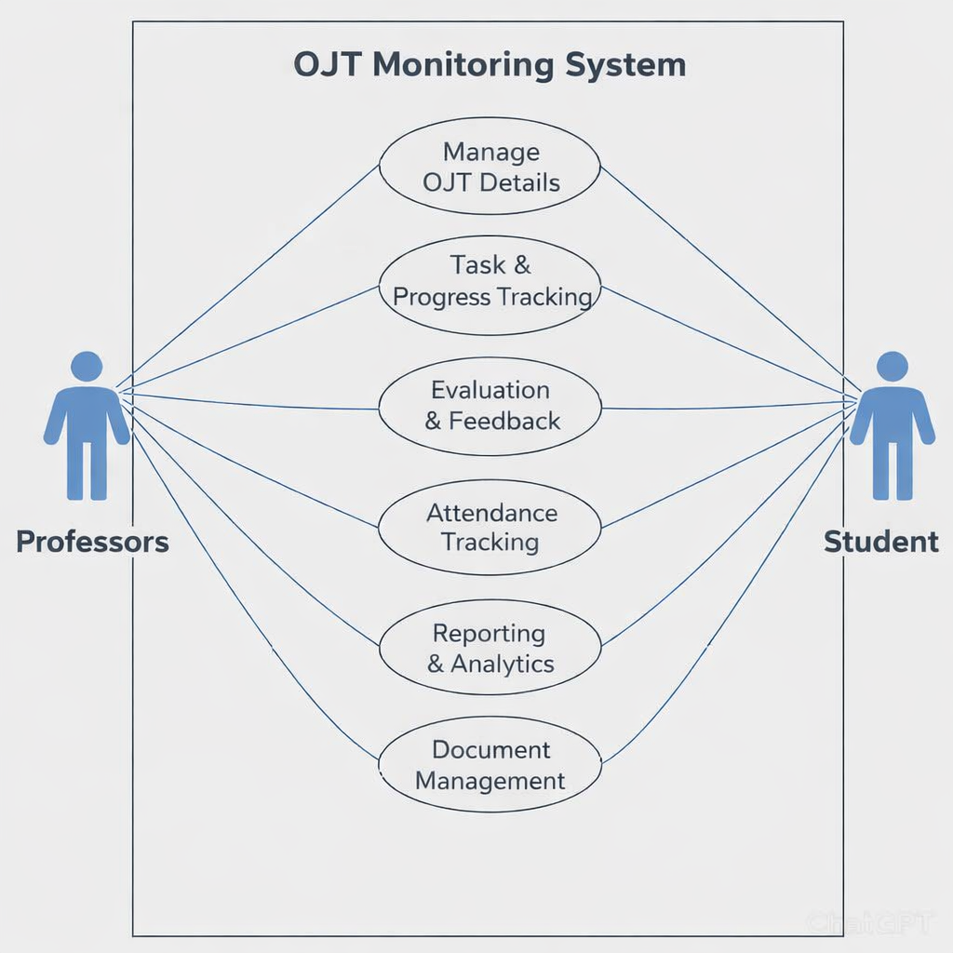
Background

Slide 19
Background
Benefits of the System
• Real-time monitoring of student performance
• Accurate and complete records
• Automatic report generation
• Faster evaluation and feedback

Slide 20
Statement of the Problem
Current OJT monitoring is done manually using paper logs and spreadsheets, making tracking and evaluation slow, error-prone and inefficient.
How can the OJT monitoring process be automated to reduce manual work and errors?
How can the system provide real-time tracking of student performance?
How can automated reporting improve the evaluation and feedback process for professors ?
How can a digital OJT monitoring system enhance accessibility and organization of student records?

Slide 21
Objectives
General Objective
Develop an OJT Monitoring System to automate the tracking, evaluation and reporting of student performance during training.

Slide 22
Objectives
Key Objectives
Replace manual logs with a digital system for efficient and accurate record-keeping.
Allow Professors to track student progress instantly.
Produce accurate and timely performance reports for evaluation and feedback.

Slide 23
Theoretical Framework
This study is anchored on Management Information Systems MIS Theory which highlights the role of technology in organizing and delivering information to support decision-making and efficiency Laudon et al., 2016 Applying MIS principles, the system enables accurate tracking of student progress, attendance, and performance, enhancing transparency, accountability and collaboration.

Slide 24
Methods
Research Design: The study used a Descriptive Developmental Research Design
Respondents: Professor and students served as respondents.
Research Environment: The study was conducted at the JMRSU-TC campus.
Statistical Tool: Frequency, Percentage, and Weighted Mean were used to interpret data.
Project Management: The system was developed using the Agile Model

Slide 25
Reference
Laudon, K. C., & Laudon, J. P. (2016). Management information systems: Managing the digital firm (14th ed.). Pearson Education

Slide 26
Title:3
Online Faculty Consultation System

Slide 27
Background
Current Situation
• Faculty consultation scheduled manually via phone or email
• Students visit offices without prior confirmation
• Logs of consultations recorded manually
• Feedback and follow-ups not systematically tracked

Slide 28
Background
Resulting Problems
• Scheduling conflicts and missed appointments
• Time-consuming for both students and faculty
• Difficulty monitoring consultation history
• Limited accessibility and inefficient communication

Slide 29
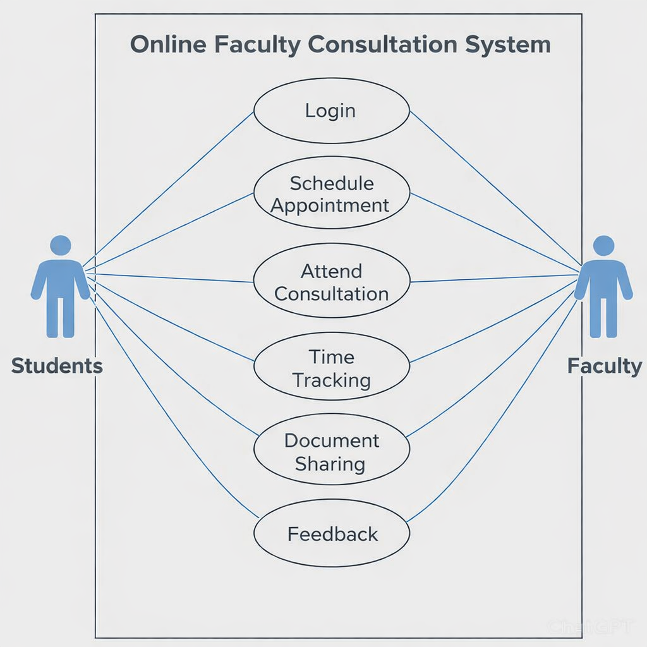
Background

Slide 30
Background
Benefits of the System
• Efficient online scheduling and approval
• Real-time tracking of consultation logs
• Reduces missed appointments
• Improves communication between students and faculty

Slide 31
Statement of the Problem
Faculty consultation is currently scheduled manually through phone, email, or walk-ins which is inefficient and prone to errors.
How can the consultation scheduling process be automated to reduce conflicts and missed appointments?
How can students and faculty track consultations in real-time?
How can consultation logs and records be managed digitally to improve accessibility and efficiency?
How can the system improve communication between students and faculty during consultation?

Slide 32
Objectives
General Objective
Develop an Online Faculty Consultation System to automate scheduling, tracking, and reporting of student consultations.

Slide 33
Objectives
Key Objectives
Students can book consultations online faculty can approve automatically.
Faculty and students can view consultation schedules and logs instantly.
The system automatically keeps consultation history and produces reports for evaluation.

Slide 34
Theoretical Framework
The Online Faculty Consultation System is anchored on the findings of Shen et al. (2024) who emphasized that online consultation platforms integrate both technical systems and social interaction to improve accessibility and efficiency. Applying this framework, the system ensures streamlined scheduling, documentation, and feedback while fostering meaningful academic dialogue between students and faculty.

Slide 35
Methods
Research Design: Descriptive-developmental method using the System Development Life Cycle (SDLC).
Respondents: Faculty and students
Research Environment: The study was conducted at the JMRSU-TC campus.
Statistical Tool: The study used weighted mean and Likert scale analysis to evaluate survey responses and measure the usability of the Online Faculty Consultation System.
Project Management: The system was developed using the Agile Model

Slide 36
Reference
Shen, T., Li, Y., & Chen, X. (2024). A systematic review of online medical consultation research. Healthcare, 12(16), 1687. https://doi.org/10.3390/healthcare12171687 (doi.org in Bing)

Slide 37

Thank you very much!

