Slide 1

Shri Vaishnav Vidyapeeth Vishwavidyalaya
Class - B.TECH, Computer Science Engineering
Specialization - ARTIFICIAL INTELLIGENCE
----- Developed By ----- Guided By
l 18100BTCSAII02860 Sajal Jain Gaurav Thulla
18100BTCSAII02868 Sparsh Tiwari
18100BTCSAII02873 Viral Khatri
18100BTCSAII02873 Vibhor Joshi

Slide 2





Football League Prediction

Slide 3
INTRODUCTION
Our project is a brief description about the statistical management of teams in the league.
In this project we are going to analyze the previous data and records of the teams and are going to predict their standings in the league.
This is a data visualization project developed in R language.

Slide 4
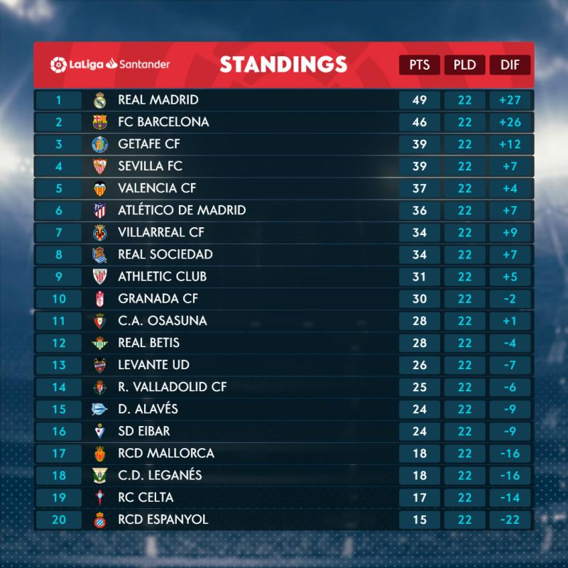

Slide 5
Problems
It is hard to manage the data and statistics of so many teams in real leagues.
As each team contain minimum 16 players then it gets much more harder to manage their individual records.
The individual performances of a player might affect the performance of a team as the players might get transferred to other teams, due to this strength or performance of a team can differ in different seasons.
Hence, these problems plays a major role in the standings of a team in a particular league.

Slide 6
Synopsis
This is just a basic model based on real life situations i.e. the real football leagues which consists of more teams and tougher situations.
This model consist of 4 teams and is small scale version of the real leagues. Through this model we are going to predict the standings of these teams in the following league.
On the basis of the provided data set we are going to predict the winner of the league, Player of the tournament, Best Goalkeeper etc.
All of the data will be presented in a tabular format so it will be easy to manage.
We are using R language for this work because its main function is to provide the data in a statistical and graphical format.

Slide 7
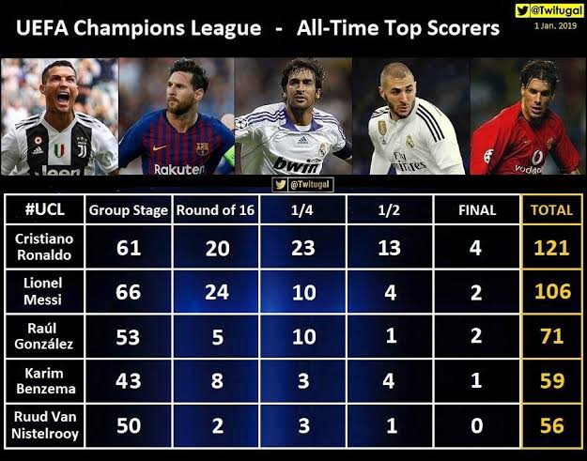

Slide 9
Why we choose this topic
The main reason behind choosing this subject is the popularity of this game at the global level.
This is a topic of public interest which deals with larger data sets and probability.
Dealing with this type of dynamic situation could be difficult and so is to manage its data that’s why we are creating a model which can predict the future performances of these teams on the basis of the previous data available.
To promote basic knowledge of football.

Slide 10
CONCLUSION
By using this project we can learn how to manage larger data sets in an efficient manner.
This project helps us to acquire more and more knowledge about functions and features of R language.
With the help of this project we can arrange our data in the graphical and statistical manner which is easy to understand.
Our project helps us to provide the basic knowledge of football and its leagues.

Slide 11
THANK YOU

