Slide 1

Shri Vaishnav Institute Of Information Technology
PREDICTING WINE QUALITY
GROUP MEMBERS :
Shantanu Tyagi (18100BTCSAII02865)
Priyanshi Tandon (18100BTCSAII02856)
SUBMITTED TO: Prof. Gaurav Thulla

Slide 2
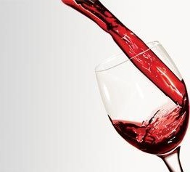
PROBLEM STATEMENT:
The main goal of this machine learning project is to build a machine learning model to predict the quality of wines by exploring their various chemical properties like alcohol quantity, fixed acidity , volatile acidity , determination of density , PH and more .

Slide 3
PROJECT DESCRIPTION :
In this data set project we will explore wine data set for red wine quality .
The objective is to explore which chemical properties influence the quality of red wines.
We do analysis with different factors in terms of quality and decides how it can lead to faulty or poor quality wines

Slide 4
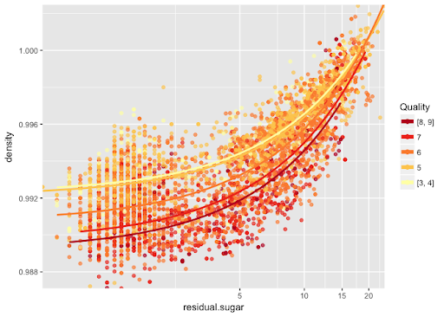
OBJECTIVE:
Data Prediction:- Dividing quality score into three different categories such as Excellent , Normal and poor wine quality.
Create Visualization to depict how residual sugar, density and alcohol affect the quality of wine.
Univariate Analysis :- It is nothing but analysis with only single variable in which we visualize the distribution of data whether it is normalize or not , if it is not normalize then we normalized it
Bivariate Analysis:- It is correlation between two variables show how one variable affect the other factors .

Slide 5
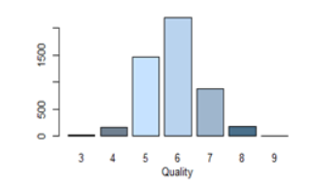
DATA DESCRIPTION:
INPUT VARIABLES
OUTPUT VARIABLES
Fixed acidity
Volatile acidity
Citric acid
Residual sugar
Chlorides
Free sulphur dioxide
Total sulphur dioxide
Density
PH
Sulphates
Alcohol
Quality
Notes:
In Slide Show mode, click the arrow to enter the PowerPoint Getting Started Center.

Slide 6
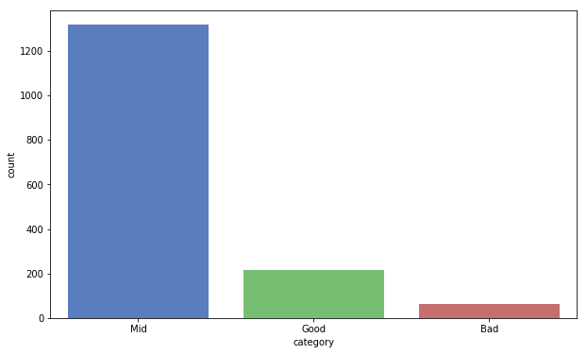
RESULT :
Classifying wine quality .
1. Good (Quality >=7)
2. Medium (7 < Quality >= 5)
3. Poor (Quality <5 )
we improve the quality of wine by visualizing the different corelations.
Volatile acidity , citric acid , chlorides , density and alcohol play major role in classifying the wine quality .

Slide 7
THANK YOU

