Slide 1
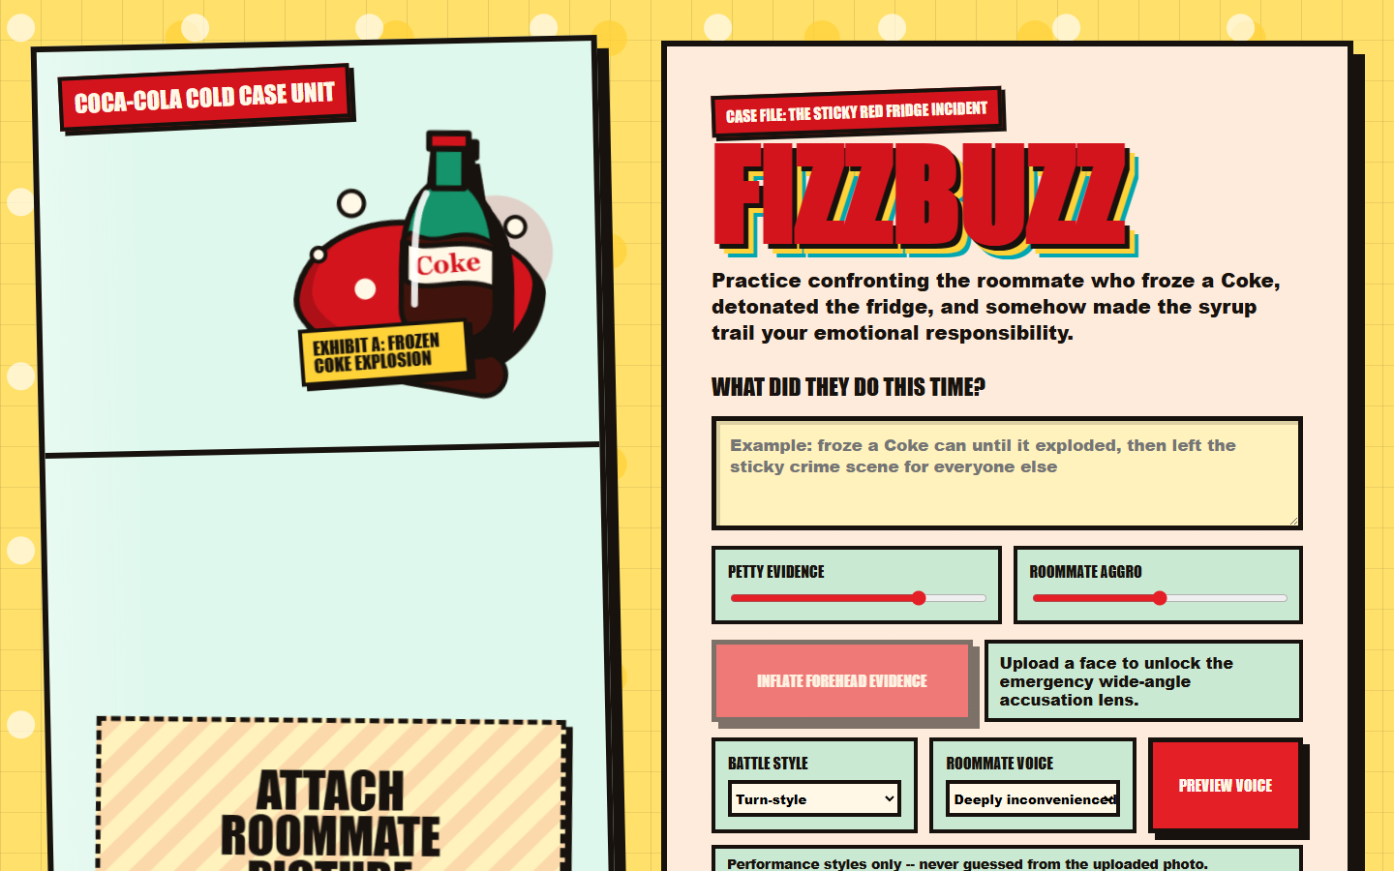
ROOMMATE BOSS BATTLE
FizzBuzz
Practice the awkward confrontation before it becomes a kitchen incident.
AI roommate deflections + live speech + comic boss-battle coaching
DEMO SIDEKICK DECK

Slide 2
The Problem
FIZZBUZZ / HACKATHON DEMO
Roommate conflict is small enough to avoid and big enough to rot the apartment.
People rehearse what to say in their heads, then still freeze at the door.
One Sentence
Advice apps feel too clinical; comedy lowers the stakes enough to practice.
A funny AI practice arena for confronting your roommate without losing your mind.
The best demo conflict is instantly legible: the exploded freezer Coke incident.
VALUE: PRACTICE, NOT PUNISHMENT

Slide 3
Live Demo Flow
FIZZBUZZ / HACKATHON DEMO
Judges can understand the loop in the first 20 seconds.
1
Case
2
Photo
3
Knock
4
Speak
5
Dodge
6
Card
Coke crime
Roommate photo
Door opens
Speak live
AI dodges
Fight card
Audience Sees
Judges Remember
Animated door transition keeps the demo theatrical.
The product converts a tense real-life moment into structured practice.
Deepgram captions make the sponsor integration visible.
Every external API has a fallback, so the demo keeps moving.

Slide 4
The Product Moment
FIZZBUZZ / HACKATHON DEMO
The setup screen makes the joke and the job-to-be-done obvious.
Setup gives the AI context
Conflict description
Photo evidence
Evidence + aggro sliders
Voice style selection
COMEDY UI WITH REAL INPUTS

Slide 5
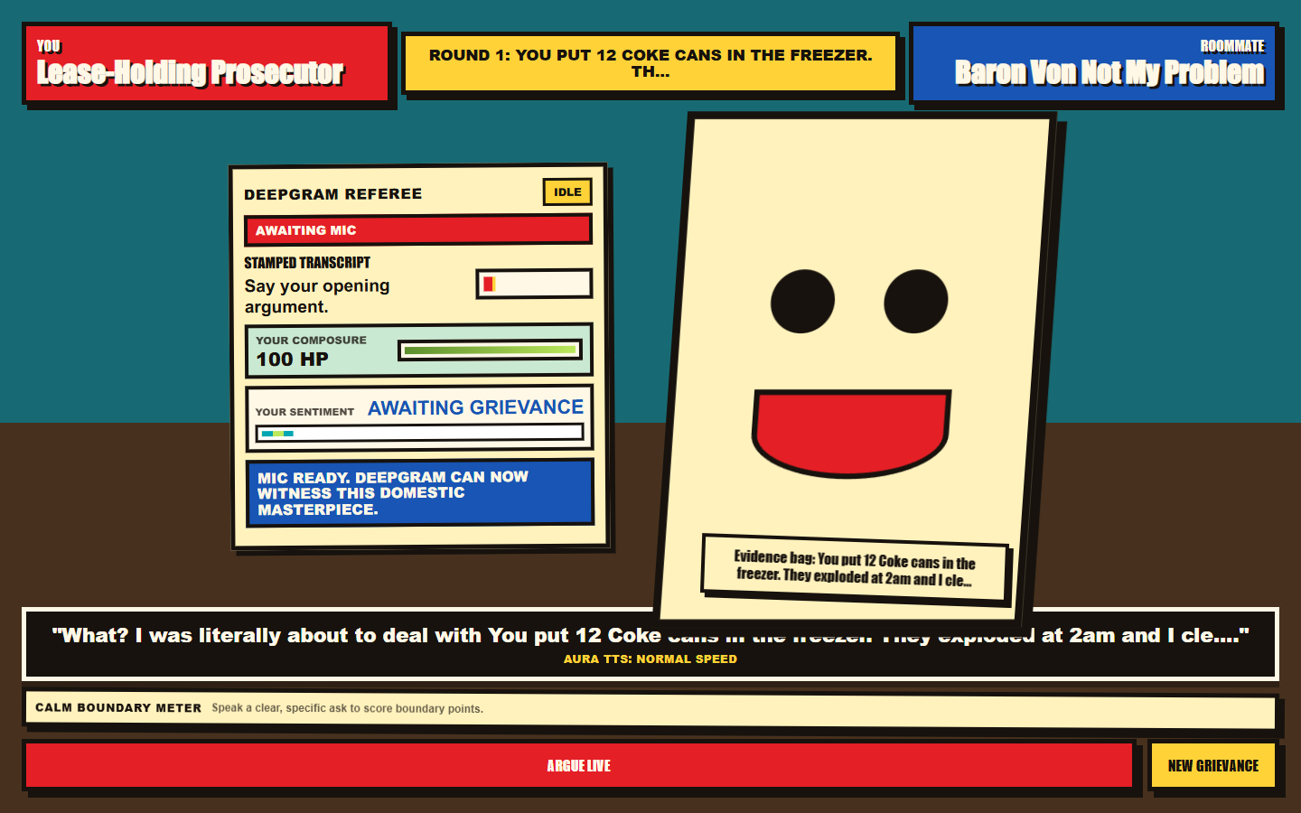
Confrontation Loop
FIZZBUZZ / HACKATHON DEMO
Speech turns become boss-battle progress and coaching signals.
Visible sponsor beats
Deepgram Referee
Aura TTS Roommate
Gemini Deflection Engine
Pika Media Hook
The UX turns latency and transcripts into part of the game, so technical state is readable on stage.

Slide 6
Architecture
FIZZBUZZ / HACKATHON DEMO
One Express/Vite app, multiple AI services, fallbacks everywhere.
Deepgram
STT / Agent
Deepgram
Aura TTS
Browser UI
Express API
Boss Battle
State
Gemini
Dialogue
Pika
Video Hook
MOCK MODES KEEP THE LOOP ALIVE

Slide 7
Demo Reliability
FIZZBUZZ / HACKATHON DEMO
The live pitch survives missing keys, slow media generation, and mic weirdness.
Integration
Live path
Fallback
Gemini text
Scenario-aware roommate lines
Canned excuse engine
Deepgram STT
Flux/Nova live transcript
Browser speech recognition
Deepgram TTS
Aura roommate voice
Browser speech synthesis
Gemini image
Forehead evidence edit
Original uploaded image
Pika video
Mood loops when key is available
CSS yapping avatar
TODAY: GEMINI + DEEPGRAM ON, PIKA OFF

Slide 8
60-Second Judge Script
FIZZBUZZ / HACKATHON DEMO
Use this while the app is open beside the deck.
1. We built a funny AI practice arena for one of the most common low-stakes high-friction conflicts: roommates.
2. I enter the exploded Coke incident, set evidence and aggro, and knock on the roommate door.
3. Deepgram listens to my spoken boundary; Gemini makes the roommate dodge responsibility in context.
4. Aura TTS voices the roommate back, the boss HP moves, and the fight card summarizes my best line.
5. The important part: it stays demoable with graceful fallbacks when an API is missing or slow.
CLOSE: PRACTICE REAL WORDS BEFORE REAL CONFLICT

