Slide 1

OPTIMIZATION FOR MACHINE LEARNING
ADAGRAD
HO CHI MINH CITY UNIVERSITY OF TECHNOLOGY
Faculty of Computer Science and Engineering
Mathematical Foundation for Computer Science
Lecturer: Dr . Nguyễn An Khương
Students: Ngô Nhất Toàn - 2570515
Trần Hoàng Ân - 2570548
Trần Huy Phước - 2570482
Lê Thành Đạt - 2370497
Phạm Minh Quang - 2570302

Slide 2
INTRODUCTION
01
SPARSE FEATURES
02
TABLE OF CONTENTS
ADAGRAD
03
04
Q&A
Loss Function & Optimization
Issues with optimization
What is it ?
Why SGD struggle with it?
Motivation
Preconditioning
The Algorithm
Exercise

Slide 3
01
INTRODUCTION

Slide 4
LOSS FUNCTION & OPTIMIZATION
HO CHI MINH CITY UNIVERSITY OF TECHNOLOGY
Faculty of Computer Science and Engineering

Slide 5
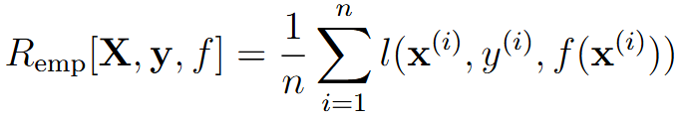
Loss Function & Optimization
In supervised learning, the training error (or empirical risk) is a mathematical measure of how far the model’s predictions are from the true labels in the training dataset, and is defined as:

Slide 6

Gradient
The gradient of a function is a vector of partial derivatives.
The gradient points in the direction of the steepest increase of the function.

Slide 7


Gradient
Given a 2-dimensional function:
We can calculate the gradient vectors equals:

Slide 8
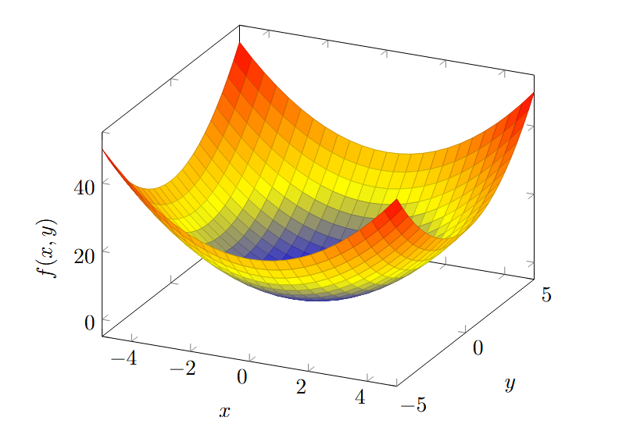
Gradient

Slide 9
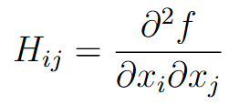
Hessian Matrix
A square matrix of second-order partial derivatives of a scalar-valued function.
Describe the local curvature of a function of multiple variables.
For a function f (X) with n variables X = (x1, x2, ..., xn), the Hessian matrix H is defined as:

Slide 10
Hessian Matrix
At a critical point where the objective function gradient is zero:
If H is positive definite, the point is a local minimum.
If H is negative definite, the point is a local maximum.
If H is indefinite, the point is a saddle point.
If H has a determinant of zero, or if any of its eigenvalues are zero, the point is called a degenerate critical point, and the second derivative test is inconclusive.

Slide 11
KEY OPTIMIZATION CHALLENGES
1. Local Minima
2. Saddle Points
3. Vanishing Gradient

Slide 12
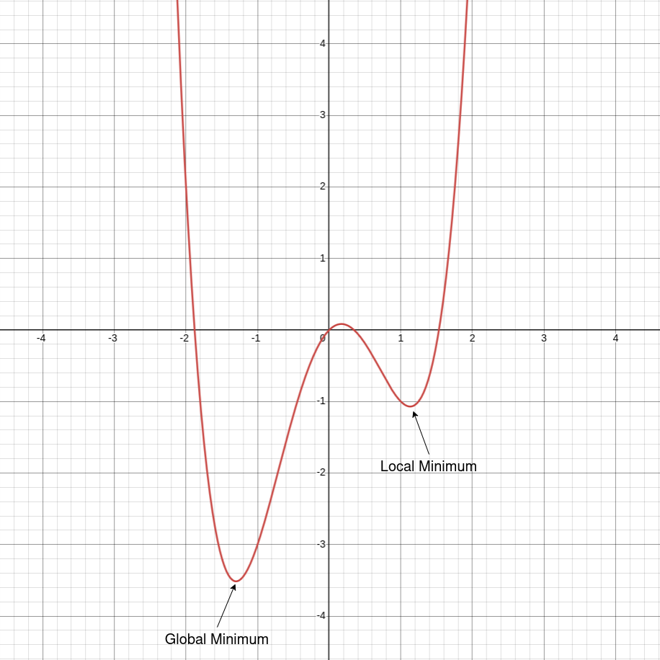
KEY OPTIMIZATION CHALLENGES
1. Local Minima
f(x) = x⁴ − 3x² + x
Problem: The optimizer may get trapped in a point where the loss is lower than its surroundings but still not the global minimum.
Impact: The gradient becomes very small (∇L ≈ 0) even though the algorithm has not found the best possible solution. Leads to premature convergence.

Slide 13
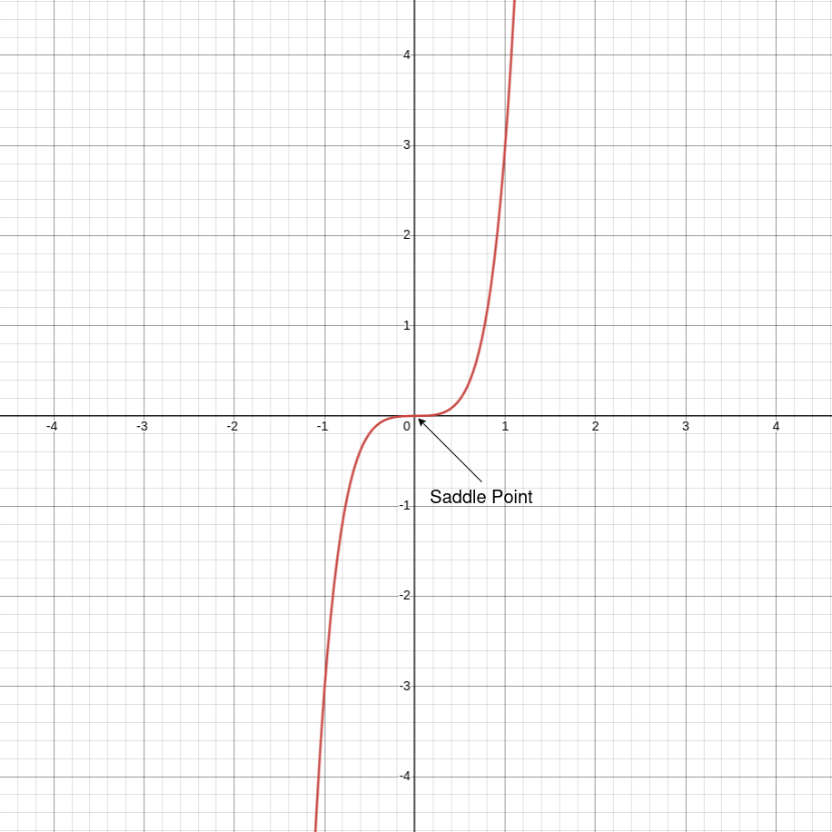
KEY OPTIMIZATION CHALLENGES
2. Saddle Points
f(x) = x³ + 2x⁵
Problem: A saddle point has gradient ∇L = 0, but it is neither a minimum nor a maximum. The surface curves upward in one direction and downward in another.
Impact: Gradients near saddle points are extremely small → causes very slow progress ("plateau problem").

Slide 14
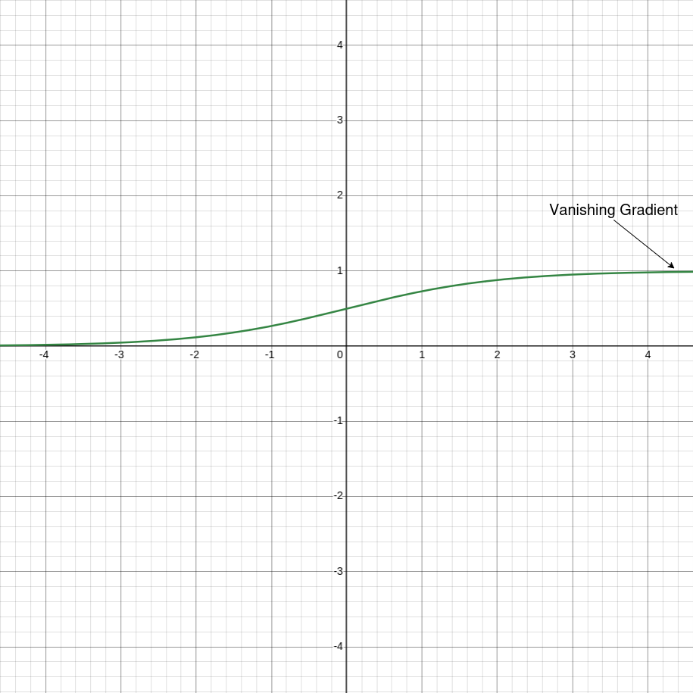
KEY OPTIMIZATION CHALLENGES
3. Vanishing Gradient
Problem: In deep networks, gradients gradually shrink when backpropagated through many layers. Multiplying many small derivatives leads to values approaching zero.
f(x) = 1 / (1 + e⁻ˣ)
Impact: Early layers learn extremely slowly → training becomes unstable or ineffective.

Slide 15
02
SPARSE FEATURES

Slide 16
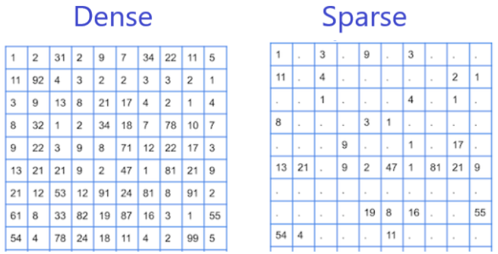
What is Sparse Features?
Sparse features refer to data where most values are zero, and only a small fraction of dimensions are non-zero for each sample.
NLP (Text Classification): Bag-of-Words.
Recommendation Systems: User-item interaction matrix.

Slide 17
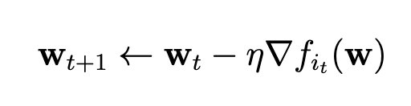
Stochastic Gradient Descent (SGD)
Stochastic Gradient Descent Update
Select a random sample (or group of samples) to estimate the gradient
and update w
where it ∼ Uniform(1, n) is the randomly selected sample index at step
t and η is learning rate.

Slide 18
Challenges of SGD with Sparse Features
Unequal Update Frequency
Different features are updated at vastly different rates:
Common features are updated frequently.
Rare features are updated infrequently.

Slide 19
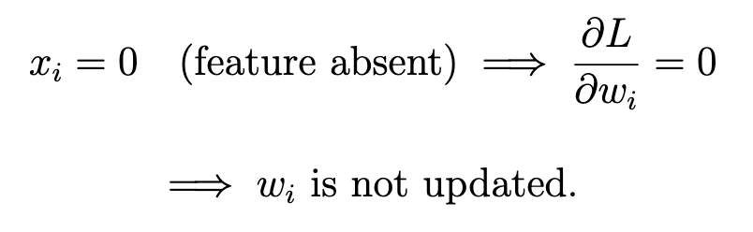
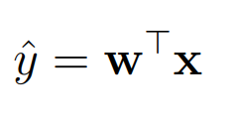
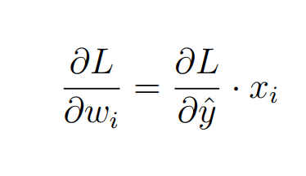
Challenges of SGD with Sparse Features
Sparse Gradients
Simple linear model:
The gradient of the loss function L with respect to weight Wi:
Only some parameters updated per SGD step
Most parameters remain unchanged for many iterations
Update frequency is unpredictable and unequal

Slide 20
Challenges of SGD with Sparse Features
Learning Rate Dilemma
If η is SMALL (ex: 0.001):
Rare features learn very slowly.
Common features converge smoothly.
If η is LARGE (ex: 0.1):
Rare features have chance to learn.
Common features oscillate.

Slide 21
03
ADAGRAD

Slide 22
Motivation
This imbalance shows in previous section , leads to an optimization paradox if a fixed learning rate is used:
For frequently occurring features: Their gradients are updated continuously. If learning rate is too large, the optimization process will oscillate heavily and fail to converge.
For rare (sparse) features: Their gradients are often very small or "only rarely large". If learning rate is set small to accommodate frequent features, these rare features will learn almost nothing because the small update step is multiplied by low frequency.
=> Adagrad proposes a coordinate-wise adaptive learning rate.

Slide 23
Motivation
This imbalance shows in previous section , leads to an optimization paradox if a fixed learning rate is used:
For frequently occurring features: Their gradients are updated continuously. If learning rate is too large, the optimization process will oscillate heavily and fail to converge.
For rare (sparse) features: Their gradients are often very small or "only rarely large". If learning rate is set small to accommodate frequent features, these rare features will learn almost nothing because the small update step is multiplied by low frequency.
=> Adagrad proposes a coordinate-wise adaptive learning rate.

Slide 24
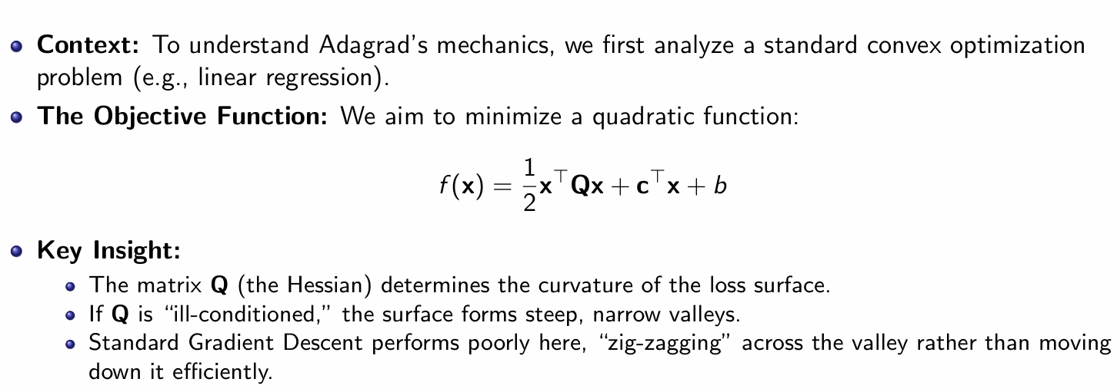
Precondition (Convex Quadratic Problems)

Slide 25
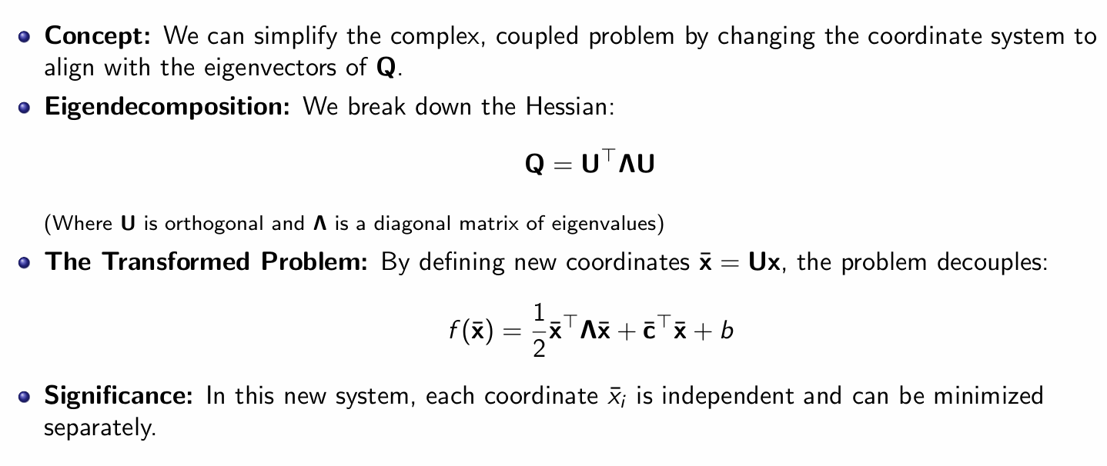
Precondition (Convex Quadratic Problems)

Slide 26
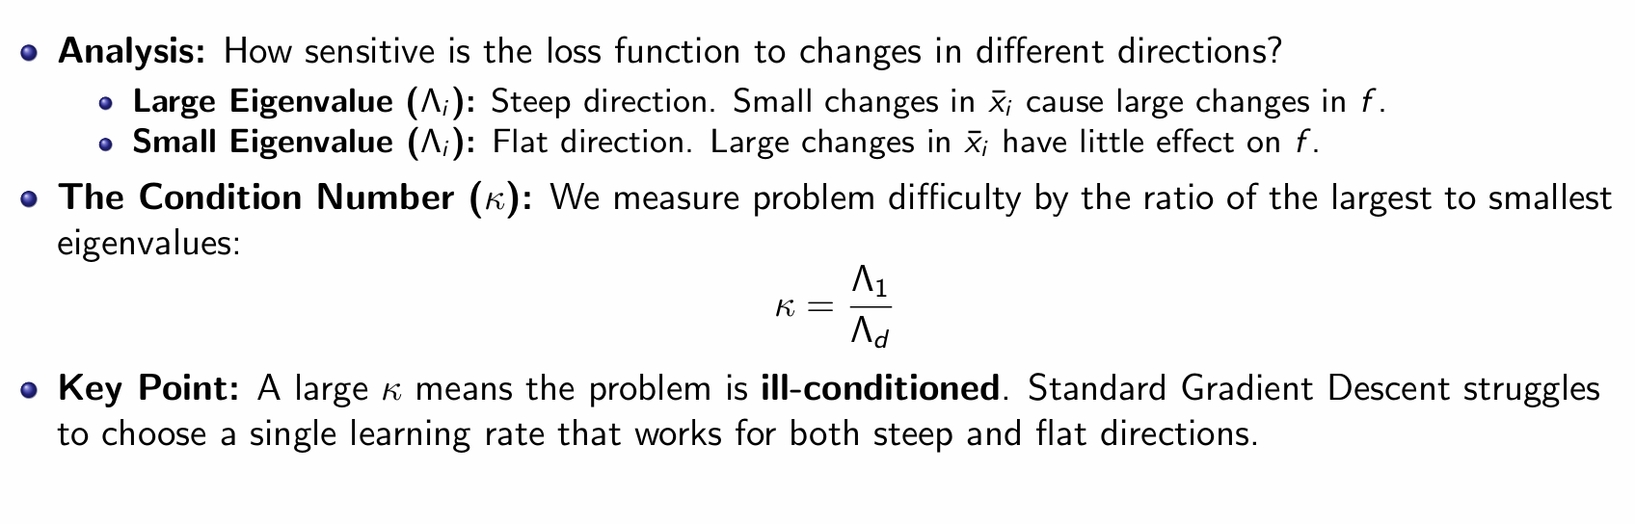
Precondition (Convex Quadratic Problems)

Slide 27
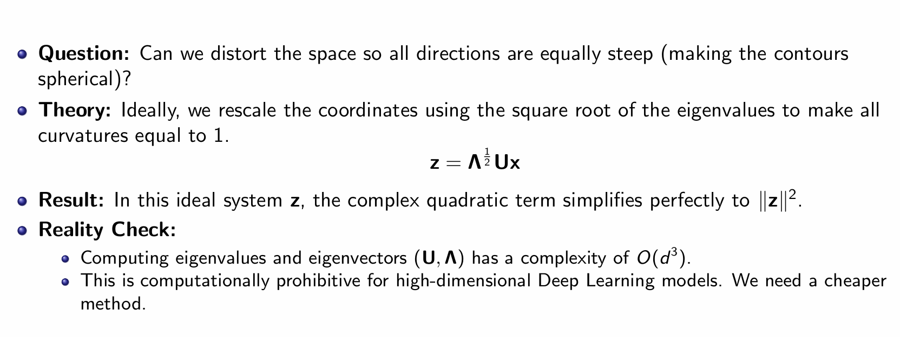
Precondition (Convex Quadratic Problems)

Slide 28
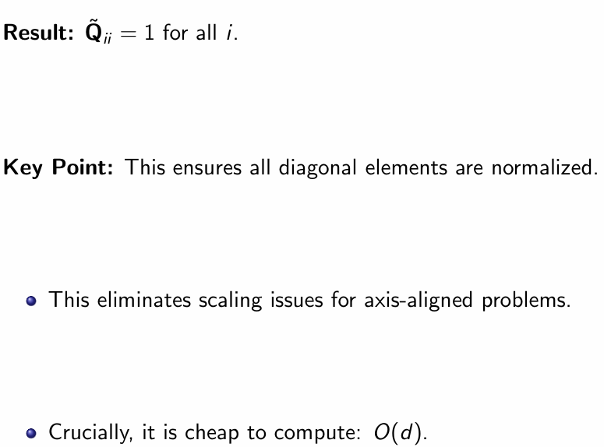
Precondition (Convex Quadratic Problems)

Slide 29
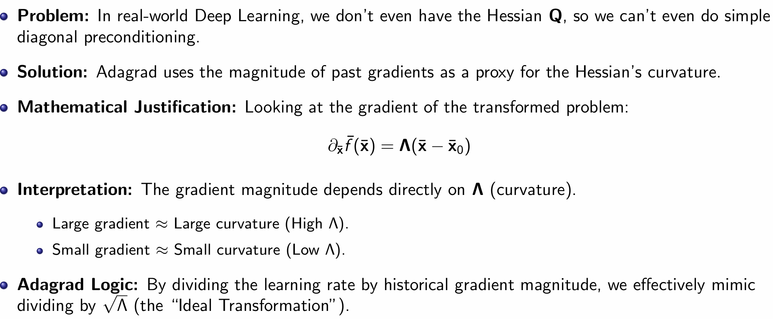
The Algorithm Adagrad

Slide 30
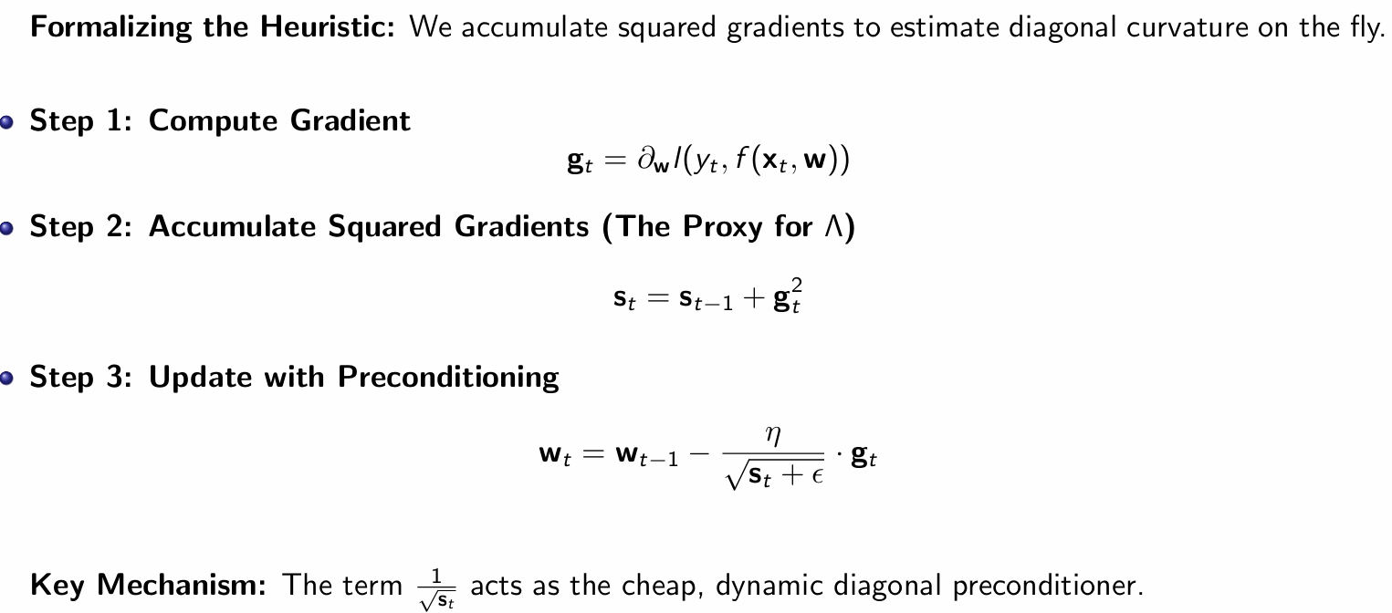
The Algorithm Adagrad

Slide 31
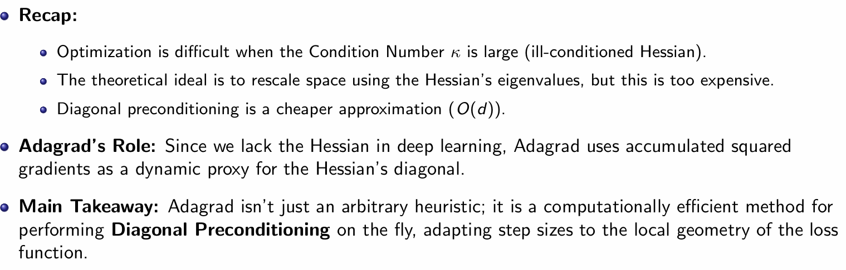
Summary of Adagrad

Slide 32
Resolve exercises
HO CHI MINH CITY UNIVERSITY OF TECHNOLOGY
Faculty of Computer Science and Engineering

Slide 33

Prove that for an orthogonal matrix and a vector the following holds:
HO CHI MINH CITY UNIVERSITY OF TECHNOLOGY
Faculty of Computer Science and Engineering
Why does this mean that the magnitude of perturbations does not change after an orthogonal change of variables?

Slide 34
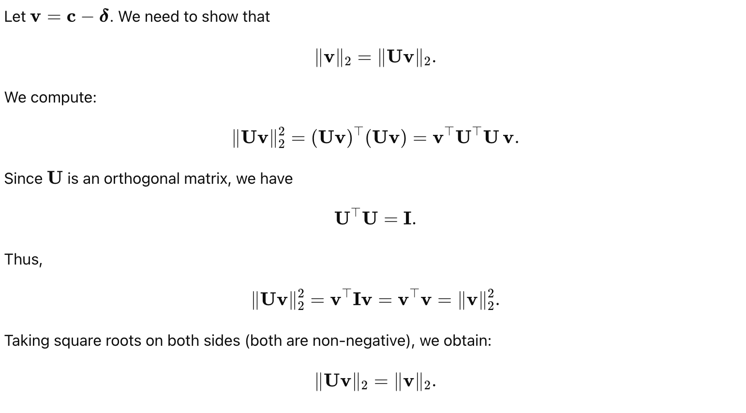

Slide 35
An orthogonal matrix represents an isometry in Euclidean space: it performs rotations or reflections (or their combinations). These transformations preserve lengths and angles. Therefore, the magnitude of the perturbation c−δ remains unchanged under an orthogonal change of basis via U
HO CHI MINH CITY UNIVERSITY OF TECHNOLOGY
Faculty of Computer Science and Engineering
Notes:
Ma trận trực giao là một isometry (phép giữ khoảng cách) trong
không gian Euclid: nó biểu diễn các phép quay hoặc phản chiếu (hoặc tổ hợp của chúng)
nên không thay đổi độ dài vector và góc giữa các vector. Vì vậy độ lớn của nhiễu
(perturbation) c − δ không đổi khi ta thay đổi cơ sở bằng một biến đổi trực giao U.

Slide 36

4. What does Gerschgorin’s theorem tell us about the eigenvalues of the diagonally preconditioned matrix
HO CHI MINH CITY UNIVERSITY OF TECHNOLOGY
Faculty of Computer Science and Engineering

Slide 37



The original formula in the document is:
HO CHI MINH CITY UNIVERSITY OF TECHNOLOGY
Faculty of Computer Science and Engineering
For convenience, define the scaling diagonal matrix:
Then we have:

Slide 38
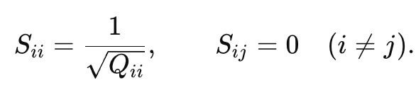
Assume Q is any square matrix.
The matrix Q: its entry in row i, column j, is Q_{ij}​.
HO CHI MINH CITY UNIVERSITY OF TECHNOLOGY
Faculty of Computer Science and Engineering
The matrix S is diagonal

Slide 39

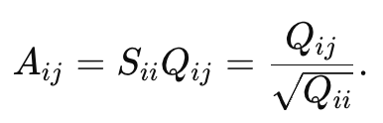
Step 1: Left multiplication
Let A=SQ.
Because S is diagonal, it multiplies each row of Q by S_{ii}
HO CHI MINH CITY UNIVERSITY OF TECHNOLOGY
Faculty of Computer Science and Engineering
We compute:

Slide 40


HO CHI MINH CITY UNIVERSITY OF TECHNOLOGY
Faculty of Computer Science and Engineering
Step 2: Right multiplication
Multiplying by a diagonal matrix on the right scales each column by S_{jj}

Slide 41
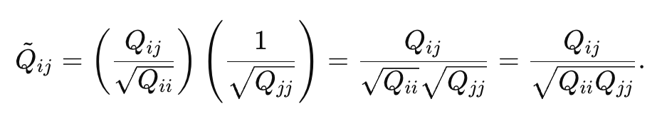
Substituting A_{ij}
HO CHI MINH CITY UNIVERSITY OF TECHNOLOGY
Faculty of Computer Science and Engineering

Slide 42
Q&A

