Slide 1
RLL PROJECT PRESENTATION
Product Recommendation Preparation
Sudharsan M
2620738

Slide 2
Scenario: Process purchase history to create customer-product mappings.
INPUT:
OUTPUT:
CustomerID | ProductID
C001 | 101
C002 | 102
CustomerID | ProductID
C001 | Laptop
C002 | Mouse
Activities:
1. Map customer purchases to product details.
2. Aggregate product purchases by customer.
3. Identify top products for each customer
Files:
customer_purchases_2024.csv
customer_purchases_2023.csv
product_master.csv

Slide 3
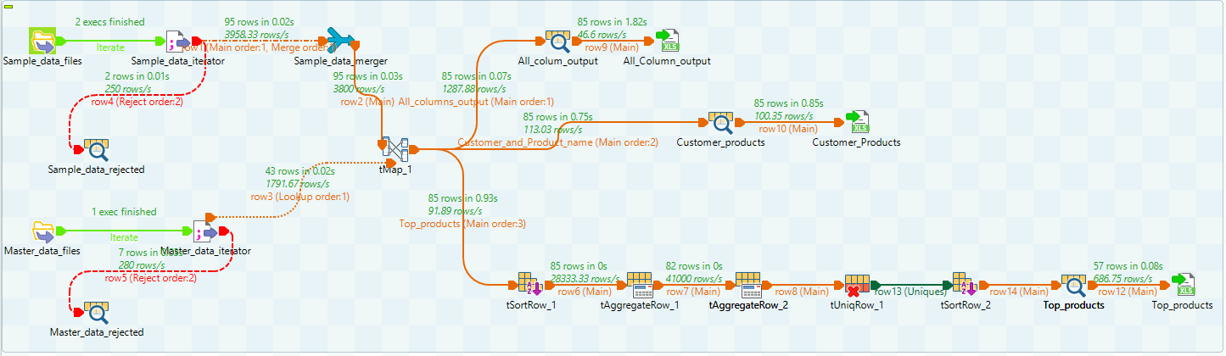
COMPONENTS AND PIPELINES

Slide 4
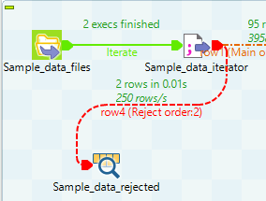
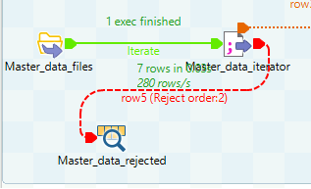
INPUTS DATA CLEANING
If the data has some “INVALID” records in a column we need to reject to make sure we handle with the valid data
In our example the price and the quantity has some invalid values so we need to reject it to handle the right datas
For data sets
For Master Data

Slide 5
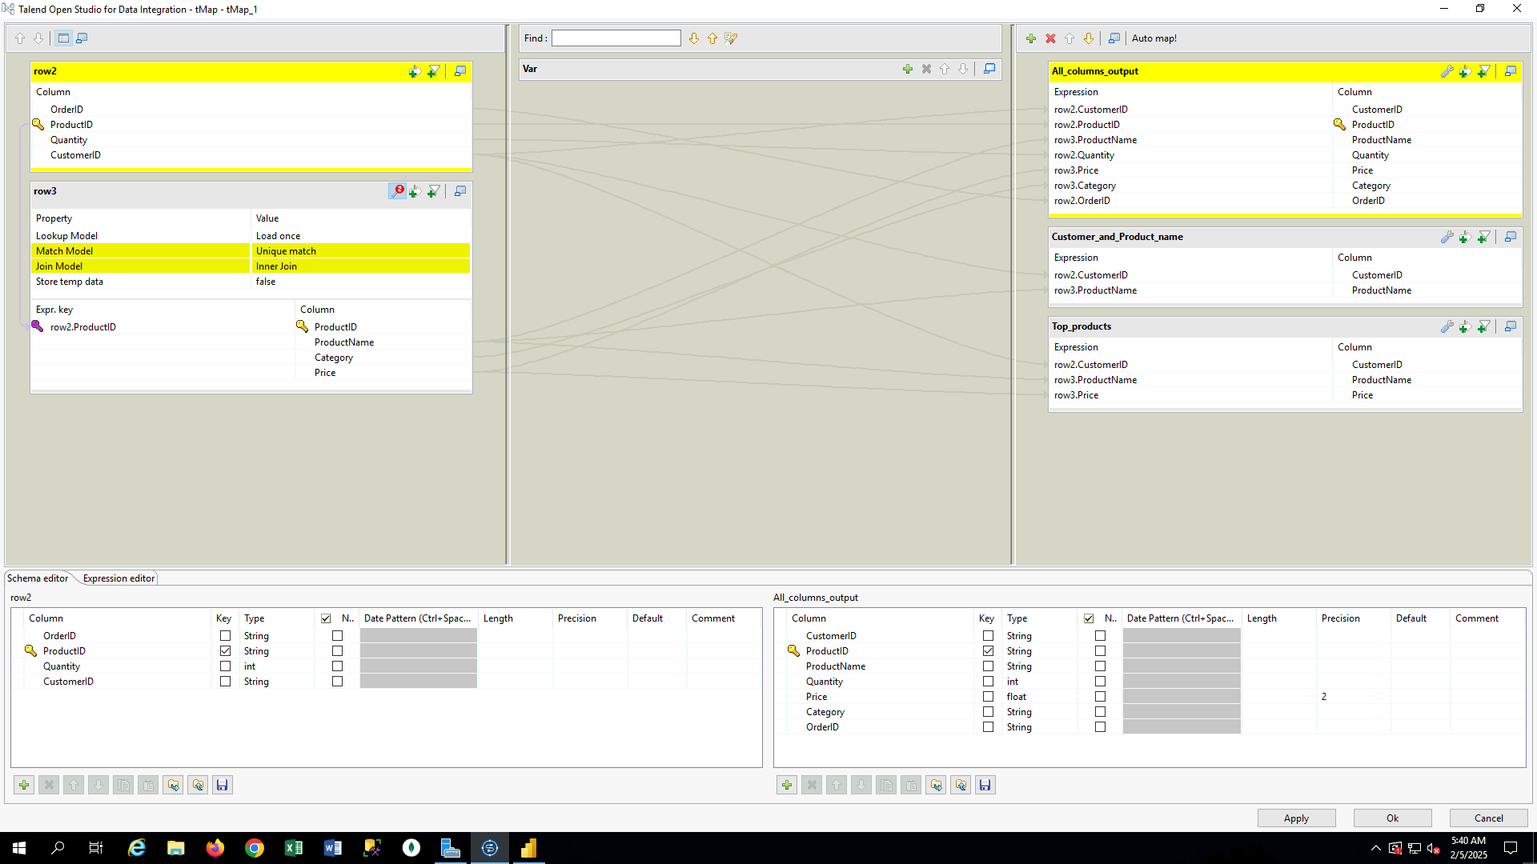
Data Mapping
For data Joining Inner Join was used to join the customer data to product details to show the customers products

Slide 6
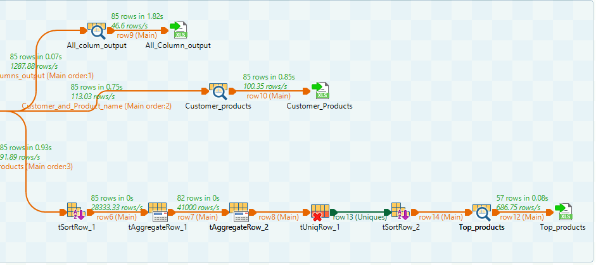
Outputs
First Output:
will show all the columns in table
Second Output:
will show only the customers product name
Third Output:
will show the top products of each customers

Slide 7
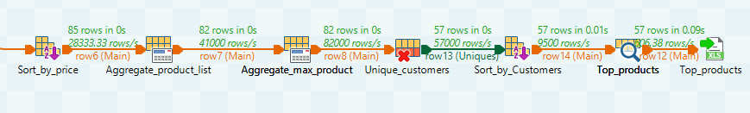
Top Product Output
Sort by Price in descending order
Aggregate group by customer and price and operation with product by list
Aggregate group by customer and price and operation with product by Max to get the maximum product
tunique will remove the duplicates and give the unique values(First)
Sort by customers
Log the result

Slide 8
Thank You

