Slide 1
-GOLang-
-Concurrency And Its Benefits-

Slide 2
What is golang?
Golang or Go is a statically typed, concurrent, and garbage-collected programming language created at Google in 2009.
It is designed to be simple, efficient, and easy to learn, making it a popular choice for building scalable network services, web applications, and command-line tools.
Programs are assembled by using packages, for efficient management of dependencies.

Slide 3
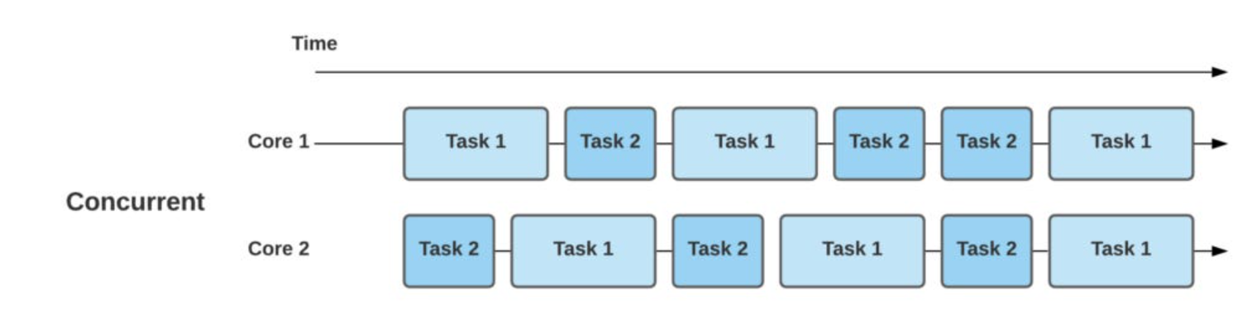
Concurrency
Concurrency is when multiple computations are happening simultaneously.
Instead of waiting for one task to be completed, in concurrent programming, other tasks are run simultaneously.
In layman’s terms, it is doing more than one thing at the same time.

Slide 4
Sequential / concurrent
Sequential
concurrent
Implemented using a single thread
All functions in a program are run in one single thread.
Programs are executed in a sequential order
Since there is a specific order for completion, problems in one program affect other programs.
Uses the concept of multi-thread
A single program can run its functions on multiple threads
Programs are executed concurrently
Due to the absence of any specific order, problems in one program do not affect other programs

Slide 5
Why concurrency?
It allows multiple applications to be executed or run simultaneously, thus increasing efficiency and the total output of workstations
It enables resources to be utilised efficiently, thus making programs efficient
It improves the performance of the program
Multiple systems now run using multi-threaded processes, which are all headed by concurrency such as Operating Systems, Video Games, Web Browsers, etc.

Slide 6
Goroutines
Go language provides a special feature known as a Goroutines.
A Goroutine is a function or method which executes independently and simultaneously in connection with any other Goroutines present in your program.
Every concurrently executing activity in Go language is known as a Goroutines

Slide 7
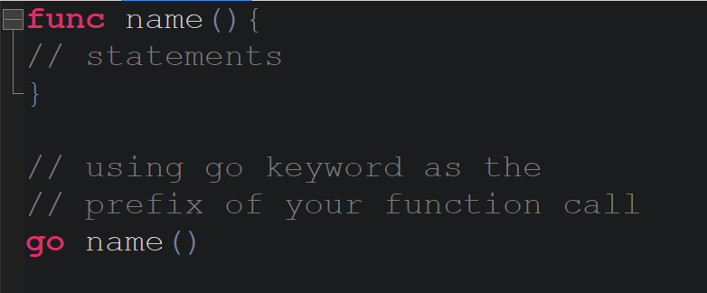
Creating goroutines
You can create your own Goroutine simply by using go keyword as a prefixing to the function or method call as shown in the below syntax

Slide 8
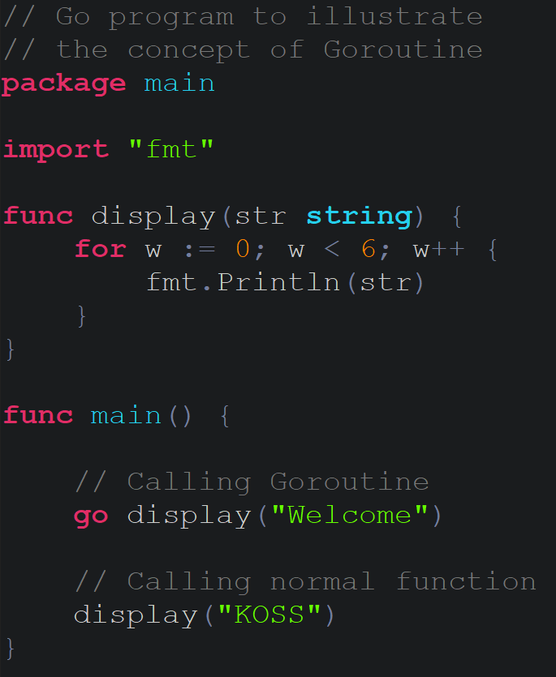
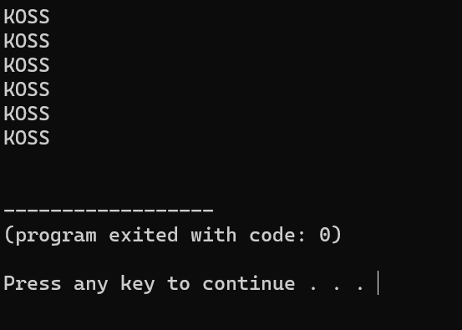
example
OUTPUT:

Slide 9
In the above example, we simply create a display() function and then call this function in two different ways first one is a Goroutine, i.e. go display(“Welcome”) and another one is a normal function, i.e. display(“KOSS”).
But there is a problem, it only displays the result of the normal function that does not display the result of Goroutine because when a new Goroutine executed, the Goroutine call return immediately.
The control does not wait for Goroutine to complete their execution just like normal function they always move forward to the next line after the Goroutine call and ignores the value returned by the Goroutine.
So to overcome this, certain changes have to be made to the code.

Slide 10
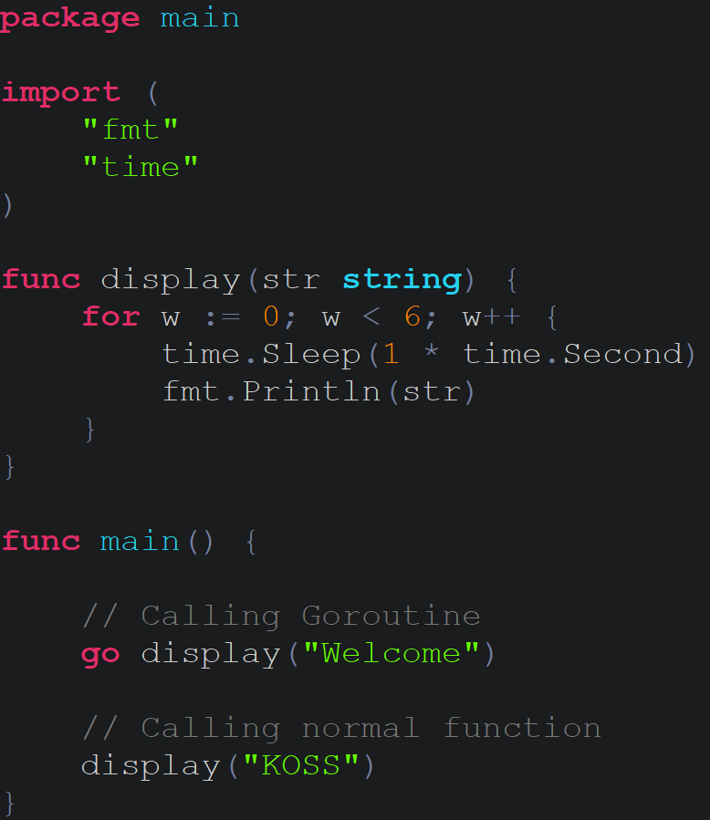
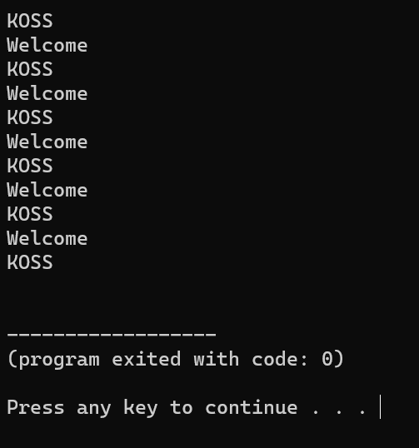

Slide 11
What is the difference?
Adding the Sleep() method in the program which makes the main Goroutine sleeps for 1 second in between 1-second the new Goroutine executes, displays “welcome” on the screen, and then terminate after 1-second main Goroutine re-schedule and perform its operation.
This process continues until the value of the n<6 after that the main Goroutine terminates.
Both Goroutine and the normal function work concurrently

Slide 12
Advantages of goroutines
Goroutines are cheaper than threads.
Goroutine are stored in the stack and the size of the stack can grow and shrink according to the requirement of the program. But in threads, the size of the stack is fixed.
Goroutines can communicate using the channel and these channels are specially designed to prevent race conditions when accessing shared memory using Goroutines.

Slide 13
waitgroups
While using Goroutines, we had paused the program for one second for the goroutine to run.
In real life scenarios, wherein 1000s of goroutines are involved, waiting 1 second for each will be highly inefficient.
This is where Waitgroups are utilised to solve the problem.

Slide 14
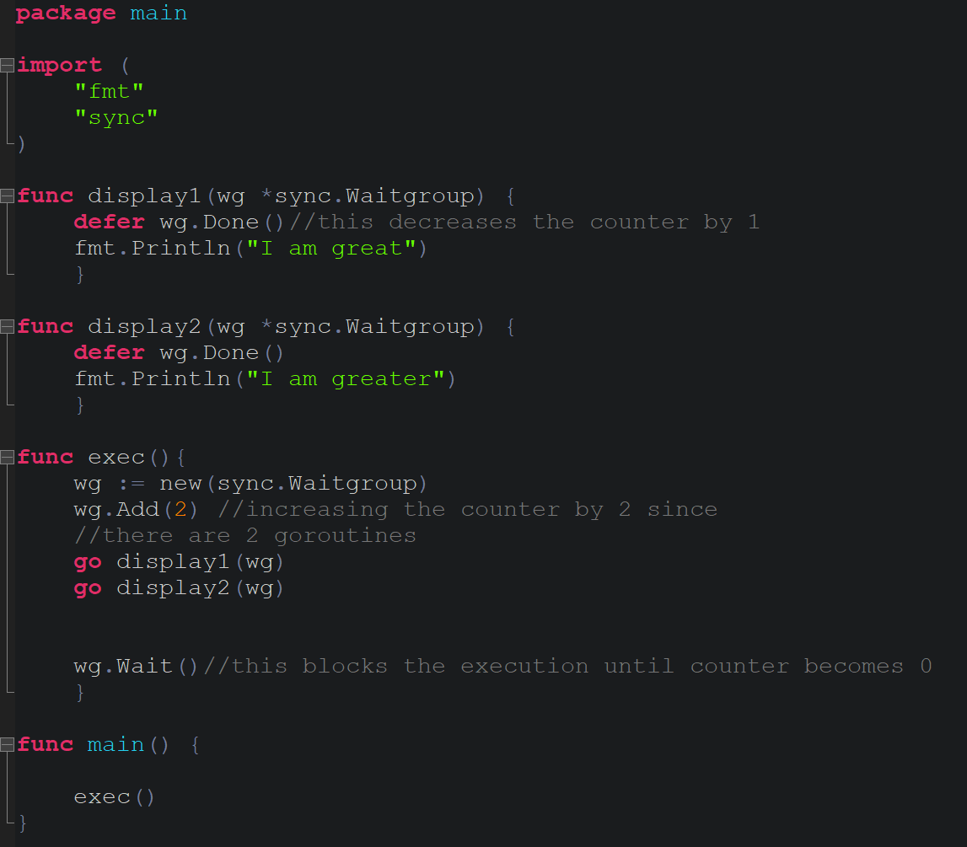
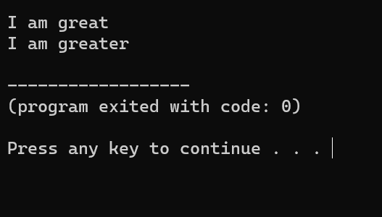
Example code
Instead of waiting for a second the program is executed instantly

Slide 15
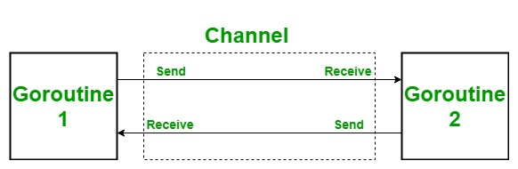
Channels
In Go language, a channel is a medium through which a goroutine communicates with another goroutine and this communication is lock-free.
A channel is a technique which allows to let one goroutine to send data to another goroutine.
By default channel is bidirectional, means the goroutines can send or receive data through the same channel as shown in the below image

Slide 16
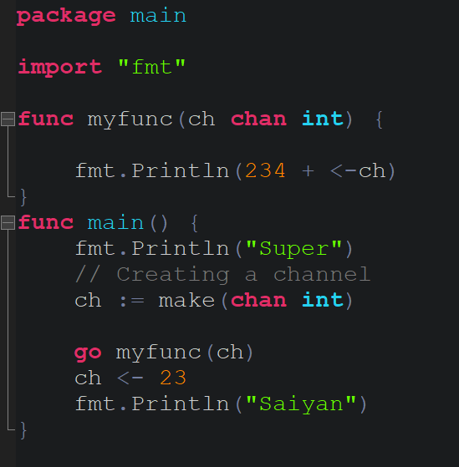
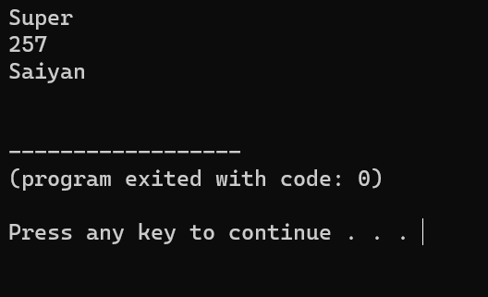
Example code

Slide 17
mutex
A Mutex is a method used as a locking mechanism to ensure that only one Goroutine is accessing the critical section of code at any point of time.
This is done to prevent race conditions from happening.
A race condition occurs when two threads access a shared variable at the same time.
The first thread reads the variable, and the second thread reads the same value from the variable
Mutex is a great method to avoid race conditions from occurring keeping the program intact.

Slide 18
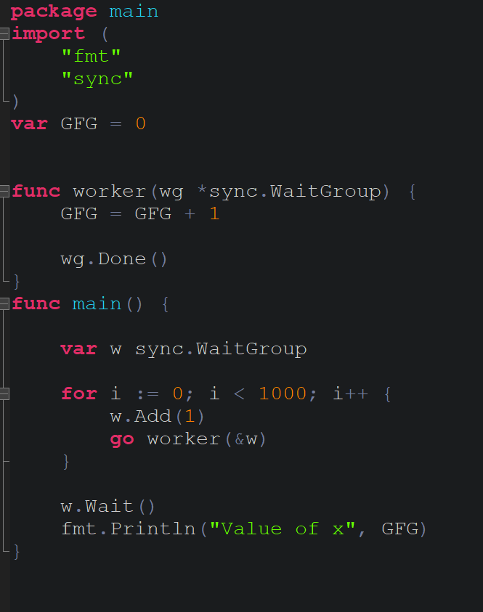
Example of race condition
In the program above, the worker function in line no. 8 increments the value of GFG by 1 and then calls Done() on the WaitGroup to inform its completion.
The worker function is called 1000 times. Each of these Goroutines run simultaneously and race condition occurs when trying to increment GFG in line no. 9 as multiple Goroutines try to access the value of GFG concurrently.
Running the same program multiple times gives different outputs each time because of the race condition.

Slide 19
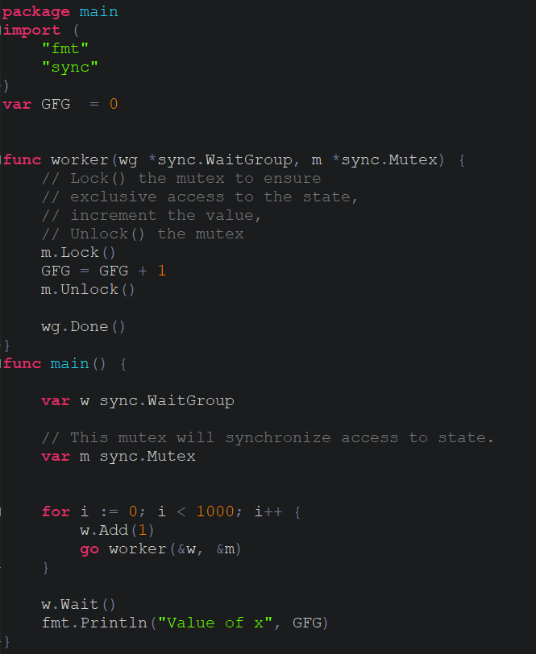
Fixing the problem using mutex
Mutex is a struct type and variable m of type Mutex is created in line no.19.
The worker function is changed so that the code which increments GFG in line no. 18 between m.Lock() and m.Unlock().
Now only one Goroutine is allowed to execute this piece of code at any point of time and thus race condition is dealt with.
The address of mutex has to be passed in line no. 22. If the mutex is passed by value instead then each Goroutine will have its own copy of the mutex and the race condition will still persist.

Slide 20
summary
Brief about Go, its uses and ties with concurrency.
Compared to other concurrent programming languages, like Python, Go is a lot faster and more efficient.
Information about the utilisation of Goroutines, Waitgroups, Channels and Mutex and how they aid in efficient concurrency with Go.
Go is a splendid language for developing multiple multi-threaded applications

Slide 21
THANK YOU

