Slide 1
MainButton
Toolbar (More Option)
Circle Content
Navigation Page Area
Background

Slide 2
MainButton
Toolbar (More Option)
Navigation Page Area
Background

Slide 3
Toolbar (More Option)
CircleSurface
Action Button Area
Content

Slide 4
Toolbar (More Option)
CircleSurface
Button Areas (Left, Bottom, Right)
Content

Slide 5
Toolbar (More Option)
CircleSurfaceItems on CircleSurface
Action Button
Content

Slide 6
Button Areas (First, Second)
Content
Title

Slide 7
Toolbar (More Option)
CircleSurface
Bottom Button ➔ Button with “bottom” Style
Content

Slide 8
Hr
Min
07
:
54
AM
Toolbar (More Option)
CircleSurface ➔ CircleDateTimeSelector
Bottom Button Area
Content ➔ CircleDateTimeSelector

Slide 9
List 1
List 2
List 3
Toolbar (More Option)
CircleSurface ➔ CircleGenList
Bottom Button Area
Content ➔ CircleGenList

Slide 10
Toolbar (More Option)
CircleSurface ➔ CircleProgressBar
Bottom Button Area
Content

Slide 11
Toolbar (More Option)
CircleSurface ➔ CircleScroller
Bottom Button Area
Content ➔ CircleScroller

Slide 12
Toolbar (More Option)
CircleSurface ➔ CircleSlider
Bottom Button Area
Content

Slide 13
07
Toolbar (More Option)
CircleSurface ➔ CircleSpinner
Bottom Button Area
Content ➔ CircleSpinner

Slide 14
BG
BG
Circle Surface
Evas_Object *layout = elm_layout_add(naviframe);
elm_layout_theme_set(layout , "layout", "application", "default");
BG
Content
Evas_Object *content = elm_layout_add(naviframe);
elm_layout_theme_set(content , "layout", "bottom_button", "default");

Slide 15
Toolbar (More Option)
Circle Surface
Navigation Page Area
Background

Slide 17
BarAngleOffset (degree)
BackgroundColor
Value 0.0
BarAngleMinimum (degree)
Value 1.0
BarColor
BarRadius
BackgroundAngleOffset (degree)
BarLineWidth
BarLineWidth/2
BackgroundLineWidth/2
BarAngleMaximum (degree)
BackgroundAngle (degree)
BackgroundRadius

Slide 18
BarAngleOffset (degree)
BackgroundColor
Value Minimum
BarAngleMinimum (degree)
Value Maximum
BarColor
BarRadius
BackgroundAngleOffset (degree)
BarLineWidth
BarLineWidth/2
BackgroundLineWidth/2
BarAngleMaximum (degree)
BackgroundAngle (degree)
BackgroundRadius

Slide 19
Minimum
1st Value
Maximum
Increment
unit
2nd Value
Title
5.0
MarkerColor
LabelFormat
ex) 1.1f
MarkerLineWidth
Value
ex) 5

Slide 20
ContentPage
Scroll

Slide 21
Confirmation Popup
Title
FirstButton
Content
SecondButton
Text

Slide 22
Check
Radio
Default
Onoff
Small

Slide 23
Button
Button
Offset.Y
Offset.X
Ok
Text1
Text2
A item with default text PositionOption = BottomOfView
Two items with custom texts BottomOfView with Offset

Slide 24
Icon
Toast message
Toast message
Text

Slide 25
Information Popup
IsProgressRunning = false
Information Popup
IsProgressRunning = true
Title
Text
Text
Text
Text
Bottom Button
Bottom Button

Slide 26
SegmentRatio

Slide 27
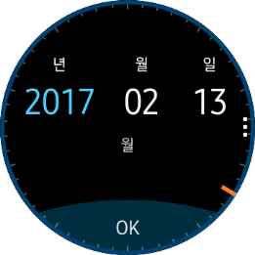
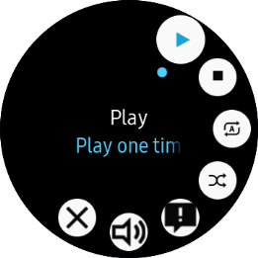
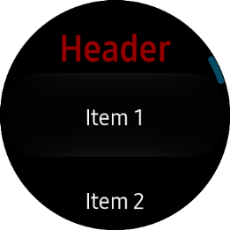
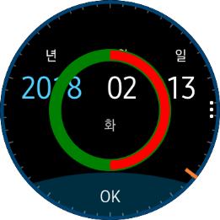
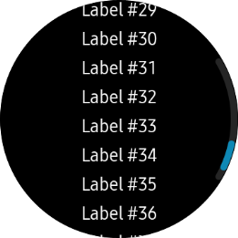
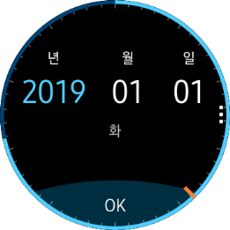
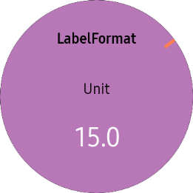
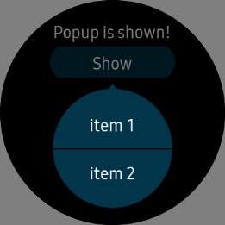
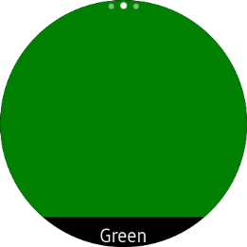
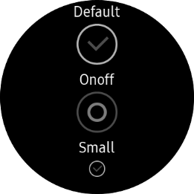
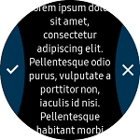
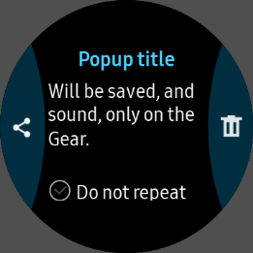

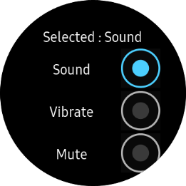
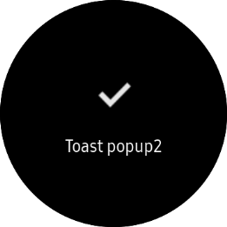
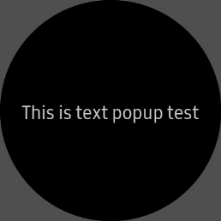
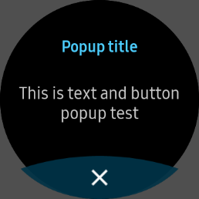
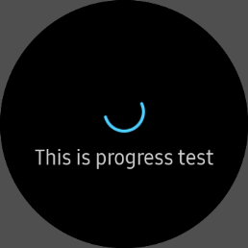
CirclePage +
CircleDateTimeSelector
CirclePage +
MoreOption
CircleListView
CirclePage +
CircleSliderSurfaceItem
CircleScrollView
CirclePage +
CircleProgressBarSurfaceItem
CircleStepper
ContextPopupEffectBehavior
IndexPage
Check
TwoButtonPage
ConfirmationPopup
RotationReceiver
Radio
Toast
InformationPopup +
Text
InformationPopup +
Title + Button
InformationPopup +
Progress

Slide 28
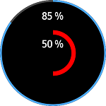
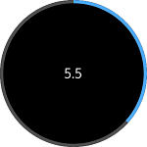
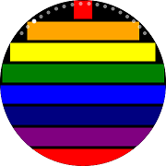
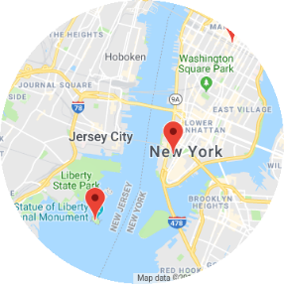
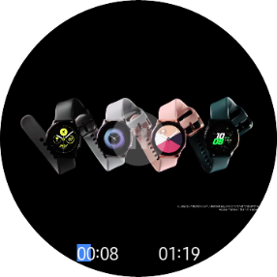
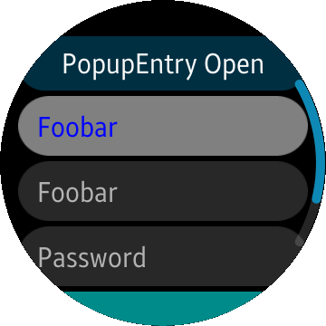
Check
CirclePage +
CircleDateTimeSelector
CircleListView
CirclePage + MoreOption
CircleProgressBar
SurfaceItem
CircleSliderSurfaceItem
CircleScrollView
CircleStackLayout
CircleStepper
ContextPopupEffect
Behavior
IndexPage
InformationPopup
IRotationReceiver
GoogleMapView
MediaView
PopupEntry
Radio
Toast
TwoButtonPopup
TwoButtonPage

