Slide 1

IBM Z DATATHON 2025
TEAM:SAV 106 BIG IRON

Slide 2

AI-Powered Heart MRI Classification for Clinical Decision Support

Slide 3



IBM Z Datathon 2025
TECH FOR GOOD
TEAM : BIG IRON- SAV106

Slide 4


TEAM MEMBERS
SHIVRAJ R
G M MADHURI
SRIRAM V
G DARSHANI

Slide 5



Inefficiency in Cardiac Diagnostics
The diagnosis of cardiovascular disease relies heavily on expert analysis of MRI scans. However, this manual process is slow, subjective, and creates significant delays in a busy clinical environment, posing a risk to both patient outcomes and hospital efficiency
Problem
Statement
Inefficiency in Cardiac Diagnostics
Challenges
Slow Diagnosis: Manual review of complex MRI scans by radiologists is a time-consuming bottleneck, delaying critical treatment decisions.
No Proactive Insights: Clinicians lack an automated system to flag high-priority cases or identify trends in diagnostic data overtime.
Lack of Trust in AI: Many AI tools are "black boxes," making it difficult for medical experts to trust or verify the machine's conclusions.

Slide 6
AI-Powered Heart MRI Classification for Clinical
Decision Support
TEAM : BIG IRON- SAV106

Slide 7



Main Objective
Innovative Solution
To develop an enterprise-grade AI clinical co-pilot, aligned with IBM Healthcare's mission, to automate MRI classification.
Our solution fosters diagnostic efficiency and builds trust through integrated Explainable AI and proactive decision support.
Key Features
Explainable AI Heatmaps show why a diagnosis is made. Proactive Alerts flag recent, high-priority "Sick" cases upon login.
Watsonx Chatbot for instant data retrieval from the live IBM Db2 database.
Secure IBM Cloud Architecture using Db2 and Cloud Object Storage.
AI-Powered Heart MRI Classification for Clinical Decision Support

Slide 8

Innovative Solution
Benefits
Faster Diagnosis to reduce radiologist workload and patient wait times.
Increased Clinical Trust through transparent and explainable AI.
Improved Workflow by automatically prioritizing the most critical patient scans.
AI-Powered Heart MRI Classification for Clinical Decision Support

Slide 9
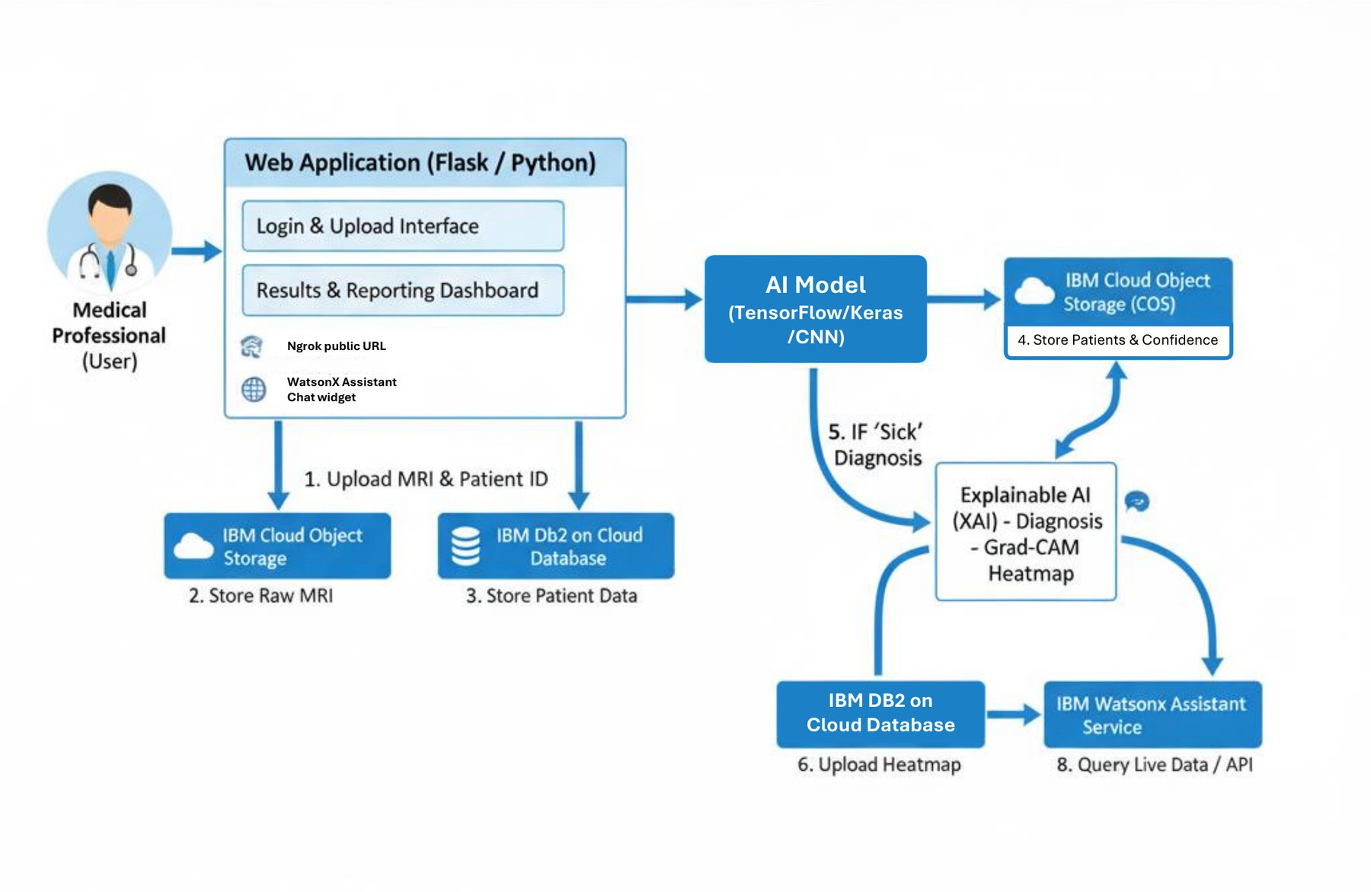
SYSTEM ARCHITECTURE

Slide 10

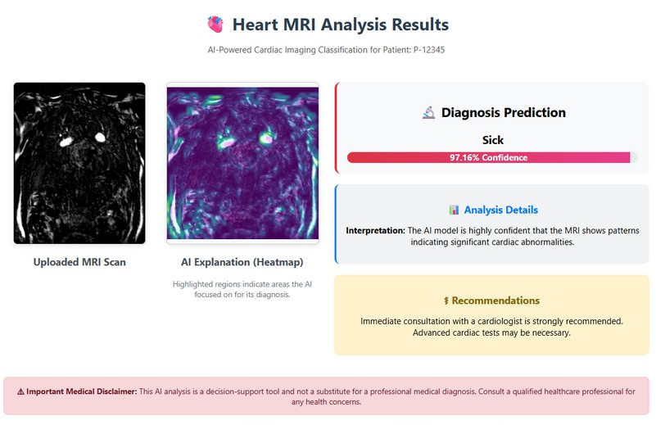
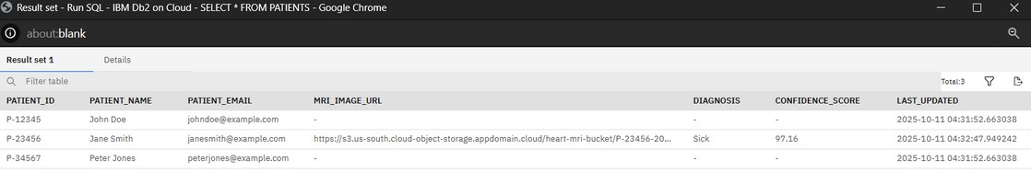
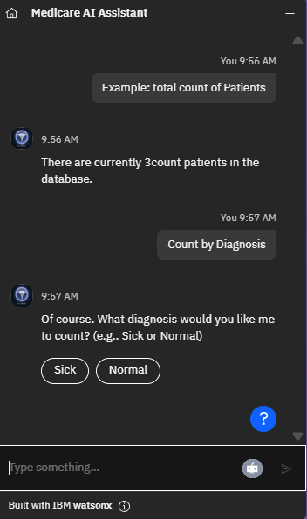
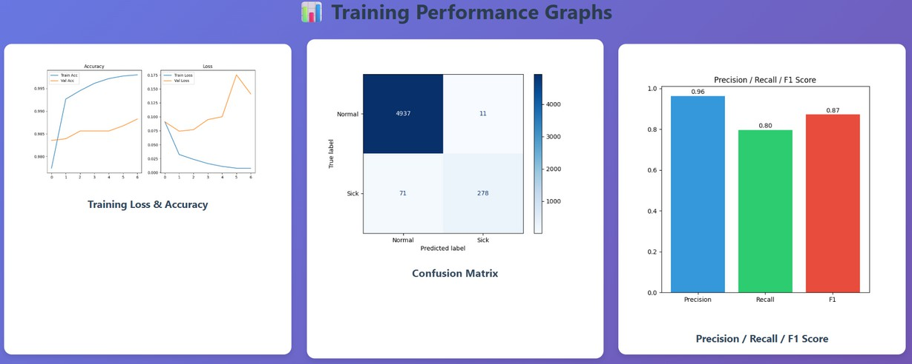
Working Prototype

Slide 11








Tech Stack
IBM Watsonx Assistant
Used to build a powerful, data-driven conversational AI. The chatbot acts as an intelligent digital assistant, capable of performing live queries against our Db2 database to provide instant insights.
IBM Cloud Object Storage Implemented as the secure and scalable solution for handling large, unstructured data files, specifically the sensitive patient MRI images, following industry best practices.
IBM Db2 on Cloud
The core of our data architecture. Used as a secure, scalable, and enterprise-grade database for managing all structured patient records and the results of our AI analysis.
TensorFlow & Keras
These deep learning libraries were used to build and train our core AI: a Convolutional Neural Network (CNN) for
the accurate classification of heart MRI scans.
Explainable AI (tf-explain)
This library was integrated to build trust in our AI. It generates Grad-CAM heatmaps to visually show which parts of an MRI influenced a "Sick" diagnosis, making our model's decisions transparent.
Python & Flask
Python was the primary programming language, and the Flask framework was used to build the robust backend web server, user authentication system, and the complete API for our application.

Slide 12




WOW Factors
Explainable AI (XAI) for Clinical Trust
This application doesn't just give a "black box" diagnosis. For every "Sick" patient, it generates a Grad-CAM heatmap, visually showing the radiologist the exact regions of the MRI that influenced the AI's decision. This builds trust and makes our tool a true clinical partner.
Proactive AI Clinical Analyst
The system is more than a reactive tool; it's a co- pilot. Upon login, it proactively queries the IBM Db2 database to display "Actionable Insights," instantly alerting the user to recent, high-priority "Sick" cases, which helps in managing clinical workload.
Enterprise-Grade IBM Cloud Architecture
This entire platform is built on a secure and scalable foundation. We use IBM Db2 on Cloud for structured patient data and IBM Cloud Object Storage for handling large, sensitive MRI image files, demonstrating a professional, real-world implementation ready for clinical environments.
Data-Driven Conversational AI
We have integrated an IBM Watsonx Assistant that is not just a simple Q&A bot. It is a powerful digital assistant that can perform complex, live queries against our IBM Db2 database to provide instant data insights, such as getting a patient summary or counting diagnoses.

Slide 13


Learnings
3
3
4
4
1
2
IBM LinuxONE System
Gained insights into the importance of a scalable and secure platform for deploying mission-critical applications like our healthcare AI solution.
Watson X
IBM DB 2
IBM Cloud Storage
Explored the capabilities of Watsonx Assistant to build an intelligent, data-driven conversational AI that acts as a powerful digital assistant for professional users.
Learned about the challenges and best practices of integrating IBM Db2 for enterprise- grade database management, ensuring data integrity and reliability for our patient records.
Understood the critical importance of using a secure, scalable, and dedicated storage solution like IBM Cloud Object Storage for handling large and sensitive medical image data, separating it from the main database.

Slide 14

Product Demo

Slide 15
Thank You
TEAM : BIG IRON- SAV106
Thank you for your time and attention - we look forward to the future possibilities this project brings!

