Slide 1
Start script detect_lego_markers_simple_cl.m.
This script identifies markers for objects of known dimensions. As calibration objects we used 4 Lego® plates. Each plate is seen by 4 cameras. Thus the script needs to be run 16 times (4 plate for each of the 4 cameras). Each time a data file is saved (e.g. camera1_lego_h0_data.mat for plate 0 from camera 1).
Once all plates and cameras are saved you can use calibrate_cameras_cl.m to estimate the camera matrices.

Slide 2
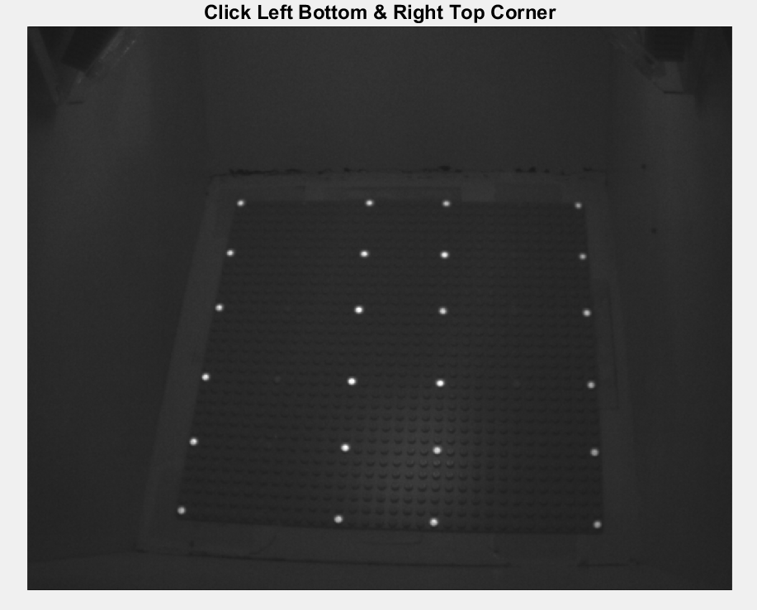
Start script detect_lego_markers_simple_cl.m. You should see this screen:
Make 2 clicks on left bottom and right top corners (clicks indicated by arrows here)

Slide 3
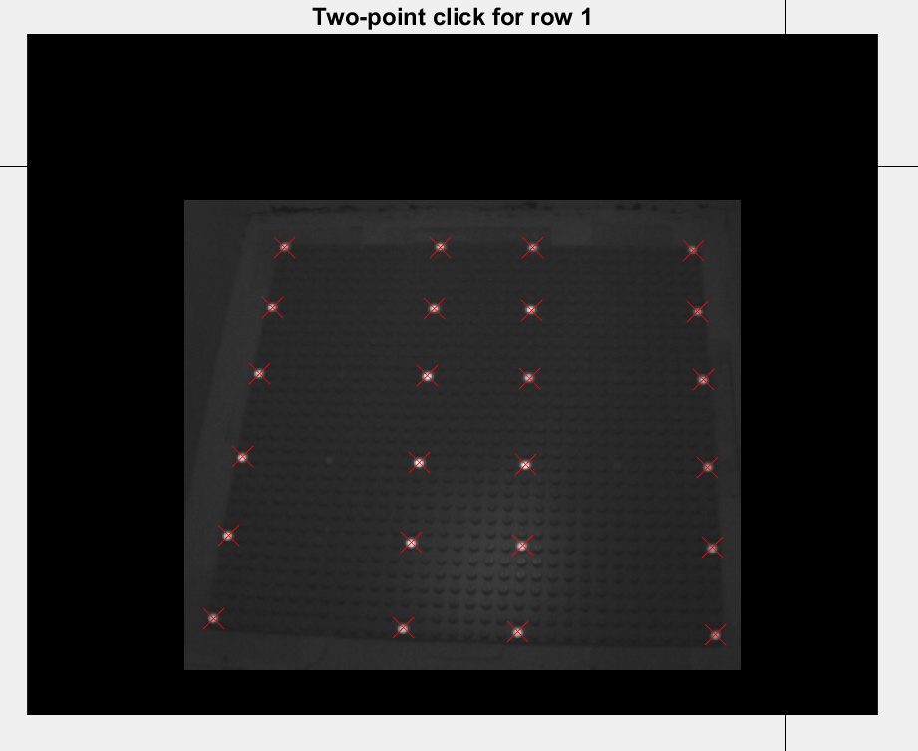
Now you should see this screen:
Make 2 clicks to draw a line sufficiently close to all markers on row 1 (clicks indicated by arrows here)

Slide 4
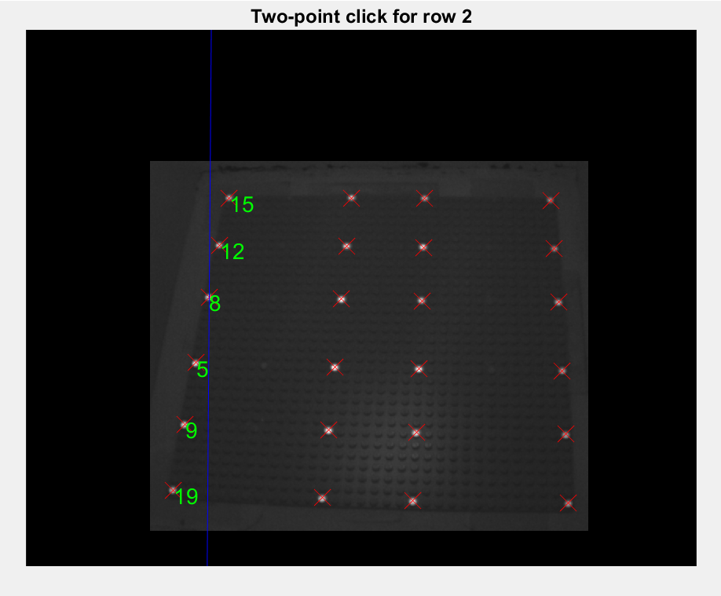
Now you should this screen
If correct all markers on row 1 will be assigned with a marker

Slide 5
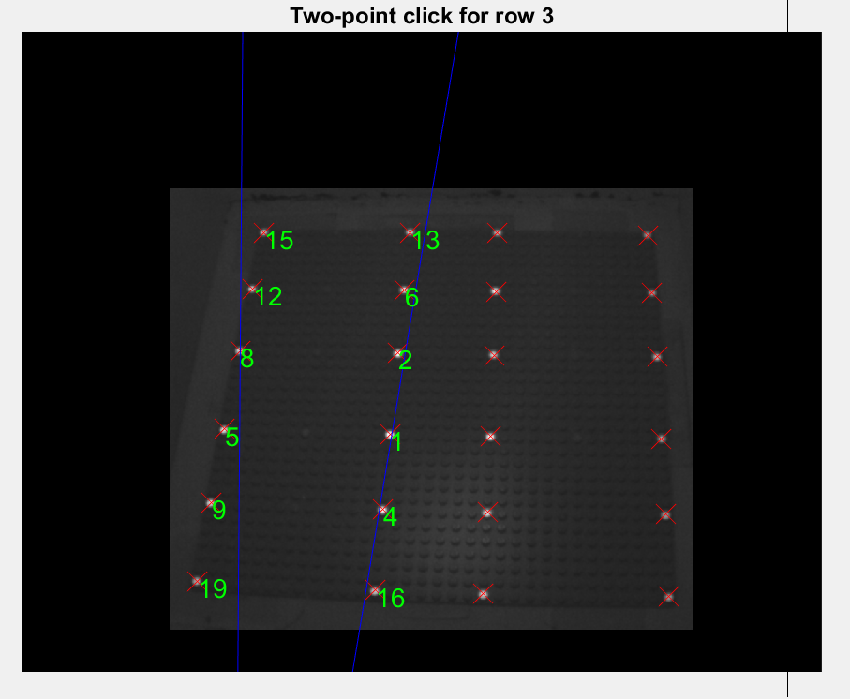
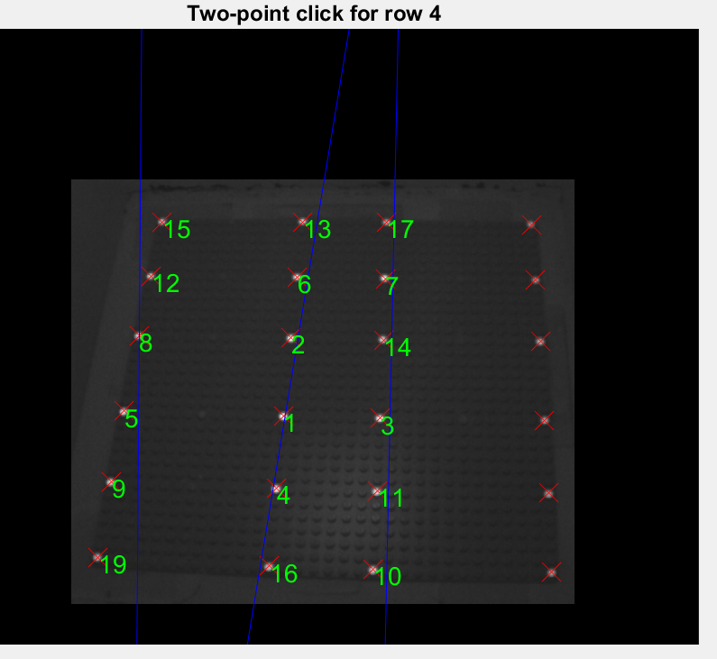
Then repeat for rows 2,3,4 (here rows 2 and 3 shown)

Slide 6
The final output looks like this. The numbering of each marker is important since each marker will be assigned to its real-world 3D coordinates (previously measured). Incorrect ordering results in incorrect calibration

