Slide 1
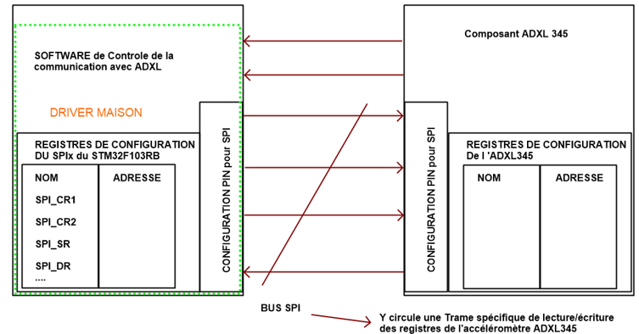
INT1
INT2
/CS
SCLK
MOSI
MISO
0x00
0x04
0x08
0x0C
POWER_CTL
INT_MAP
DATAX1
0x2D
0X2F
0x32

Slide 2
