Slide 1
Big Data Analytics for Competitive Advantage ITCS 6100 Analysis of Gun Violence data from 2013-2021
Group 17
Nimal Kumarr Arunkumar (801317922)
Samhitha Mudiam (801329504)
Hrushi Pappuri (801060321)
Tanuj Darla (801316530)
Shravan Naidu Gollu (801318790)

Slide 2
Introduction
★ The Problem:
One of the biggest issues that America has faced in the past few decades has been the rise of gun violence in civilian life and it has become particularly prevalent in the past decade.
According to the U.S. Centers for Disease Control and Prevention, 33,636 Americans were killed in 2013 and that figure rose to 38,658 deaths in 2016.₁ While the official number for the total number of deaths in 2017 has yet to be released, the organization estimates it to surpass 2016 based on end-of-the-year figures.
★ The Goal:
To analyze and explore data on gun violence in the US over the last few years.
To create a Machine Learning model that can predict the number of people killed and injured based on features about the shooting incidents.

Slide 3
Clients
★ Government Agencies (ex. U.S. Centers for Disease Control and Prevention)
Identify which factors can help predict the number of casualties in shooting incidents.
Determine which models are most efficient for analyzing gun violence data.
★ Pro - Gun Control Organizations
Inform the public where the most dangerous cities are in terms of gun violence.
Understand which factors are most important in predicting casualties even if they don’t have the data.

Slide 4
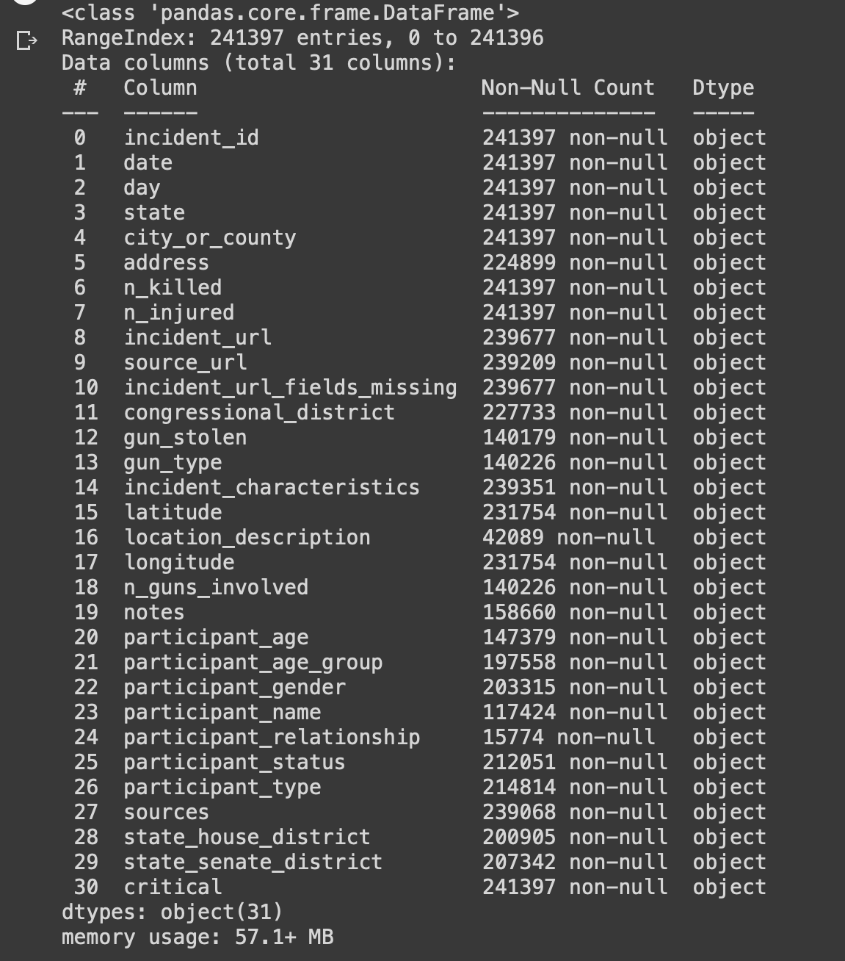
Dataset
★ The data was provided by James Ko: https://www.kaggle.com/jameslko/gun-violence-da ta
https://www.kaggle.com/datasets/konivat/us-gun-violence-archive-2014
★ Data was web-scraped from: http://www.gunviolencearchive.org/
★ Contains gun-violence data in the US from 2013 - 2021.

Slide 5
Data Dictionary
incident_id: ID of the crime report
date: Date of crime
state: State of crime
city_or_county: City/ County of crime
address: Address of the location of the crime
n_killed: Number of people killed
n_injured: Number of people injured
incident_url: URL regarding the incident
source_url: Reference to the reporting source
incident_url_fields_missing: TRUE if the incident_url is present, FALSE otherwise
congressional_district: Congressional district id
gun_stolen: Status of guns involved in the crime (i.e. Unknown, Stolen, etc...)
gun_type: Typification of guns used in the crime
incident_characteristics: Characteristics of the incidence
latitude: Location of the incident
location_description: Location description
longitude: Location of the incident
n_guns_involved: Number of guns involved in incident
notes: Additional information of the crime
participant_age: Age of participant(s) at the time of crime
participant_age_group: Age group of participant(s) at the time crime
participant_gender: Gender of participant(s)
participant_name: Name of participant(s) involved in crime
participant_relationship: Relationship of participant to other participant(s)
participant_status: Extent of harm done to the participant
participant_type: Type of participant
sources: Participants source
state_house_district: Voting house district
state_senate_district: Territorial district from which a senator to a state legislature is elected.
critical : denotes a boolean value for the seaverarity of the incident as TRUE or FALSE

Slide 6
Data Wrangling
★ Drop columns that are irrelevant to the project
★ Remove columns/rows with excessive amount of missing data
★ Choose age-group column over age column for better prediction
★ Include only the top 15 cities with most incidents for better prediction
★ Add new date columns (year, month, weekday)
★ Remove incident characteristics due to data leakage
★ Create new numerical columns for Categorical columns (ex. mapped_cities)
★ Nearly 200,000 rows of data were dropped as a result

Slide 7
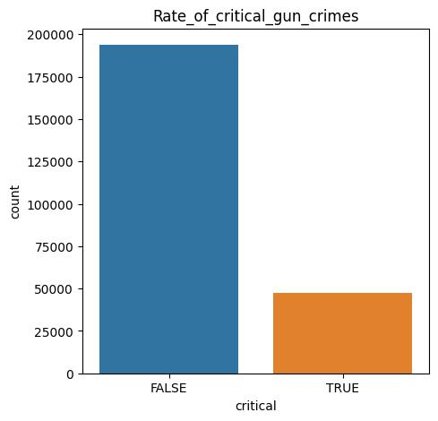
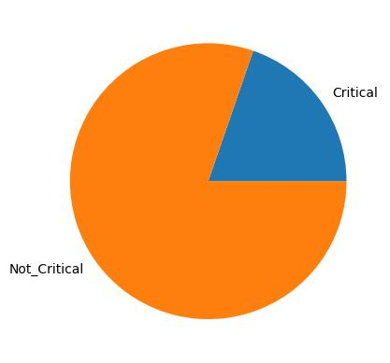
Number of Killed and Injured
Number of Critical cases : 47607
Number of Non-critical cases : 193790

Slide 8
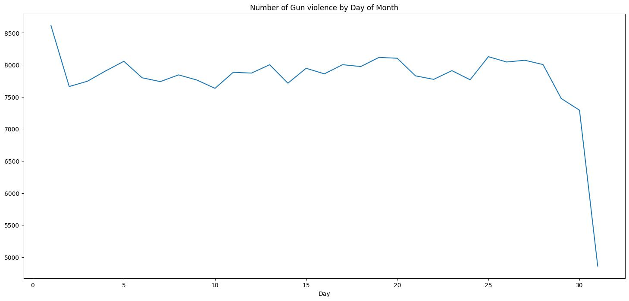
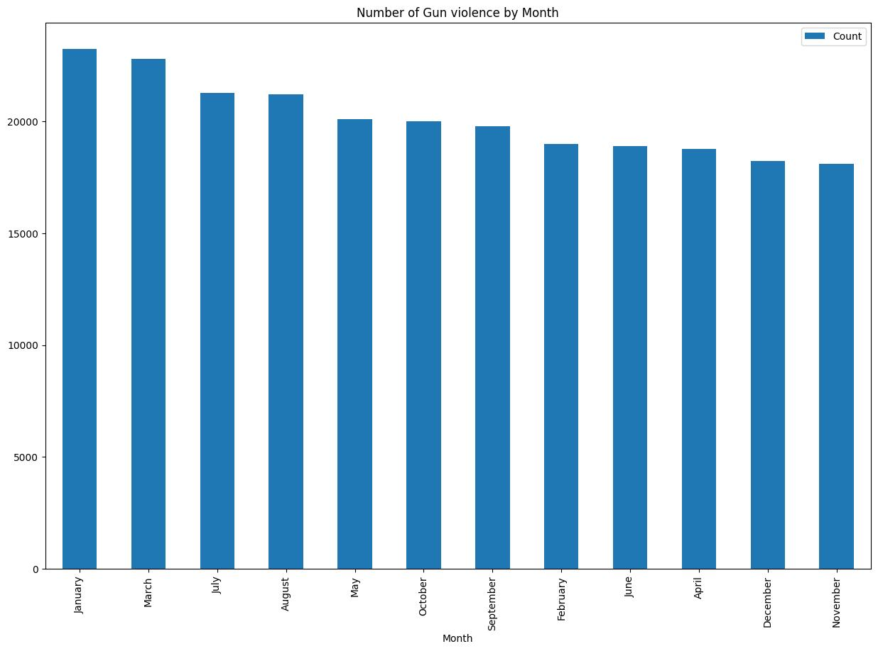
Casualties by Month
We have visualized which month was more likely to see gun incidents and to no surprise January, March and July are high on the list due to obvious two big celebrations in New Year and 4th of July.
Based on this figure we can see, the incidents are really common during the start of the month as people are more likely to go out partying, drinking at the start of the month (Fresh Paychecks) compared to the end of the month with the incident almost crashing down.

Slide 9
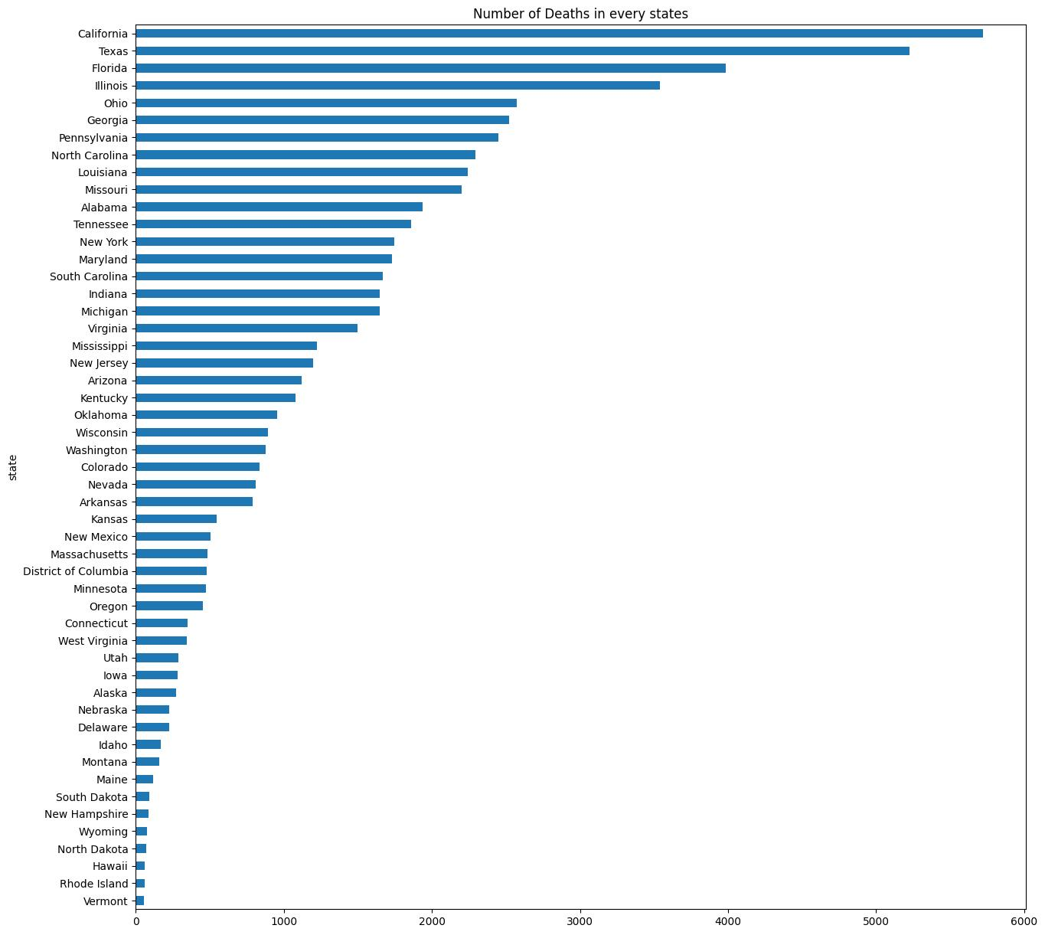
Casualties by State
This graph however shows an interesting information as California comes across as the state with the most number of Gun related deaths closely followed by Texas and Florida.
The graph shows the least at Vermount, Rhode Island and Hawaii. But, we are seeing the medain deaths in New Jersey, Arizona and Mississippi.

Slide 10
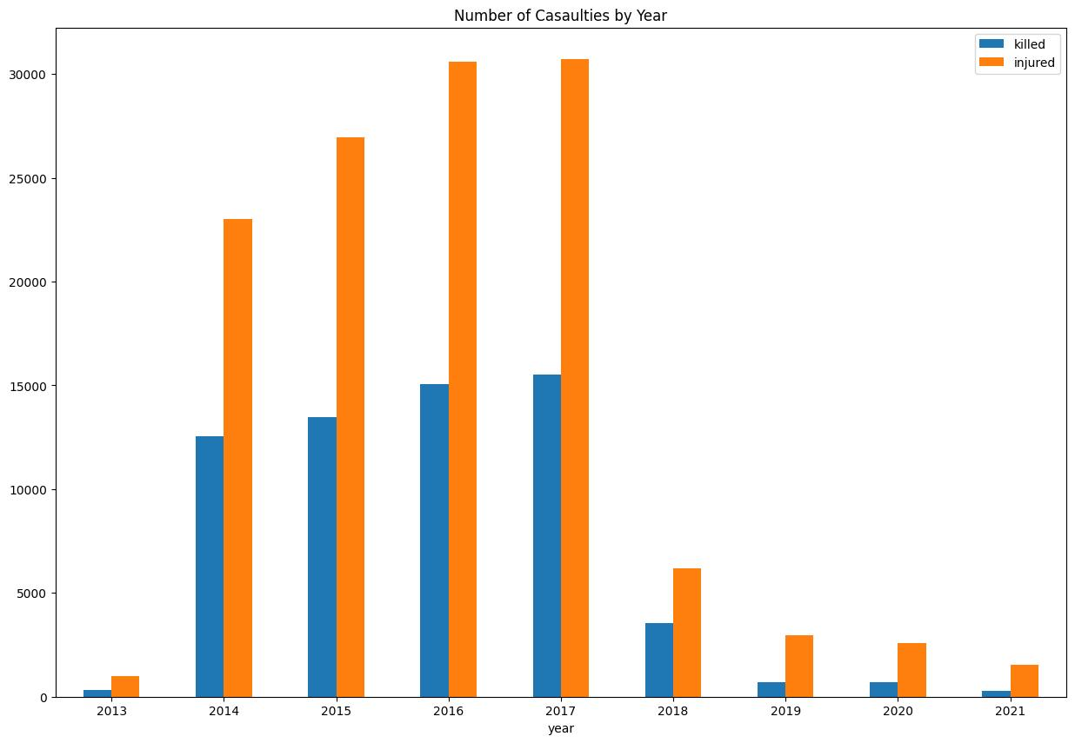
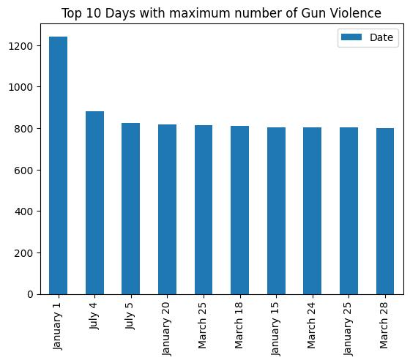
Casualties by Date
It comes as no surprise that two of the most severe days are 1st of January and 4th of July. The reason could be a large number of public events and people being intoxicated and prone to being violent early
From the graph we have projected the number of casulaties by year and can see the highest casulaities are in 2016 and 2017. We can see that the gun violence rate has gradually decreased after financial crisis in 2018 and covid disease in 2020. This both factors have impacted a lot on the gun violence rates in the USA.

Slide 11
Feature Selection
★ Using the Chi-Square Test for Independence and previously creating numerical columns for the Categorical data, features were selected for the machine learning models.
★ Two types of feature sets were created: one for predicting the number of people killed (killed) and the other for predicting the number of people injured (injured).
★ Both feature sets included the same features shown on the right, except the set for predicting the number of people killed included n_injured as a feature and vice versa.

Slide 12
Baseline/Linear Regression
★ A simple baseline was created using the DummyRegressor regressor to compare with the results of the models.
★ 2 primary metrics were used:
RMSE (Root Mean Squared Error)
R-Squared
★ 3 different Linear Regression Models were used:
Linear Regression without Regularization
Lasso Regularization
Ridge Regularization
★ Application: The number of people injured had the highest coefficient value for predicting the number of people killed, and vice versa.
For every person injured in a shooting incident, there was a decrease of 0.3 deaths. In other words, there was a negative correlation between the 2 variables.
Baseline | n_killed | n_injured
RMSE | 0.5067 | 0.7654
R-Squared | -0.0001 | 0
Linear Regression | n_killed | n_injured
RMSE | 0.4123 | 0.6005
R-Squared | 0.3193 | 0.4207

