Slide 1
Movement Explained
IMR/PPGCC/PUCRS
2018/2

Slide 2
Basic Trigonometry
* Nikolaus Correll. Introduction to Autonomous Robots, 1st edition, 2016

Slide 3
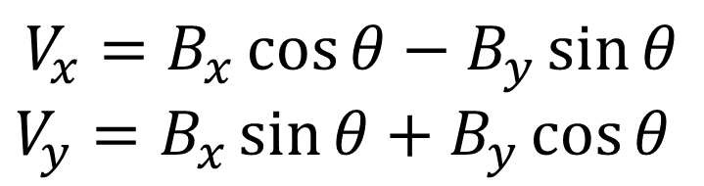
Rigid Body Rotation in 2D
$$V_{x}=B_{x}\cos{θ}−B_{y}\sin{θ}$$
$V_{y}=B_{x}\sin{θ}+B_{y}\cos{θ}$
Peter Corke 2017. sec 2.1.1

Slide 4
Translation/Rotation in 2D
Notes:
t = deg2rad(30);
T = [cos(t) -sin(t) 0; sin(t) cos(t) 0; 1 2 1]
https://www.tutorialspoint.com/execute_matlab_online.php

Slide 5
To Remember and Practice
Few suggested links for those who need to remember
https://pages.mtu.edu/~shene/COURSES/cs3621/NOTES/geometry/geo-tran.html
https://en.wikipedia.org/wiki/Translation_(geometry)
https://en.wikipedia.org/wiki/Rotation_matrix
http://demonstrations.wolfram.com/Understanding2DTranslation/
http://www.mathsisfun.com/geometry/translation.html
http://www.mathsisfun.com/geometry/rotation.html

Slide 6
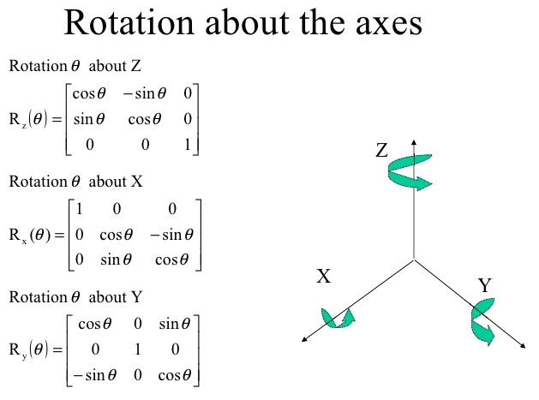
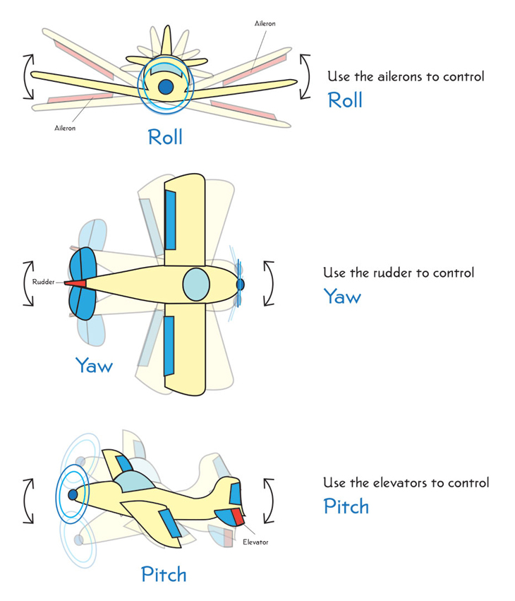
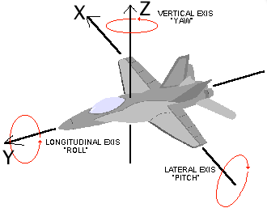
3D Representation

Slide 7
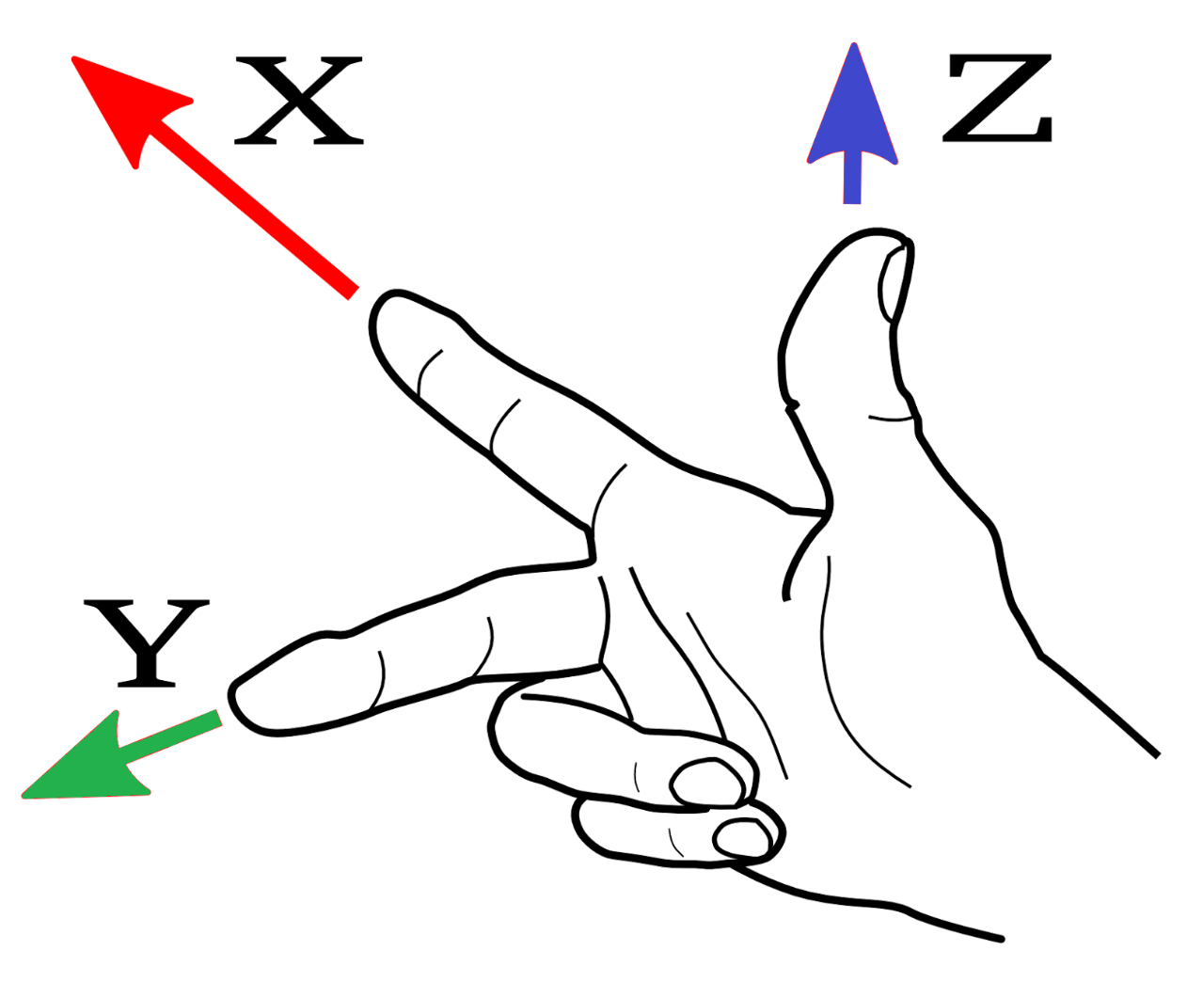
geometry_msgs/Twist
x forward/backward
y left/right
z up/down
* http://www.ros.org/reps/rep-0103.html
pitch
yaw
geometry_msgs/Vector3 linear float64 x float64 y float64 z geometry_msgs/Vector3 angular float64 x float64 y float64 z
roll
- Linear (translational) velocity: m/s
- Angular (rotational) velocity: rad/s

Slide 8
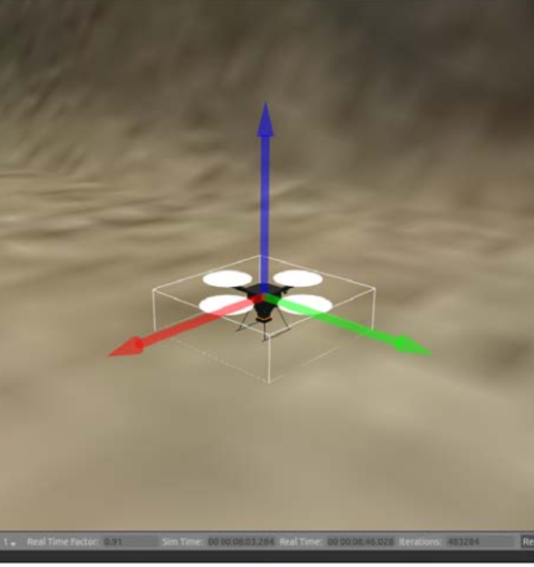
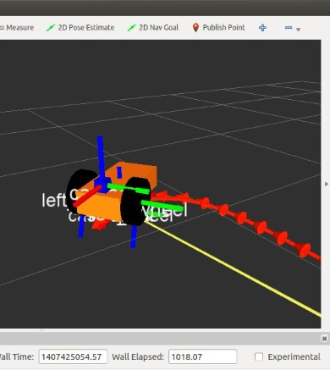
3D position in simulators
The Red, Green, Blue convention is also used in the simulators

Slide 9
Common Wheel Configurations
* Siegwart. Introduction to Autonomous Mobile Robots. 2011

Slide 10
Common Wheel Configurations
* Siegwart. Introduction to Autonomous Mobile Robots. 2011

Slide 11
* Siegwart. Introduction to Autonomous Mobile Robots. 2011

Slide 12
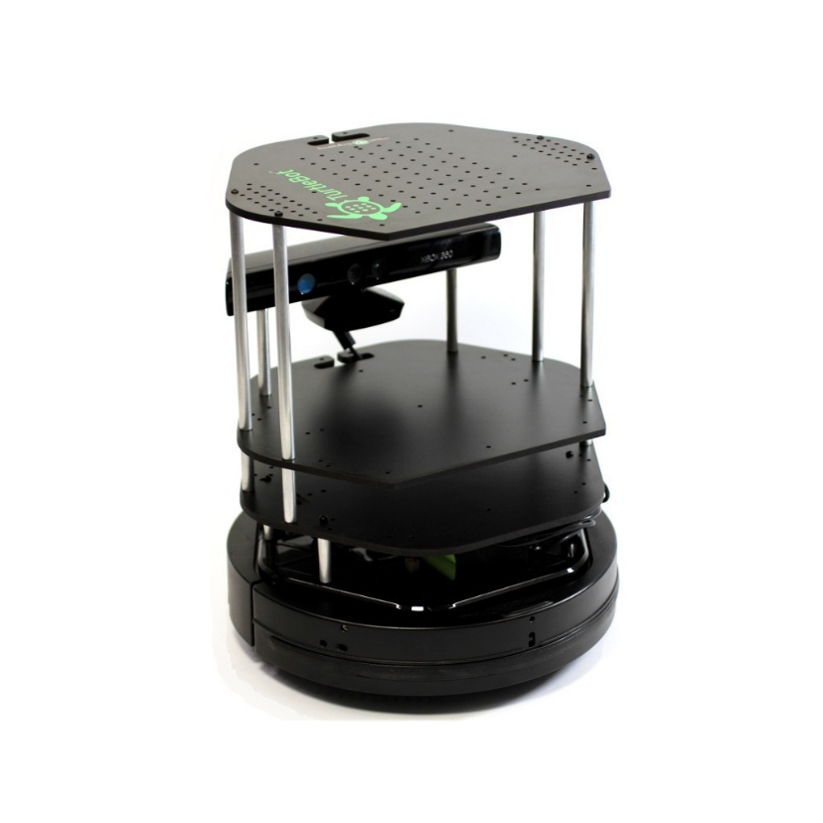
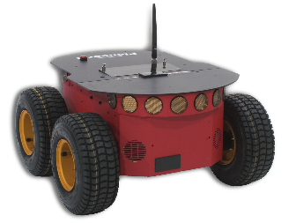
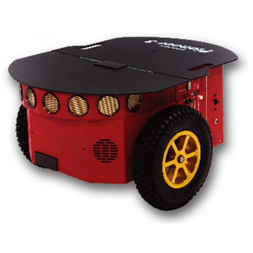
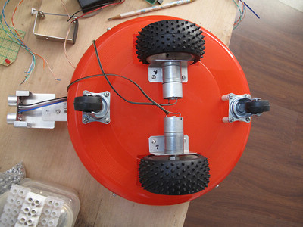
Differential Steering

Slide 13
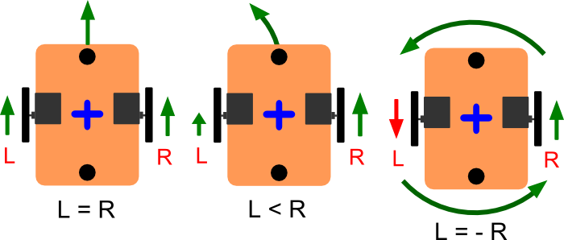
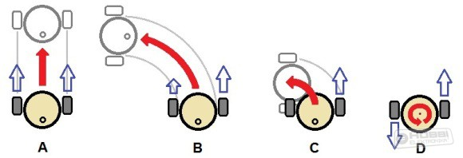
Differential Steering

Slide 14
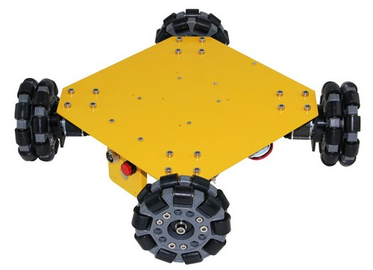
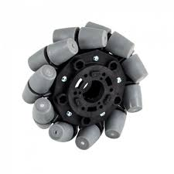
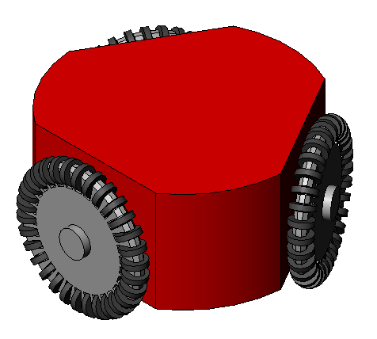
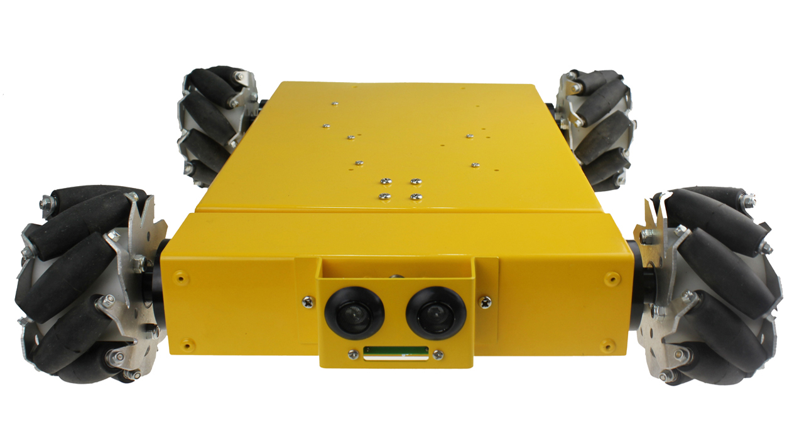
Omnidirectional Steering

Slide 15
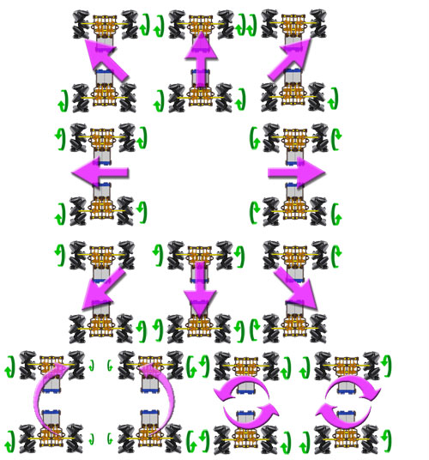
Omnidirectional Steering

Slide 16
Movement of Common Mobile Models
Differential robot
Linear: x
Angular: z
omni-directional robot
Linear: x and y
Angular: z
pitch
yaw
Non-holonomic kinematic model
Holonomic kinematic model
roll
The velocity vector of a holonomic robot can point into any arbitrary direction at any time. It moves to any direction without any restriction from its mechanics

Slide 17
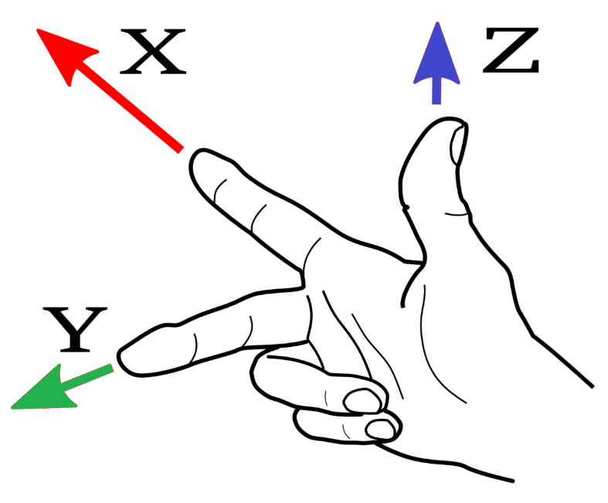
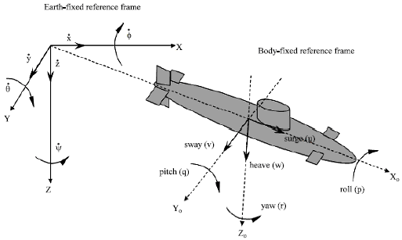
Movement of Common Mobile Models
Submarine
Linear: ????
Angular: ????
pitch
yaw
roll

Slide 18
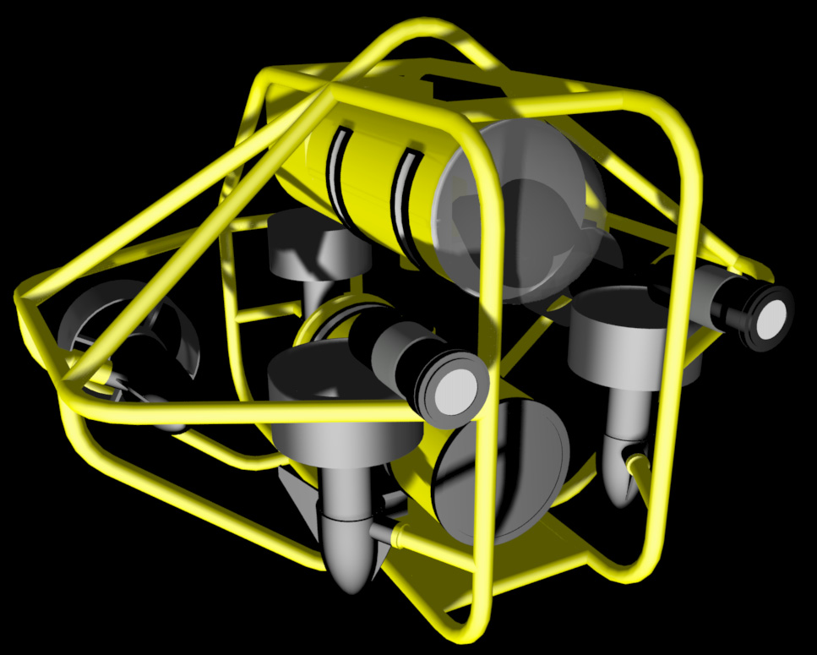
Movement of Common Mobile Models
Autonomous Underwater Vehicle
Linear: ????
Angular: ????
pitch
yaw
roll

Slide 19
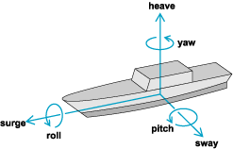
Movement of Common Mobile Models
Boat
Linear: ????
Angular: ????
pitch
yaw
roll

Slide 20

Moving a Differential Robot - Forward
Differential robot
Linear: x
Angular: z
X>0: forward
X<0: backward
$ rostopic pub /turtle1/cmd_vel geometry_msgs/Twist '{linear: {x: 0.2, y: 0, z: 0}, angular: {x: 0, y: 0, z: 0}}'
$ rostopic pub /turtle1/cmd_vel geometry_msgs/Twist '{linear: {x: 0.2}}'

Slide 21
Moving a Differential Robot - Turn
Differential robot
Linear: x
Angular: z
z>0: left
z<0: right
$ rostopic pub /turtle1/cmd_vel -r 10 geometry_msgs/Twist ‘{angular: {z: 0.5}}'

Slide 22
Differential Drive Foward Kinematics Model

Slide 23

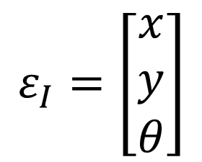
Pose Estimation
Which pose will be reached after applying the following control parameters ?
Pose related to the global reference frame
y
$${(ε}_{I})$$
x
$$ε_{I}=\left[\begin{matrix}x \\ y \\ θ\end{matrix}\right]$$
* LaValle. Planning Algorithms. 2006
* https://www.youtube.com/watch?v=aE7RQNhwnPQ

Slide 24

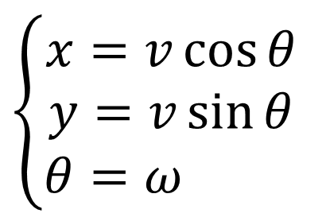



Pose Estimation
Linear
velocity
$$\left\{\begin{aligned}x=v\cos{θ} \\ y=v\sin{θ} \\ θ=ω \end{aligned}\right.$$
$$v$$
$$v_{l}$$
$$v_{r}$$
$$ω$$
Angular velocity
The linear and angular velocities are inputs of the model (Twist Message)
* LaValle. Planning Algorithms. 2006
* https://www.youtube.com/watch?v=aE7RQNhwnPQ

Slide 25


Pose Estimation
Differential drive model
$$v_{l}$$
$$v_{r}$$
$$v=\frac{R}{2}(v_{r}+v_{l})$$
R
$$ω=\frac{R}{L}\left(v_{r}−v_{l}\right)$$
L
* LaValle. Planning Algorithms. 2006
* https://www.youtube.com/watch?v=aE7RQNhwnPQ

Slide 26
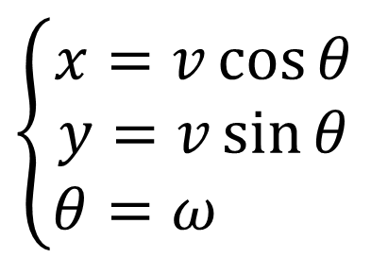
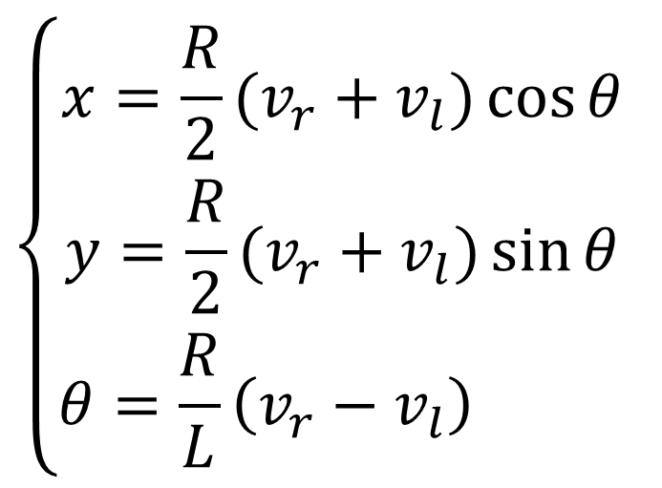
Pose Estimation
$$\left\{\begin{aligned}x=\frac{R}{2}(v_{r}+v_{l})\cos{θ} \\ y=\frac{R}{2}(v_{r}+v_{l})\sin{θ} \\ θ=\frac{R}{L}\left(v_{r}−v_{l}\right) \end{aligned}\right.$$
$$v=\frac{R}{2}(v_{r}+v_{l})$$
$$\left\{\begin{aligned}x=v\cos{θ} \\ y=v\sin{θ} \\ θ=ω \end{aligned}\right.$$
$$ω=\frac{R}{L}\left(v_{r}−v_{l}\right)$$
vr and vl are the control parameters in a diff drive robot
* LaValle. Planning Algorithms. 2006
* https://www.youtube.com/watch?v=aE7RQNhwnPQ

Slide 27
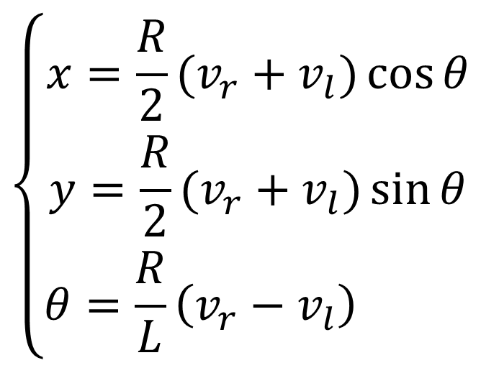
Pose Estimation
Differential drive model
$$v_{l}$$
$$v_{r}$$
$$\left\{\begin{aligned}x=\frac{R}{2}(v_{r}+v_{l})\cos{θ} \\ y=\frac{R}{2}(v_{r}+v_{l})\sin{θ} \\ θ=\frac{R}{L}\left(v_{r}−v_{l}\right) \end{aligned}\right.$$
R
L
* LaValle. Planning Algorithms. 2006
* https://www.youtube.com/watch?v=aE7RQNhwnPQ

Slide 28
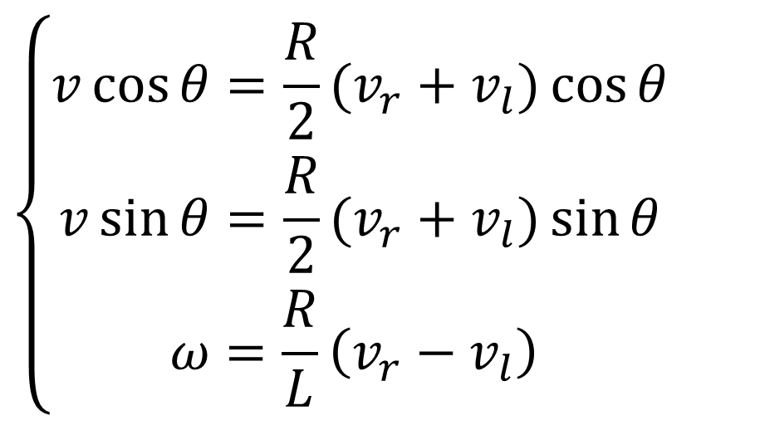
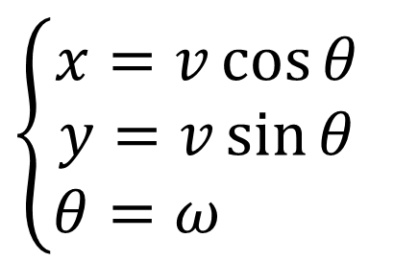
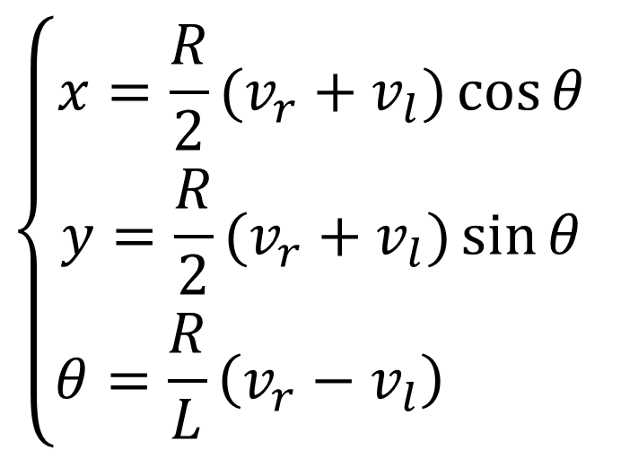
Pose Estimation
$$\left\{\begin{aligned}x=v\cos{θ} \\ y=v\sin{θ} \\ θ=ω \end{aligned}\right.$$
$$\left\{\begin{aligned}v\cos{θ}=\frac{R}{2}(v_{r}+v_{l})\cos{θ} \\ v\sin{θ}=\frac{R}{2}(v_{r}+v_{l})\sin{θ} \\ ω=\frac{R}{L}\left(v_{r}−v_{l}\right) \end{aligned}\right.$$
$$\left\{\begin{aligned}x=\frac{R}{2}(v_{r}+v_{l})\cos{θ} \\ y=\frac{R}{2}(v_{r}+v_{l})\sin{θ} \\ θ=\frac{R}{L}\left(v_{r}−v_{l}\right) \end{aligned}\right.$$
* LaValle. Planning Algorithms. 2006
* https://www.youtube.com/watch?v=aE7RQNhwnPQ

Slide 29

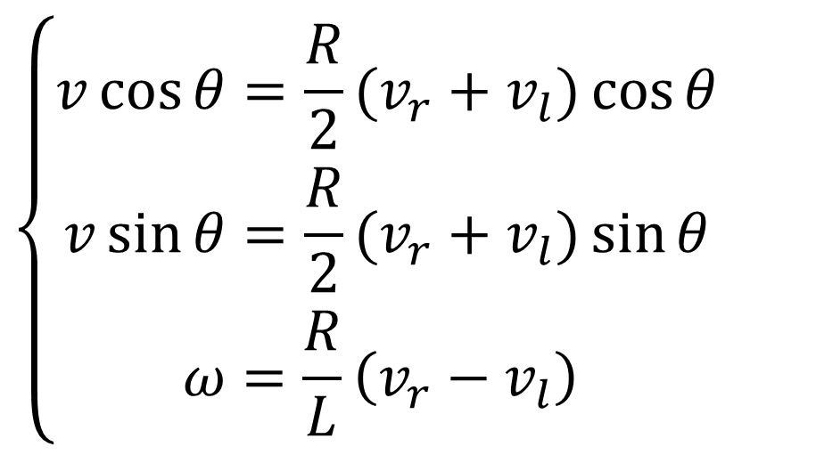
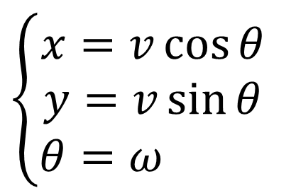

Pose Estimation
$$\left\{\begin{aligned}v\cos{θ}=\frac{R}{2}(v_{r}+v_{l})\cos{θ} \\ v\sin{θ}=\frac{R}{2}(v_{r}+v_{l})\sin{θ} \\ ω=\frac{R}{L}\left(v_{r}−v_{l}\right) \end{aligned}\right.$$
$$v=\frac{R}{2}(v_{r}+v_{l})$$
$$ω=\frac{R}{L}\left(v_{r}−v_{l}\right)$$
$$\left\{\begin{aligned}x=v\cos{θ} \\ y=v\sin{θ} \\ θ=ω \end{aligned}\right.$$
* LaValle. Planning Algorithms. 2006
* https://www.youtube.com/watch?v=aE7RQNhwnPQ

Slide 30
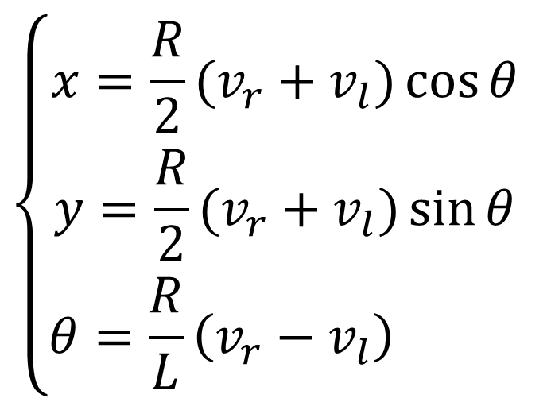
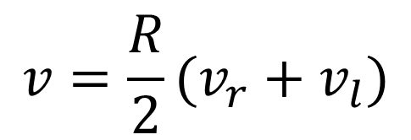

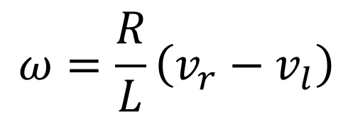

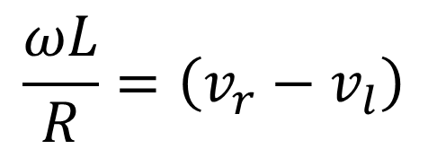
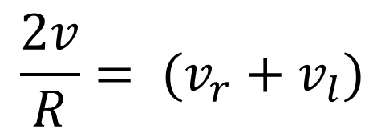
Pose Estimation
$$v=\frac{R}{2}(v_{r}+v_{l})$$
$$\frac{2v}{R}= (v_{r}+v_{l})$$
$$v_{r}=\frac{2v+ωL}{2R}$$
$$ω=\frac{R}{L}\left(v_{r}−v_{l}\right)$$
$$\frac{ωL}{R}=\left(v_{r}−v_{l}\right)$$
$$v_{l}=\frac{2v−ωL}{2R}$$
$$\left\{\begin{aligned}x=\frac{R}{2}(v_{r}+v_{l})\cos{θ} \\ y=\frac{R}{2}(v_{r}+v_{l})\sin{θ} \\ θ=\frac{R}{L}\left(v_{r}−v_{l}\right) \end{aligned}\right.$$
vr and vl are the control parameters in a diff drive robot
* LaValle. Planning Algorithms. 2006
* https://www.youtube.com/watch?v=aE7RQNhwnPQ

Slide 31
More About Differential Base Controller
Effective Robotics Programming with ROS
Chap 5 - Creating our base controller

Slide 32
Odometry of Diff Drive with Encoders

Slide 33


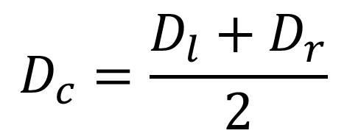

Differential Drive Odometry Model
$$D_{c}$$
$$D_{r}$$
$$D_{c}=\frac{D_{l}+D_{r}}{2}$$
$$D_{l}$$
* https://www.youtube.com/watch?v=XbXhA4k7Ur8

Slide 34



Differential Drive Odometry Model
Initial position
$$D_{c}$$
$$D_{r}$$
$$D_{l}$$
$$θ$$
$$y$$
$$x$$
* https://www.youtube.com/watch?v=XbXhA4k7Ur8

Slide 35



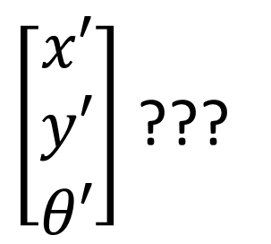
Differential Drive Odometry Model
Next position
$\left[\begin{matrix}x′ \\ y′ \\ θ′\end{matrix}\right]$ ???
$$y′$$
$$θ′$$
$$D_{c}$$
$$D_{r}$$
$$D_{l}$$
$$x′$$
* https://www.youtube.com/watch?v=XbXhA4k7Ur8

Slide 36
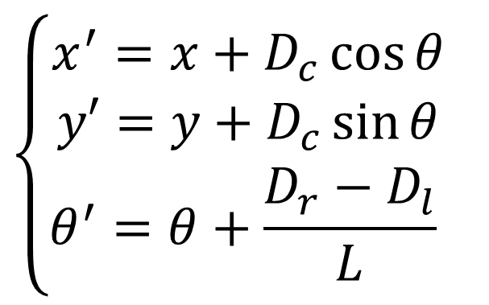






Differential Drive Odometry Model
Next position
$$\left\{\begin{aligned}x^{′}=x+D_{c}\cos{θ} \\ y′=y+D_{c}\sin{θ} \\ θ^{′}=θ+\frac{D_{r}−D_{l}}{L} \end{aligned}\right.$$
$$y′$$
$$θ′$$
$$D_{c}$$
$$D_{r}$$
$$D_{l}$$
$$x′$$
* https://www.youtube.com/watch?v=XbXhA4k7Ur8

Slide 37
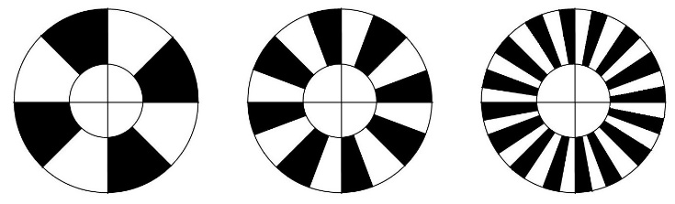
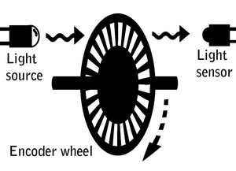
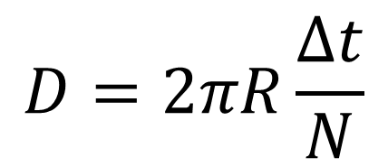
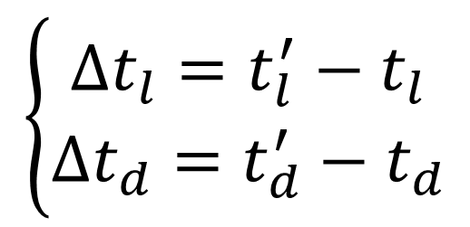
Wheel Encoders
Tick count is used to determine Dl and Dr
Assume the wheel has N tick per revolution
current # ticks
previous # ticks
$$\left\{\begin{aligned}∆t_{l}=t_{l}^{′}−t_{l} \\ ∆t_{d}=t_{d}^{′}−t_{d}\end{aligned}\right.$$
$$D=2πR\frac{∆t}{N}$$
* https://www.youtube.com/watch?v=XbXhA4k7Ur8

Slide 38







Odometry with Wheel Encoders
$$D_{r}=2πR\frac{{∆t}_{r}}{N}$$
$$D_{l}=2πR\frac{{∆t}_{l}}{N}$$
$$\frac{2πR\frac{{∆t}_{r}}{N}+2πR\frac{{∆t}_{l}}{N}}{2}=$$
$$\frac{2(πR\frac{{∆t}_{r}}{N}+πR\frac{{∆t}_{l}}{N})}{2}$$
$$D_{c}=\frac{D_{r}+D_{l}}{2}=$$
$$πR\frac{{∆t}_{r}}{N}+πR\frac{{∆t}_{l}}{N}=$$
$$\frac{πR}{N} ({∆t}_{r}+{∆t}_{l})$$

Slide 39





Odometry with Wheel Encoders
$$D_{r}=2πR\frac{{∆t}_{r}}{N}$$
For a given initial pose $\left[\begin{matrix}x & y & θ\end{matrix}\right]$
1st step: read the tick counts for left and right wheels (${∆t}_{r}$ and ${∆t}_{l}$)
2nd step: calculate the distance travelled ($D_{r}$, $D_{l},D_{c}$)
3rd step: determine the new pose $\left[\begin{matrix}x′ & y′ & θ′\end{matrix}\right]$
R, N, and L are robot design constants
$$D_{l}=2πR\frac{{∆t}_{l}}{N}$$
$$D_{c}=\frac{πR}{N} ({∆t}_{r}+{∆t}_{l})$$
$$\left\{\begin{aligned}x^{′}=x+D_{c}\cos{θ} \\ y′=y+D_{c}\sin{θ} \\ θ^{′}=θ+\frac{D_{r}−D_{l}}{L} \end{aligned}\right.$$

Slide 40
Odometry Message
geometry_msgs/PoseWithCovariance pose geometry_msgs/Pose pose geometry_msgs/Point position float64 x float64 y float64 z geometry_msgs/Quaternion orientation float64 x float64 y float64 z float64 w float64[36] covariance
Header header string child_frame_id geometry_msgs/PoseWithCovariance pose geometry_msgs/TwistWithCovariance twist
geometry_msgs/TwistWithCovariance twist geometry_msgs/Twist twist geometry_msgs/Vector3 linear float64 x float64 y float64 z geometry_msgs/Vector3 angular float64 x float64 y float64 z float64[36] covariance

Slide 41
Odometry Message
geometry_msgs/PoseWithCovariance pose geometry_msgs/Pose pose geometry_msgs/Point position float64 x float64 y float64 z geometry_msgs/Quaternion orientation float64 x float64 y float64 z float64 w float64[36] covariance
Header header string child_frame_id geometry_msgs/PoseWithCovariance pose geometry_msgs/TwistWithCovariance twist
geometry_msgs/TwistWithCovariance twist geometry_msgs/Twist twist geometry_msgs/Vector3 linear float64 x float64 y float64 z geometry_msgs/Vector3 angular float64 x float64 y float64 z float64[36] covariance
at what time the data was produced and in what coordinate frame it is represented

Slide 42
Odometry Message
geometry_msgs/PoseWithCovariance pose geometry_msgs/Pose pose geometry_msgs/Point position float64 x float64 y float64 z geometry_msgs/Quaternion orientation float64 x float64 y float64 z float64 w float64[36] covariance
Header header string child_frame_id geometry_msgs/PoseWithCovariance pose geometry_msgs/TwistWithCovariance twist
geometry_msgs/TwistWithCovariance twist geometry_msgs/Twist twist geometry_msgs/Vector3 linear float64 x float64 y float64 z geometry_msgs/Vector3 angular float64 x float64 y float64 z float64[36] covariance
report the robot’s position and orientation

Slide 43
Odometry Message
geometry_msgs/PoseWithCovariance pose geometry_msgs/Pose pose geometry_msgs/Point position float64 x float64 y float64 z geometry_msgs/Quaternion orientation float64 x float64 y float64 z float64 w float64[36] covariance
Header header string child_frame_id geometry_msgs/PoseWithCovariance pose geometry_msgs/TwistWithCovariance twist
geometry_msgs/TwistWithCovariance twist geometry_msgs/Twist twist geometry_msgs/Vector3 linear float64 x float64 y float64 z geometry_msgs/Vector3 angular float64 x float64 y float64 z float64[36] covariance
needed for downstream to reason about uncertainty

Slide 44
More about Differential Drive Odometry
Learning Robotics Using Python
Chap 3- Mathematical modeling of the robot
Learning ROS for Robotics Programming - Second Edition
Chap 8 - Creating our own odometry
C++
Effective Robotics Programming with ROS
Chap 5 - Creating our own odometry, pg 252
ROS Robotics By Example (Python)
Chap 3: Driving around with turtlebot
ROS By Example (in Python)
Chap 7 – Controlling a Mobile Base

Slide 45
Differential Drive Inverse Kinematics Model
Path Planning

Slide 46
Differential Drive Inverse Kinematics Model
How can the control parameters be selected so as to have the robot obtain a specific global pose or follow a specific trajectory?
How to reach pose [x’,y’,a’] ? Which control parameters must be applied to reach pose [x’,y’,a’] ?
Assume pose [x,y,a] at time t, determine Vl and Vr controls parameters that lead to the pose [x’,y’,a’] at t + dt
desired_pose=[x’,y’,a’]
Vl and Vr ?????
current_pose=[x,y,a]
Goal = initial_rotation + translation + final_rotation

Slide 47
Differential Drive Inverse Kinematics Model
Translation
Rotation
* Dudek and Jenkin. Computational Principles of Mobile Robotics

Slide 48


Differential Drive Inverse Kinematics Model
Variables changed to the convention used in the next slides. Dc is defined later
$$\left\{\begin{aligned}x^{′}=x+D_{c}\cos{θ} \\ y′=y+D_{c}\sin{θ} \\ θ^{′}=θ \end{aligned}\right.$$
Translation
No change in angle
$$\left\{\begin{aligned}x^{′}=x \\ y^{′}=y \\ θ^{′}=θ+\frac{{2D}_{c}}{L}\end{aligned}\right.$$
Rotation
change in angle only

Slide 49
Differential Drive Inverse Kinematics Model
* Probabilistic Robotics. 2005

Slide 50
Feedback Control for Path Planning
* Siegwart. Introduction to Autonomous Mobile Robots. 2011

Slide 51

Homework
Control the wheel velocity of a diff robot
Inputs : linear and angular velocities (Twist); linear x and angular z
Assume initial pose is [0 0 0]
Output: print vl and vr
Estimate the new pose of a diff robot based on wheel encoder
Inputs: current pose [x, y, $θ$], ticks l, ticks r , L, R
Output: print new pose [x’, y’, $θ$’]
Basic Path planning
Input : current pose [x, y, $θ$] and new pose [x’, y’, $θ$’]
Output: chart printing the path, print rot1, trans, rot2
Resource
https://matplotlib.org/1.5.1/examples/animation/index.html
https://drive.google.com/open?id=0B0k1Rlg3GieXQjVjYnhTYWlBaHc (https://goo.gl/VHpHqq )⬅

