Slide 1
PRESENTATION TITLE
Predictive Modeling for Home Loan Approvals
23/10/2024

Slide 2
TEXT LAYOUT 1
Agenda
Data Science Lifecycle​
Project Overview​
Data
Analysis
Modeling
Model Evaluation
Recommendations

Slide 3
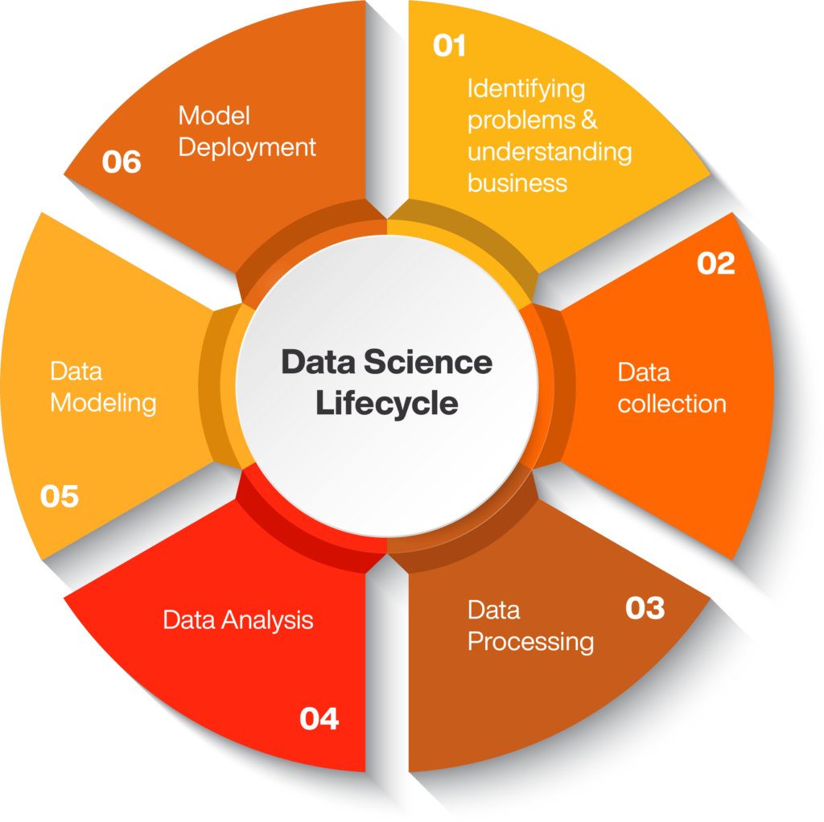
TEXT LAYOUT 1
Data Science Lifecycle

Slide 4
TEXT LAYOUT 1
Project Overview
Business Problem: Home loan applications require 2-3 days for a decision, slowing down the customer experience.
Business Objective: Automate loan approval decisions to reduce processing time to seconds.
Hypothesis: Using historical data, ML models can classify applications as approved or declined in real time.

Slide 5
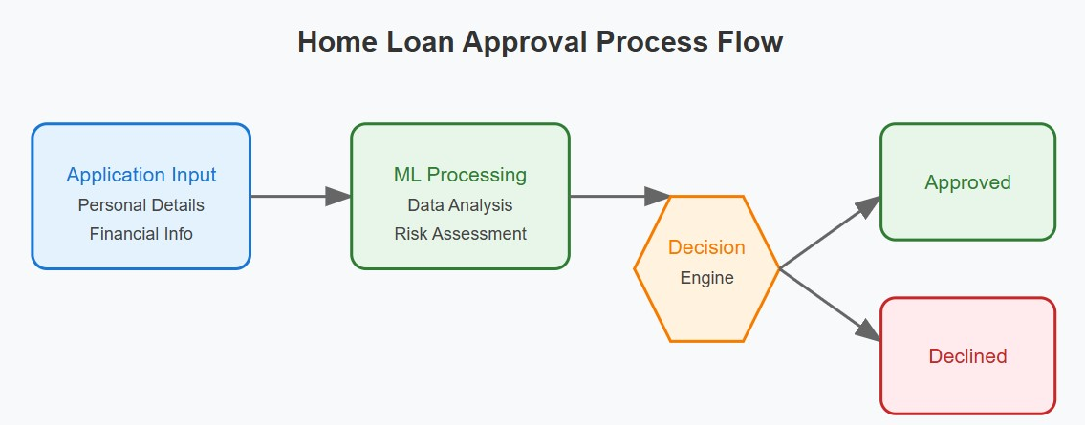
TEXT LAYOUT 1
Process Overview / Solution
Description: Applicants input their details, and the ML model provides instant feedback on the application's status (approved/declined).

Slide 6
TEXT LAYOUT 1
Data
Describe Data
Dataset Summary:Records: 614
Columns: 13 (5 numerical, 8 categorical)
Target Variable: Loan Status with 422 approvals and 192 declines

Slide 7
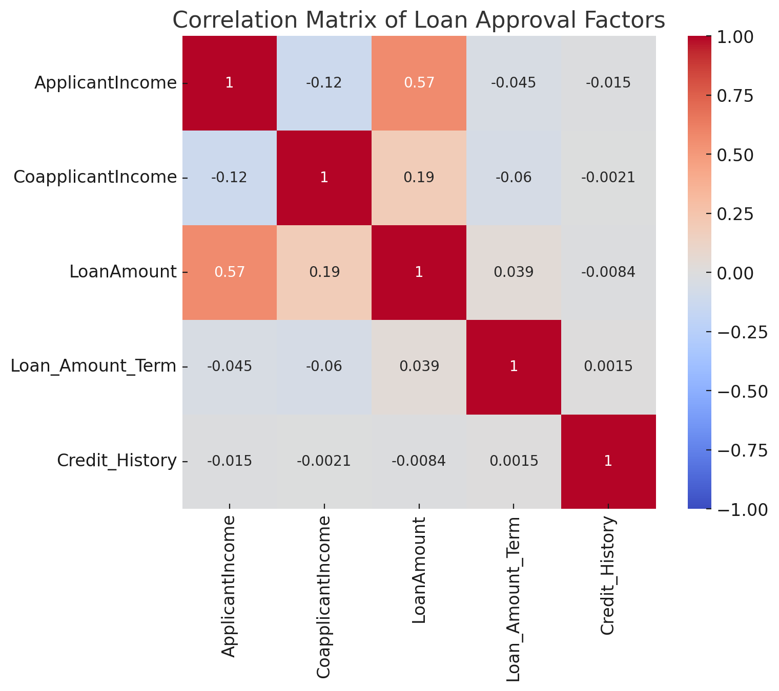
TEXT LAYOUT 1
Analysis
Applicant Income and Loan Amount: Higher applicant income is linked to larger loan amounts, which makes sense since higher-income people can qualify for higher loans.
Coapplicant Income and Loan Amount: There’s only a weak connection here, so coapplicant income doesn’t significantly impact the loan amount.
Credit History: Minimal correlation with other factors, suggesting it’s a standalone criterion—either credit history is good or bad, directly influencing loan approval rather than being affected by income or loan term.

Slide 8
TEXT LAYOUT 1
Modeling
Models Used: Comparison between custom model (with preprocessing) and AutoML.
Details: The custom model required manual preprocessing, while AutoML did not, yielding similar results.

Slide 9
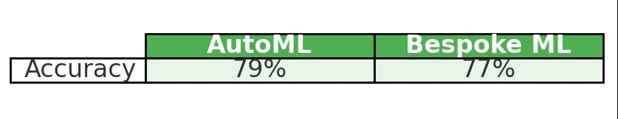
TEXT LAYOUT 1
Model Evaluation
This table compares the accuracy of AutoML (79%) and Bespoke ML (77%) models for loan approval predictions, highlighting AutoML's slightly better performance.

Slide 10
TEXT LAYOUT 1
Recommendations
Recommendation: Bespoke ML is preferred due to better transparency in model inputs and algorithm choice.
Future Use: AutoML as a baseline, with custom model refinement for potential real-time applications.
Summary: The ML model significantly reduces loan processing time.
Next Steps: Deployment planning, team training, and ongoing model performance monitoring.

