Slide 1

PROJECT PRESENTATION
BY:DARLSY LIDA OTIENO
COM/B/01-00101/2018
SUPERVISOR:
Dr. JASPER ONDULO

Slide 2
CUSTOMER SEGMENTATION USING
MACHINE LEARNING

Slide 3
ABSTRACT
Customer segmentation is the practice of dividing a customer
base into groups of individuals that are similar in specific ways.
Broadcasting same offer to all customers can be tiresome and waste of resources. With the help of this project, company can broadcast product to customers that most likely be interested.
A number of customer segmentation has been done on customer data. However, with proper data preparation and feature engineering, I aimed at producing a model with higher accuracy level.

Slide 4
PROBLEM STATEMENT
Customers can get annoyed when they got disrupted with advertisement of product that they dont have interest in, company strive to make their customers happy.
It is very expensive and waste of resources broadcasting the same offer to all customers.

Slide 5
OBJECTIVES
MAIN
To come up with a more accurate model that help in predicting customers that best fit the offer.
SPECIFIC
To reduce cost of broadcasting offers and deals to customers.
To analyze and reduce the risk in deciding where, when, how and whom a product ,service or brand will be marketed.

Slide 6
SYSTEM REQUIREMENTS
Software requirements
Python 3.7
Anaconda
Python Libraries- numpy, pandas, matplotlib, sklearn, wordcloud, flask
Ubuntu (OS)
Visual Studio Code
Hardware Requirements
Computer (intel corei5, ROM 500GB, RAM 4GB

Slide 7
Functional Requirements
Classifying customer into segments.
The model is able to predict customer segment that best fit the offer.
Non-Functional Requirements
Reliabilty: Model is available all time in good condition
Perfomance: The model has high percentage of accuracy to give correct prediction.
Simplicity: Interractive user interface.
Efficiency: Perform efficiently in short time.

Slide 8
METHODOLOGY
AGILE METHODOLOGY
For proper design and implementation of the project, iterative process development will be adopted, which enhances iteration with additional features added and testing until there is fully functional model.
Input
Training
Customer
categories
Segmentation
model
Deploy
model
Customer
Dataset
Feature
Extraction
Testing

Slide 9
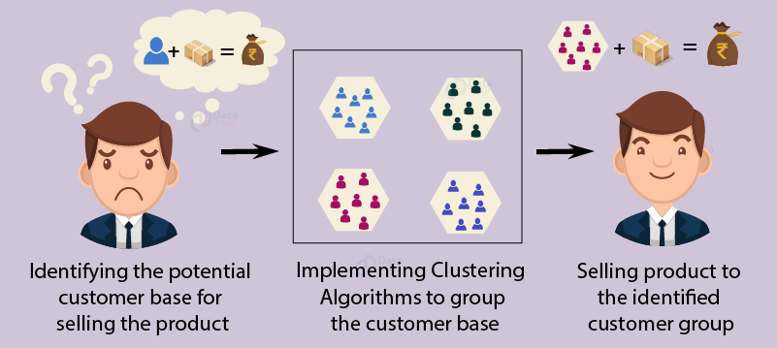
SYSTEM DESIGN AND IMPLEMENTATION

Slide 10
SYSTEM DESIGN AND IMPLEMENTATION
To design and implement this suggested model, following process were used:
Data preparation
Insight on product categories
Classifying customers
Training and Testing
Deploying Model.

Slide 11
PROJECT SCHEDULE
 |  | WEEKS
ACTIVITY | 1&2 | 3&4 | 4&5 | 6&7 | 8&9 | 10
Data preparation
Insight on product categories
Classifying Customers
Training & Testing
Deploy model
Documentation

Slide 12
PROJECT BUDGET
ITEM | COST(KSh.)
Internet bundles | 1000
Laptop | owned

Slide 13


Slide 14


