Slide 1
Student Performance Prediction Using Linear Algebra
Applying RREF, Gram-Schmidt, QR Decomposition, Projection and Least Squares
Mohnish Tulsian — PES1UG25AM554
Chirag H — PES1UG25AM551
Pranay KR — PES1UG25AM557
Sathvik BR — PES1UG25AM560
Course: Mathematical Foundations for AI and Data Science (MFAD)
Faculty: Prof Shwetha DS
Student Data
Matrix Representation
Linear Algebra
Prediction

Slide 2
Problem Statement
Student performance depends on many academic and social factors
Goal: predict the final grade G3
Look at the mathematics behind the prediction, not a black box
studytime | failures | absences | G1 | G2 | freetime | goout | G3
2 | 0 | 6 | 5 | 6 | 3 | 4 | 6
2 | 0 | 4 | 5 | 5 | 3 | 3 | 6
2 | 3 | 10 | 7 | 8 | 3 | 2 | 10
3 | 0 | 2 | 15 | 14 | 2 | 2 | 15
Features
studytime · failures · absences · G1 · G2 · freetime · goout
Target: G3 — final grade
Dataset preview is illustrative — UCI Student Performance
2

Slide 3
Converting the Dataset into a Matrix
Ax ≈ b
A = ⎡ 1 x₁₁ x₁₂ … x₁ₙ ⎤
⎢ 1 x₂₁ x₂₂ … x₂ₙ ⎥
⎢ ⋮ ⋮ ⋮ ⋱ ⋮ ⎥
⎣ 1 xₘ₁ xₘ₂ … xₘₙ ⎦
A — feature matrix
x — unknown coefficients
b — actual final grades
Ax — predicted final grades
First column of 1s = intercept
Student Dataset
Feature Matrix A
Linear Algebra Operations
Predicted G3
Matrix form lets us apply linear algebra directly.
3

Slide 4
Independent vs Redundant Information
G_sum = G1 + G2 ⇒ G1 + G2 − G_sum = 0
G1
rank(A) = 8
G_sum
columns = 9
G2
nullity = 1
G_sum is exactly dependent on G1 and G2.
Rank — independent columns
Nullity — dependent directions
Pivot columns — independent
Free columns — redundant
rank([A|b]) > rank(A)
No exact solution to Ax = b → use least squares
4

Slide 5
Creating an Independent Basis
Remove redundant G_sum. G1 and G2 are still strongly correlated — Gram-Schmidt makes them perpendicular.
Original vectors
Orthogonal vectors
v₂
q₂
Gram-Schmidt
v₁
90°
q₁
A = QR
Q: orthonormal basis · R: upper triangular
5

Slide 6
Finding the Best Approximation
p = QQᵀb
b actual grades
e = b − p
Aᵀe = 0
e residual
Rx = Qᵀb
p prediction
Residual ⟂ feature space.
Choose x that minimizes total squared error.
Col(A)
6

Slide 7
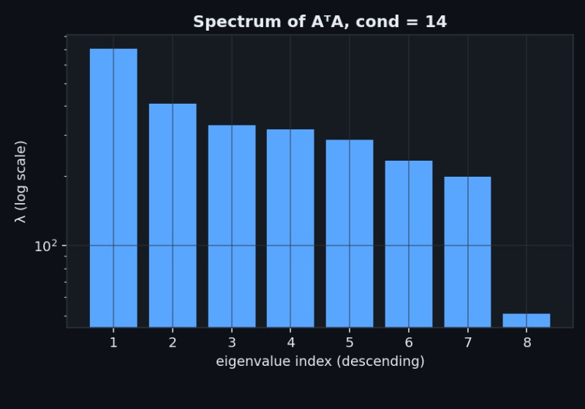
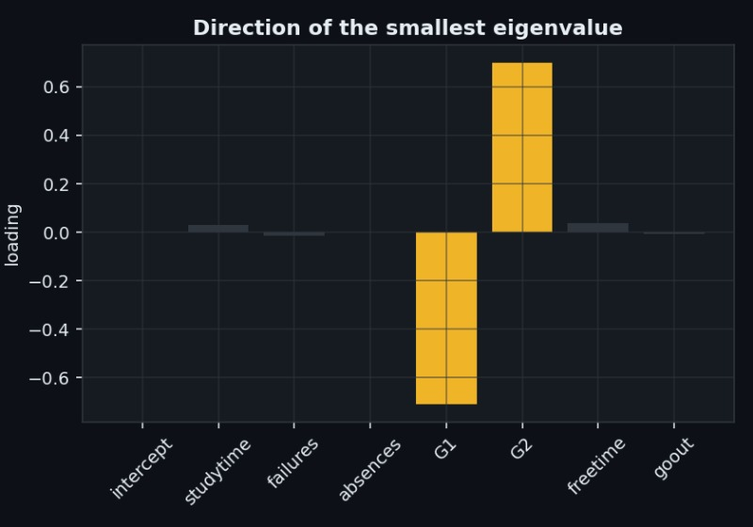
Eigenvalues and Numerical Stability
With G_sum: one eigenvalue ≈ 0
After removal: λmin ≈ 50.8, λmax ≈ 706.5
cond(AᵀA) ≈ 13.9 · cond(A) ≈ 3.7
Removing the redundant feature eliminates the near-zero eigenvalue and improves conditioning.
7

Slide 8
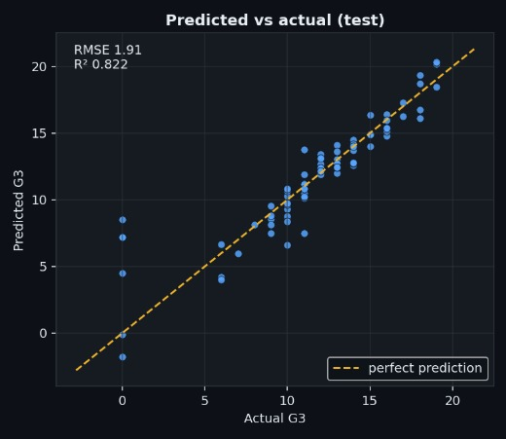
Prediction Results
Metric | Training | Testing
RMSE | ~1.5–1.6 | ~1.906
R² | ~0.86–0.88 | ~0.822
RMSE: typical error ≈ 1.9 grade points
R²: ≈ 82% of variation in final grades explained
Points closer to the diagonal = better predictions
8

Slide 9
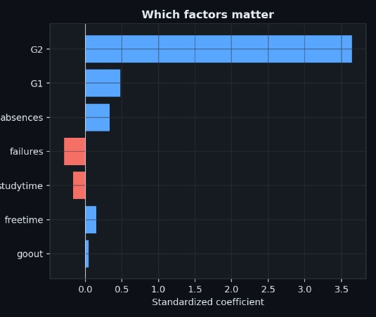
Which Features Influence the Prediction?
Positive coefficient → raises predicted G3
Negative coefficient → lowers predicted G3
Larger |coefficient| → stronger influence
G2 has the strongest positive influence — it captures the student's previous-period performance.
9

Slide 10
Conclusion
RREF exposed redundant information
Rank & nullity: independent directions
Gram-Schmidt / QR: stable orthonormal basis
Projection: closest prediction in Col(A)
Eigenvalues: conditioning & multicollinearity
Test R² ≈ 0.82 on unseen data
“Linear algebra is not only theoretical — it provides the mathematical foundation for real-world prediction models.”
Dataset
Matrix A
RREF
Independent Features
Gram-Schmidt / QR
Projection
Least Squares
Eigenvalues
G3
10

