Slide 1
Inheritance (in Unity)
Ryan McClennen

Slide 2
What is Inheritance?
Some background information
A class is a way of organizing code into a single object with properties (variables) and methods (functions)
Every script you have created so far is a class!
A function declaration/signature is the line containing the function’s visibility, return type, and name
Inheritance is a way of organizing classes so that classes with shared traits are related
Creates “parent” and “child” classes, where the “child” classes “inherit” the properties and methods of the “parent” classes
The “parent” is also sometimes referred to as the “base” class
Code shared between children only has to be written once in the parent, while code unique to the children is written in each individually

Slide 3
For Example (Pseudocode):
Animal (Parent Class)
Walk() { Debug.Log(“The animal walks around!”) }
Talk() { Debug.Log(“GENERIC ANIMAL NOISE”) }
Cat : Animal (Child Class)
Talk() { Debug.Log(“MEOW”) }
The Result:
animal.Walk() // Outputs “The animal walks around!” animal.Talk() // Outputs “GENERIC ANIMAL NOISE”
cat.Walk() // Outputs “The animal walks around!” cat.Talk() // Outputs “MEOW”

Slide 4
What does that mean for Unity?
Easy organization of a variety of enemies, projectiles, weapons, obstacles, interactables, etc
Create a “template” class which contains the basic components of one type of thing (Ex: projectiles)
Create all the child classes as children of that
Need a slight variation of an existing script?
Create a child class!

Slide 5
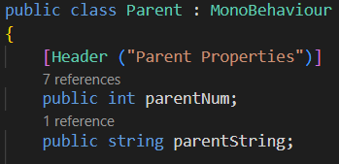
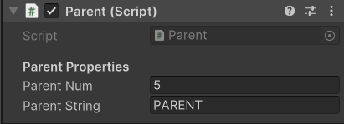
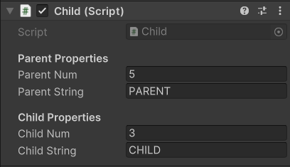
How is Inheritance Implemented?
Remember where it says ClassName : Monobehaviour at the top of a script?
Switch MonoBehaviour to the name of your parent!
Should be: Child : Parent
And that’s all! Child now inherits from parent!
Some notes…
Any properties in Parent MUST be public for Child to access them
The public properties for both Parent and Child will show in the inspector for a Child script

Slide 6
Concept 1: Virtual
In the parent class: the keyword virtual means that a method can be overridden by a child class
Comes after private/public and before the return type when defining a method
Ex: public virtual void Update()
A method MUST be public to be overridden, so all virtual methods must be virtual
All virtual methods act as normal methods in the child class unless they are overridden

Slide 7
Concept 2: Override
In the child class: the override keyword allows a child class to replace a virtual method in its parent class
Comes after private/public and before the return type when defining a method
Ex: public override void Update()
The overriding method MUST have the same method declaration as the virtual method, other than replacing virtual with override
If you need to use the code written in the parent for the method that you are overriding, you can use base.methodName()

Slide 8
An Example: Parent and Child
using UnityEngine;
public class Child : Parent {
public int childNum;
public string childString;
public override void Start(){
base.Start();
childNum = parentNum - 3;
}
public override void Update(){
base.Update();
if (Time.time == lastChange &&
parentNum == 8) {
childNum++;
if (childNum % 2 == 0) {
Debug.Log(childString);
}
}
}
}
using UnityEngine;
public class Parent : MonoBehaviour {
public int parentNum;
public string parentString;
public float lastChange = 0;
public virtual void Start(){
lastChange = Time.time;
}
public virtual void Update(){
if (Time.time > lastChange + 1f) {
lastChange = Time.time;
if (parentNum < 8) {
parentNum++;
Debug.Log(parentNum);
} else {
Debug.Log(parentString);
parentNum = 0;
}
}
}
}

Slide 9
Concept 3: Abstract
In the parent class: the abstract keyword makes a class a common interface, or template, for its child classes
Abstract classes force all of their child classes to define certain methods
The keyword abstract is added in the class declaration
Ex: public abstract class Vehicle : MonoBehaviour
Best used when there is no base behaviour to put in the parent (every child requires its own unique code) for a certain method
Some things are the same!
Properties and methods still need to be public for child classes to access them
Virtual methods can still be overridden
In other words, most of the code in abstract classes works exactly the same as it does in normal inheritance

Slide 10
Concept 3: Abstract (cont)
Some things are different!
methods can now be labeled abstract
Ex: public abstract void HandleAccel();
An abstract method is not given a definition in the parent class, it is only declared
Child classes must override an abstract class
In other words, child classes are “forced” to define previously abstract methods
Abstract classes cannot be added to GameObjects
Because abstract classes act like templates, they aren’t fully functional their own
That means they sit in the Scripts folder! Abstract classes help with organization and consolidating code, but can’t do anything alone

Slide 11
When do I Use Abstract Inheritance?
Need to make tons things of one type with different behaviours?
Ex: All your enemies use the same patrolling AI, but require different battle AIs because of their different weapons (bows stay back, swords get close, shields go in front, etc)
We have many different subclasses of enemies, so we can make an abstract Enemy class that creates a template for each subclass
The Enemy class would contain all the shared traits of the enemy subclasses (health, patrol AI, etc)
The enemy class would also create an abstract method for battle AI
All of Enemy’s children would override the battle AI method and provide their own code, giving each unique behaviour!

Slide 12
When don’t I Use Abstract Inheritance?
Need a similar behaviour with slightly different functionality?
Ex: You already have a Sword class, and you want a Dagger class with the same swinging ability, but throwing instead of blocking
Assume that, in this case, the sword and the dagger are the only weapons in your game. There will never be any other weapons, so there isn’t much of a point in setting up an Abstract class for weapons
So, we can make Sword the Parent and Dagger the child!
Make the necessary (blocking) methods virtual in the Sword, and make the Dagger class override those methods!

Slide 13
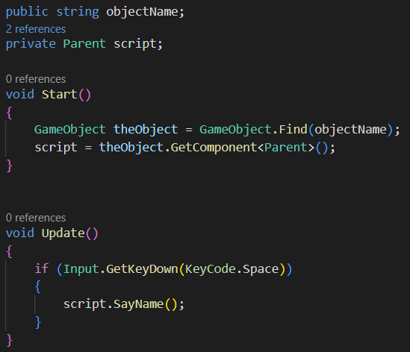
One More Advantage of Inheritance: Polymorphism!
Scripts can be held in code under the type of their parent
This is super useful for getting scripts on other game objects!
For example, if enemies all act differently when hit and are all children of one script, you can get that script from them on hit and call the method that handles the hit movement!

Slide 14
Any QUestions?

Slide 15
Demo Time!

Slide 16
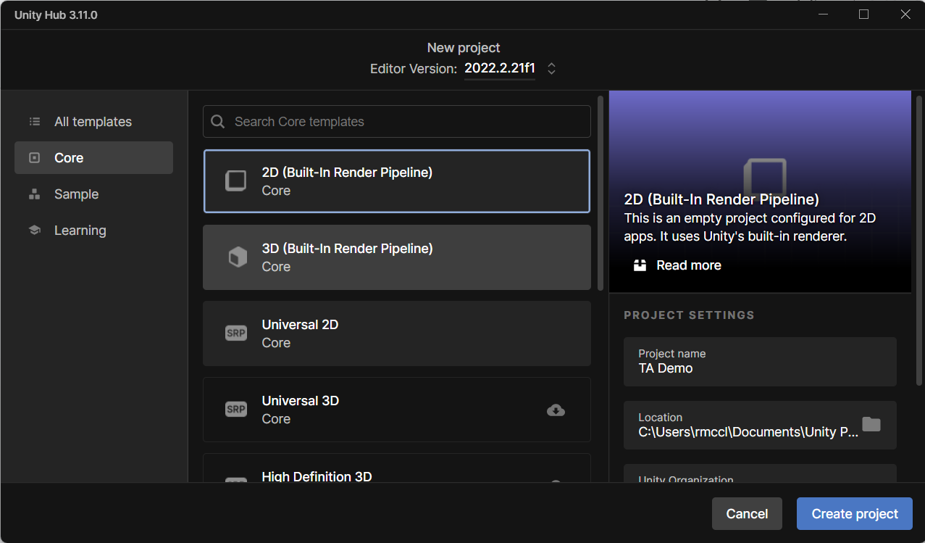
Step 1
Open your 2D tutorial (Catch a Tree)
If you haven’t already, download my Unity package from the course website

Slide 17
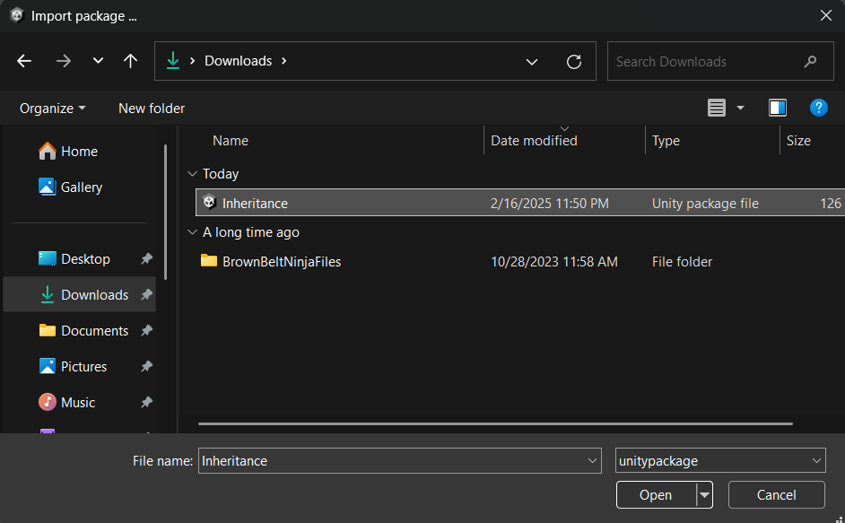

Step 2
Import my package by right-clicking in the Project tab and choosing Import Package > Custom Package. Choose my package in the File Explorer and hit “Open”!
You should see:

Slide 18
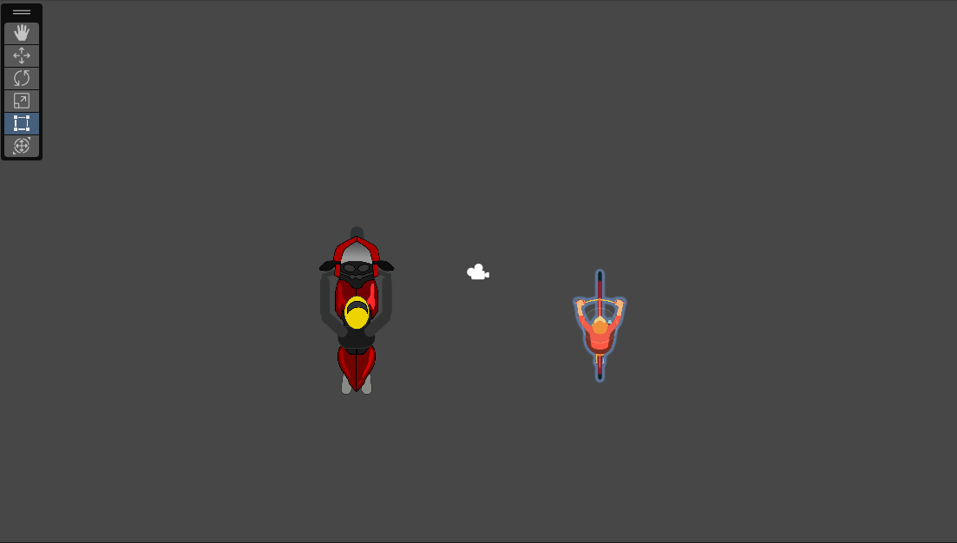
Step 3
Open the scene called Vehicles. You should see a motorcycle and a bike in a top down view
Play the scene and drive the motorcycle around using W to accelerate, S to decelerate, and A/D to turn
Stop the scene

Slide 19
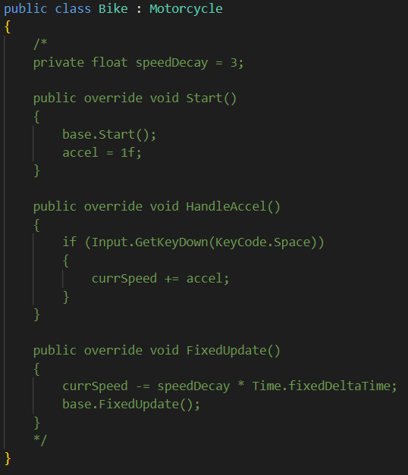
Step 4
Notice how bike didn’t method? We already have a class that works a lot like a bike, so let's implement Bike using inheritance!
Open Motorcycle.cs and Bike.cs. Looking at Bike.cs, you will see it inherits from Motorcycle, but all of the code is currently commented out

Slide 20
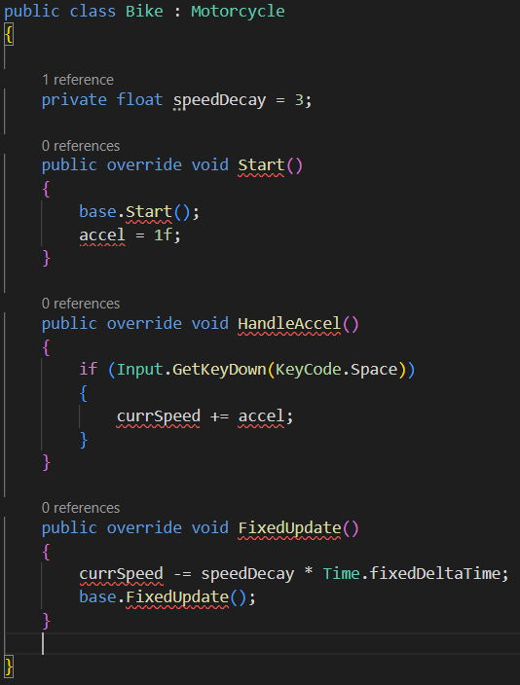
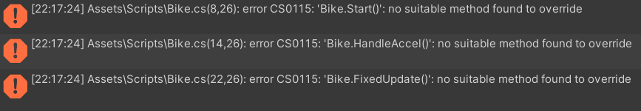
Step 5
Uncomment the code in Bike. This should create a lot of errors because Bike is trying to inherit from Motorcycle, but Motorcycle is not set up to be a parent!
There are properties and methods in Motorcycle that Bike needs to access, so we need to set them to be public
Which methods and properties does Bike need access to?

Slide 21




Step 6
Open Motorcycle.cs
Set the accel and currSpeed properties to be public instead of private
Set the Start, FixedUpdate, and HandleAccel methods to be public virtual instead of private
Reload Unity. Your errors should now be gone because Bike can access and override everything it needs from Motorcycle!

Slide 22
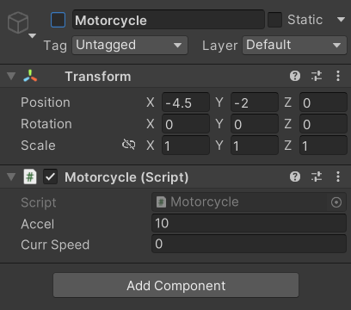
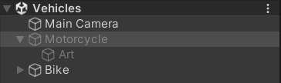
Step 7
Disable the Motorcycle GameObject.
Play the scene. Drive around the Bike using Space to “peddle” and A/D to turn.
Stop the scene. You just implemented a Bike by reusing most of the functionality of a Motorcycle!

Slide 23
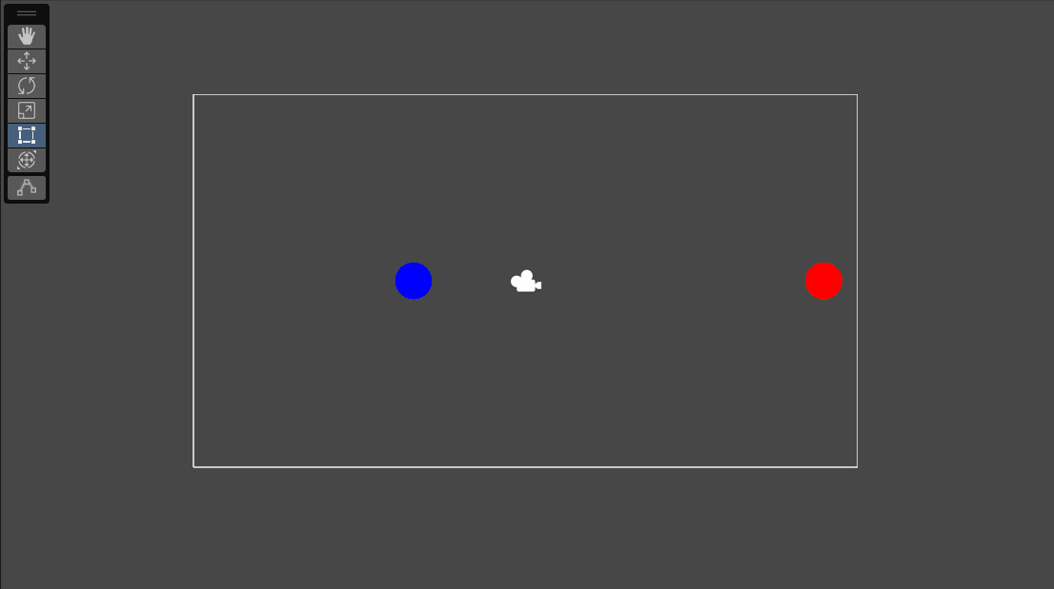
Step 8
Save the Vehicles scene and open the Enemies scene. You should see blue Player and a red Enemy on screen. Both should have a circle collider and a rigidbody, and the player should have a Player script
Play the scene. You can shoot at the mouse by clicking, but shooting the enemy does nothing right now
Stop the scene

Slide 24
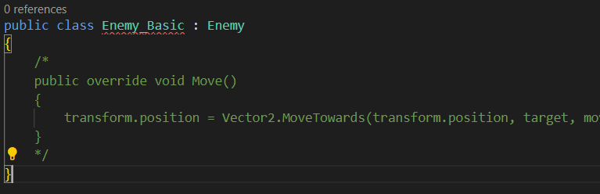
Step 9
Open the Enemy.cs script. This abstract class holds the basic Layout for an enemy. Notice that everything is implemented except for the abstract Move method
Open the Enemy_Basic.cs script, a child of Enemy. Try commenting out the Move method and returning to Unity. You should get and error!
Uncomment the Move method in Enemy_Basic and return to Unity

Slide 25
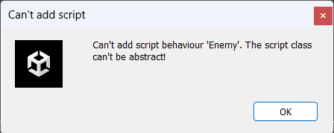
Step 10
Try adding the Enemy script to the Enemy GameObject.
If you search for the script in AddComponent, you won’t be able to find it! If you try to drag the script into the GameObject, you will get an error from Unity! Because Enemy is an abstract class, Unity won’t let us add it to a GameObject

Slide 26
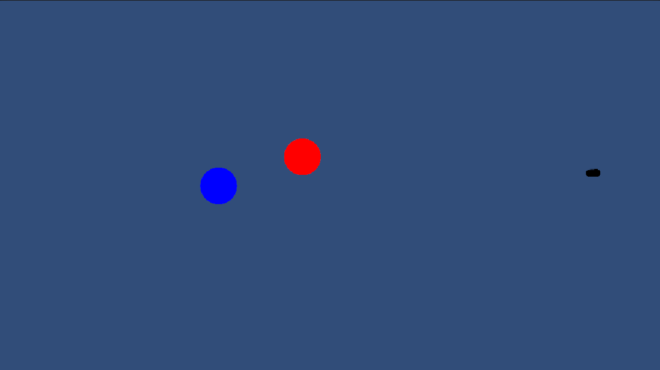
Step 11
Try adding the different children of Enemy (Enemy_Basic, Enemy_Sin, and Enemy_Arc) to the Enemy GameObject.
Notice that each Enemy variant has a different movement pattern, but they all have the same health system with three lives and they all delete the player upon reaching it
So, all of these different Enemy variants come from one abstract class, but have Unique movement!

Slide 27
And We’re Done!
If you have any questions, feel free to ask on Piazza, during office hours, after class, or by emailing me at Ryan.McClennen@tufts.edu

Slide 28
Credits
Motorcycle image: https://www.clipsafari.com/clips/o203366-person-on-racing-motorcycle
Bike image: https://www.istockphoto.com/vector/top-view-of-man-riding-bicycle-aerial-shot-of-male-cartoon-character-biker-with-red-gm1158181978-316283312

