Slide 1
Simple AI in Unity：
Using Mecanim to manage NPC behavior
Tutorial Steps based on Jo Chung’s CS23 Game Design TA demo, 2/2023
Includes all 6 scripts and the character spritesheet.

Slide 2
BIG PICTURE: THREE PARTS
This tutorial covers how to recreate the NPC “Food Delivery” State Machine behavior demo created by Jo Chung, 2/2023.
PART 1: Create a base character object, which can then be used for both a Player and the start of the NPC.
We start with a character spritesheet to create just idle and walk animations, hook them up with a bool parameter called “Walk” in the Mecanim State Machine, then duplicate the character and Animator Controller, to make two distinct characters.
PART 2: Create the Food Spawner. This is quick!
PART 3: (the main work of this tutorial): For the NPC, add a new Mecanim Layer to add new States and Parameters, along with scripts, to manage the flow of multiple NPC behaviors:
[GatherFood], [FindPlayer], [GiveFood], repeat.

Slide 3
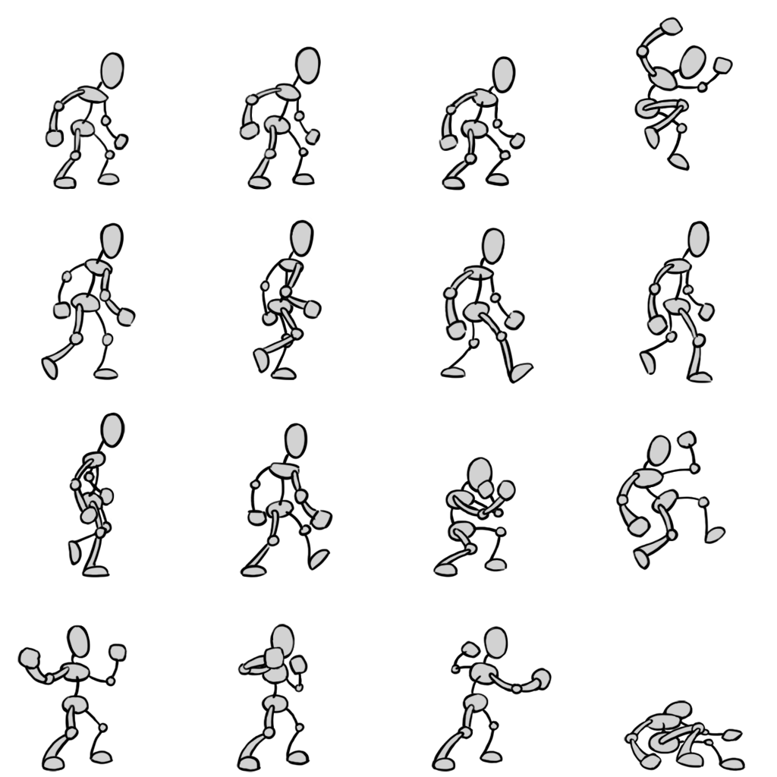
BIG PICTURE: SPRITESHEET
The provided spritesheet, available in our 2D Art tutorial (or RightClick the image here and Save As Picture):

Slide 4
PART 1a: Create a single, starting Base Character
[1]. Empty Game Object and Spritesheet slices:
a. In a new Unity Scene, create an Empty Game Object.
In the Inspector name it “CharBase” and reset Transforms.
[Add Component]: BoxCollider2D and Rigidbody2D (type = Kinematic).
b. Import the provided Spritesheet to the Project panel Assets folder. Rename it “CharSprite” to be shorter.
In the Inspector set Sprite Mode = Multiple, hit [Apply].
Open the [Sprite Editor] (halfway up Inspector), set Slice Type = Cell Count, choose 4x4, hit [Slice], hit [Apply].
c. In the Project panel, find the Spritesheet’s right-side triangle, and click it to view the slices. Drag the first image (CharSprite_0) up into the Hierarchy, then drag it onto CharBase to make it a child.
In the Inspector rename it “char_art”, reset Transforms if needed.

Slide 5
PART 1a: Create a single, starting Base Character
[2]. Animation, part 1/3:
d. Create animation clips for idle and walk:
Open Window > Animation > Animation.
With char_art selected in the Hierarchy, click the button in the Animation panel that says [Create a new clip]. Name the clip “char_idle.anim”, and hit [Save].
Add a second clip: In the Animation panel, click on the left-side dropdown to choose [Create New Clip…]. Name it “char_walk.anim”, and hit [Save].

Slide 6
PART 1a: Create a single, starting Base Character
[3]. Animation, part 2/3:
e. Add the IDLE animation sprites:
In the Animation panel dropdown (left) open the char_idle clip.
In the Project panel, select poses CharSprite_0, CharSprite_1, and CharSprite_2 (the first 3 poses, to make an up-and-down idle “breathing ”motion).
Drag these poses into the Animation Timeline (right-side).
Note the images appear as diamonds surrounded by blue lines. Click-drag the right-side blue line to extend these 3 images over 30 frames (half a second).
To complete the loop, select pose CharSprites_0 again, and drag it into frame 40.

Slide 7
PART 1a: Create a single, starting Base Character
[4]. Animation, part 3/3:
f. Add the WALKING animation sprites:
In the Animation panel dropdown (left) open char_walk clip.
In the Project panel, select 6 poses for the full walk cycle: CharSprite_4, CharSprite_5, CharSprite_6, CharSprite_7, CharSprite_8, CharSprite_9.
Drag these poses into the Animation Timeline (right-side).
Click-drag the right-side blue line to extend these 6 images over 50 frames.
To complete the loop, select pose CharSprites_4 again, and drag it into frame 60.

Slide 8
PART 1a: Create the Base Character
[5]. Opening Mecanim, Transitions, Parameters:
g. Open the Mecanim State Machine:
Window > Animation > Animator, or DoubleClick the Animator Controller object in the Project panel, created with your clips.
h. Check the default clip:
In Mecanim, the orange clip plays by default. If [char_idle] is not orange, RightClick [char_idle] to choose “Set as default”.
i. Add two transitions:
RightClick [char_idle] to add a transition arrow to [char_walk].
RightClick [char_walk] to add a transition arrow back to [char_idle].
j. On the left open the Parameters panel (instead of Layers).
Hit the [+] icon to add a bool parameter. Name it "Walk".
k. Apply this condition to both transition arrows:
Select the arrow from [char_dle] → [char_walk]. In the Inspector hit [+] to add Walk, set to true. Turn off “Has Exit Time”, above.
Select the arrow from [char_walk] → [char_idle]. In the Inspector hit [+] to add Walk, set to false. Turn off “Has Exit Time”, above.

Slide 9
PART 1b: Duplicate CharBase for NPC and PC
[6]. Duplicate the character object for the NPC
a. Define the NPC:
In the Hierarchy select CharBase.
RightClick to make a duplicate of CharBase.
Select the duplicate CharBase (1).
In the Inspector, rename it “NPC”.
Create a new Tag: In the Inspector UpperLeft corner, find and click Tag: [Untagged]. At the bottom of the menu choose [Add Tag...] In the menu that appears, hit [+] to add a new tag called “NPC”.
Add the Tag: Re-select the NPC character in the Hierarchy. Click [Untagged] again, choose NPC to add this tag to the NPC.
In the Scene, click the Move tool to move it away from CharBase (be sure the parent object NPC is selected in the Hierarchy, so the art is not moved away from the parent).
In the Project panel select the Animator Controller, and re-name it: "Animator_NPC“.
In the Hierarchy, select the NPC child char_art, rename it “npc_art”.

Slide 10
PART 1b: Duplicate CharBase for NPC and PC
[7]. Duplicate the Animator, for the Player:
b. Define and complete the PLAYER:
In the Project panel, duplicate the Animator_NPC Controller ([Ctrl / Cmd] +[d]) and name the copy "Animator_Player".
In the Hierarchy Select the CharBase original.
In the Inspector name it “Player” and add the tag “Player”.
Select the child char_art.
In the Inspector, rename it “player_art” and change the color to green.
With player_art still selected, drag Animator_Player into the Animator > Controller slot.
Add a new C# script PlayerMoveAround.cs to the project and drag it onto the Player parent. (See script provided in the next slide of this tutorial).
Optionally, hit [Play] to test player input.

Slide 11
PART 1c: Player Movement Script (copy/paste):
using System.Collections.Generic; using System.Collections; using UnityEngine; public class PlayerMoveAround : MonoBehaviour { public Animator anim; public Rigidbody2D rb2D; private bool FaceRight = true; // determine which way player is facing. public static float runSpeed = 10f; public float startSpeed = 10f; void Start(){ anim = gameObject.GetComponentInChildren<Animator>(); rb2D = transform.GetComponent<Rigidbody2D>(); } void Update(){ //NOTE: Horizontal axis: [a] / left arrow is -1, [d] / right arrow is 1 //NOTE: Vertical axis: [w] / up arrow, [s] / down arrow Vector3 hvMove = new Vector3(Input.GetAxis("Horizontal"), Input.GetAxis("Vertical"), 0.0f); transform.position = transform.position + hvMove * runSpeed * Time.deltaTime; if ((Input.GetAxis("Horizontal") != 0) || (Input.GetAxis("Vertical") != 0)){ anim.SetBool ("Walk", true); } else { anim.SetBool ("Walk", false); } // Turning. Reverse if input is moving the Player right and Player faces left. if ((hvMove.x < 0 && !FaceRight) || (hvMove.x > 0 && FaceRight)){ playerTurn(); } } private void playerTurn(){ // NOTE: Switch player facing label FaceRight = !FaceRight; // NOTE: Multiply player's x local scale by -1. Vector3 theScale = transform.localScale; theScale.x *= -1; transform.localScale = theScale; } }

Slide 12
PART 2a: Create the Food Prefab
[1]. Make a Food Item as a Prefab:
Parent object:
RightClick the Hierarchy to create an Empty Game Object.
In the Inspector name it “FoodItem”, reset Transforms.
[Add Component] BoxCollider2D, set isTrigger = on.
Create a new Tag: In the Inspector UpperLeft corner, find and click Tag: [Untagged]. At the bottom of the menu choose [Add Tag...] In the menu that appears, hit [+] to add a new tag called “Food”.
Add the Tag: Re-select FoodItem, click [Untagged] again, choose Food to add this tag to FoodItem.
Child art:
In the Hierarchy RightClick FoodItem to create a child: 2D Objects > Sprites > Circle.
In Inspector name it “food_art”, set Color as desired.
Prefab:
Select FoodItem in the Hierarchy and drag it into the project panel to make it a Prefab.
Finally, delete FoodItem from the Hierarchy.

Slide 13
PART 2b: Create the Food Spawner
[2]. Spawn food items for the NPC to Gather and Deliver:
CREATE THE SPAWNER:
RightClick the Hierarchy to create an Empty Game Object.
In Inspector name it “FoodSpawner”, reset Transforms.
Add a new C# script FoodSpawner.cs to the project and drag it onto FoodSpawner (provided in the next slide of this tutorial).
Fill the script slot:
With FoodSpawner selected, note in the Inspector an empty script slot: Spawn Object
Fast-Drag your FoodItem Prefab from the Project panel into this empty slot in the FoodSpawner’s Inspector.

Slide 14
PART 2c: Food Spawner Script (copy/paste):
using System.Collections;
using System.Collections.Generic;
using UnityEngine;
public class FoodSpawner : MonoBehaviour{
public GameObject spawnObject;
public float minInterval = 5f;
public float maxInterval = 10f;
float timeUntilSpawn = 10f;
void Update(){
//Spawns the given gameObject in a random range, with a random interval
timeUntilSpawn -= Time.deltaTime;
if (timeUntilSpawn <= 0){
Vector3 spawnPos = new Vector3(Random.Range(-8, 8), Random.Range(-3, 3), 0);
GameObject spawnedObject = Instantiate(spawnObject, spawnPos, Quaternion.identity);
timeUntilSpawn = Random.Range(minInterval, maxInterval);
}
}
}

Slide 15
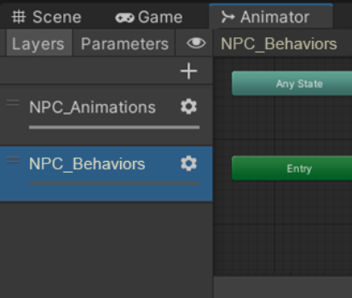
PART 3a: NPC State Machine Behavior: ADD LAYER
[1]. Add Behavior LAYER and STATES to Animator_NPC:
Re-open the Mecanim State Machine to show Animator_NPC: Either Select the NPC child npc_art and open Window > Animation > Animator, or DoubleClick the Animator_NPC Controller in the Project panel.
On the left, switch from Parameters to Layers. Select the Base Layer and rename it “NPC_Animations".
Hit [+] to add a new Layer.
Name it “NPC_Behaviors”.
We now have a clean layer to add new States.

Slide 16
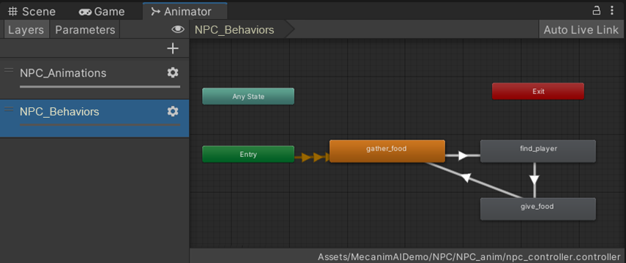
PART 3a: NPC State Machine Behavior: ADD STATES
Add 3 new States to the new Layer: RightClick empty space to Create State > Empty.
Select a State, in Inspector rename them "GatherFood", "FindPlayer", "GiveFood“.
RightClick each State to add these transitions:
[GatherFood] → [FindPlayer]
[FindPlayer] → [GiveFood]
[GiveFood ] → [GatherFood] (makes a loop-triangle)

Slide 17
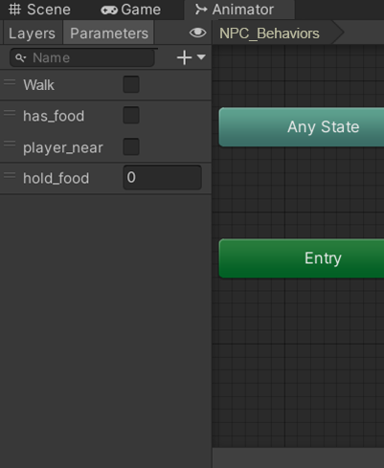
PART 3b: NPC State Machine Behavior: ADD PARAMETERS
[2]. Add PARAMETERS to Transitions in Animator_NPC:
Switch the left-side panel from Layers to Parameters.
Hit the [+] icon to add these 3 Parameters:
bool named "has_food“
bool named "player_near“
int named "hold_food“
Select the Transition arrow from [GatherFood] → [FindPlayer]. In the Inspector, under Conditions, hit [+] once to add a single Condition. Click the rolldown to choose “hold_food”, Greater, 0.
Select the Transition arrow from [FindPlayer] → [GiveFood]. In the Inspector, under Conditions, hit [+] twice to add two Conditions. Click the first condition rolldown to choose “player_near”, true. Set the second condition to “hold_food”, Greater, 0.
Select the Transition arrow from [GiveFood] → [GatherFood]. In the Inspector, under Conditions, hit [+] once to add a single Condition. Click the rolldown to choose “hold_food”, Equals, 0.

Slide 18
PART 3c: NPC State Machine Behavior: ADD SCRIPTS
[3]. Add SCRIPTS to states in Animator_NPC:
a. Create 4 C# scripts:
“GatherFood_State.cs”
“FindPlayer_State.cs”
“GiveFood_State.cs”
“NPCController.cs”
Copy and paste the contents from the following tutorial slides (Note the last script, NPCController.cs, covers 3 slides).
The first 3 scripts are behaviors scripts, with classes inheriting from StateMachineBehaviour, NOT MonoBehaviour.
These scripts depend on our Tags: Player, NPC, and Food.
b. In Mecanim, in the Behaviors Layer, select a State.
In the Inspector, click [Add Behaviour] to add the behaviour script that matches the name of each State
(Add GatherFood_State.cs to [GatherFood], etc.)
c. In the Hierarchy, select NPC, add script: NPCController.cs.
We are finished! Hit [Play] to watch the NPC serve the Player!

Slide 19
PART 3d: NPC Behavior Script #2: GatherFood_State
using System.Collections;
using System.Collections.Generic;
using UnityEngine;
public class GatherFood_State : StateMachineBehaviour{
public GameObject food; public GameObject NPC; float timeUntilMove;
// OnStateEnter is called when a transition starts and the state machine starts to evaluate this state
override public void OnStateEnter(Animator animator, AnimatorStateInfo stateInfo, int layerIndex){
//Find one food gameObject present at the start of the behaviour
food = GameObject.FindWithTag("Food"); NPC = GameObject.FindWithTag("NPC");
if (food != null) { NPC.GetComponent<NPCController>().moveToLocation(food.transform.position); } }
// OnStateUpdate is called on each Update frame between OnStateEnter and OnStateExit callbacks
override public void OnStateUpdate(Animator animator, AnimatorStateInfo stateInfo, int layerIndex){
//If food items exists in the Scene, go to one of their positions. Otherwise, move around randomly
if (food == null){
food = GameObject.FindWithTag("Food");
if (food != null){ //Debug.Log("Food found, moving to " + food.transform.position);
moveNPCTo(food.transform.position);
} else{
timeUntilMove -= Time.deltaTime;
if (timeUntilMove <= 0){ //Send NPC to a random position
moveNPCTo(new Vector3(Random.Range(-8, 8), Random.Range(-3, 3), 0));
//Debug.Log("Moving to " + startPos);
timeUntilMove = Random.Range(10, 15); } } } }
void moveNPCTo(Vector3 transform){ NPC.GetComponent<NPCController>().moveToLocation(transform); }
}

Slide 20
PART 3d: NPC Behavior Script #2: FindPlayer_State
using System.Collections;
using System.Collections.Generic;
using UnityEngine;
public class FindPlayer_State : StateMachineBehaviour{
public GameObject NPC;
public GameObject player;
// OnStateEnter is called when a transition starts and the state machine starts to evaluate this state
override public void OnStateEnter(Animator animator, AnimatorStateInfo stateInfo, int layerIndex){
//Sets the NPC to follow the player
NPC = GameObject.FindWithTag("NPC");
player = GameObject.FindWithTag("Player");
NPC.GetComponent<NPCController>().followPosition(player.transform);
}
// OnStateExit is called when a transition ends and the state machine finishes evaluating this state
override public void OnStateExit(Animator animator, AnimatorStateInfo stateInfo, int layerIndex){
NPC.GetComponent<NPCController>().moveToLocation(player.transform.position);
}
}

Slide 21
PART 3d: NPC Behavior Script #3: GiveFood_State
using System.Collections;
using System.Collections.Generic;
using UnityEngine;
public class GiveFood_State : StateMachineBehaviour{
public GameObject NPC;
//OnStateEnter is called when a transition starts and the state machine starts to evaluate this state
override public void OnStateEnter(Animator animator, AnimatorStateInfo stateInfo, int layerIndex){
NPC = GameObject.FindWithTag("NPC");
}
// OnStateUpdate is called on each Update frame between OnStateEnter and OnStateExit callbacks
override public void OnStateUpdate(Animator animator, AnimatorStateInfo stateInfo, int layerIndex){
//if the NPC has food, then give food to player
if (animator.GetInteger("hold_food") > 0){
//Remove every food object the NPC is holding
foreach (Transform transform in NPC.transform){
if (transform.CompareTag("Food")){
transform.gameObject.SetActive(false);
} }
animator.SetInteger("hold_food", 0);
} }
}

Slide 22
PART 3d: NPC Script #4: NPCController 1/3
using System.Collections;
using System.Collections.Generic;
using UnityEngine;
public class NPCController : MonoBehaviour{
public float speed = 5f; public Vector3 targetLocation;
public Transform followTransform;
Vector3 moveTowards; public bool followTarget;
bool faceRight = true; public Animator anim;
void Start(){
anim = gameObject.GetComponentInChildren<Animator>(); followTarget = true;
targetLocation = this.transform.position; followTransform = this.transform;
}
void Update(){
moveTowards = getCurrTargetLocation();
//Moves the character to the target location
transform.position = Vector2.MoveTowards(transform.position, moveTowards, speed * Time.deltaTime);
if (transform.position == moveTowards){ anim.SetBool(“Walk", false); }
else{ anim.SetBool(“Walk", true); }
//If the character is not facing the target location, turn around
if ((moveTowards.x < this.transform.position.x) && faceRight){ turnAround(); }
else if ((moveTowards.x > this.transform.position.x) && !faceRight){ turnAround(); }
}

Slide 23
PART 3d: NPC Script #4: NPCController 2/3
//Chooses the current target location based on the type of location given (Transform or Vector3 transform.location)
private Vector3 getCurrTargetLocation(){
if (followTarget){ return followTransform.position; }
else { return targetLocation; }
}
//Move character towards a specific location (Vector3 gameObject.transform.location)
public void moveToLocation(Vector3 location){
followTarget = false;
targetLocation = location;
}
//Move character to follow another gameObject's transform (Transform gameObject.transform)
public void followPosition(Transform transform){
followTarget = true;
followTransform = transform;
}
private void turnAround(){
// NOTE: Switch player facing label (avoids constant turning)
faceRight = !faceRight;
// NOTE: Multiply player's x local scale by -1.
Vector3 theScale = transform.localScale; theScale.x *= -1;
transform.localScale = theScale;
}

Slide 24
PART 3d: NPC Script #4: NPCController 3/3
void OnTriggerEnter2D(Collider2D col){
//If the character found food, then make the food object a child
if (col.gameObject.tag == "Food"){
anim.SetInteger("hold_food", (anim.GetInteger("hold_food") + 1));
//Debug.Log("NPC found food, currently holding " + anim.GetInteger("hold_food"));
col.transform.parent = this.transform;
}
//If NPC finds player, then set player_near parameter in Mecanim = true. May or may not trigger a transition
if (col.gameObject.tag == "Player"){
//Debug.Log("Player is near NPC");
anim.SetBool("player_near", true);
}}
void OnTriggerExit2D(Collider2D col){
if (col.gameObject.tag == "Player"){
//Debug.Log("Player is not near NPC");
anim.SetBool("player_near", false);
}}
private void OnTriggerStay2D(Collider2D col){
if (col.gameObject.tag == "Player"){
//Debug.Log("Player is near NPC");
anim.SetBool("player_near", true);
}}
} // End of NPCController script

