Slide 1

PREDICTING PROBLEMATIC INTERNET USE IN CHILDREN AND ADOLESCENTS
Presented By : 2020/E/027
EC 9560 DATA MINING| 2024
Notes:
Now, I’ll be presenting on ‘Predicting Problematic Internet Use in Children and Adolescents.’

Slide 2
2
OVERVIEW
Objective
Dataset Overview
Data preprocessing
Model Training
Model selection
EC 9560 DATA MINING| 2024
Notes:
this is the contents i'll cover here

Slide 3
3
OBJECTIVE
1
Develop a model to predict the level of problematic internet usage in children and adolescents.
EC 9560 DATA MINING| 2024
Use data from HBN Instruments, including steps, activity hours, and fitness metrics, to predict internet usage behavior.
2
3
Identify early indicators for timely interventions, encouraging healthier digital habits.
Notes:
The main goal of this project is to predict how much children and teenagers may be struggling with problematic internet use.

Slide 4
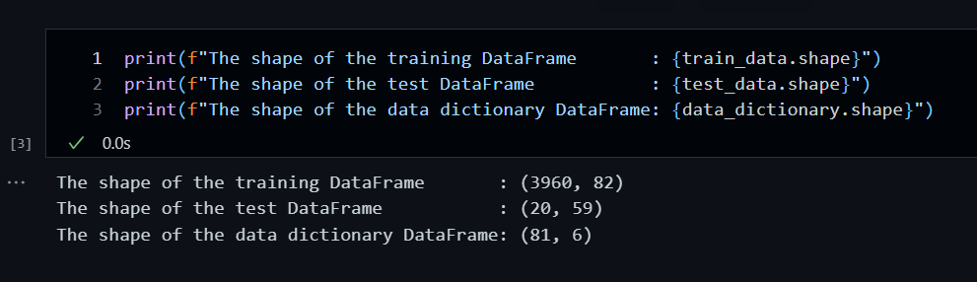
4
DATASET OVERVIEW
Source of Data:
Dataset structure:
Kaggle Competition Dataset — Child Mind Institute: Problematic Internet Use
train.csv
test.csv
data_dictionary.csv
EC 9560 DATA MINING| 2024
Notes:
The dataset we’re using is from the Child Mind Institute.
This dataset
training, test, and a data dictionary file.
The data dictionary provides a description of each feature.
The training file includes 3,960 samples with 82 features, while the test file contains only 58 features and 20 samples.

Slide 5
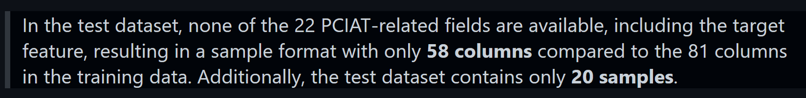
5
Features
Target
The training dataset includes 3,960 records of children and adolescents, each with 81 features (excluding the ID column).
The target variable is derived from the `PCIAT_Total` field, scored out of 100.
EC 9560 DATA MINING| 2024
Notes:
Given the large number of features, the main task in preprocessing was to identify the most important features.
The target variable
in this dataset is PCIAT_total, which represents the level of problematic internet use.
However, the test data does not include PCIAT features,
and overall, the dataset contains over 100,000 missing values.

Slide 6
DATA PREPROCESSING
EC 9560 DATA MINING| 2024
Notes:
Data preprocessing

Slide 7
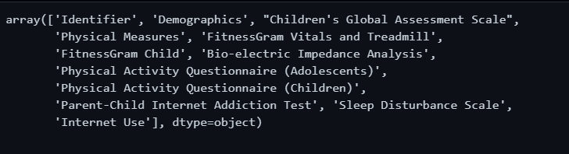
7
FEATURES
EC 9560 DATA MINING| 2024
Notes:
Each feature in this dataset corresponds to measurements taken using various instruments from the Healthy Brain Network (HBN).
There are 12 unique types of measurements

Slide 8
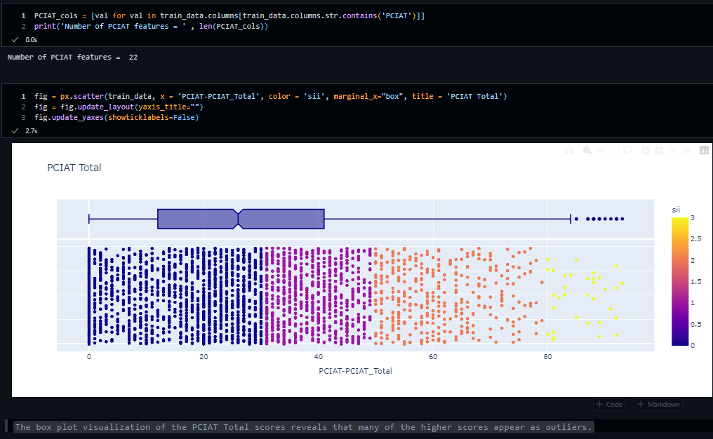
8
TARGET - PCIAT FEATURES
EC 9560 DATA MINING| 2024
Notes:
The primary target variable, PCIAT_Total, summarizes the PCIAT results, which are categorized as:
0: None
1: Mild
2: Moderate
3: Severe
Now it’s time to discuss how I selected the most relevant features for our model.

Slide 9
9
CORRELATIONS
Given the large number of available features, I decided to perform feature selection to assess its impact on the model.
Here, I selected features with the strongest correlation to the PCIAT total score, discarding those with weaker correlations.
EC 9560 DATA MINING| 2024
Notes:
I started by analyzing correlations between each feature and the target variable.
In doing so, I found that most features have either
a weak positive or negative correlation with the target.

Slide 10
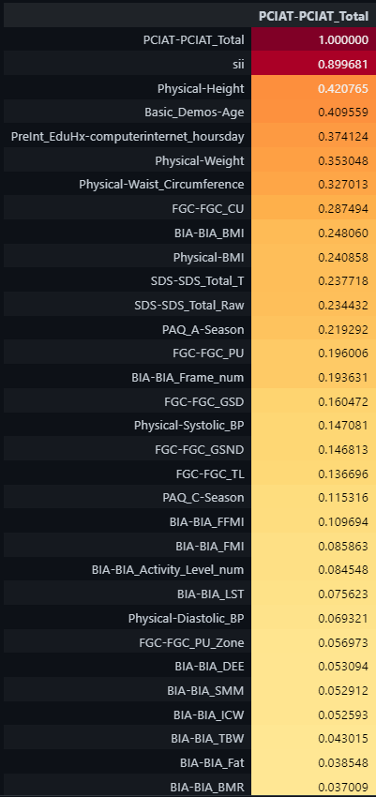
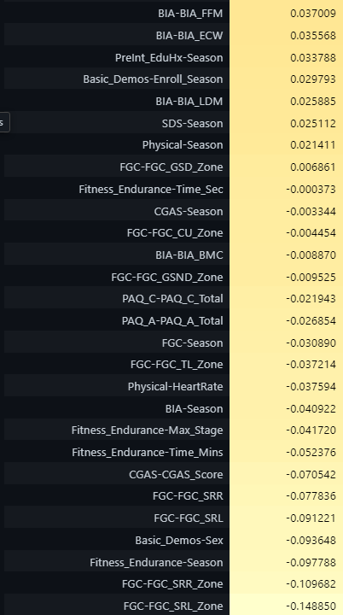
10
EC 9560 DATA MINING| 2024
Notes:
This is the summary of correlations,

Slide 11
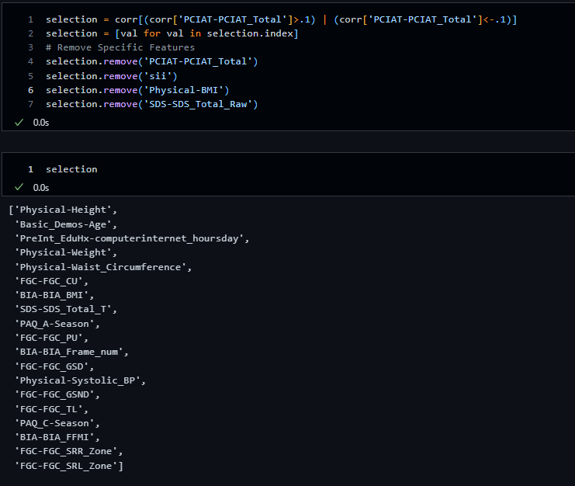
11
EC 9560 DATA MINING| 2024
Notes:
I removed any features that had a correlation below -0.1 or above 0.1 with the target.
This left us with 18 features

Slide 12
12
MISSING VALUES
The dataset contains a significant number of missing values.
46 columns have missing values.
8 columns have more than 50% of their values missing.
I will drop the columns that have more than half of their values missing.
EC 9560 DATA MINING| 2024
Notes:
Next, I addressed missing values. First, I removed any samples that didn’t have values for the target feature.

Slide 13
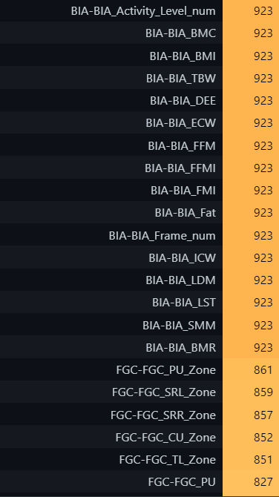
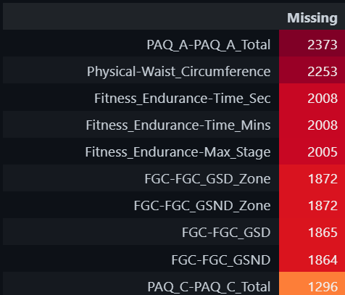
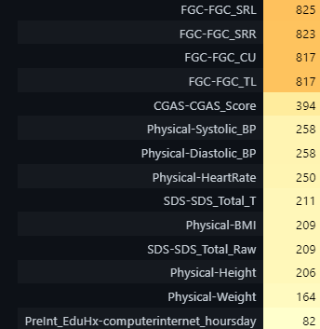
13
EC 9560 DATA MINING| 2024
Notes:
Then, I analyzed the remaining
features. Some features had more than 50% of their values missing,

Slide 14
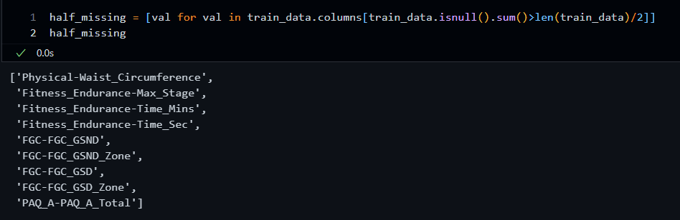
14
EC 9560 DATA MINING| 2024
Notes:
finally 16 features use to building the model.

Slide 15
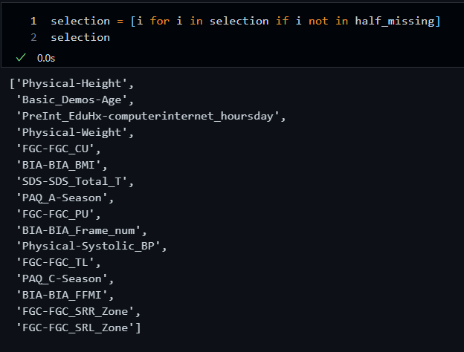
15
FINAL SELECTED FEATURES
EC 9560 DATA MINING| 2024
Notes:
These are the selected features,

Slide 16
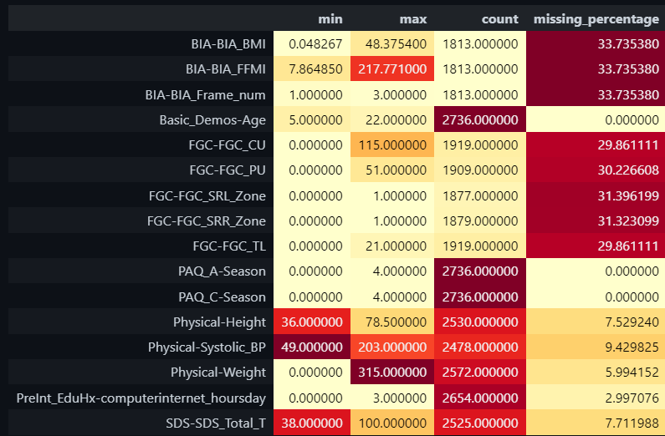
16
EC 9560 DATA MINING| 2024
Notes:
this is the summary of selected featers.

Slide 17
17
Handling Missing Values
1. For Features with Less than 10% Missing Values
Numerical Features: Apply mean or median imputation to replace missing values.
Categorical Features: Use mode imputation to fill missing values.
2. For Features with More than 10% Missing Values
Create Indicator Variable: Add a binary indicator to specify whether a value was missing.
Impute Missing Values:
For Numerical Features: Use mean or median imputation.
For Categorical Features: Use mode imputation.
Data Normalization
After handling missing values, Min-Max scaling will be applied to numerical features to standardize data across a 0–1 range, ensuring consistent scales across features.
Notes:
To handle missing values:
For features with less than 10% missing data:
use mean, median and mode imputatuons
For features with more than 10% missing data:
I created an indicator variable to mark when values were missing.
After handling missing data, I applied Min-Max scaling to normalize all numerical features. between 0 and 1,

Slide 18
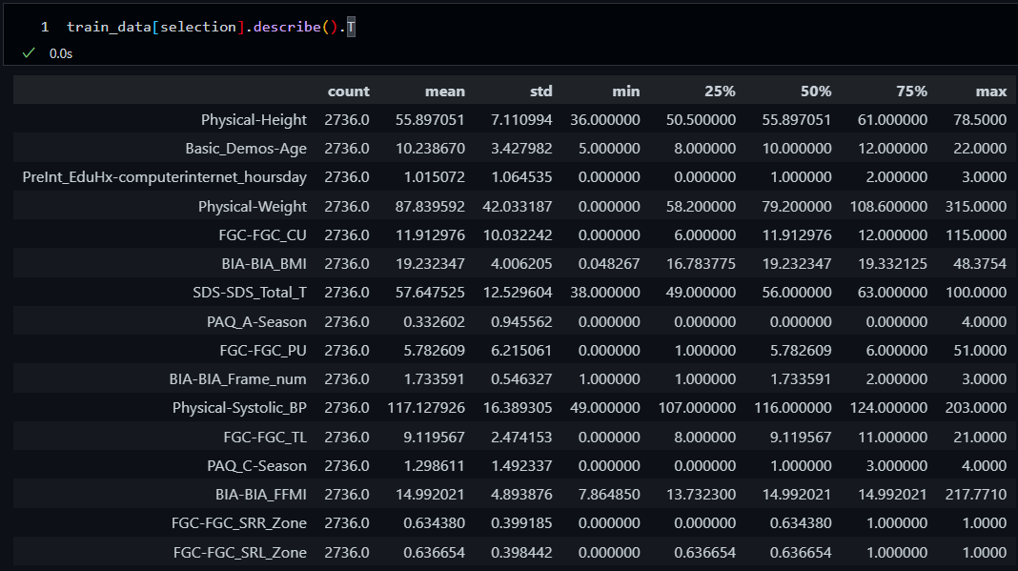
18
HANDLING MISSING VALUES
EC 9560 DATA MINING| 2024
Notes:
This is the summary of slected features of data.

Slide 19
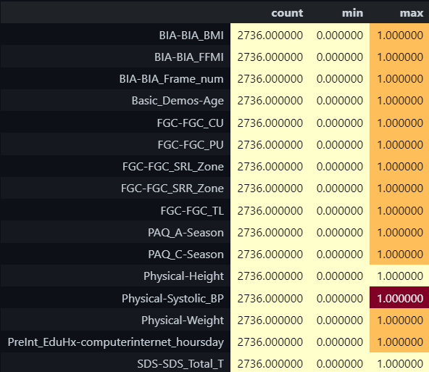
19
DATA NORMALIZATION WITH MIN-MAX SCALER
EC 9560 DATA MINING| 2024
Notes:
Now, with a clean and normalized dataset, we’re ready to move on to building
the model.

Slide 20
MODEL
TRAINING
EC 9560 DATA MINING| 2024

Slide 21
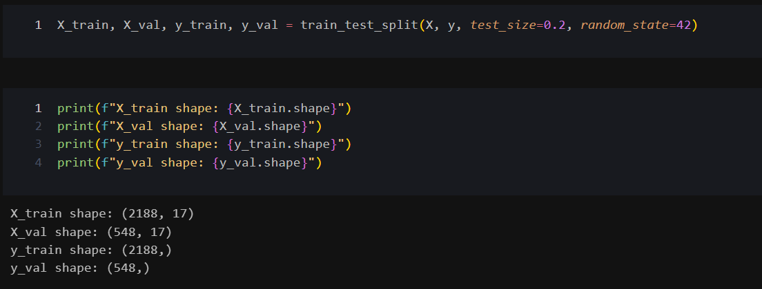
DATA SPLITTING
21
EC 9560 DATA MINING| 2024
Notes:
Here, i split 80% of data for train and rest of them for validations.

Slide 22
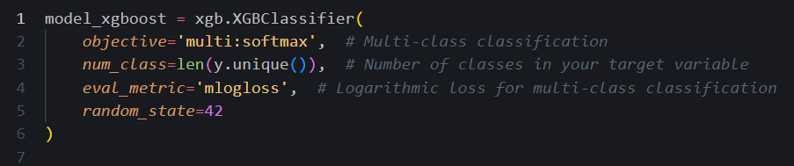
XGBOOST MODEL
22
The XGBClassifier is used for multi-class classification.
objective='multi:softmax' parameter -> we're solving a multi-class
classification problem
num_class -> number of unique classes in the target variable y.
EC 9560 DATA MINING| 2024
Notes:
So, for selecting models for the dataset, I first trained the
XGBoost model because the dataset originally had more missing
values, and the test data also contained some missing values.
I trained the model that could handle missing values, which is
why I started with XGBoost.
Then, I built it using the default
parameters,

Slide 23

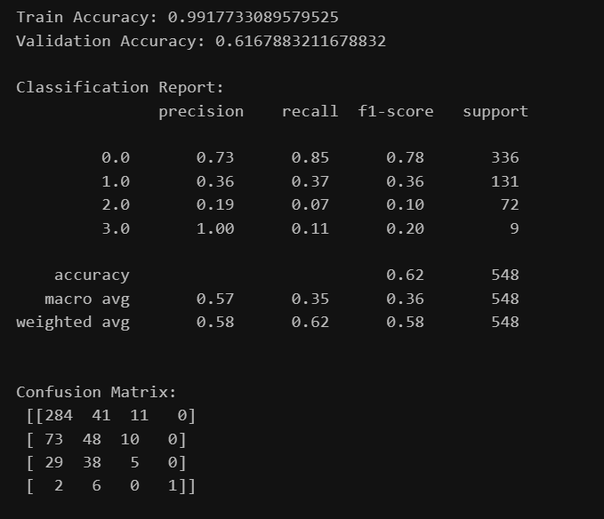
23
MODEL EVALUATION METRICS
Indicating overfitting
EC 9560 DATA MINING| 2024
Adjust the parameters of the XGBoost model.
Notes:
but I ended up with an overfitted model.

Slide 24
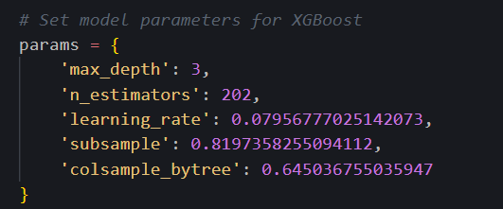
HYPERPARAMETERS FOR THE XGBCLASSIFIER
24
Maximum depth of a tree, controlling overfitting.
Number of boosting rounds (trees).
Step size shrinkage to prevent overfitting
Fraction of samples used for fitting each tree.
Fraction of features to use when building each tree.
EC 9560 DATA MINING| 2024
Notes:
After
identifying the hyperparameters, as following, to build a better model.

Slide 25
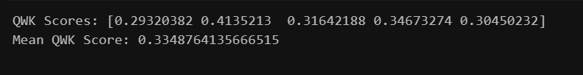
25
QUADRATIC WEIGHTED KAPPA SCORES
QWK Scores -> For each fold of cross-validation
Mean QWK Score -> Their mean.
EC 9560 DATA MINING| 2024
This is a metric used to evaluate the agreement between two raters (between the true and predicted values).
Ensures that each fold of the cross-validation maintains the same proportion of classes as the original dataset (for imbalanced class distributions).
Notes:
quadratic weighted kappa scores for each fold of cross-validation and their mean.
this metric used to evaluate
the agreement between two raters that the true and predicted values

Slide 26
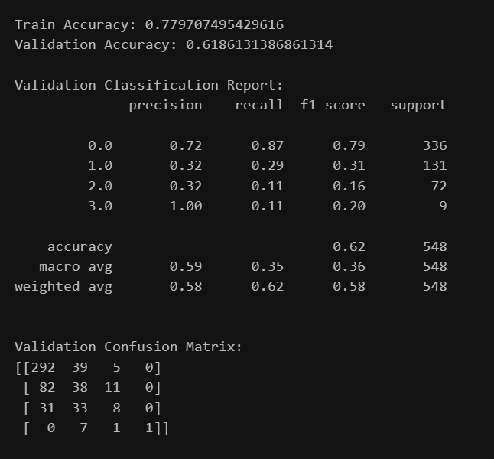
OBSERVATIONS
FROM MODEL EVALUATION
26
Key Observations
Indicates better generalization by the model.
Achieves the best balance between training and validation accuracy
Signifies reduced overfitting and improved model performance.
EC 9560 DATA MINING| 2024
Notes:
I re-trained the model, and
here are the evaluation metrics. From these metrics, we can see
that I got a better model compared to before.

Slide 27
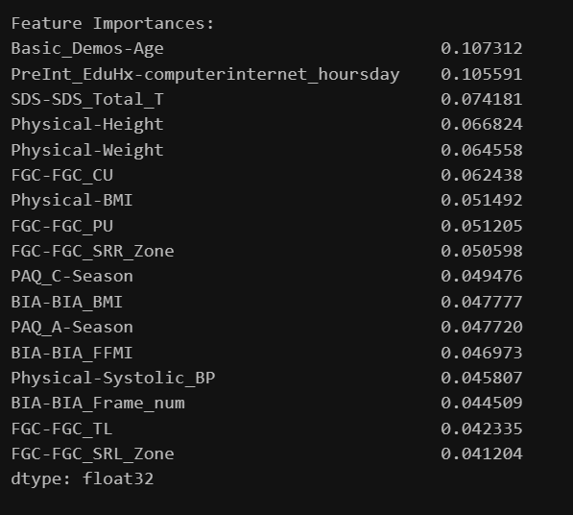
FEATURE IMPORTANCE
27
Most influential features
Age
Computer and internet usage
EC 9560 DATA MINING| 2024
Notes:
Here, based on this approach help to identifying the importance of each feature in making
predictions.
Here, age and computer and internet usage are the most influential features in here.

Slide 28
TRAIN THE MODEL FOR
DIFFERENT ALGORITHMS
28
Logistic Regression with a maximum of 1000 iterations to ensure convergence.
Decision Tree Classifier.
Random Forest Classifier.
Naive Bayes Classifier (GaussianNB).
EC 9560 DATA MINING| 2024
Notes:
Next, I selected four machine learning algorithms to train different models.
and used data that had missing values handled for training.
Logistic Regression
Decision Tree Classifier.
Random Forest Classifier.
Naive Bayes Classifier (GaussianNB).
are the selected algorithms
I trained every model and got the following evaluation metrics. Now, let's look at the performance of each algorithm,

Slide 29
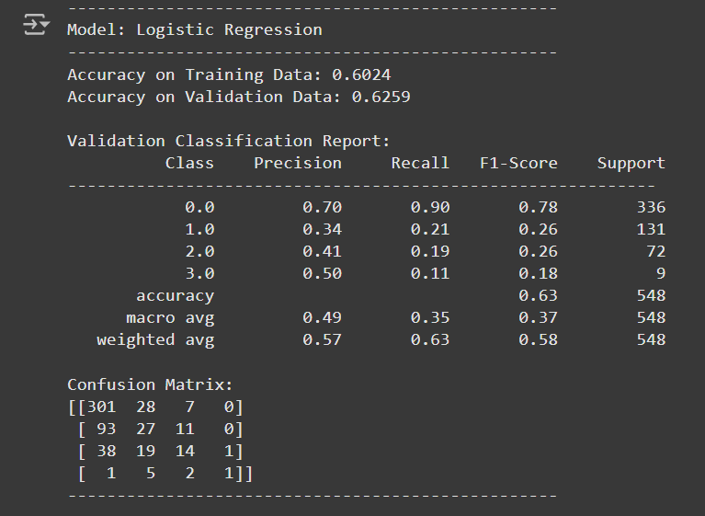
29
MODEL EVALUATION - LOGISTIC REGRESSION
Performs reasonably well with a weighted average F1-score of 0.58.
Shows good precision and recall for class 0.0 but struggles with lower recall for other classes, especially class 3.0.
Confusion matrix reveals a bias towards classifying instances as class 0.0
Performs moderately well on majority classes but struggles with imbalanced classes, leading to poor performance on minority classes (1.0, 2.0, 3.0).
EC 9560 DATA MINING| 2024
Notes:
starting with Logistic Regression. Here are my observations:
It shows good precision and recall for class 0.0 but struggles with lower recall for other classes,
The confusion matrix reveals a bias towards classifying instances as class 0.0.
In conclusion, it performs well on the majority of classes but struggles with imbalanced classes, leading to poor performance on minority classes

Slide 30
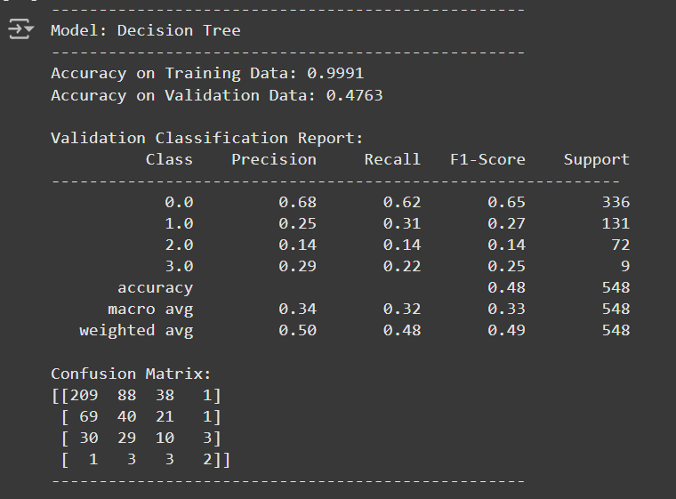
30
MODEL EVALUATION - DECISION TREE
Extremely high training accuracy suggests overfitting.
Poor validation accuracy indicates that the model fails to generalize.
The F1-scores for minority classes (1.0, 2.0, 3.0) are very low, indicating weak performance in these categories.
It is not suitable model for this dataset.
EC 9560 DATA MINING| 2024
Notes:
Next, the Decision Tree:
Extremely high training accuracy suggests overfitting.
Poor validation accuracy indicates that the model fails to generalize.
The F1-scores for minority classes are very low, indicating weak performance in these categories.
So, it is not a suitable model for this dataset.

Slide 31
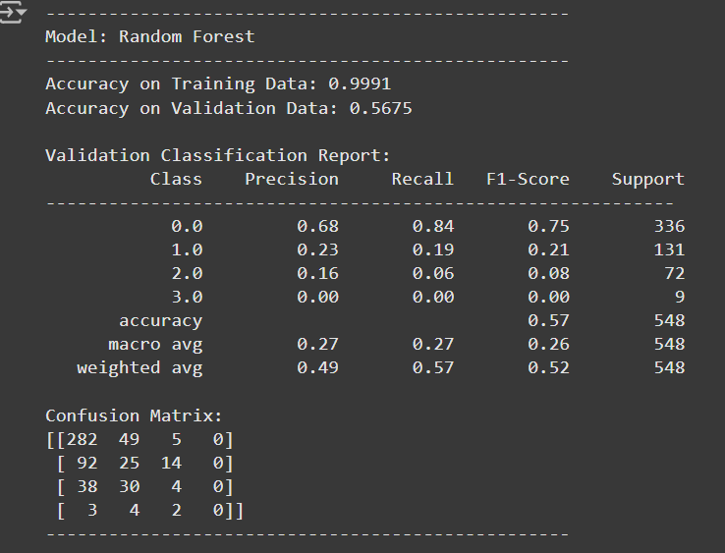
31
MODEL EVALUATION - RANDOM FOREST
Similar to Decision Tree, the model is overfitting with nearly perfect training accuracy.
Performs better than Decision Tree on validation data but still struggles with minority classes.
Weighted average F1-score of 0.52 suggests that while the model performs well for class 0.0, its performance is weak for other classes.
Random Forest offers slight improvement over Decision Tree but still overfits. It does not effectively handle the imbalanced data.
EC 9560 DATA MINING| 2024
Notes:
Now, for the Random Forest:
Similar to the Decision Tree, the model is overfitting with nearly perfect training accuracy.
It performs better than the Decision Tree on validation data but still struggles with minority classes.
\
Random Forest offers a slight improvement over the Decision Tree but still overfits. It doesn't effectively handle the imbalanced data.

Slide 32
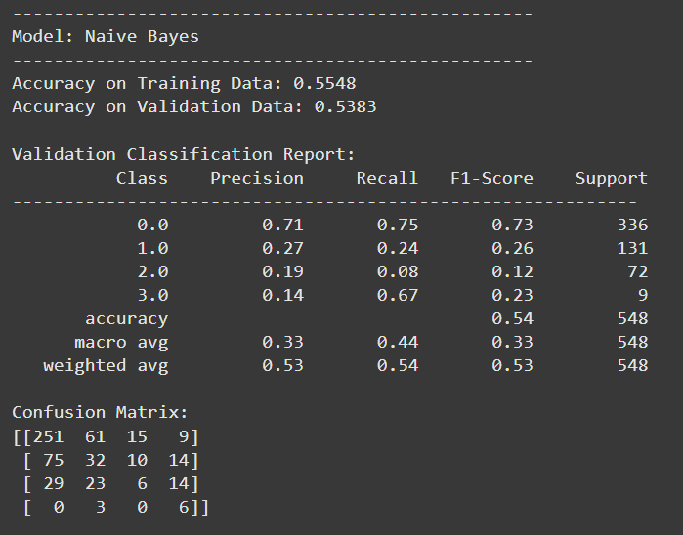
32
MODEL EVALUATION - GAUSSIANNB
Performs comparably across training and validation sets, showing no overfitting.
Weighted average F1-score of 0.53 suggests reasonable performance, especially for class 0.0.
Surprisingly, it recognizes class 3.0 instances better than other models, albeit with limited overall effectiveness.
Performs consistently on training and validation sets, but its simplistic assumptions limit its ability to handle complex patterns and imbalanced classes effectively.
EC 9560 DATA MINING| 2024
Notes:
Now, for Naive Bayes:
It performs comparably across training and validation sets, showing no overfitting.
Surprisingly, it recognizes class 3.0 instances better than other models, with limited overall effectiveness.
It performs consistently on both training and validation sets, but its simplistic assumptions limit its ability to handle complex patterns and imbalanced classes effectively.

Slide 33
33
BEST MODEL
XGBoost
XGBoost offers the most balanced performance, with better generalization than Decision Tree and Random Forest.
Robustness to Missing Data
EC 9560 DATA MINING| 2024
Notes:
Finally, I selected the best model among them based on the evaluation performance metrics.
The XGBoost model stands out for the following reasons:
It still achieve relatively high performance makes it an excellent model, especially since the missing values were not imputed before training.
Although Logistic Regression showed a slightly higher validation accuracy, XGBoost's performance without imputation is a strong point in its favor,]
this also has higher training accuracy compared to Logistic Regression, indicating that it has learned better patterns from the data.

Slide 34
34
CONCLUSION
Logistic Regression: Performs well after imputing missing values.
XGBoost: Outperforms Logistic Regression due to:
Robustness in handling missing data.
Better handling of feature interactions.
Higher training accuracy.
Key Point: XGBoost achieves high validation accuracy without imputation, making it the best model for scenarios with missing data.
EC 9560 DATA MINING| 2024
Notes:
In conclusion,
while Logistic Regression works well after filling in missing data,
XGBoost is a better choice.
It handles missing data effectively, deals with feature interactions better, and has higher training accuracy.
Since XGBoost achieved good validation accuracy without needing to fill in missing data, it is likely to work better in situations where data might be incomplete, making it the best model for this case.
Thank you!

Slide 35
EC 9560 DATA MINING| 2024
THANK YOU
Presented By : 2020/E/027

