Slide 1
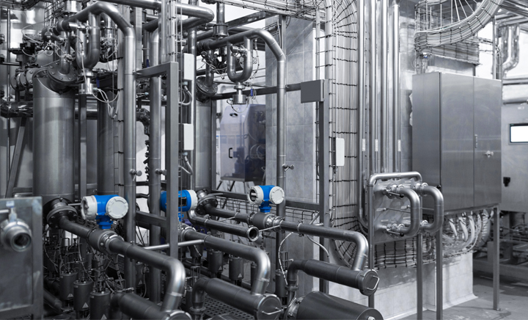

Ultrasonic Meter-Reader
Darren, Carter, Austin.

Slide 2
What is an Ultrasonic Meter Reader (USMR)?
Uses ultrasonic waves to measure the density of an acoustically conductive liquid/gas through a pipe.
Gas or water

Slide 3
What Problem Would We Be Solving By Building a USMR?
Meter readings for billing without the need for a technician physically travelling to the site
Data will be accessed easily on customers device due to network integration
Currently, a technician is responsible for walking throughout a building and manually taking the readings of multiple(100+) pipes.

Slide 4
About Our Sponsor (Eyedro)
Track, React, Save!
Develops technologies to measure, analyse and store electricity usage and cost information.
Presents live data to customers while being engaging, informative and easy to understand.

Slide 5
How Eyedro Will Support Us
Financially
Mentorship
Experience (programmers/technicians)

Slide 6
Hardware Involved
Microcontroller
Ethernet Chip
Wi-Fi Chip
Transducer(s)
(Tentative)
Power Supply(s)
ATSAMD20E18
ENC28J60
ATWINC1500
H2KA150KA1CD00
H2KA300KA1CD00
Custom

Slide 7
Software Involved
AWS Route53
AWS EC2
AWS RDS (SQL)
LAMP Stack
Embedded C
UX (DHTML)

Slide 8
Network Protocol Used
MQTT

Slide 9
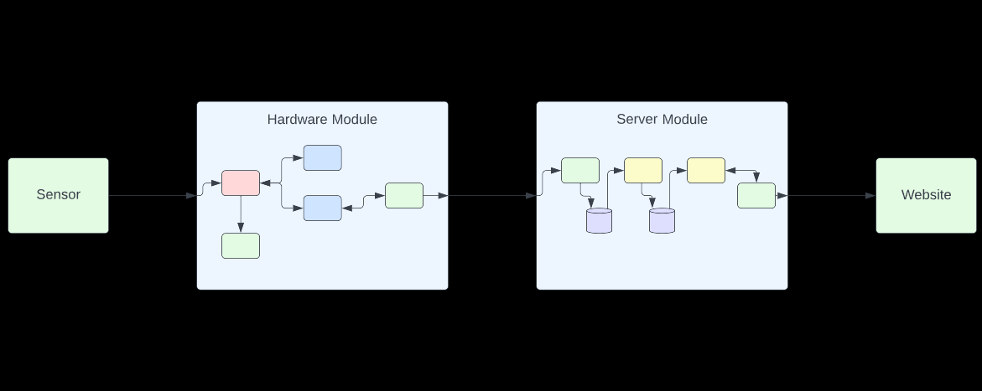
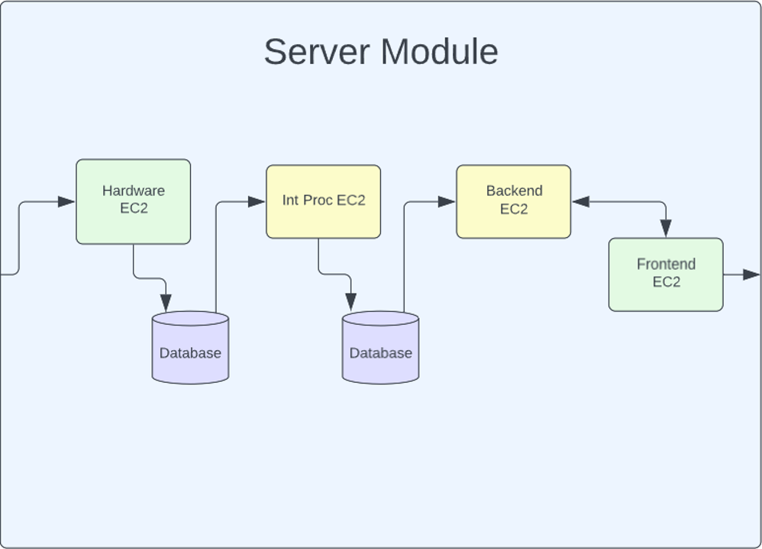
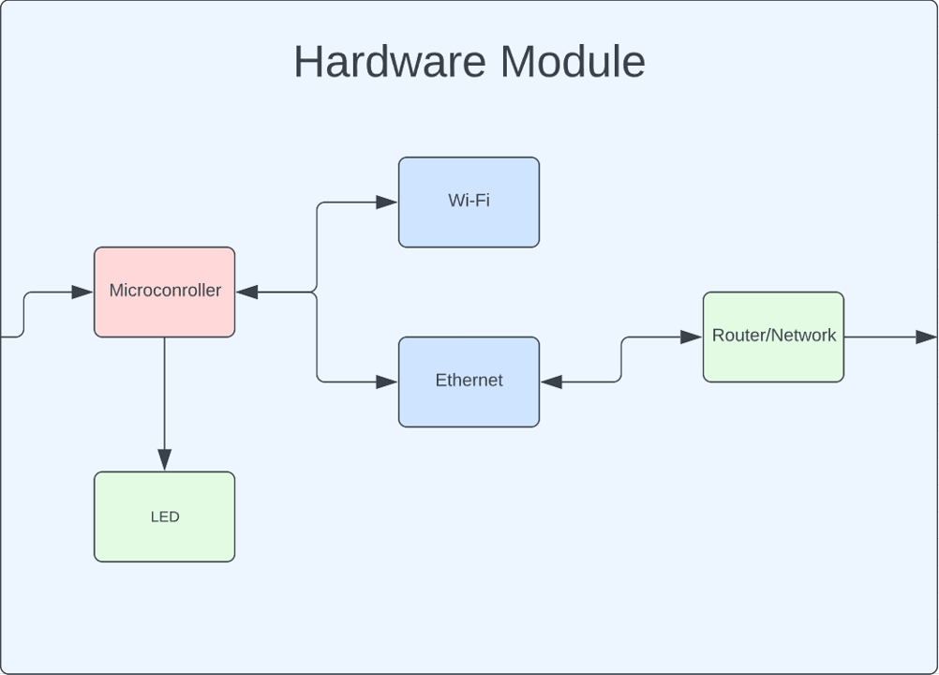
Block Diagram

Slide 10
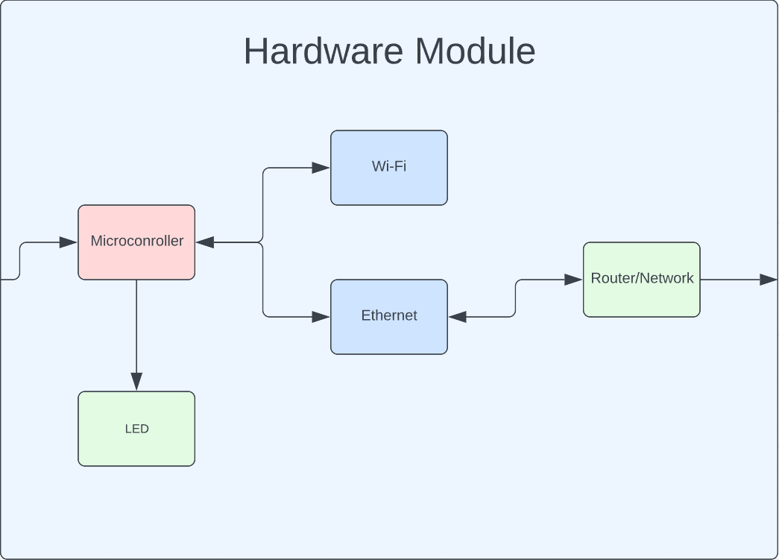

Slide 11


Slide 12
Significant Hurdles to Overcome
R&D of Ultrasonic sensor
Developing embedded system while inexperienced with the chip
Working with MQTT versus TCP
Working in an AGILE format in parallel with 3 team members in different “departments”
Functioning prototype with a slightly constricted schedule

Slide 13
Questions/Comments/Concerns?

