Slide 1
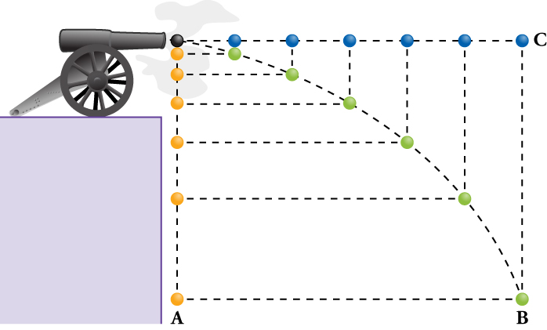
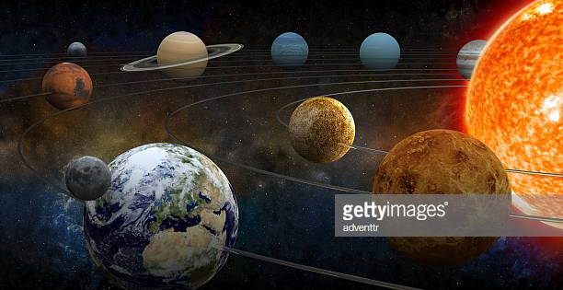
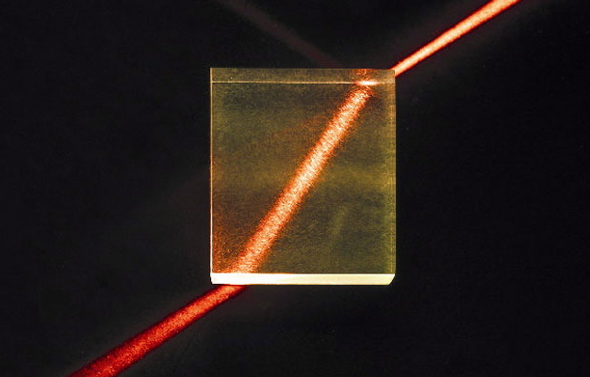


Group 47
Project Background
WebXR Physics
Project Description
WebXR is an exciting new API that will let developers bring virtual and augmented reality experiences into their websites. This means that users won’t have to download a mobile app to see the VR or AR content. It can also seamlessly deploy across different operating system and browsers without compromising capabilities.
The WebXR specification is still in development, so there are not a lot of resources out there for developers to go off of for making new AR and VR apps for the browser. One of the primary goals was to build a working example project that future developers could reference when building their applications.
That goal left us with a wide variety of possibilities for what the project could look like. Our next goal was to make an open source project that could help solve a real-world problem. Since VR simulations have proven to be so beneficial to learning, we wanted to make a way for high school students to experience physics labs without the need for expensive lab equipment. Another goal of the project is to showcase an application that can be impossible to preform without a VR device while progressively enhancing the experience to users.
What we did, how we did it, why we did it this way
WebXR Physics is a virtual reality physics simulation built into a web browser using the latest web virtual reality technology, WebXR, with the intent of showcasing WebXR's potential use cases. In this case, we created a virtual physics lab that can be accessed straight from a web browser without any additional downloads.
Our project incorporated the major facets of the VR and controller portions of the WebXR API and includes physically accurate experiment stations ready to be explored. This makes it a good reference for physics students without fancy equipment and engineers considering incorporating WebXR into their own products.
WebXR Device API can fully support FireFox, Chrome, and Edge.
In-browser virtual reality experience designed for students in underfunded schools to learn physics
experiments
PLANETARY DIORAMA
FALLING OBJECTS
A simulation of the solar system, with the user standing in the center. The planets orbit around the user (and the sun) with both diameter and time scaled so they're more visible. The user can pause and edit the mass, position, and velocity of planets.
Drop various objects in a gravity chamber and observe the effects different levels of gravity has on them.
API
- Application Programming Interface
VR
- Virtual Reality
XR
- Virtual/Augmented Reality
LASER REFRACTION
PENDULUM PERIOD PUZZLE
Team members & sponsor
This experiment demonstrates light motion through varying materials. Simulation uses Snell's Law to recreate the directional change in light waves. User can aim laser to hit targets for fun.
Simple pendulums only have a few factors which determine their period. Most physics labs change the length of the pendulum but ours changes the length and the value for local gravity by virtually taking the pendulum to different planets. It concludes by challenging the experimenter to calculate the value of local G on an unknown planet.
Brooks Mikkelsen (mikkelsb@oregonstate.edu)
Jonathan Jones (jonesjon@oregonstate.edu)
Tim Forsyth (forsytht@oregonstate.edu)
Brandon Mei (meib@oregonstate.edu)
Evan Brass (brassev@oregonstate.edu)
Sponsor: Alexis Menard (Intel)

