Slide 1
Advanced Processor Architectures
Out-of-order Architecture

Slide 2
From Previous Week
What is pipelining? What are its benefits?
What is a Control Hazard? How can we mitigate Control Hazards’ negative effects?
What is a Data Hazard?
  A data dependency between instructions. If pipeline is not instrumented an outdated value could be fetched from the register bank as a recently calculated value will not be updated there until the end of the pipeline.
How can we mitigate Data Hazards’ effects?
  Extra lines in the data path (Forwarding). Adding NOPs. Reordering instructions.

Slide 3
From Previous Week
What is a Superscalar processor?
  A processor that is able to execute more than 1 instruction in parallel (n-way superscalar means n instructions in parallel), potentially, n times faster execution
What is necessary to transform a scalar processor into a superscalar processor?
  Add extra execution lanes (ALUs) and increase the number of ports to memory and register bank to serve enough instructions in parallel
What are the main scalability limitations of superscalar architectures?
  The complexity of the hardware (control/forwarding/etc) increases greatly with every extra lane
  Applications may not exhibit enough parallelism to exploit such a processor

Slide 4
Modern Processor Architecture
COMP25212

Slide 5
Classic 5-stage pipeline
Inst Cache
Data Cache
Fetch
Logic
Decode
Logic
Exec
Logic
Mem
Logic
Write
Logic
A single execution flow
  All instructions follow the same datapath

Slide 6
Modern Pipelines
Many execution flows
Ld1
Ld2
Write
Back
_{Pipelined}
Inst Cache
Add1
Write
Back
Functional Units
Fetch
Decode
Mul1
Mul2
Mul3
Write
Back
Div1
Div2
Div3
Write
Back
_{Not Pipelined}

Slide 7
Structural Hazards
Some functional units may not be pipelined
This means only one instruction can use them at once
If all suitable Functional Units for executing an instruction are busy, then the instruction can not be executed

Slide 8
Example Structural hazard
_{MUL R1, R2, R2}
_{MUL R4, R0, R3}
_{FU is in use! Can not be}
_{sent to execution until}
_{FU is released.}
Ld1
Ld2
Write
Back
Inst Cache
Add1
Write
Back
Fetch
Decode
Mul1
Mul2
Mul3
Write
Back
Div1
Div2
Div3
Write
Back

Slide 9
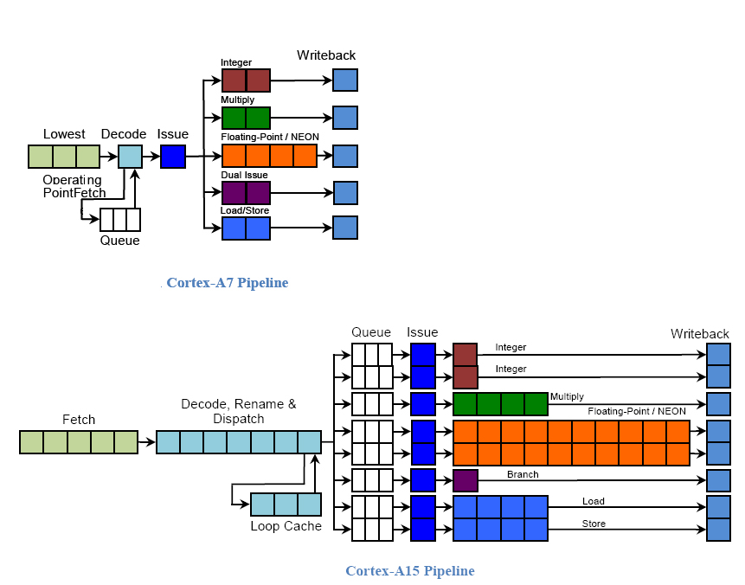
In ARM Processors
In-order processor
These diagrams are only illustrative
You do not need to remember these architectures!
Out of order processor

Slide 10
Out-of-order Processors

Slide 11
Out of Order Execution
The original order in a program is not preserved
Processors execute instructions as input data becomes available
Pipeline stalls due to conflicted instructions are avoided by processing instructions which are able to run immediately
Take advantage of ILP
Instructions per cycle increases

Slide 12
Conflicted Instructions
Cache misses: long wait before finishing execution
Structural Hazard: the required resource (i.e., Functional Unit) is not available
Data hazard: dependencies between instructions

Slide 13
More complex data dependencies
Out-of-order execution imposes new types of data
Dependencies to preserve program semantics
True dependency
  r1 <- r2 op r3
  r4 <- r1 op r5
Anti-dependency
  r1 <- r2 op r3
  r2 <- r4 op r5
Output dependency
  r1 <- r2 op r3
  r1 <- r4 op r5
Read-after-write
RAW
Write-after-read
WAR
Write-after-write
WAW

Slide 14
Dynamic Scheduling
Key Idea: Allow instructions behind stall to proceed => Instructions executing in parallel. There are multiple execution units, so use them
DIV F0, F2, F4
ADD F10, F0, F8
SUB F12, F8, F14
Dynamic pipeline scheduling overcomes the limitations of in-order pipelined execution by allowing out-of-order instruction execution
Even though ADD stalls, the
SUB has no dependencies
and could be executed

Slide 15
Out of Order Execution with Scoreboard
Notes:
CDC 6600 (1964)
First out-of-order processor
Centralized control -> limits scalability

Slide 16
Scoreboard
The scoreboard is a centralized hardware mechanism
  Instruction are executed as soon as their operands are available and there are no hazard conditions
Hardware constructs dynamically the dependency graph for a window of instructions as they are issued in program order
The scoreboard is a data structure that provides the information necessary for all pieces of the processor to work together

Slide 17
The Key idea of Scoreboards
Out-of-order execution divides ID stage:
  1. Issue —decode instructions, check for structural hazards
  2. Read operands —wait until no data hazards, then read operands
Scoreboard allows instruction to execute whenever 1 & 2 hold, not waiting for prior instructions
We will use In-order issue, out-of-order execution, out-of-order commit ( also called completion)

Slide 18
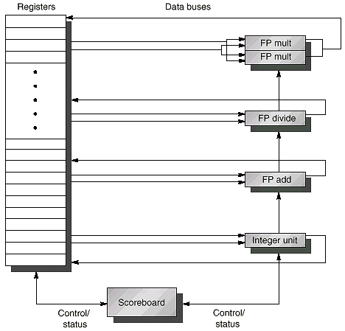
Typical Scoreboard Structure
_{Functional Units}

Slide 19
Stages of a Scoreboard Pipeline
Read
Operands
Mem
Access
Write
Back
Execute
FP Multiplication
Read
Operands
Write
Back
Execute
FP Multiplication
Fetch
Issue
Read
Operands
Write
Back
Execute
FP Add
Execute
FP Division
Read
Operands
Write
Back
Read
Operands
Write
Back

Slide 20
Stages of a Scoreboard Pipeline
1. Issue (ID)—decode instructions & check for structural & WAW hazards
  If a suitable FU is free (no structural hazards) and no other active instruction has the same destination register (no WAW), the scoreboard issues the instruction to the FU and updates its info.
  If a structural or WAW hazard exists, then the instruction issue stalls, and no further instructions will issue until these hazards are cleared.
2. Read operands (RO)—wait until no data hazards, then read operands
  A source operand is available if no earlier issued active instruction is going to write it (no RAW).
  Once all source operands are available, the scoreboard tells the FU to proceed to execution.
Always
done in
program
order
Can be
done
out of
program
order

Slide 21
Stages of a Scoreboard Pipeline
3. Execution (EX)— operate on operands
  The FU begins execution upon receiving operands. When the result is ready, it notifies the scoreboard.
4. Write result (WB)— finish execution and write results
  Once the FU completes execution, the scoreboard checks for WAR hazards. If none, it writes results, otherwise WB is stalled and FU remains busy.
Example:
DIVD F0,F2,F4
ADDD F10,F0,F8
SUBD F8,F8,F14
Scoreboard would stall SUBD until ADDD reads operands
Can be
done
out of
program
order
Can be
done
out of
program
order

Slide 22
Information within the Scoreboard
1. Instruction status—which of 4 stages the instruction is in
2. Functional unit status—Indicates the state of the functional unit (FU). 9 fields for each functional unit
Busy—Indicates whether the unit is being used or not
Op—Operation to perform in the unit (e.g., + or –)
Fi—Destination register
Fj, Fk—Source-register numbers
Qj, Qk—Functional units producing source registers Fj, Fk
Rj, Rk—Flags indicating when Fj, Fk are ready. Set to Yes once each operand is read.
3. Register result status—Indicates which functional unit will write each register
Notes:
What you might have thought
1. 4 stages of instruction executino
2.Status of FU: Normal things to keep track of (RAW & structura for busyl):
Fi from instruction format of the mahine (Fi is dest)
Add unit can Add or Sub
Rj, Rk - status of registers (Yes means ready)
Qj,Qk - If a no in Rj, Rk, means waiting for a FU to write result; Qj, Qk means wihch FU waiting for it
3.Status of register result (WAW &WAR)s:
which FU is going to write into registers
Scoreboard on 6600 = size of FU
6.7, 6.8, 6.9, 6.12, 6.13, 6.16, 6.17
FU latencies: Add 2, Mult 10, Div 40 clocks

Slide 23
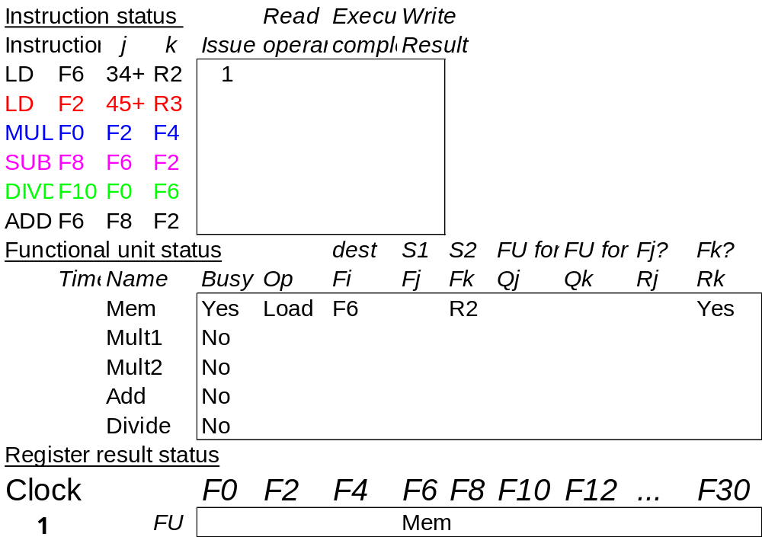
Instruction Status
Instruction stream
Instruction status:
Scoreboard only
records the status
We will show the
times for each stage,
for convenience

Slide 24
Information within the Scoreboard
1. Instruction status—which of 4 stages the instruction is in
2. Functional unit status—Indicates the state of the functional unit (FU). 9 fields for each functional unit
Busy—Indicates whether the unit is being used or not
Op—Operation to perform in the unit (e.g., + or –)
Fi—Destination register
Fj, Fk—Source-register numbers
Qj, Qk—Functional units producing source registers Fj, Fk
Rj, Rk—Flags indicating when Fj, Fk are ready. Set to Yes once each operand is read.
3. Register result status—Indicates which functional unit will write each register
Notes:
What you might have thought
1. 4 stages of instruction executino
2.Status of FU: Normal things to keep track of (RAW & structura for busyl):
Fi from instruction format of the mahine (Fi is dest)
Add unit can Add or Sub
Rj, Rk - status of registers (Yes means ready)
Qj,Qk - If a no in Rj, Rk, means waiting for a FU to write result; Qj, Qk means wihch FU waiting for it
3.Status of register result (WAW &WAR)s:
which FU is going to write into registers
Scoreboard on 6600 = size of FU
6.7, 6.8, 6.9, 6.12, 6.13, 6.16, 6.17
FU latencies: Add 2, Mult 10, Div 40 clocks

Slide 25
FU status
Functional Units:
1 Mem
2 Multiplication
1 Addition
1 Division
FU count
down
Source and
destination
registers
Which FU will
produce each
operand
Operands
Ready?

Slide 26
Information within the Scoreboard
1. Instruction status—which of 4 stages the instruction is in
2. Functional unit status—Indicates the state of the functional unit (FU). 9 fields for each functional unit
Busy—Indicates whether the unit is being used or not
Op—Operation to perform in the unit (e.g., + or –)
Fi—Destination register
Fj, Fk—Source-register numbers
Qj, Qk—Functional units producing source registers Fj, Fk
Rj, Rk—Flags indicating when Fj, Fk are ready. Set to Yes once each operand is read.
3. Register result status—Indicates which functional unit will write each register
Notes:
What you might have thought
1. 4 stages of instruction executino
2.Status of FU: Normal things to keep track of (RAW & structura for busyl):
Fi from instruction format of the mahine (Fi is dest)
Add unit can Add or Sub
Rj, Rk - status of registers (Yes means ready)
Qj,Qk - If a no in Rj, Rk, means waiting for a FU to write result; Qj, Qk means wihch FU waiting for it
3.Status of register result (WAW &WAR)s:
which FU is going to write into registers
Scoreboard on 6600 = size of FU
6.7, 6.8, 6.9, 6.12, 6.13, 6.16, 6.17
FU latencies: Add 2, Mult 10, Div 40 clocks

Slide 27
Register status
Clock cycle
counter
Which FU will write in each register?

Slide 28
A Scoreboard Example
The following code is run on a scoreboard pipeline with:
    L.D F6, 34(R2)
    L.D F2, 45(R3)
    MUL.D F0, F2, F4
    SUB.D F8, F6, F2
    DIV.D F10, F0, F6
    ADD.D F6, F8, F2
Functional Unit (FU) # of FUs EX cycles
Access Mem 1 1
Floating Point Multiply 2 10
Floating Point Add 1 2
Floating point Divide 1 40
Functional units
are not pipelined!!!

Slide 29
Dependency Graph For Example
1
Example Code
L.D F6, 34 (R2)
1
2
3
4
5
6
L.D F6, 34(R2)
L.D F2, 45(R3)
MUL.D F0, F2, F4
SUB.D F8, F6, F2
DIV.D F10, F0, F6
ADD.D F6, F8, F2
2
L.D F2, 45 (R3)
3
MUL.D F0, F2, F4
Data Dependence:
(1, 4) (1, 5) (2, 3) (2, 4)
(2, 6) (3, 5) (4, 6)
Output Dependence:
(1, 6)
Anti-dependence:
(5, 6)
4
SUB.D F8, F6, F2
5
DIV.D F10, F0, F6
Real Data Dependence (RAW)
Anti-dependence (WAR)
Output Dependence (WAW)
6
ADD.D F6, F8, F2

Slide 30
Scoreboard Example Cycle 1
Issue LD #1

Slide 31

Scoreboard Example Cycle 2
LD#1 reads operands
LD #2 can’t issue since Mem unit is busy
MULT can’t issue because we require in-order issue.
Pipeline Stalls
Stall

Slide 32

Scoreboard Example Cycle 3
LD #1 completes

Slide 33
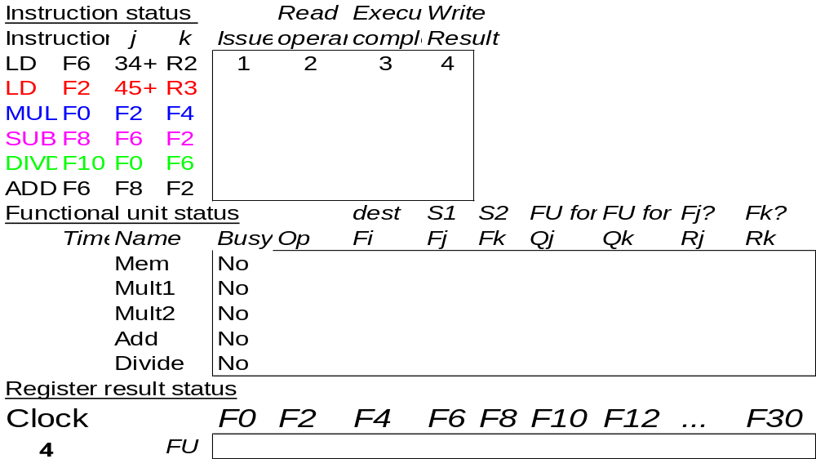
Scoreboard Example Cycle 4
LD #1 writes back and frees Mem FU and
register F6

Slide 34
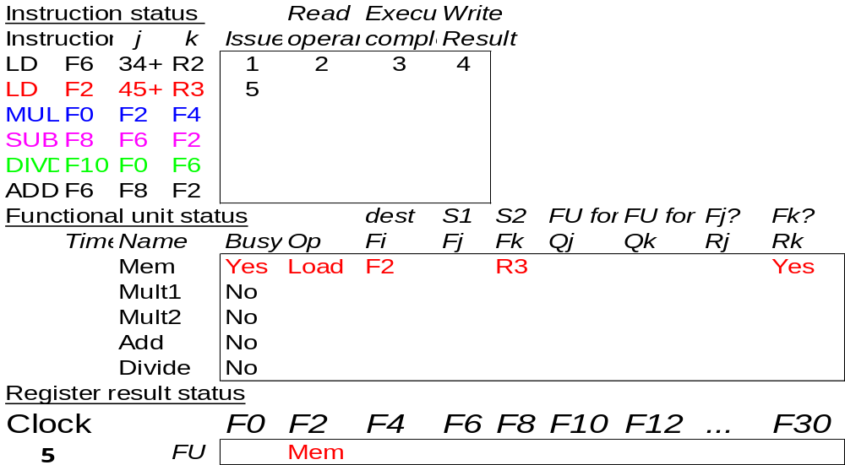
Scoreboard Example Cycle 5
Issue LD #2 since Mem unit is now free.

Slide 35
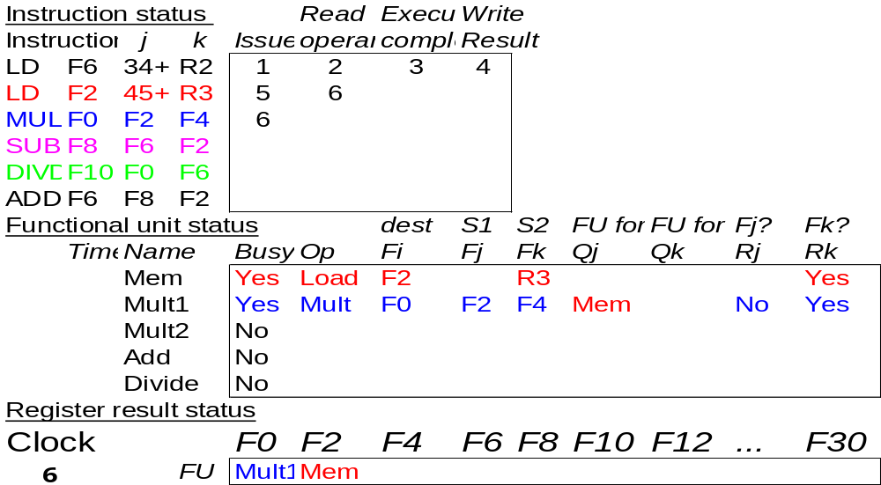
Scoreboard Example Cycle 6
Issue MULT.

Slide 36
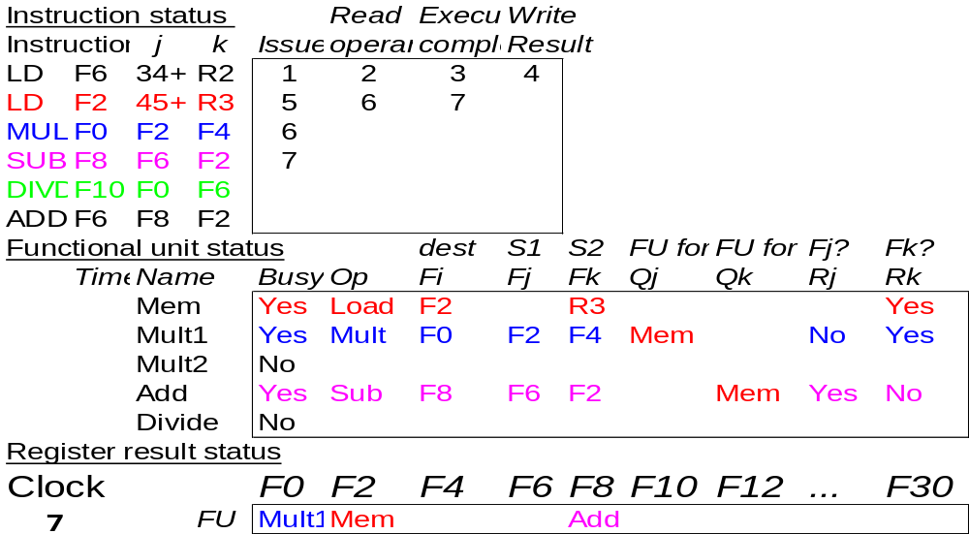
Scoreboard Example Cycle 7
MULT can’t read its operands (F2) because LD #2 hasn’t finished.
SUBD is issued

Slide 37
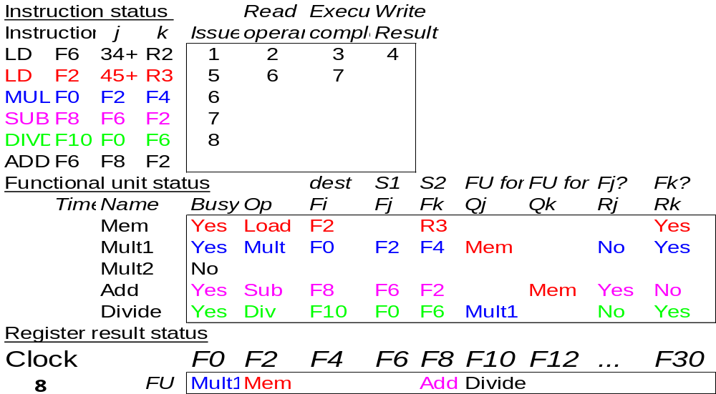
Scoreboard Example Cycle 8a
MULT and SUBD both waiting for F2.
DIVD issues.

Slide 38
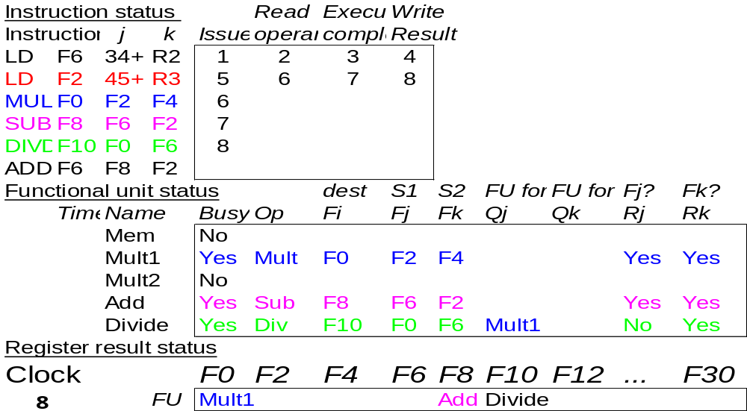
Scoreboard Example Cycle 8b
LD #2 writes F2.

Slide 39
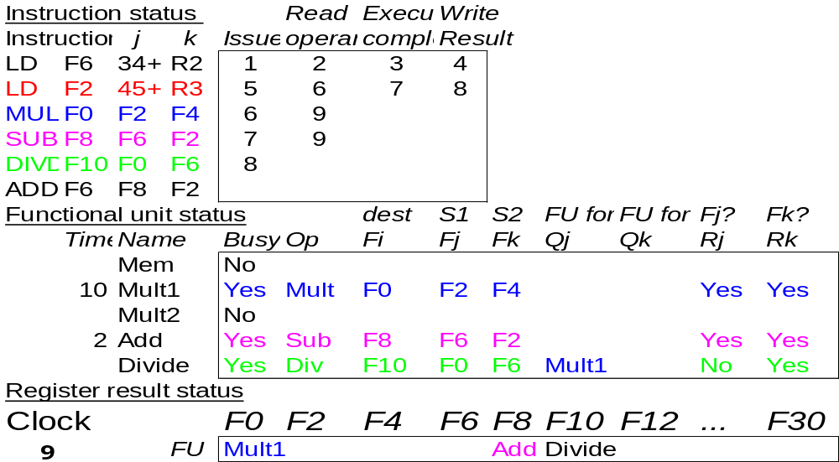
Scoreboard Example Cycle 9
Now MULT and SUBD can both read F2.
ADDD can not be issued because Add unit is busy.

Slide 40
Scoreboard Example Cycle 10
MULT and SUB continue operation
9
1

Slide 41
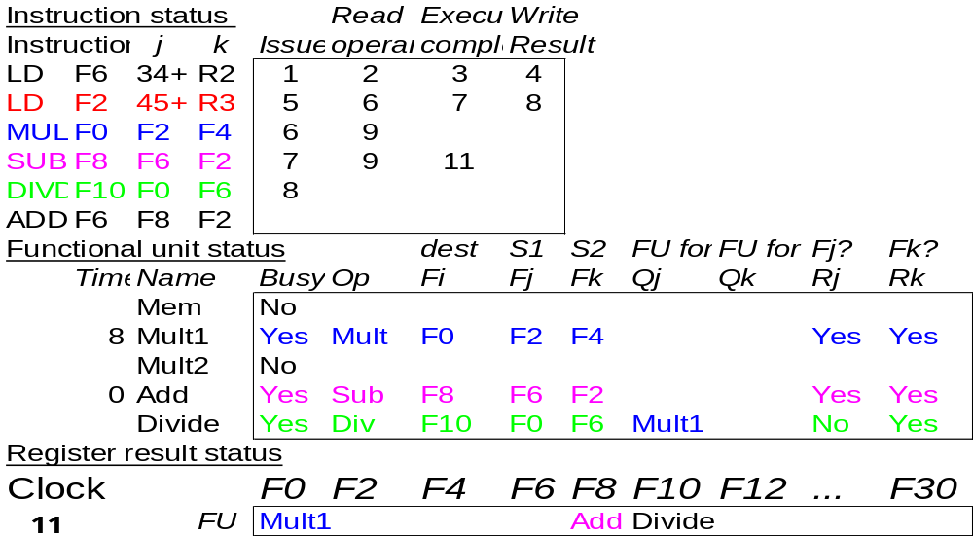
Scoreboard Example Cycle 11
SUBD completes

Slide 42
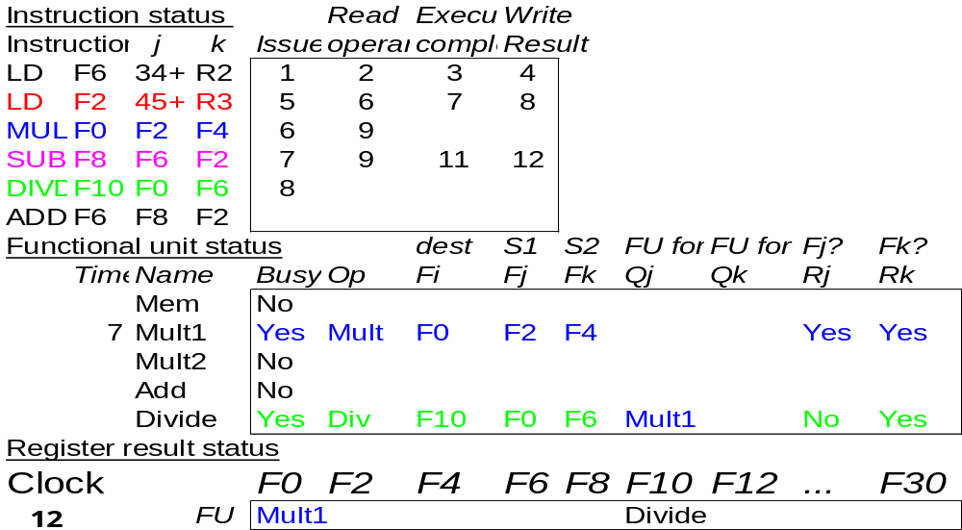
Scoreboard Example Cycle 12
SUBD finishes.
DIVD waits for F0

Slide 43
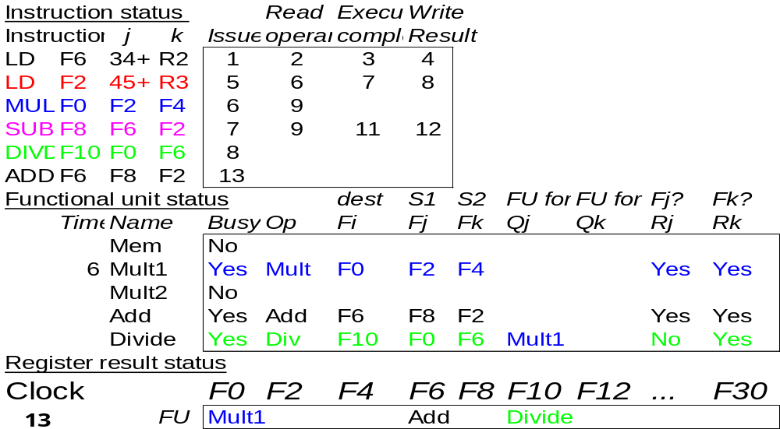
Scoreboard Example Cycle 13
ADDD issues.

Slide 44
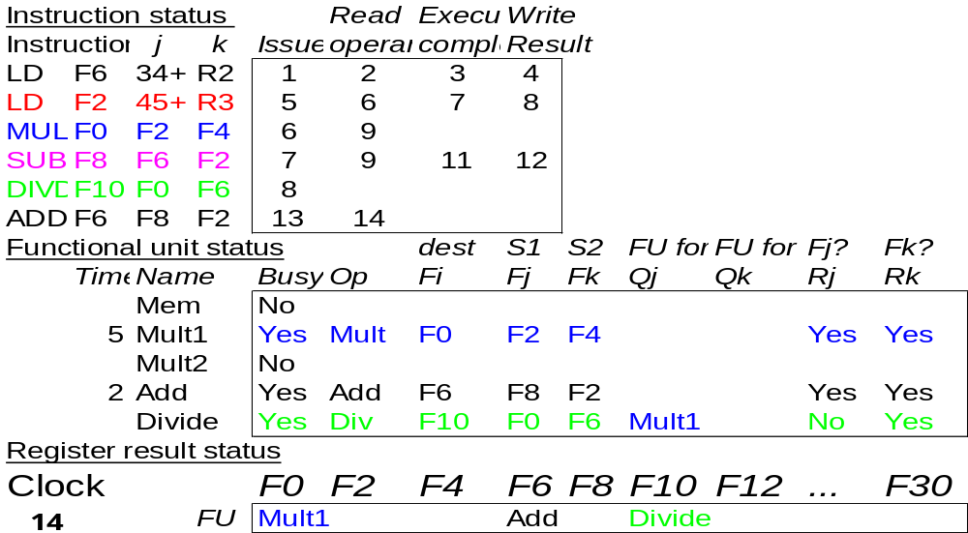
Scoreboard Example Cycle 14
MULT and ADDD
continue their operation

Slide 45

Scoreboard Example Cycle 15
Nearly there…

Slide 46
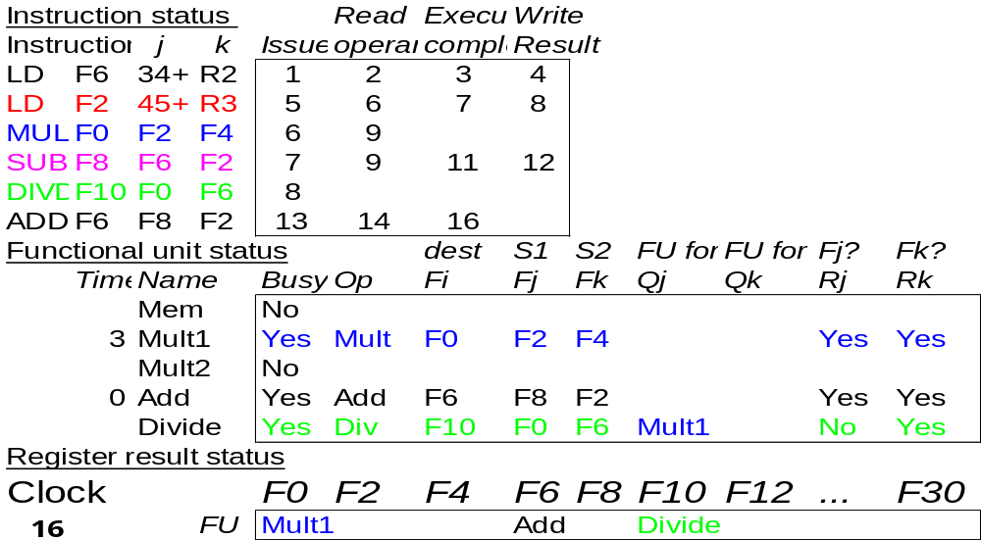
Scoreboard Example Cycle 16
ADDD completes execution

Slide 47

Scoreboard Example Cycle 17
ADDD can’t write because of RAW with DIVD so it stalls write back

Slide 48

Scoreboard Example Cycle 18
MULT still continues
its execution

Slide 49
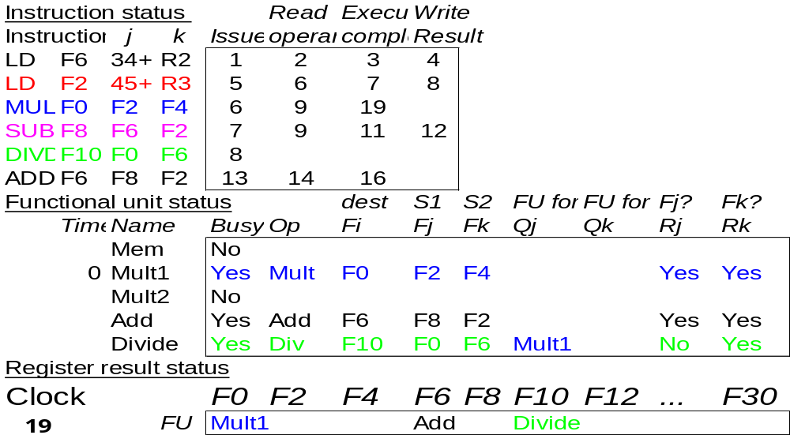
Scoreboard Example Cycle 19
MULT completes execution.

Slide 50
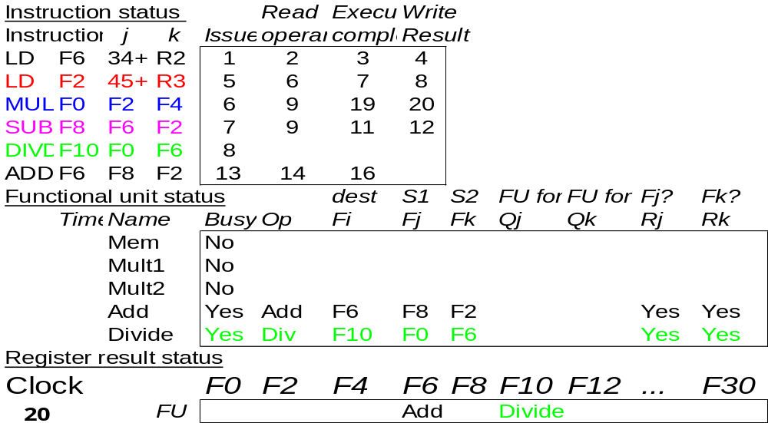
Scoreboard Example Cycle 20
MULT writes and frees FU and register F0

Slide 51
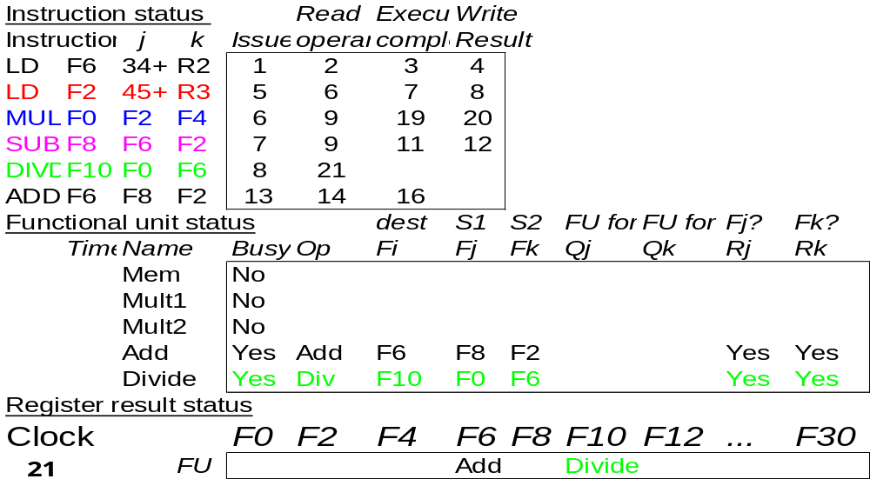
Scoreboard Example Cycle 21
DIVD can read operands

Slide 52
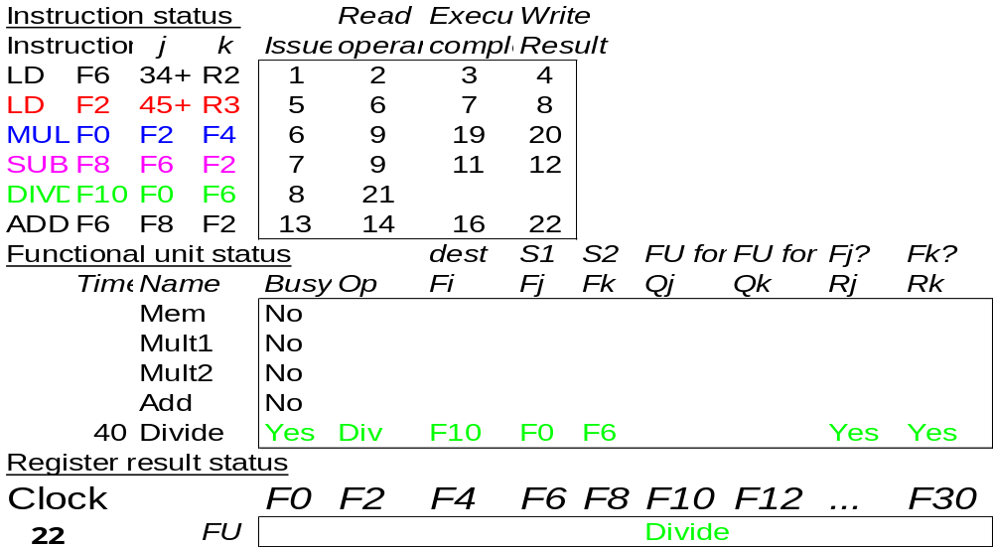
Scoreboard Example Cycle 22
Now ADDD can write since WAR removed
ADD FU and register F6 freed

Slide 53
39 cycles later…

Slide 54
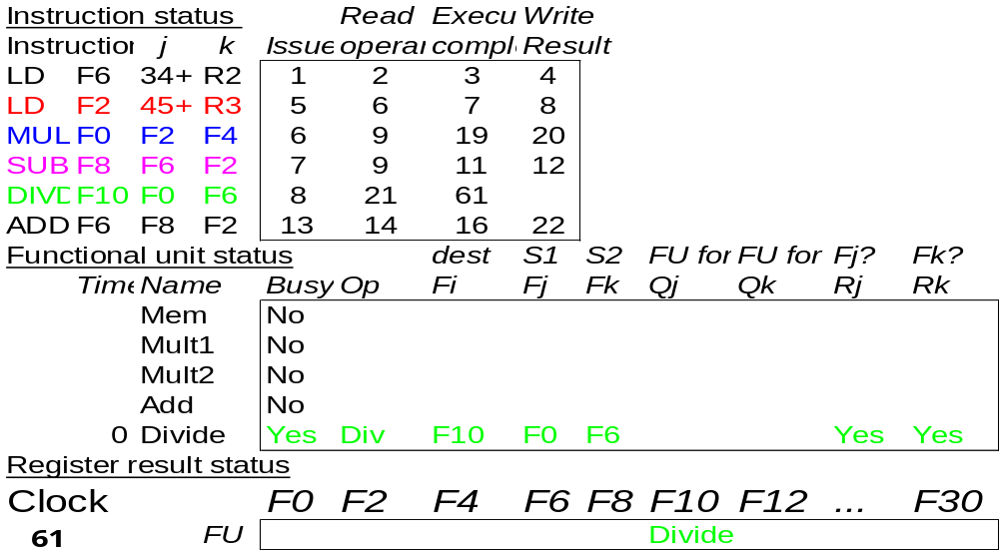
Scoreboard Example Cycle 61
DIVD completes execution

Slide 55
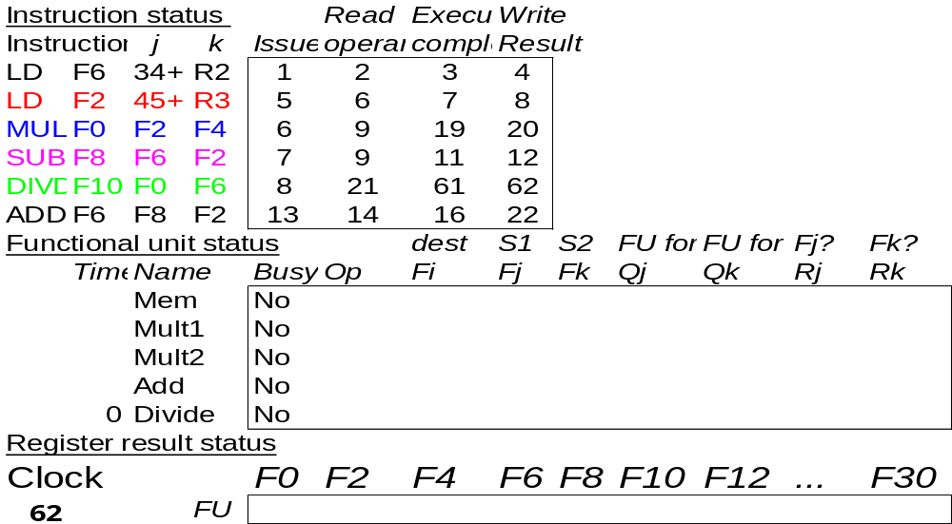
Scoreboard Example Cycle 62
DIVD writes back
and frees resources
Execution Complete

Slide 56
Scoreboard Example Cycle 62
In-order issue
Out-of-order execution
Out-of-order completion

Slide 57
Limitations of Scoreboard
The amount of parallelism available among the instructions (chosen from the same basic block)
  Specially since the presence of WAR and WAW dependences leads to stalls.
Centralized structures are not too scalable. Scales more than linearly with:
  The number of score entries (The size of the scoreboard determines the size of the window)
  The number and types of functional units (Structural hazards increase when out of order execution is used)

Slide 58
Summary
Scoreboard techniques to deal with hazards:
  Result forwarding to reduce or eliminate RAW hazards
  Hazard detection hardware to stall the pipeline during hazards
  Uses hardware-based dynamic scheduling to rearrange instruction execution order to reduce stalls
    Better dynamic exploitation of instruction-level parallelism (ILP) than compiler-generated code
Still in use nowadays
  E.g., nVidia Fermi GPUs use a scoreboard

Slide 59
Consider the following program which implements R = A^2 + B^2 + C^2 + D^2
  LD r1, A
  MUL r2, r1, r1 -- A^2
  LD r3, B
  MUL r4, r3, r3 -- B^2
  ADD r11, r2, r4 -- A^2 + B^2
  LD r5, C
  MUL r6, r5, r5 -- C^2
  LD r7, D
  MUL r8, r7, r7 -- D^2
  ADD r12, r6, r8 -- C^2 + D^2
  ADD r21, r11, r12 -- A^2 + B^2 + C^2 + D^2
  ST r21, R
The current code is not really suitable for a superscalar pipeline because of its
low instruction-level parallelism
Reorder the instructions to exploit superscalar execution. Assume all kinds of forwarding are implemented.

