Slide 1
From last week
Out of Order Execution
  Processor executes instructions as input data becomes available
New types of dependencies arise
  True dependency (Read-after-Write RAW)
  Anti-dependency (Write-after-Read WAR)
  Output dependency (Write-after-Write WAW)
Two main implementations
  Scoreboard
  Tomasulo

Slide 2
Tomasulo
Describe briefly the Tomasulo architecture
  Distributed OoO architecture.
  Based on reservation stations which track the status of operands and instructions and perform register renaming which removes WAW and WAR dependencies
  Uses a Common Data Bus which performs result forwarding among FUs/RSs

Slide 3
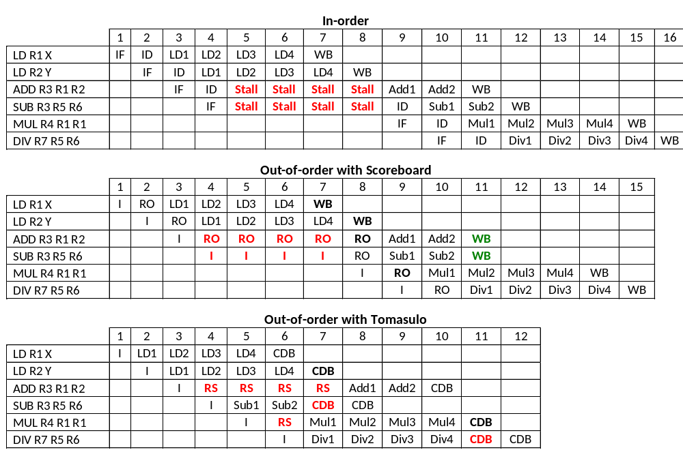
In-order vs Out-of-order

Slide 4
Hardware Multithreading
COMP25212

Slide 5
Learning Outcomes
To be able to:
  To describe the motivation for hardware multithreading
  To distinguish hardware and software multithreading
  To understand multithreading implementations and their benefits/limitations
  To be able to estimate performance of these implementations
  To explain when multithreading is inappropriate

Slide 6
Increasing Processor Performance
Minimizing memory access impact – caches
By increasing clock frequency – pipelining
  Maximizing pipeline utilization – branch prediction
  Maximizing pipeline utilization – forwarding
By running instructions in parallel – superscalar
Maxing instruction issue – dynamic scheduling,
out-of-order execution

Slide 7
Increasing Parallelism
Amount of parallelism that we can exploit is limited by the programs
  Some areas exhibit great parallelism
    Many independent instructions
  Some others are essentially sequential
    Lots of data-dependencies
In the later case, where can we find additional independent instructions?
  In a different process!
Hardware Multithreading allows several threads to share a single processor
  Essentially distinct from Software Multithreading

Slide 8
Software Multithreading
Support from the Operating Systems
to handle multiple processes/threads
aka. Multitasking

Slide 9
Software Multithreading - Revision
Modern Operating Systems support several processes/threads to be run concurrently
Transparent to the user – all of them appear to be running at the same time
BUT, actually, they are scheduled (and interleaved) by the OS

Slide 10

Example
Notes:
Desktop
Terminal
Pdf reader – script
Editor
Browser
Music player
… OS

Slide 11
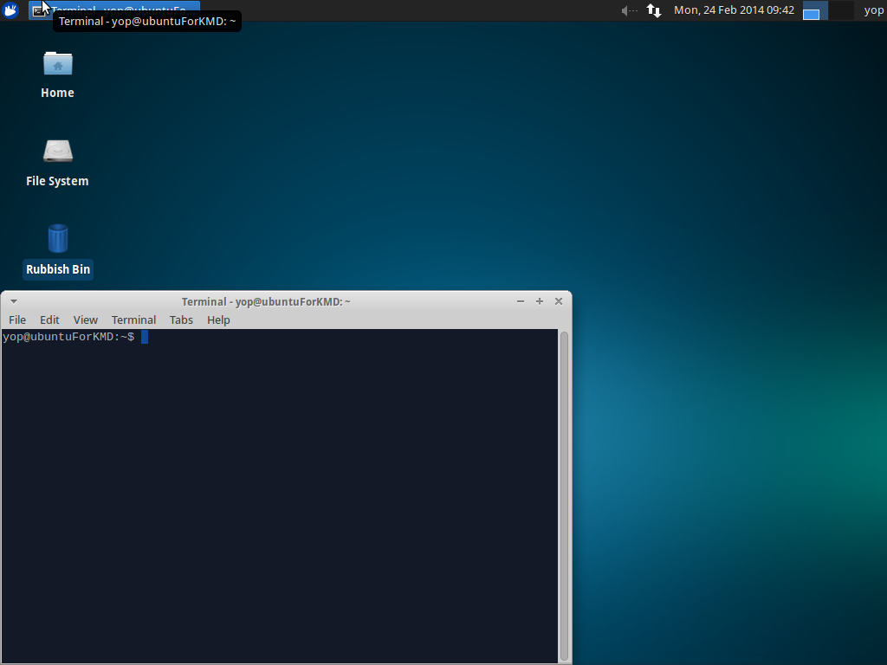
Example
Notes:
Desktop
Terminal
Pdf reader – script
Editor
Browser
Music player
… OS

Slide 12
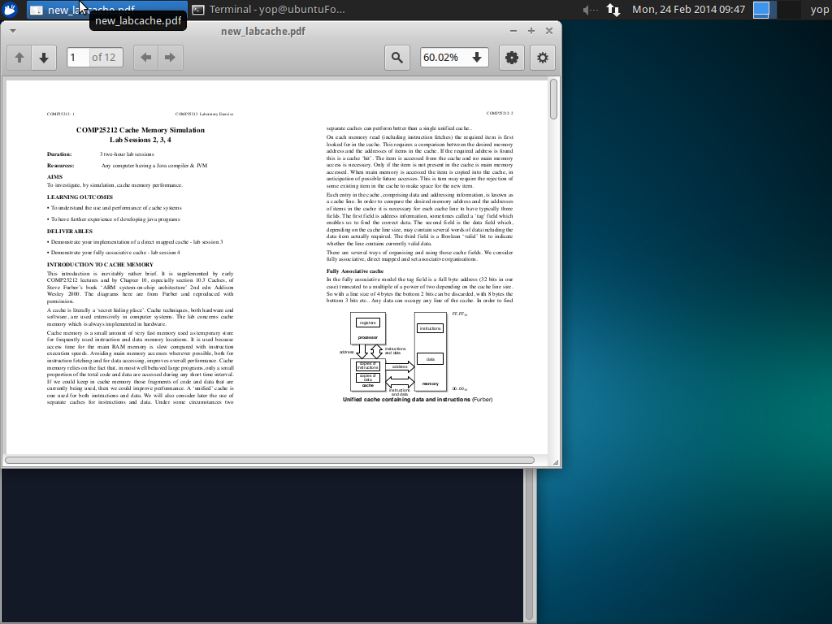
Example
Notes:
Desktop
Terminal
Pdf reader – script
Editor
Browser
Music player
… OS

Slide 13
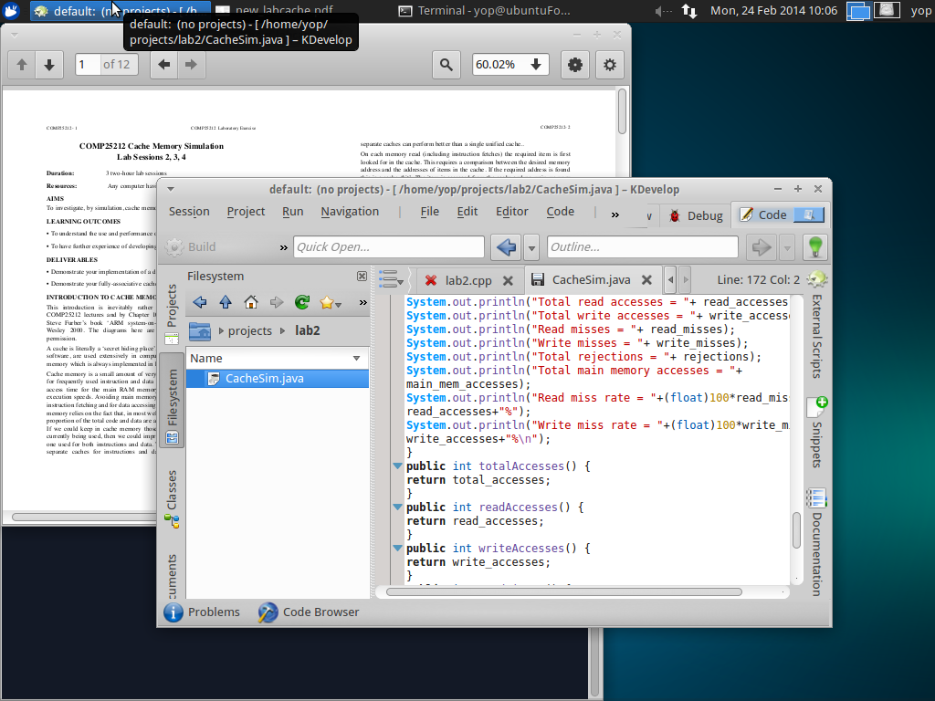
Example
Notes:
Desktop
Terminal
Pdf reader – script
Editor
Browser
Music player
… OS

Slide 14
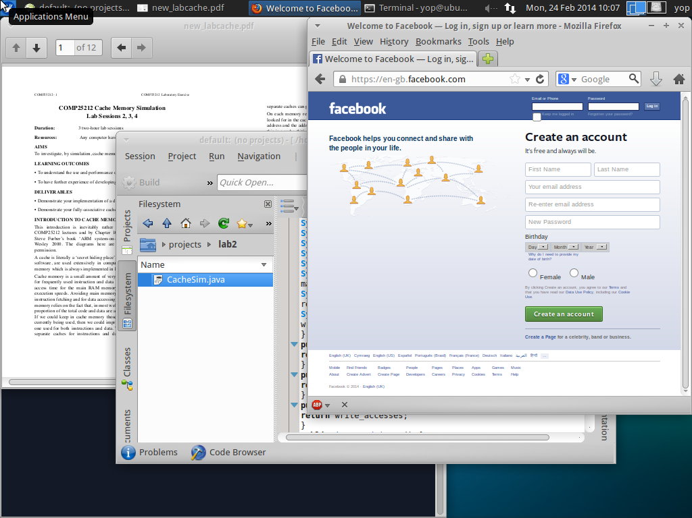
Example
+ Lots of OS Processes
Notes:
Desktop
Terminal
Pdf reader – script
Editor
Browser
Music player
… OS

Slide 15
OS Thread Switching - Revision
Operating System
Thread T₀
Thread T₁
Exec
Save state into PCB₀
Context
Switching
Wait
Load state fromPCB₁
Wait
Exec
Save state into PCB₁
Context
Switching
Load state fromPCB₀
Wait
Exec
Context switching between available threads is done so often (typically
every few ms) that, to the user, applications seem to run in parallel
COMP25111 – Lect. 5

Slide 16
Process Control Block (PCB) - Revision
PCBs store information about the state of ‘alive’ processes handled by the OS
Process ID
Process State
PC
Stack Pointer
General Registers
Memory Management Info
Open File List, with positions
Network Connections
CPU time used
Parent Process ID
Lots of information!
Context switching at this level has a huge overload

Slide 17
OS Process States - Revision
Wait (e.g. I/O)
Terminated
Running on a CPU
Blocked waiting for event
Pre-empted
Ready waiting for a CPU
Event
occurs
Dispatched
New
COMP25111 – Lect. 5

Slide 18
Hardware Multithreading
Processor architectural support
to exploit instruction level parallelism

Slide 19
Hardware Multithreading
Allow multiple threads to share a single processor
Requires replicating the HW that stores the independent state of each thread
  Registers
  TLB
Virtual memory can be used to share memory among threads
  Beware of synchronization issues

Slide 20
CPU Support for Multithreading
VA Mapping_{A}
Address
Translation
VA Mapping_{B}
Inst Cache
Data Cache
PC_{A}
PC
PC_{B}
Fetch Logic
Fetch Logic
Decode Logic
Fetch Logic
Exec Logic
Fetch Logic
Mem Logic
Write Logic
Register_{A}
Register Bank
Register_{B}

Slide 21
Hardware Multithreading Decisions
How HW MT is presented to the OS
  Normally present each hardware thread as a virtual processor (Linux, UNIX, Windows)
  Requires multiprocessor support from the OS
Needs to share or replicate resources
  Registers – need to be replicated
  Caches – normally shared
    Each thread will use a fraction of the cache
    Cache trashing issues – severely harm performance

Slide 22
Example of Trashing - Revision
Memory Accesses
Thread A |  | Thread B
: |  | :
0x075A13D0 | MISS | :
 |  | 0X018313D4 | MISS
0x075A13D4 | MISS
 |  | 0X018313D8 | MISS
0x075A13D8 | MISS
: |  | 0X018313DC | MISS

Slide 23
Example of Trashing - Revision
Memory Accesses
Thread A |  | Thread B
: |  | :
0x075A13D0 | MISS | :
 |  | 0x018313D4 | MISS
0x075A13D4 | MISS
 |  | 0x018313D8 | MISS
0x075A13D8 | MISS
: |  | 0x018313DC | MISS

Slide 24
Example of Trashing - Revision
Memory Accesses
Thread A |  | Thread B
: |  | :
0x075A13D0 | MISS | :
 |  | 0x018313D4 | MISS
0x075A13D4 | MISS
 |  | 0x018313D8 | MISS
0x075A13D8 | MISS
: |  | 0x018313DC | MISS
Same index

Slide 25
Example of Trashing - Revision
Direct Mapped cache
Memory Accesses |  |  |  |  |  |  | Line 13D
Thread A |  | Thread B |  |  | Action taken |  | Tag
: |  | : |  |  |  |  | Invalid
0x075A13D0 | MISS | :
 |  | 0x018313D4 | MISS
0x075A13D4 | MISS
 |  | 0x018313D8 | MISS
0x075A13D8 | MISS
: |  | 0x018313DC | MISS

Slide 26
Example of Trashing - Revision
Direct Mapped cache
Memory Accesses |  |  |  |  |  | Line 13D
Thread A |  | Thread B |  | Action taken |  | Tag
: |  | : |  |  |  | Invalid
0x075A13D0 | MISS | : |  | Load 0x075A |  | 0x075A

Slide 27
Example of Trashing - Revision
Direct Mapped cache
Memory Accesses |  |  |  |  |  | Line 13D
Thread A |  | Thread B |  | Action taken |  | Tag
: |  | : |  |  |  | Invalid
0x075A13D0 | MISS | : |  | Load 0x075A |  | 0x075A

Slide 28
Example of Trashing - Revision
Direct Mapped cache
Memory Accesses |  |  |  |  |  |  | Line 13D
Thread A |  | Thread B |  |  | Action taken |  | Tag
: |  | : |  |  |  |  | Invalid
0x075A13D0 | MISS | : |  |  | Load 0x075A |  | 0x075A
 |  | 0x018313D4 | MISS |  | Load 0X0183 |  | 0X0183

Slide 29
Example of Trashing - Revision
Direct Mapped cache
Memory Accesses |  |  |  |  |  |  | Line 13D
Thread A |  | Thread B |  |  | Action taken |  | Tag
: |  | : |  |  |  |  | Invalid
0x075A13D0 | MISS | : |  |  | Load 0x075A |  | 0x075A
 |  | 0x018313D4 | MISS |  | Load 0x0183 |  | 0x0183

Slide 30
Example of Trashing - Revision
Direct Mapped cache
Memory Accesses |  |  |  |  |  |  | Line 13D
Thread A |  | Thread B |  |  | Action taken |  | Tag
: |  | : |  |  |  |  | Invalid
0x075A13D0 | MISS | : |  |  | Load 0x075A |  | 0x075A
 |  | 0x018313D4 | MISS |  | Load 0x0183 |  | 0x0183
0x075A13D4 | MISS |  |  |  | Load 0x075A |  | 0x075A

Slide 31
Example of Trashing - Revision
Direct Mapped cache
Memory Accesses |  |  |  |  |  |  | Line 13D
Thread A |  | Thread B |  |  | Action taken |  | Tag
: |  | : |  |  |  |  | Invalid
0x075A13D0 | MISS | : |  |  | Load 0x075A |  | 0x075A
 |  | 0x018313D4 | MISS |  | Load 0x0183 |  | 0x0183
0x075A13D4 | MISS |  |  |  | Load 0x075A |  | 0x075A

Slide 32
Example of Trashing - Revision
Direct Mapped cache
Memory Accesses |  |  |  |  |  |  | Line 13D
Thread A |  | Thread B |  |  | Action taken |  | Tag
: |  | : |  |  |  |  | Invalid
0x075A13D0 | MISS | : |  |  | Load 0x075A |  | 0x075A
 |  | 0x018313D4 | MISS |  | Load 0x0183 |  | 0x0183
0x075A13D4 | MISS |  |  |  | Load 0x075A |  | 0x075A
 |  | 0x018313D8 | MISS |  | Load 0x0183 |  | 0x0183
0x075A13D8 | MISS |  |  |  | Load 0x075A |  | 0x075A
: |  | 0x018313DC | MISS |  | Load 0x0183 |  | 0x0183

Slide 33
Hardware Multithreading
Different ways to exploit this new source of parallelism
When & how to switch threads?
  Coarse-grain Multithreading
  Fine-grain Multithreading
  Simultaneous Multithreading

Slide 34
Coarse-Grain Multithreading

Slide 35
Coarse-Grain Multithreading
Issue instructions from a single thread
Operate like a simple pipeline
Switch Thread either:
  On Expensive operation, e.g., I-cache or D-cache miss
  After a Quantum of execution

Slide 36
Switch Threads on Icache miss
 | 1 | 2 | 3 | 4 | 5 | 6 | 7
Inst a | IF | ID | EX | MEM | WB
Inst b |  | IF | ID | EX | MEM | WB
Inst c |  |  | IF MISS | ID | EX | MEM | WB
Inst d |  |  |  | IF | ID | EX | MEM
Inst e |  |  |  |  | IF | ID | EX
Inst f |  |  |  |  |  | IF | ID
- | - | - | -
Inst X
Inst Y
Inst Z
Remove Inst c and switch to other thread
The next thread will continue its execution until it encounters another “expensive” operation

Slide 37
Switch Threads on Dcache miss
 | 1 | 2 | 3 | 4 | 5 | 6 | 7
Inst a | IF | ID | EX | M-Miss | WB
Inst b |  | IF | ID | EX | MEM | WB
Inst c |  |  | IF | ID | EX | MEM | WB
Inst d |  |  |  | IF | ID | EX | MEM
Inst e |  |  |  |  | IF | ID | EX
Inst f |  |  |  |  |  | IF | ID
MISS | MISS | MISS
- | - | -
Abort these
- | - | -
- | - | -
Inst X
Inst Y
Remove Inst a and switch to other thread
  Remove the rest of instructions from ‘blue’ thread
  Roll back ‘blue’ PC to point to Inst a

Slide 38
Coarse Grain Multithreading
Good to compensate for infrequent, but expensive pipeline disruption
Minimal pipeline changes
  Need to abort all the instructions in “shadow” of Dcache miss ⇨ overhead
  Resume instruction stream to recover
Short stalls (data/control hazards) are not solved
Requires a fast thread switching mechanism
  Thread switching needs to be faster than getting the cache line

Slide 39

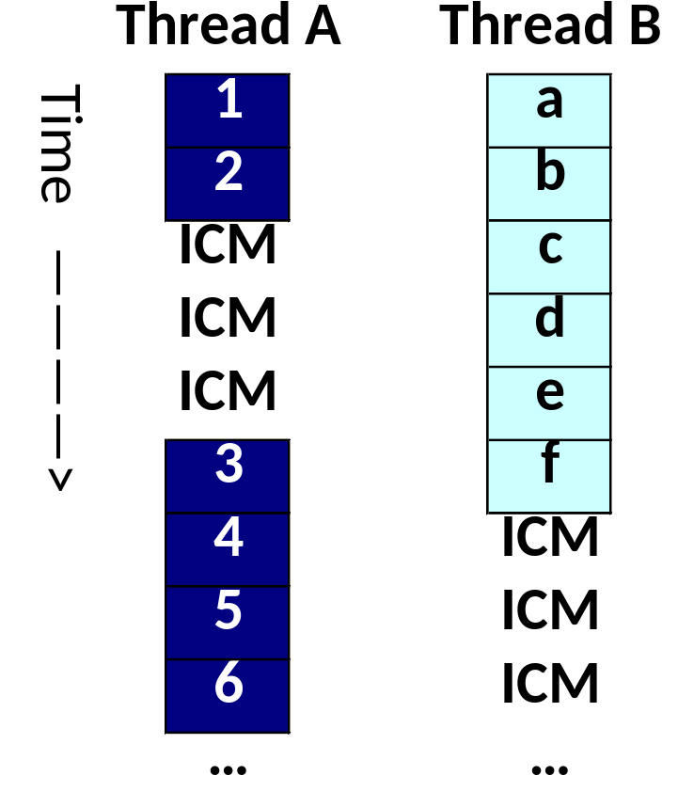
Coarse-grain Multithreading
We want to run these
two Threads
Run Thread A,
when it finishes
run Thread B

Slide 40
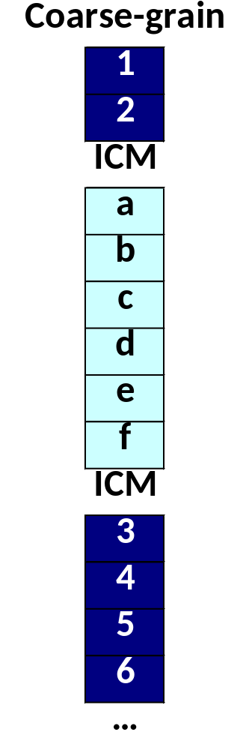
Coarse-grain Multithreading
We want to run these
two Threads
Start Thread A,
swap threads
upon ICMs

Slide 41
Fine-Grain Multithreading

Slide 42
Fine-Grain Multithreading
Overlap in time the execution of several threads
  Fetch instructions from a different thread each cycle
Typically using Round Robin among all the ‘ready’ hardware threads
  Others policies possible
Requires instantaneous thread switching
  Complex hardware

Slide 43
Fine-Grain Multithreading
Simply swap from one thread to the other
Multithreading helps alleviate fine-grain dependencies (e.g. forwarding?)
 | 1 | 2 | 3 | 4 | 5 | 6 | 7
Inst a | IF | ID | EX | MEM | WB
Inst M |  | IF | ID | EX | MEM | WB
Inst b |  |  | IF | ID | EX | MEM | WB
Inst N |  |  |  | IF | ID | EX | MEM
Inst c |  |  |  |  | IF | ID | EX
Inst P |  |  |  |  |  | IF | ID
Notes:
Separation means that forwarding no longer needs a no op

Slide 44
I-cache misses in Fine Grain Multithreading
An I-cache miss is overcome transparently
 | 1 | 2 | 3 | 4 | 5 | 6 | 7
Inst a | IF | ID | EX | MEM | WB
Inst M |  | IF | ID | EX | MEM | WB
Inst b |  |  | IF-MISS | - | - | - | -
Inst N |  |  |  | IF | ID | EX | MEM
Inst P |  |  |  |  | IF | ID | EX
Inst Q |  |  |  |  |  | IF | ID
Inst b is removed and the thread is marked as not ‘ready’
‘Blue’ thread is not ready so ‘orange’ is executed
Notes:
What is the problem with this? Two Ex stages at the same time! Worth it for cases where the miss is longer....

Slide 45
D-cache misses in Fine Grain Multithreading
Mark the thread as not ‘ready’ and issue only from the other thread
 | 1 | 2 | 3 | 4 | 5 | 6 | 7
Inst a | IF | ID | EX | M-MISS | Miss | Miss | WB
Inst M |  | IF | ID | EX | MEM | WB
Inst b |  |  | IF | ID | - | - | -
Inst N |  |  |  | IF | ID | EX | MEM
Inst P |  |  |  |  | IF | ID | EX
Inst Q |  |  |  |  |  | IF | ID
Thread marked as not ‘ready’. Remove Inst b.
Roll back PC to Instr a.
‘Blue’ thread is not ready so ‘orange’ is executed
Notes:
What is the problem with this? Two Ex stages at the same time! Worth it for cases where the miss is longer....

Slide 46
Fine Grain Multithreading in out-of-order-processors
In an out of order processor we may continue issuing instructions from both threads
  Unless O-o-O algorithm stalls one of the threads
 | 1 | 2 | 3 | 4 | 5 | 6 | 7
Inst a | IF | RO | EX | MEM | WB
Inst M |  | IF | RO | EX | MEM | WB
Inst b |  |  | IF | ID | EX | MEM | WB
Inst N |  |  |  | IF | ID | EX | MEM
Inst c |  |  |  |  | IF | ID | EX
Inst P |  |  |  |  |  | IF | ID
4 | 5 | 6 | 7
M MISS
EX | MEM | WB
ID
IF | ID | EX | MEM
 |  | IF | ID
4 | 5 | 6 | 7
M MISS | Miss | Miss | WB
EX | MEM | WB
RO | (RO) | (RO) | EX
IF | RO | EX | MEM
 | IF | (RO) | (RO)
 |  | IF | RO
Notes:
CHECK THIS IN ANIMATION

Slide 47
Fine Grain Multithreading
Utilization of pipeline resources increased, i.e. better overall performance
  Impact of short stalls is alleviated by executing instructions from other threads
Each thread perceives it is being executed slower, but overall performance is better
Requires an instantaneous thread switching mechanism
  Expensive in terms of hardware

Slide 48
Fine-grain Multithreading
We want to run these
two Threads

Slide 49
Fine-grain Multithreading
We want to run these
two Threads

Slide 50
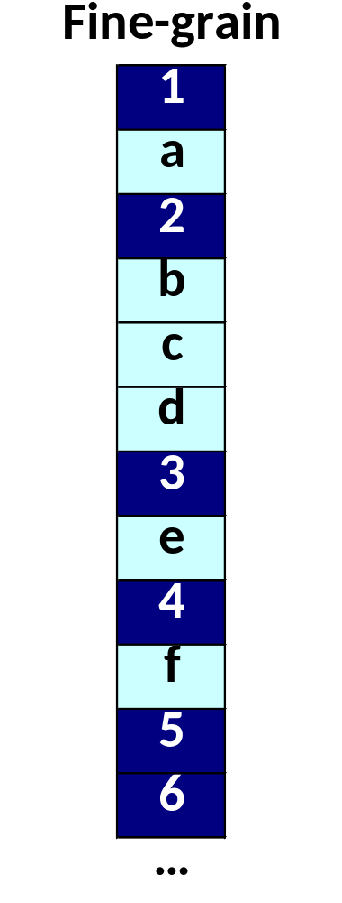
Fine-grain Multithreading
We want to run these
two Threads
Thread A not
ready, issue
from B only
Thread B not
ready, issue
from A only

Slide 51
Questions

