Slide 1
From Tuesday
What is a Multicore processor?
  It is a single computing chip with two or more independent processing units (cores), each able to execute programs independently
What is memory coherency in this context?
  Ensure changes are seen everywhere. i.e. no outdated copy remains in the system
And memory consistency?
  Ensure correct ordering of memory accesses and specially of atomic operations

Slide 2
From Tuesday
Explain the following synchronization primitives
  Lock:
    Ensure that only one thread can advance into an atomic region
  Fence:
    Ensure all the instructions before a certain point have completed before starting issuing instructions after the fence (required in out-of-order architectures)
  Barrier:
    Ensure all the threads have reached a certain point of the execution before any of the threads is able to advance.

Slide 3
Typical Multi-core Structure
core
L1 Inst L1 Data
core
L1 Inst L1 Data
Main Memory
(DRAM)
L2 Cache
L2 Cache
Memory Controller
L3 Shared Cache
On Chip
QPI or HT
PCIe
Input/Output Hub
PCIe
Graphics Card
Input/Output Controller
…
Motherboard
I/O Buses (PCIe, USB, Ethernet, SATA HD)

Slide 4
Simplified Multi-Core Structure
core
L1 L1
Inst Data
core
L1 L1
Inst Data
core
L1 L1
Inst Data
core
L1 L1
Inst Data
Interconnect
On Chip
Main Memory

Slide 5
Multi-core systems
COMP25212 System Architecture
Dr. Javier Navaridas

Slide 6
Overview of Coherence Systems
Hardware mechanisms that ensure our architecture provides a coherent view of data stored in memory
Require extra information about cache lines and many decision to be taken
  Are there other copies? Where?
  What to do when the value changes?
  How to deal with shared data?
How we share information about the caches lines
  Snooping protocols: all caches are aware of everything that happens in the memory system
  Directory protocols: cache line information is stored in a separated subsystem and changes are updated there

Slide 7
Snooping protocol

Slide 8
Snooping Protocols
Each cache ‘snoops’ (i.e. listens continually) for activity concerned with its cached addresses
  Changes status and reacts adequately when needed
  All caches are aware of all events
Requires a broadcast communications structure
  Typically a bus, so all communication are seen by all
  Other forms are possible

Slide 9
Simplest Snooping Protocols
Write Update
  A core wanting to write grabs bus cycle and broadcasts address & new data as it updates its own copy
  All snooping caches update their copy
core
IC DC
X
core
IC DC
X
core
IC DC
core
IC DC
X
core
IC DC
X
core
IC DC
str r0, X
@X, cachelineX
Bus
On Chip
Main Memory

Slide 10
Simplest Snooping Protocols
Write Invalidate
  A core wanting to write to an address, grabs a bus cycle and sends a ‘write invalidate’ message which contains the address
  All snooping caches invalidate their copy of that cache line
  The core writes to its cached copy
  Any shared read in other cores will now miss and get the value from the updated cache
core
IC DC
X
core
IC DC
X
core
IC DC
core
IC DC
Inv
core
IC DC
X
core
IC DC
str r0, X
Invalidate
Bus
On Chip
Main Memory

Slide 11
Update or Invalidate?
In both schemes, the problem of simultaneous writes is taken care of by bus arbitration
  Only one core can use the bus at any one time
Update looks the simplest and most obvious, but:
  Messages are longer
    Address+data vs address only
  Multiple writes to the same word, no intervening read
    One invalidate message vs an update for each
  Writes to words in the same cache line, no intervening read
    One invalidate vs multiple updates
Remember Write Through vs Copy Back?

Slide 12
Update or Invalidate?
Due to both spatial and temporal locality, the previous cases occur often
Bus bandwidth is a precious commodity in shared memory multi-core chips
Experience has shown that invalidate protocols use significantly less bandwidth
We will only see in detail the implementation of invalidate protocols

Slide 13
Implementation Issues
In both schemes, knowing if a cached value is not shared can avoid sending messages
  Better latency
  Lower bandwidth consumption
  Less contention for the use of the bus
Invalidate description assumes that a cache value update is ‘written through’ to memory
  If we used ‘copy back’ (better for performance) other cores could re-fetch incorrect value if read from RAM
We need a protocol to handle all this

Slide 14
MESI Protocol (1)
A practical multi-core invalidate protocol which attempts to minimize bus usage
  Also known as Illinois protocol
Allows usage of a copy back scheme
  Next level of the memory hierarchy is not updated until a ‘dirty’ cache line is displaced
Simple extension of the usual cache tags:
  Invalid tag and ‘dirty’ tag in a normal copy back cache require 2 bits

Slide 15
MESI Protocol (2)
Any cache line can be in one of 4 states (2 bits)
Modified – The cache line has been modified and is different from main memory – This is the only cached copy. (cf. ‘dirty’)
Exclusive – The cache line coherent with main memory and is the only cached copy
Shared – Coherent with main memory but copies may exist in other caches
Invalid – Line data is not valid (as in simple cache)

Slide 16
MESI Protocol (3)
Cache line state changes are a function of memory access events
Events may be either
  Due to local core activity (i.e. cache access)
  Due to bus activity – as a result of snooping
Each cache line has its own state affected only if the address matches

Slide 17
MESI Protocol (4)
Operation can be described informally by looking at memory operations in a core
  Read Hit/Miss
  Write Hit/Miss
More formally by a state transition diagram (later)

Slide 18
MESI Local Read Hit
The line must be in one of MES
This must be the correct local value (if M it must have been modified locally)
Simply return value
No state change, no message needed

Slide 19
MESI Local Read Miss (1)
Local core sends a MEM_READ message; several possibilities now
No other copy in caches
  The core waits for a response from memory
  The value is stored in the cache and marked E
One cache has an E copy
  The snooping cache sends the value through the bus
  The memory access is cancelled
  The local core caches the value
  Both lines are set to S

Slide 20
MESI Local Read Miss (2)
Several caches have a S copy
  One cache puts copy value on the bus (arbitrated)
  The memory access is cancelled
  The local core caches the value and sets the tag to S
  Other copies remain S
One cache has a M copy
  The snooping cache puts its copy of the value on the bus
  The memory access is cancelled
  The local core caches the value and sets the tag to S
  The source (M) value is copied back to memory
  The source value changes its tag from M to S

Slide 21
MESI Local Write Hit
Cache line in M – Line is exclusive and already ‘dirty’
  Update local cache value
  No state change, No message required
Cache line in E – Line is exclusive but not dirty
  Update local cache value
  Change E to M , No message required
Cache line in S – Other caches have copies
  Core broadcasts an invalidate on bus
  Snooping caches with a copy change from S to I
  The local cache value is updated
  The local state changes from S to M

Slide 22
MESI Local Write Miss (1)
Core sends a RWITM (read with intent to modify); several possibilities now:
No other copies
  Memory sends the data
  Local copy state set to M
Non-dirty copies, either in state E or S
  The snooping cores see this and set their tags to I
  The local copy is updated and sets the tag to M

Slide 23
MESI Local Write Miss (2)
Another dirty copy in state M
  The snooping core sees this
    Blocks the RWITM request and takes control of the bus
    Writes back its copy to memory
    Sets its copy state to I
  The original local core re-issues RWITM request
  This is now simply a no-copy case
    Value read from memory to local cache
    Local copy value updated
    Local copy state set to M
Notes:
The remote core needs to write back to ensure the change actually goes into memory.
The other (local) operation can be preempted and end up in a situation where the value is not actually saved into main memory and lost.
Re-issuing the RWITM by the original, local core is needed to avoid live-lock situations if a third cache tries to read, according to US Grant US6226718B1, “Method and system for avoiding livelocks due to stale exclusive/modified directory entries within a non-uniform access system“

Slide 24
MESI - local cache transactions
Read
Miss
Other
copies
Invalid
Invalid
Shared
Shared
Read
Hit
Mem Read
Write
Hit
Write
Miss
No other
copies
RWITM
Invalidate
Modified
Modified
Exclusive
Exclusive
Read
Hit
Read
Hit
Write
Hit
Write
Hit
= bus transaction

Slide 25
MESI - snooping cache transactions
RWITM
Mem Read
Invalid
Invalid
Invalidate
Shared
Shared
RWITM
Mem Read
Modified
Modified
Exclusive
Exclusive
Mem Read
Invalidate
RWITM
= copy back

Slide 26
Example of MESI
Core 0
I ???
Core 1
I ???
Core 2
I ???
Core 3
I ???
A
Bus
Main Memory

Slide 27
Example of MESI
Core 0: LDR r7, A
Core 0
I ???
Core 1
I ???
Core 2
I ???
Core 3
I ???
A
Read Miss
MEM_READ
Bus
Main Memory
‘A’ cache line

Slide 28
Example of MESI
Core 0: LDR r7, A
Core 2: LDR r3, A
Core 0
E A
Core 1
I ???
Core 2
I ???
Core 3
I ???
A
Read Miss
‘A’ cache line
MEM_READ
Bus
Main Memory

Slide 29
Example of MESI
Core 0: LDR r7, A
Core 2: LDR r3, A
Core 1: STR r0, A
Core 0
S A
Core 1
I ???
Core 2
S A
Core 3
I ???
A
Write Miss
RWITM
RWITM
RWITM
Bus
Main Memory
‘A’ cache line

Slide 30
Example of MESI
Core 0: LDR r7, A
Core 2: LDR r3, A
Core 1: STR r0, A
Core 2: LDR r5, A
Core 0
I ???
Core 1
M A
Core 2
I ???
Core 3
I ???
A
Read Miss
‘A’ cache line
‘A’ cache line
MEM_READ
Bus
Copy back
Main Memory

Slide 31
Example of MESI
Core 0: LDR r7, A
Core 2: LDR r3, A
Core 1: STR r0, A
Core 2: LDR r5, A
Core 1: STR r0, A
Core 0
I ???
Core 1
S A
Core 2
S A
Core 3
I ???
A
Write Hit
Invalidate
Bus
Main Memory

Slide 32
Example of MESI
Core 0: LDR r7, A
Core 2: LDR r3, A
Core 1: STR r0, A
Core 2: LDR r5, A
Core 1: STR r0, A
Core 0
I ???
Core 1
M A
Core 2
I ???
Core 3
I ???
A
Bus
Main Memory

Slide 33
Example of MESI
Core 0: LDR r7, A
Core 2: LDR r3, A
Core 1: STR r0, A
Core 2: LDR r5, A
Core 1: STR r0, A
Core 3: STR r2, A
Core 0
I ???
Core 1
M A
Core 2
I ???
Core 3
I ???
A
‘A’ cache line
Write Miss
RWITM
Bus
Copy back
Main Memory

Slide 34
Example of MESI
Core 0: LDR r7, A
Core 2: LDR r3, A
Core 1: STR r0, A
Core 2: LDR r5, A
Core 1: STR r0, A
Core 3: STR r2, A
Core 0
I ???
Core 1
I ???
Core 2
I ???
Core 3
I ???
A
RWITM
Bus
Main Memory
‘A’ cache line

Slide 35
Example of MESI
Core 0: LDR r7, A
Core 2: LDR r3, A
Core 1: STR r0, A
Core 2: LDR r5, A
Core 1: STR r0, A
Core 3: STR r2, A
Core 0
I ???
Core 1
I ???
Core 2
I ???
Core 3
M A
A
Bus
Main Memory

Slide 36
MOESI Protocol
A more complex protocol with an extra state (O) to avoid the need of copying back to main memory (write update)
Modified
  cache line has been modified and is different from main memory - is the only cached copy. (cf. ‘dirty’)
Owned
  cache line has been modified and is different from main memory – there can be cached copies in S state
Exclusive
  cache line is the same as main memory and is the only cached copy
Shared
  either same as main memory but copies may exist in other caches, or
  different from main memory and there is one copy in O state
Invalid
  data is not valid (as in simple cache)

Slide 37
Summary of Snooping Protocols
There is a plethora of coherence protocols
  MESI, MOESI, MSI, MOSI, MERSI, MESIF, Firefly*, Dragon* ...
Rely on global view of all memory activity
  Usually imply a global bus – a limited shared resource
As number of cores increases
  Demands on bus bandwidth increase – more total memory activity
  The bus gets slower due to increased capacitive load
General consensus is that bus-based systems do not scale well beyond a small number of cores (8-16?)
  Hierarchy of buses is possible, but complicates things and can not really be extended much further than that
* Update protocols
Notes:
R in MERSI is read-only (similar to E, but does not allow transitioning to M)
F in MESIF is Forward (similar to S, but the F cache will be in charge to forward a copy of the cache line when a MEM_READ is seen in the BUS, S caches will simply ignore the MEM_READ to avoid contention for the BUS)

Slide 38
Directory-based protocols

Slide 39
Directory-based protocols
Overcome the lack of scalability of snooping protocols by using distributed hardware
  Sounds familiar?
The memory system is equipped with a directory which stores information of what is being shared
  Stored info is more complex than in snooping protocols
    Local state, Home cache, Remote sharing caches
Coherence messages are point-to-point
  Bus can be replaced for a network-on-chip
  More messages are needed per operation
  … but many messages can be transmitted in parallel
Gaining importance as number of cores increases

Slide 40
Simplest directory Protocols
Cache lines can be in 3 states (similar to MESI/MOESI)
  I – Invalid
  S – Shared: coherent with main mem and may be other copies
  M – Modified: Value changed and no other copies around
Directory can be in 3 states
  NC – Not cached: this cache line is not present in any core
  S – Shared: This cache line is not modified and is in at least 1 core
  M – Modified: This cache line is modified and is in exactly 1 core
Directory stores a ‘sharing vector’ to know which cores have copies of each cache line
  Each bit represents a core

Slide 41
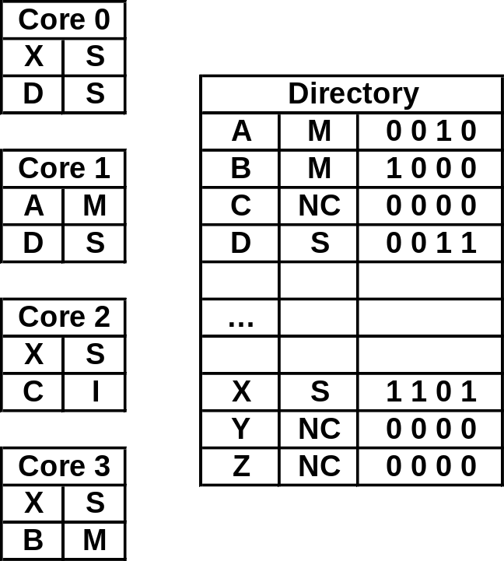
Example of Directory Coherence
Cache0
Cache1
Cache2
Cache3
Cache only has information about the address and local state
  Not global information as in Snoopy
Directory stores the global status, some directory checks are needed, e.g.
  Read Miss:
    Is the line modified?
  Writes in S or I:
    are there other copies?
    if so, invalidate them
More messages are typically needed
  but we can have parallel links not a single centralized one (the bus)
    More transitions and more bandwidth
  the overall performance is improved
Memory
Line
Sharing
Vector
Memory
Line
Directory
state
Cache state

Slide 42
Directory Based System Structure
On Chip
core
L1 L1
Inst Data
core
L1 L1
Inst Data
core
L1 L1
Inst Data
core
L1 L1
Inst Data
Interconnect
Directory
Main Memory

Slide 43
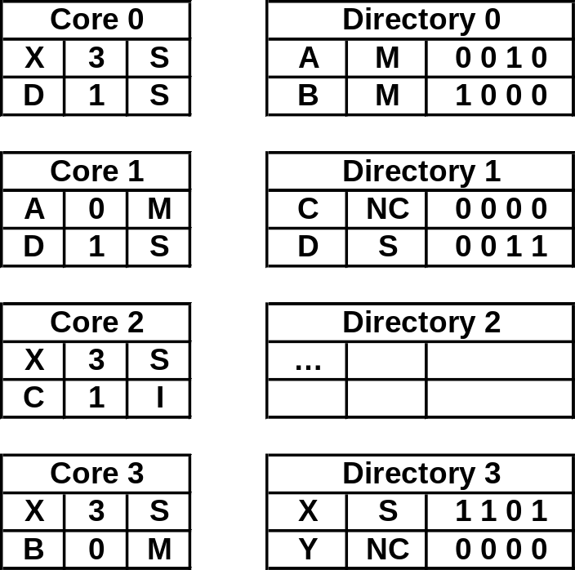
Distributed Directory
The directory is another centralized performance-limiting HW
  It can become a bottleneck
Many-core systems (e.g. TILERA, Xeon Phi) use distributed directory
  Coherence information is now distributed
  Typically with the caches
Where is the information for a line?
  We need to add ‘home’ info into the cache
  We add an extra hop
home

Slide 44
Directory Based System Structure
On Chip
core
L1 L1
Inst Data
core
L1 L1
Inst Data
core
L1 L1
Inst Data
core
L1 L1
Inst Data
Directory
Directory
Directory
Directory
Interconnect
Main Memory

Slide 45
Summary of Directory-based Protocols
More scalable and so, better suited for existing and future many-core systems
Use point-to-point messages to simplify the interconnect and allow parallel communications
Caches do not have a global view of all the caches so we need to store global state separately (in a directory)
Control becomes more complex, but overall performance is better for large systems

Slide 46
Summary of Cache Coherence Protocols
A large variety of protocols, each with their own pros and cons
  The need to minimize number of messages favours invalidate protocols
Snoopy Protocols
Caches have a global view of the cache states
  Info stored is very simple: cache state
Rely on shared medium (e.g. bus)
  Number of messages is minimal
  thanks to broadcast messages plus the availability of complete status
  BUT only one message at a time
Poor scalability
  Can be improved by using a hierarchy of buses
Directory Protocols
Caches have only local info, the Directory stores the global status
  more complex info: cache state + directory state + sharing vector
Point-to-point (network on chip)
  Extra messages needed to access directory and due to multicast traffic being serialised
  BUT many messages in parallel
Overall better scalability
  Can be further scaled up by using a distributed directory

Slide 47
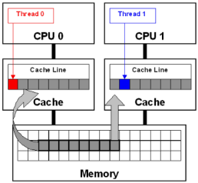
Beware of False sharing
Two cores accessing different words on the same cache line
If one of them writes, it invalidates (or updates) the other
  Large penalty in either case
Harms performance significantly (Another form of trashing!)
  If the two cores continuously modify their values, the cache line is going from one to the other all the time
  Lots of invalidations (or updates) happen
Pathological behavior independent
of the architecture or the protocol
  Parallel compilers need to be aware of it

Slide 48
Questions?

