Slide 1
Multi-core and Beyond
COMP25212 System Architecture
Dr. Javier Navaridas

Slide 2
From Last Lecture
Explain the differences between Snoopy and directory-based cache coherence protocols
  Global view vs local view + directory
  Minimal info vs extra info for directory and remote shared lines
  Centralized communications vs parallel communication
  Poor scalability vs better scalability
Explain the concept of false sharing
  Pathological behaviour when two unrelated variables are stored in the same cache line
  If they are written by two different cores often, they will generate lots of invalidate/update traffic

Slide 3
On-chip Interconnects

Slide 4
The Need for Networks
Any multi-core system must clearly contain the means for cores to communicate
  With memory
  With each other (coherence/synchronization)
There are many different options
  Each have different characteristics and tradeoffs
    Performance/energy/area/fault-tolerance/scalability
  May provide different functionality
  Can restrict the type of coherence mechanism

Slide 5
The need for Networks
Most multi- and many-core applications require some short of communication
  Why having so many cores if not, we rarely run that many number of applications at the same time
Multicore systems need to provide a way for them to communicate effectively
What ‘effectively’ means depends on the context

Slide 6
The need for Networks
Shared-memory applications
Multicores need to ensure consistency and coherence
Memory consistency: ensure correct ordering of memory accesses
  Synchronization within a core
  Synchronization across cores – needs to send messages
Memory coherence: ensure changes are seen everywhere
  Snooping: all the cores see what is going on – centralized
  Directory: distributed communications; more traffic required, but higher parallelism achieved – interconnection network

Slide 7
The need for Networks
Distributed-memory Applications
Independent processor/store pairs
  Each core has its own memory, independent from the rest
  No coherence is granted at the processor level
  Saves chip area
Communication/synchronization is introduced explicitly in the code – message passing
  Needs to be handled efficiently to avoid becoming the bottleneck
Interconnection network becomes an important part of the design
E.g. Intel Single-chip Cloud Computer – SCC (2009)
  Later replaced by the cache-coherent Xeon Phi (2012)

Slide 8
Evaluating Networks
Bandwidth: Amount of data that can be moved per unit of time
Latency: How long it takes a given piece of the message to traverse the network
Congestion: The effect on bandwidth and latency of using the network close to its peak
Fault tolerance
Area
Power dissipation

Slide 9
Bandwidth vs. Latency
Definitely not the same thing:
A truck carrying one million 256Gbyte flash memory cards to London
  Latency = 4 hours (14,400 secs)
  Bandwidth = ~128Tbit/sec (128 * 10¹² bit/sec)
A broadband internet connection
  Latency = 100 microsec (10⁻⁴ sec)
  Bandwidth = 100Mbit/sec (10⁸ bit/sec)

Slide 10
Important features of a NoC
Topology
  How cores and networking elements are connected together
Routing
  How traffic moves through the topology
Switching
  How traffic moves from one component to the next

Slide 11
Topology

Slide 12
Bus
Common wire interconnection – broadcast medium
  Only single usage at any point in time
  Controlled by clock – divided into time slots
  Sender must ‘grab’ a slot (via arbitration) to transmit
Often ‘split transaction’
  E.g send memory address in one slot
  Data returned by memory in later slot
  Intervening slots free for use by others
Main scalability issue is limited throughput
  Bandwidth divided by number of cores

Slide 13
Crossbar
E.g. to connect N inputs to N outputs
Can achieve ‘any to any’ (disjoint) in parallel
Area and power scale quadratically to the number of nodes – not scalable

Slide 14
Tree
Variable bandwidth
  (Depth of the Tree)
Variable Latency
Reliability?

Slide 15
Fat Tree

Slide 16
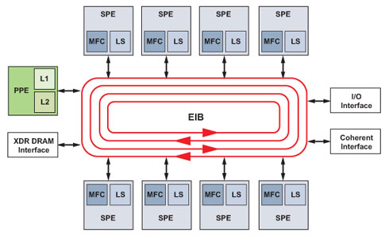
Ring
Simple but
  Low bandwidth
  Variable latency
Cell Processor - PS3 (2006)

Slide 17
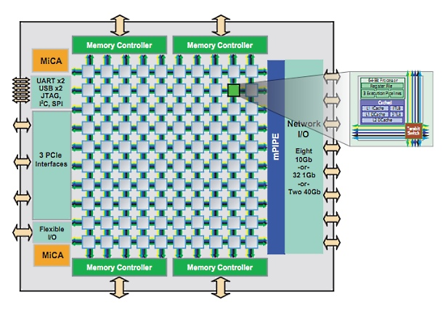
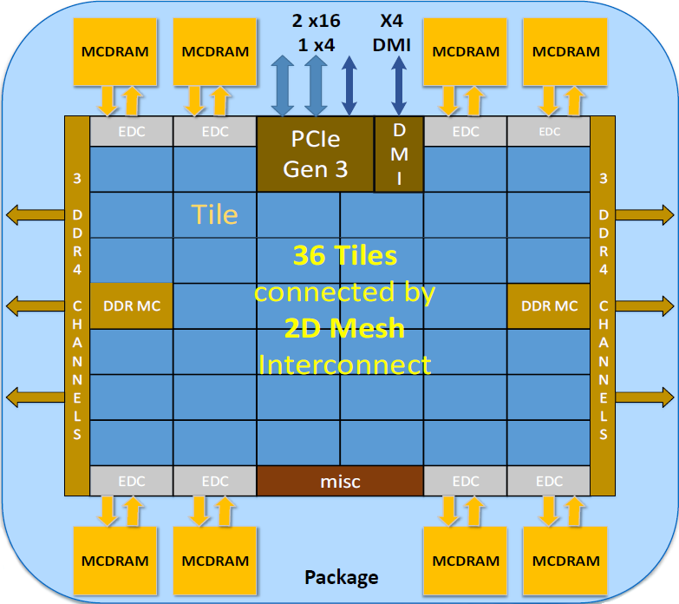
Mesh / Grid
Tilera TILE64 Processor (2007)
Xeon Phi Knights Landing Processor (2016)
Reasonable bandwidth
Variable Latency
Convenient for very large systems physical layout

Slide 18
Routing

Slide 19
Length of Routes
Minimal routing
  Selects always the shortest path to a destination
    Packets always move closer to their destination
  Packets are more likely to be blocked
Non-minimal routing
  Packets can be diverted
    To avoid blocking, keeping the traffic moving
    To run away from congested areas
  Risk of livelock

Slide 20
Oblivious routing
Unaware of network state
  Deterministic routing
    Fixed path, e.g. XY routing
  Non-deterministic routing
    More complex strategies
Pros
  Simpler router
  Deadlock-free oblivious routing
Con
  Prone to contention

Slide 21
Adaptive Routing
Aware of network state
  Packets adapt to avoid contention
Pros
  Higher performance
Cons
  Router instrumentation is required
    More complex i.e. more area and power
  Deadlock prone
    Even more hardware
Barely used in NoCs

Slide 22
Switching

Slide 23
Packet switching
Data is split into small packets and these into flits
Some extra info is added to the packets to identify the data and to perform routing
Allows time-multiplexing of network resources
  Typically better performance, specially for short messages
Several packet switching strategies
  Store and forward, cut-through, wormhole
Packet
Head
Data

Slide 24
Store and Forward Switching
A packet is not forwarded until all its phits arrive to each intermediate node
Pros
  On-the-fly failure detection
Cons
  Low performance
    Latency: distance × #phits
  Large buffering required
Long, bursty transmissions
  E.g. Internet

Slide 25
Cut-through / Wormhole Switching
A packet can be forwarded as soon as the head arrives to an intermediate node
Pros
  Better performance
    Latency: distance + #phits
Cons
  Fault detection only possible at the destination
    Less hardware

Slide 26
Beyond Multicore

Slide 27
Typical Multi-core Structure
core
L1 Inst L1 Data
core
L1 Inst L1 Data
Main Memory
(DRAM)
L2 Cache
L2 Cache
Memory Controller
L3 Shared Cache
On Chip
QPI or HT
PCIe
Input/Output Hub
PCIe
Graphics Card
Input/Output Controller
…
Motherboard
I/O Buses (PCIe, USB, Ethernet, SATA HD)

Slide 28
Multiprocessor
Shared memory
Input/Output Hub
Memory
(DRAM)
Memory
(DRAM)
Multi-core Chip
Multi-core Chip
Memory
(DRAM)
Memory
(DRAM)
Multi-core Chip
Multi-core Chip
QPI or HT
Input/Output Hub
Motherboard

Slide 29
Multicomputer
Distributed memory
...
Interconnection Network

Slide 30
Amdahl’s Law
Estimates a parallel system maximum performance based on the available parallelism of an application
  It was intended to discourage parallel architectures
  But was later reformulated to show that S is normally constant while P depends on the size of the input data
    If you want more parallelism, just increase your dataset
Speed up = | S + P
 | S + (P/N)
S = Fraction of the code which is serial
P = Fraction of the code which can be parallel
S + P = 1
N = Number of processor

Slide 31
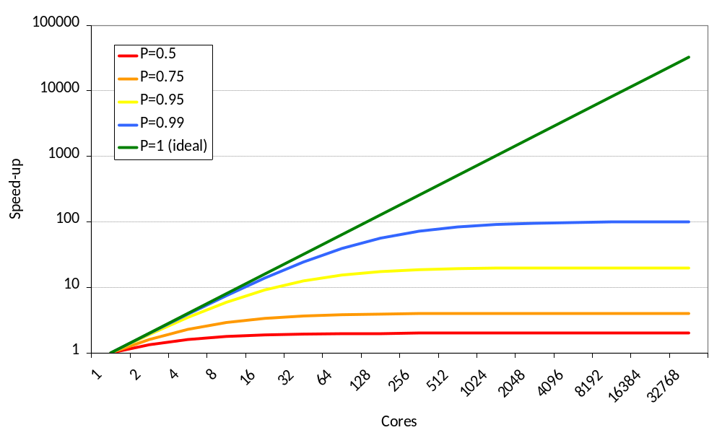
Amdahl’s Law

Slide 32
Amdahl’s Law
Estimates a parallel system maximum performance based on the available parallelism of an application
  It was intended to discourage parallel architectures
  But was later reformulated to show that S is normally constant while P depends on the size of the input data
    If you want more parallelism, just increase your dataset
Speed up = | S + P
 | S + (P/N)
S = Fraction of the code which is serial
P = Fraction of the code which can be parallel
S + P = 1
N = Number of processor

Slide 33
Clusters, Datacentres and Supercomputers

Slide 34
Clusters, Supercomputers and Datacentres
All terms overloaded and misused
  Have lots of CPU’s on lots of Mother boards
  The distinction is becoming increasingly blurred
High Performance Computing
  Run one large task as quickly as possible
  Supercomputers and (to an extent) clusters
High Throughput Computing
  Run as many tasks per unit of time as possible
  Clusters/Farms (compute) and Datacentres (data)
Big Data Analytics
  Analyse and extract patterns from large, complex data sets
  Datacentres

Slide 35
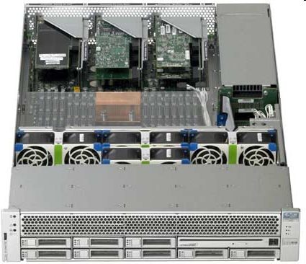
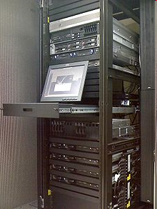
Building a Cluster,
Supercomputer or Datacentre
Large numbers of self contained computers in a small form factor
Optimised for cooling and power efficiency
Racks house 1000s of cores
High redundancy for fault tolerance
They normally also contain separate units for networking and power distribution

Slide 36
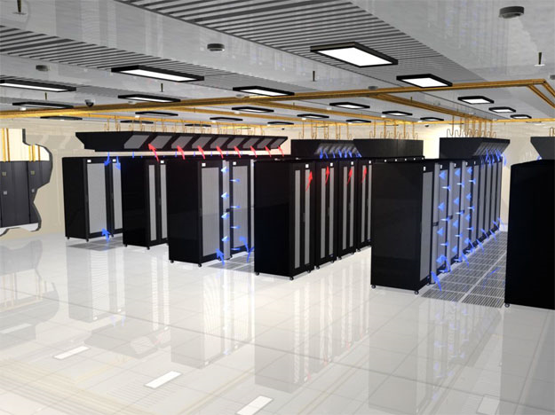
Building a Cluster,
Supercomputer or Datacentre
Join lots of compute racks
  Add a network
  Add power distribution
  Add cooling
  Add dedicated storage
Some frontend node(s)
  Small user functions (compile, read results, etc) do not affect compute nodes performance

Slide 37
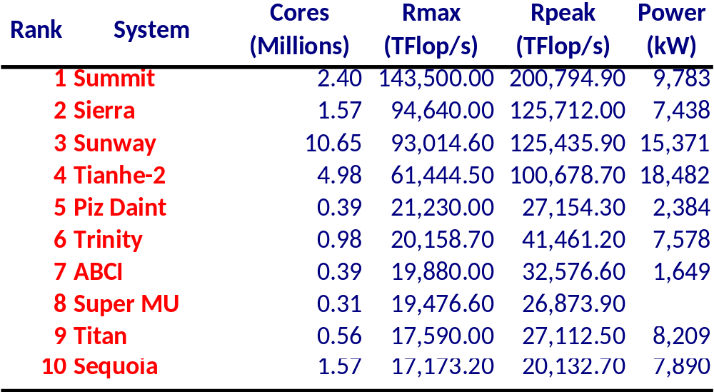
Top 500 List of Supercomputers
A list with the most powerful supercomputers in the world, updated twice a year (Jun/Nov) (www.top500.org)
Theoretical peak performance (Rpeak) vs maximum perf. running a computation intensive application (Rmax)
Let’s peek at the latest Top 10 (Nov’18)

Slide 38
Questions?

