Slide 1

Comprehensive Analysis of Billionaires Wealth
Group 1: team members
Darpankumar jiyani 017536623
Kush bindal 017441359
Dhruv patel 017507100
Shobhita agrawal 017552795

Slide 2
INTRODUCTION
In today’s world, the wealth gap continues to be a topic of significant concern and interest.
Understanding the dynamics of wealth accumulation, distribution, and the characteristics of those who possess extreme wealth can offer valuable insights into economic structures, social mobility, and policy implications.
The ‘Billionaires Statistics Dataset’ provides a comprehensive collection of data regarding individuals who have reached the pinnacle of financial success.
This dataset, sourced from Kaggle, comprises a wealth of information about billionaires spanning various industries, regions, and demographic characteristics. With over 2000 number of entries, it offers a rich resource for exploratory analysis, hypothesis testing, and predictive modeling.

Slide 3
MOTIVATION
Unlocking the secrets behind billionaire wealth distribution inspires us to understand the engines of economic growth and innovation.
Exploring the future scope of billionaire wealth distribution fuels our curiosity and empowers us to shape a more equitable and sustainable world.
As we delve into the nuances of billionaire distribution across industries, we are driven by the profound belief that understanding these patterns can unlock pathways to greater equality and opportunity.

Slide 4
OBJECTIVE
Show how billionaires money is spread across different business types and countries.
Look at billionaires ages, genders, and where they were born to see if there are any patterns.
Separate the billionaires who made their own money from those who inherited it from family.
See how a country’s economy factors like GDP, prices, taxes, and education levels might impact billionaire wealth.
Map out where in the world billionaires and their riches are located, and why they cluster in certain areas.

Slide 5
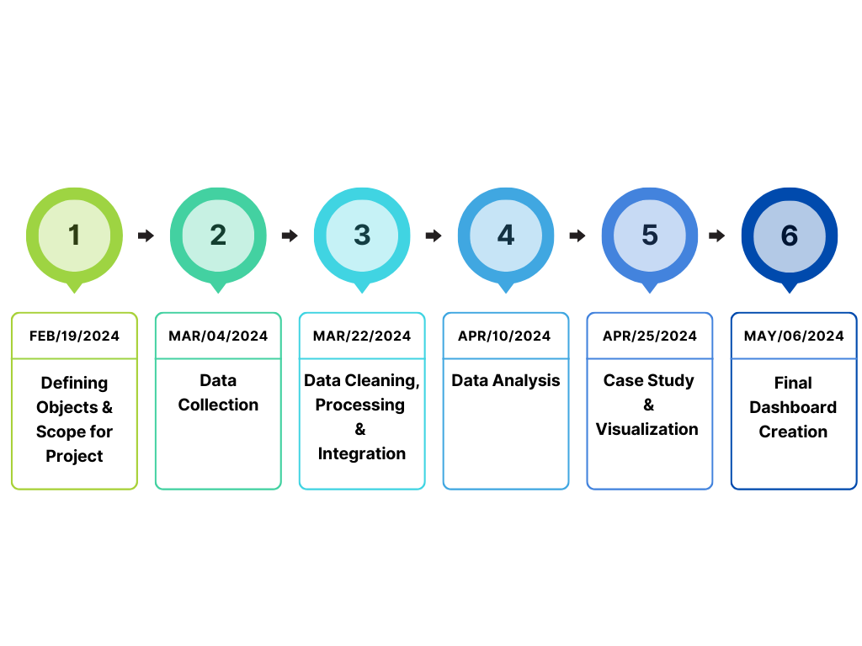
PROCESS FLOW

Slide 6
BILLIONAIRES STATISTICS DATASET – 2023
This dataset contains statistics on the world’s billionaires, including information about their businesses, industries, and personal details. It provides insights into the wealth distribution, business sectors, and demographics of billionaires worldwide.
Dataset has include:
Individual Information: Age, Country, City, Gender, First and Last name, Rank of the billionaires.
Company Information: The dataset contains details about the company they founded or are associated with. This also includes industry, company name, and possibly financial metrics related to the company.
Wealth Metrics: Information on their Net worth, the source of their wealth (e.g., Inherited, self-made)
Geographical Data: Details about where the billionaires reside or where their primary business interests are located. This could also include information about the countries or regions where they operate.

Slide 7
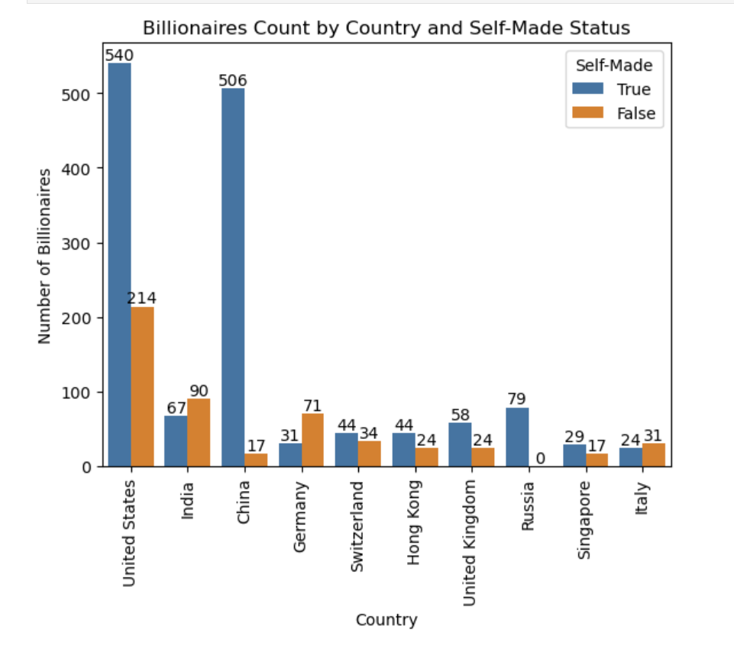
In the United States, the number of self-made billionaires surpasses 500, with 214 billionaires who did not achieve their wealth independently.
China follows closely with a total of 506 self-made billionaires. Notably, all 79 billionaires in Russia are self-made.
Additionally, among the top 10 countries Italy, Germany, and India stand out with a lower count of self-made billionaires compared to those who attained their wealth through means other than self-initiation.

Slide 8
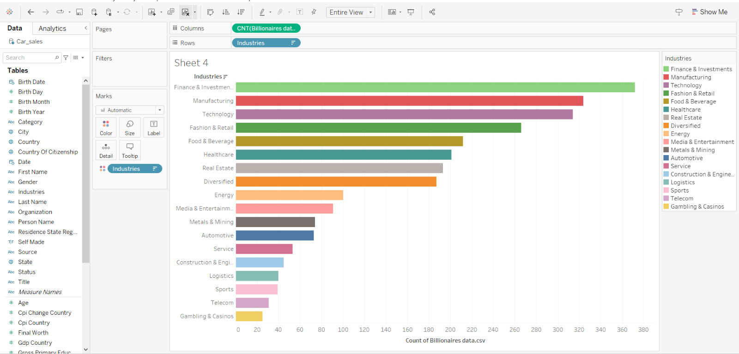
The graph represents the distribution of billionaires across different industries. Each bar on the graph corresponds to a specific industry, and the height of the bar indicates the number of billionaires associated with that industry.

Slide 9
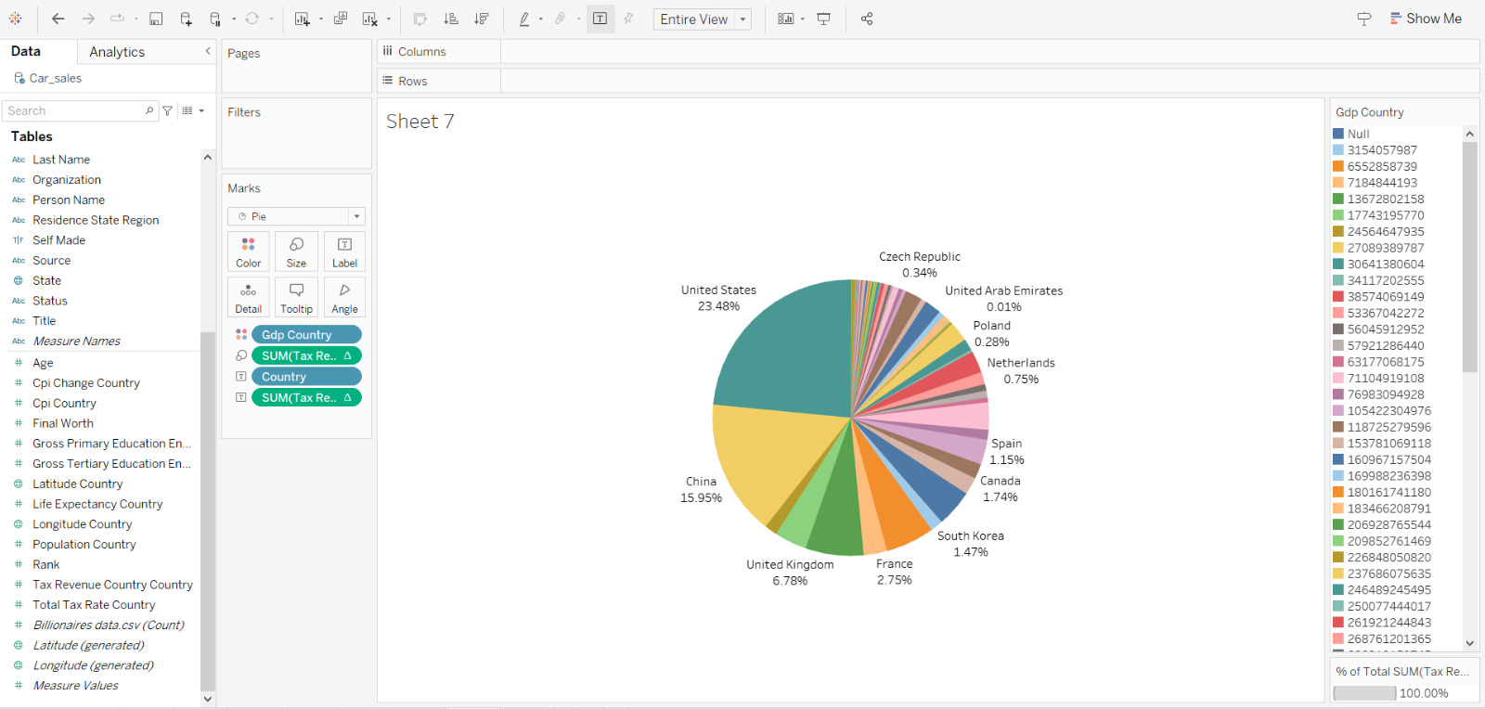
The given pie chart illustrating the percentage of tax revenue contributed by billionaires to each country's GDP.
Each slice of the pie represents a country, and the size of the slice corresponds to the percentage of tax revenue contributed by billionaires to that country's GDP.

Slide 10
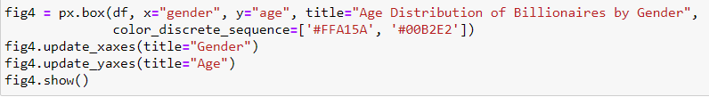
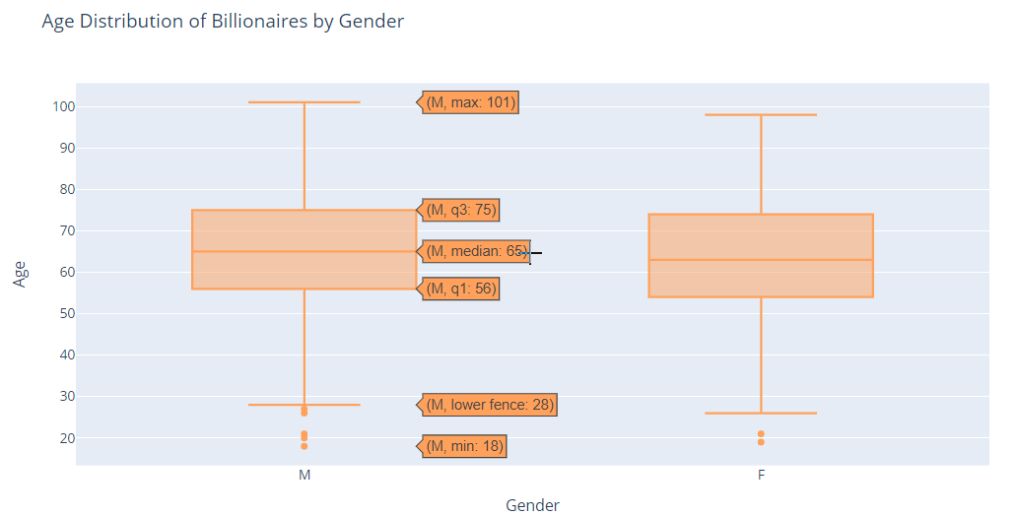
The resulting box plot visualizes the distribution
of ages among billionaires, categorized by
gender. Each box represents the interquartile
range (IQR) of ages for a specific gender category.
The horizontal line within each box represents
the median age. The whiskers extend to the
minimum and maximum ages within 1.5 times the
IQR from the first and third quartiles, respectively.
The horizontal line within each box represents the
median age. The whiskers extend to the minimum
and maximum ages within 1.5 times the IQR from
the first and third quartiles, respectively.

Slide 11
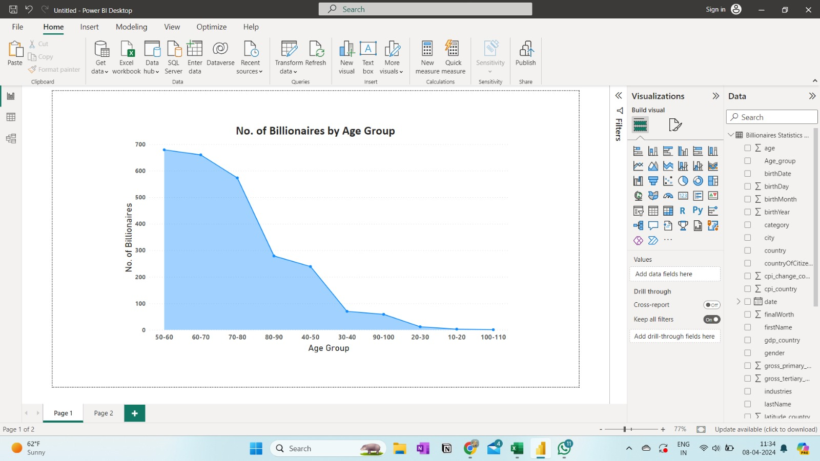
This is a graph of age distribution of billionaires. This graph is in descending order representing what age group has the maximum billionaires.
This graph gives us an insight that shows the current real situation of 2023, that what age group has maximum billionaires.
from the given graph we can see that most of the billionaires in our data are between age 50-60.
⁠from the data we can see that there are also some young billionaires that being’s to age group of 10-20 and that are too old that belongs to age group of 100-110 years old.

Slide 12
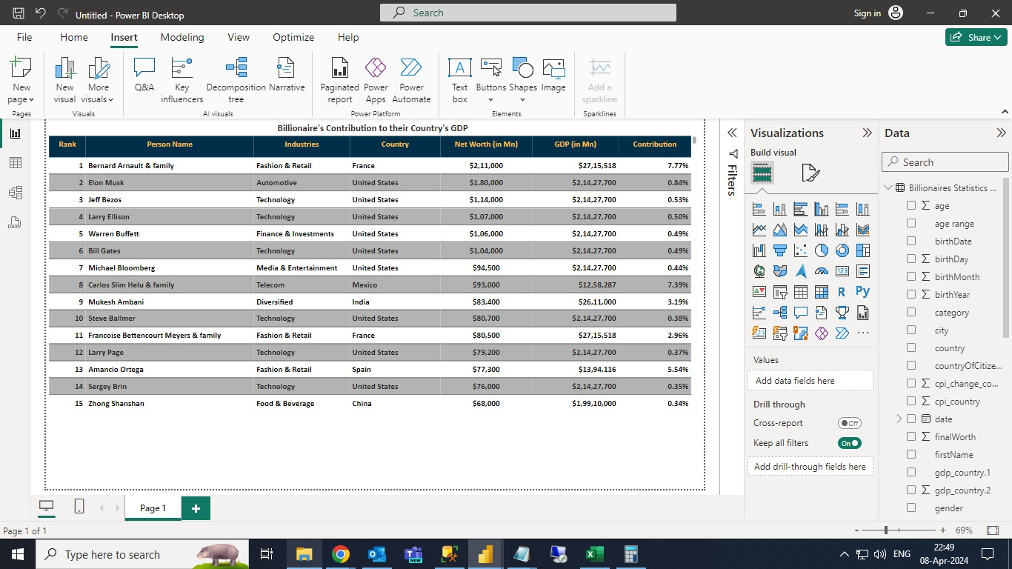
This is a matrix graph that is made in power BI that show the correlation between billionaires networth and their countries GDP.
In this graph we can get the insight of the percentage contribution if that billionaire in their countries GDP.
Here all the given values are in millions.
From the given matrix graph we can see that Bernard Arnault and family who have close to 300 Billion dollars networth are contributing 7.7% to their country Italy’s growth. Also we can see that Elon Musk percentage contribution is small although having high networth is because the GDP if USA is large compared to that of other countries.

Slide 13
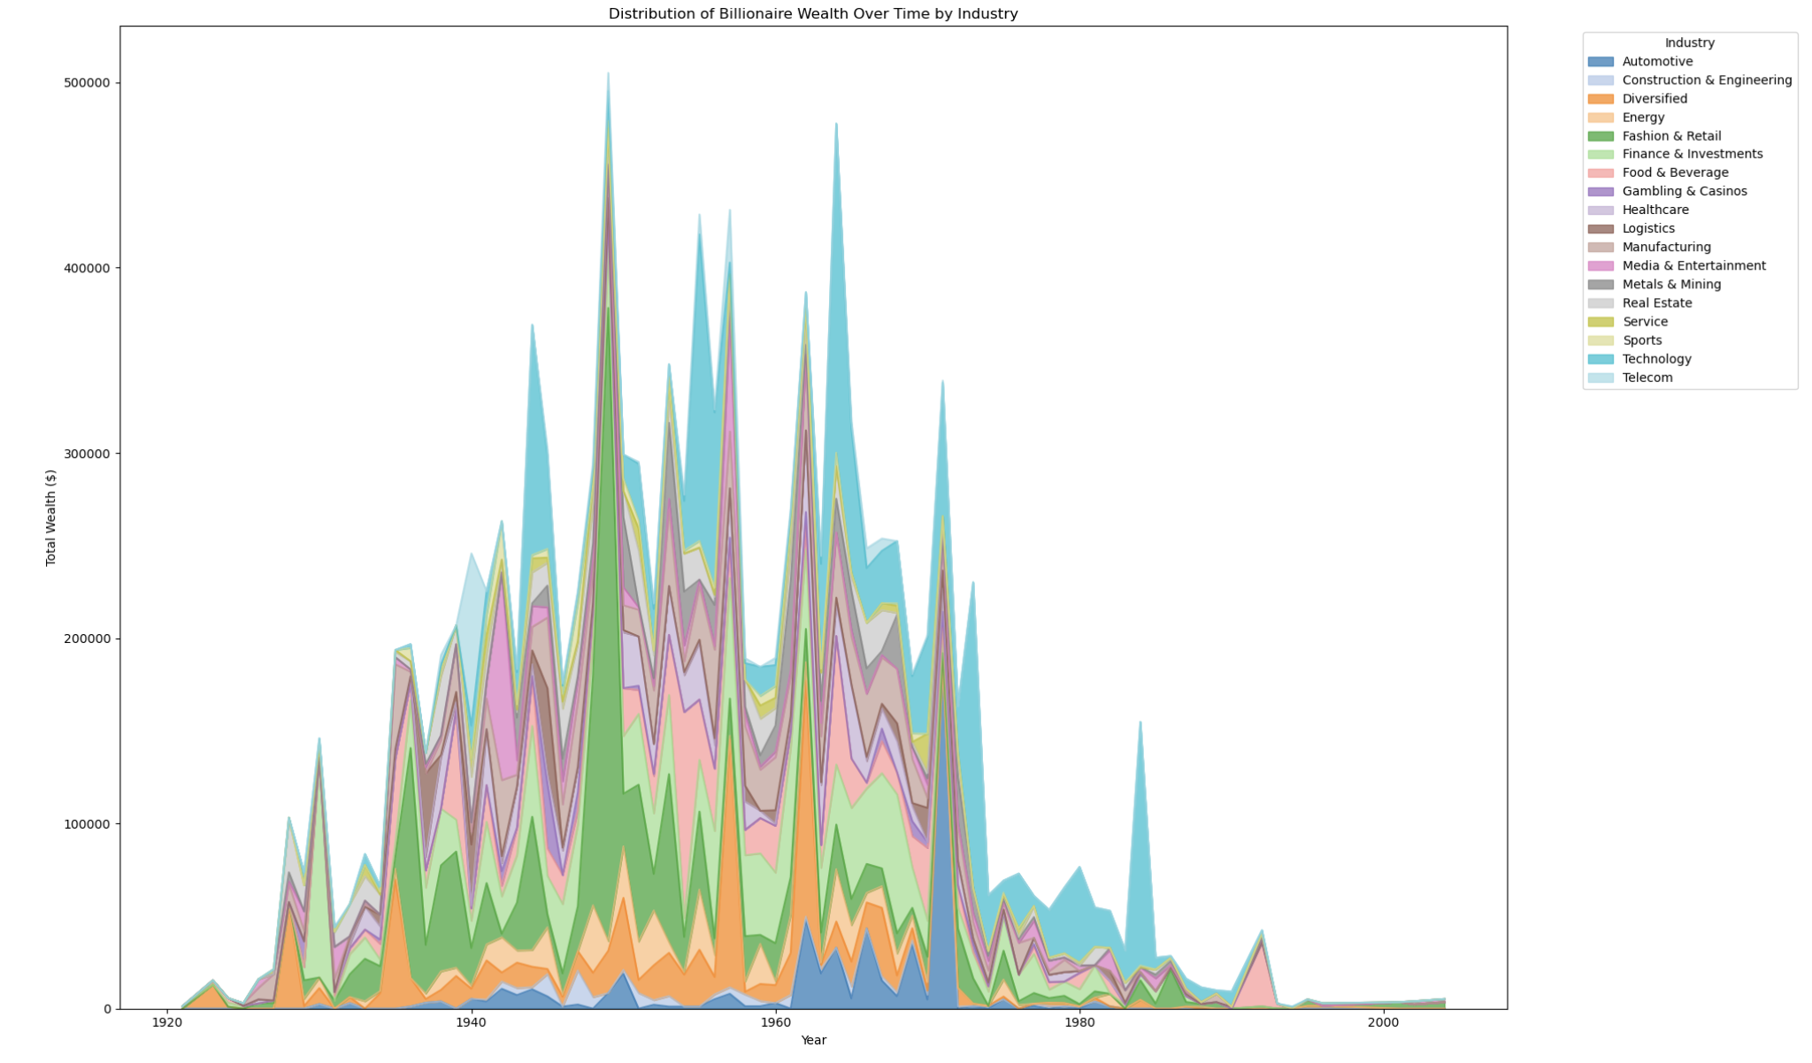
Sectoral Comparison: Quickly compare the contribution of various industries or countries to the total billionaire wealth over time.
Dominant Sectors or Countries: Identify industries or countries with highest wealth concentration by observing the areas with the tallest stacks in chart.
Sectoral Trends: Track changes in the distribution of billionaire wealth across industries or countries over time, highlighting shifts or transitions in wealth distribution patterns.
Relative Wealth Distribution: Understand the relative importance of different sectors or countries in terms of their contribution to the overall billionaire wealth landscape.

Slide 14
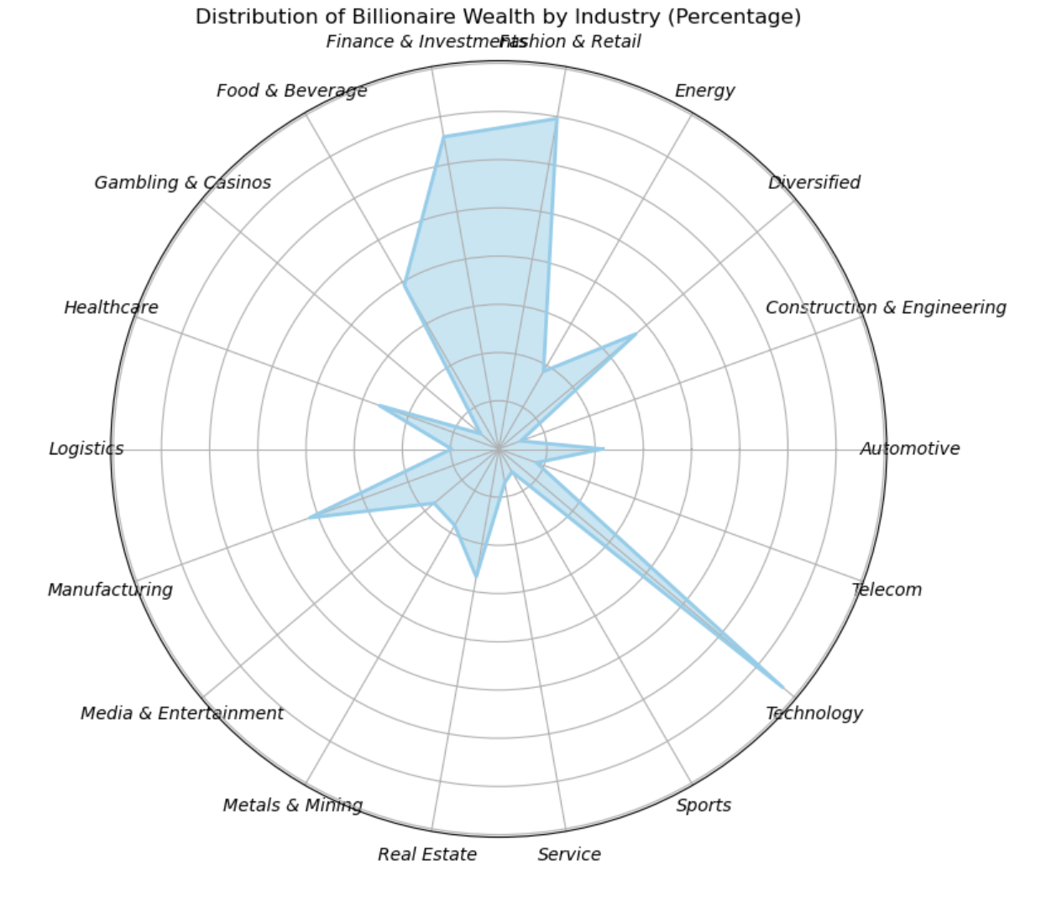
Comparison: Quickly compare the percentage of wealth held by different industries.
Dominant Sectors: Identify industries with the highest wealth concentration.
Relative Importance: Understand the significance of each industry in the billionaire wealth landscape.
Trends: Track changes in wealth distribution across industries over time.

Slide 15
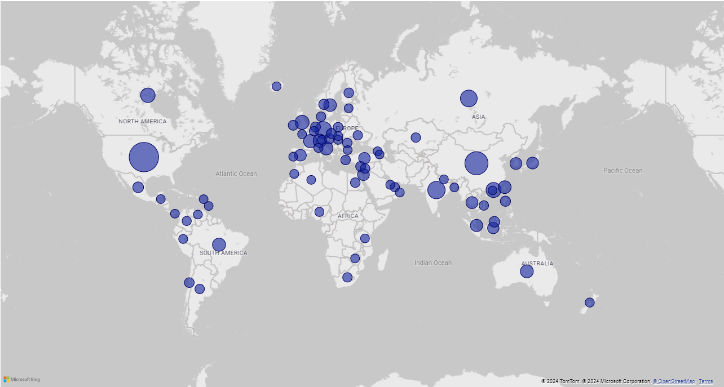
VISUALIZATION ON WORLD MAP:
Here the world map is being used in Power BI for visualization.
World map is being used with the bubbles.
Different size of bubble represents quantity of billionaires.
From the visualization we can see that USA and China has the max number of billionaires.
The at second place Russia and India has almost equal number of billionaires.

Slide 16
DASHBOARD CREATION USING POWER BI
Here we took the advantage of the Power BI to transform the raw and complex data, and transformed it into an insightful visualizations.
With the help of power query that is built in the Power BI we transformed the data as per requirement (i.e., added new columns, changing data types).
Here we created the dashboard the shows the insights about the overview of countries billionaires and their contribution.
With the help of simplicity and flexibility of the Power BI’s software tool one can easy and seamlessly understand and intricate the raw data.

Slide 17
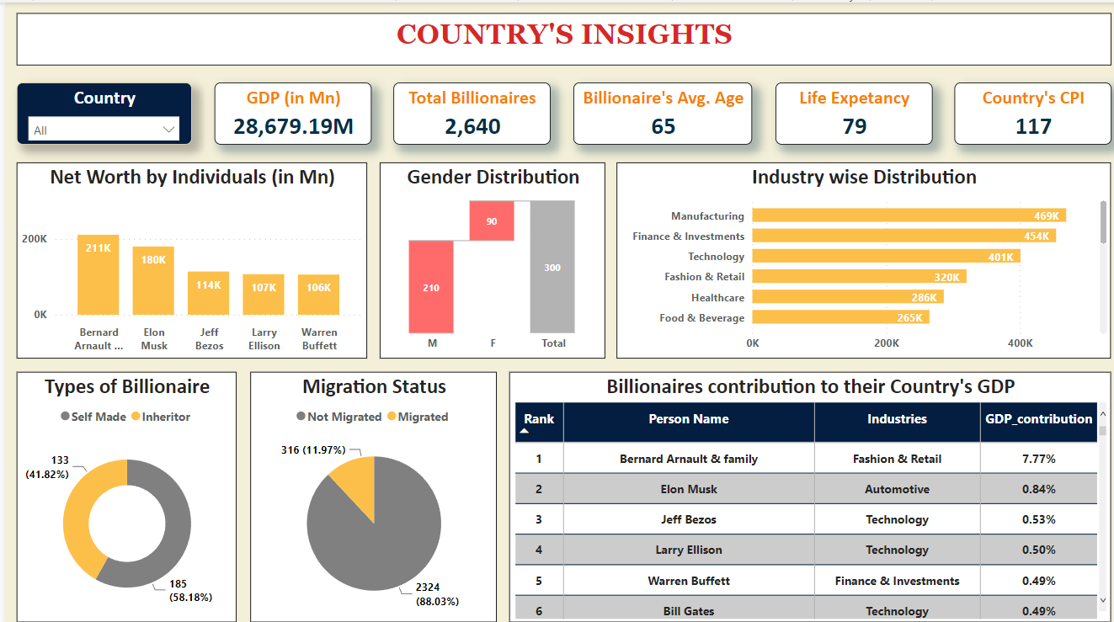

Slide 18
DASHBOARD DISCRIPTION
In total there are close to 10 visualization insights in the dashboard.
Our dashboard uses the multiple types of graphs and feature like card in Power BI for visualization.
Different types of graphs like bar chart (horizontal and vertical), pie chart, donut chart, matrix and card are being in our dashboard.
There is also slicer or also called filter being used in our dashboard for easy filtering the specific countries.
Our visualization also uses important concepts of our course like aesthetics for better visualization.
For making this dashboard many transformation to the data were made like adding new column, changing data type etc.

Slide 19
CONCLUSION
Wealth Distribution: Analysis revealed major sectors driving billionaire wealth.
Demographics: Demographic trends of age, gender, and geography were identified.
Self-Made vs. Inherited: Proportions of self-made vs. inherited billionaires were compared.
Economic Correlations: Correlations with GDP, CPI, and tax rates were explored.
Geospatial Distribution: Global distribution of billionaire wealth was visualized.

Slide 20

THANK YOU
ANY QUESTION?

