Slide 1
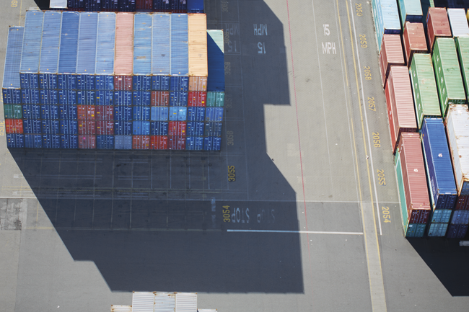
Kubernetes for Developers
An Introduction with Azure Container Service
Jason Poon Senior Software Developer Microsoft
Notes:
Poll: how many use containers? containers in production?
use kubernetes? kubernetes in production?
my experience with docker + kubernetes

Slide 2
You will leave here knowing…
How Kubernetes solves the hard problems of a containerized infrastructure
Key components of a Kubernetes cluster
How to deploy and interact with a Kubernetes cluster
Common application patterns

Slide 3
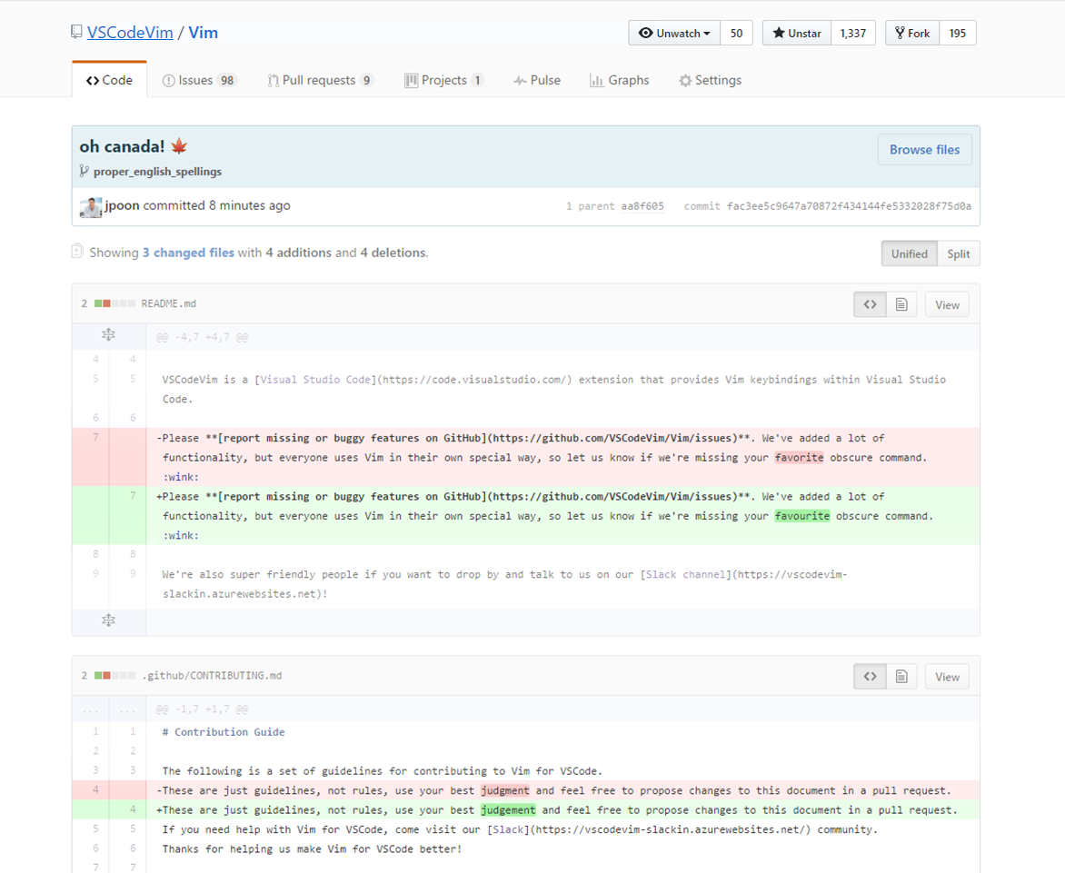

Slide 4
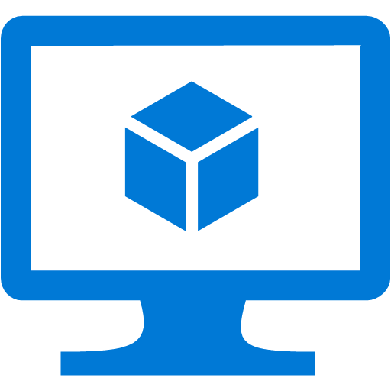
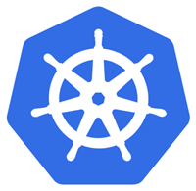
Challenges of a Containerized World
instance 1
Compute Node
Security
Scheduling
Availability
Service Discovery
Monitoring
Load Balancing
instance 2
Compute Node
API Server
Kubernetes Cluster
…
instance n
Compute Node
Notes:
One Node - You're done. Don't need the rest of this talk
Two Node - Shell scripts, configuration management (puppet, chef, salt stack)
Security - Securely control access to machines and running containers
Scheduling – Deciding where your application should run
Availability – Keep application running despite failures
Service Discovery – containers need to discover and talk to each other
Monitoring – debug what the containers are doing and how to debug when things go wrong
Load Balancing – distribute traffic across your application
Abstracts multiple nodes as a single machine.
what you’re interacting with is the API and not the docker containers or the nodes
Similar to multi-core processors, nobody pins application to run on a particular core. Run this application somewhere, don't care where.

Slide 5
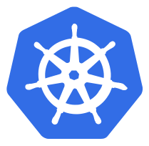
Kubernetes (aka “k8s”)
/koo-ber-nay'-tace/
Inspired by Borg at Google
Open-sourced system for deployment, scaling, management, and composition of containers across a cluster of hosts
Runs on private and public clouds, RPi
Used in commercial/open source projects:
Tectonic (CoreOS)
OpenShift (RedHat)
Deis Workflow (Microsoft?)
Notes:
more than just a “container orchestrator”. It aims to eliminate the burden of orchestrating physical/virtual compute, network, and storage infrastructure, and enable application operators and developers to focus entirely on container-centric primitives for self-service operation.
Portable. Kubernetes runs everywhere -- public cloud, private cloud, bare metal, laptop
General-purpose. Kubernetes should run all major categories of workloads to enable you to run all of your workloads on a single infrastructure, stateless and stateful, microservices and monoliths, services and batch, greenfield and legacy.

Slide 6
2013
2014
2015
2016
2017
February 2017
Kubernetes GA on Azure Container Service
March 2013 Docker initial release
July 2015
Kubernetes v1.0
Donated to CNCF
June 2014
Kubernetes first commit in GitHub
November 2016
Azure Container Service Engine open sourced
July 2016
Brendan Burns joins Microsoft

Slide 7
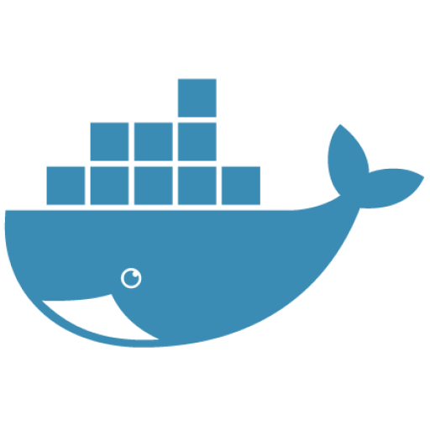
Concepts
Node
Machine that acts as a Kubernetes worker
Pod
One or more containers deployed on a node
node
pod
Notes:
Pod = smallest compute unit that can be defined, deployed, managed.
support helper applications that assist a primary application
ambassador/sidecar/proxy container patterns
Example: apache web server, log pusher to Splunk
Each pod has it’s own IP. I'll repeat that, each pod has it's own IP address.

Slide 8
Pod
Pod 1
Pod 2
nodes
Notes:
Kubernetes monitors and reports the status of the Pod and reports Pod Lifecycle:
Pending: accepted by system but image not yet created
Running: pod is bound to a node, containers are running
Succeeded: containers in pod have terminated in success, will not be restarted
Failed: containers in pod have terminated with at least one returning non-zero exit code
Unknown: state of pod could not be obtained

Slide 9
Concepts
Node
Machine that acts as a Kubernetes worker
Pod
One or more containers deployed on a node
Controller
Define state of your pods
node
pod
Notes:
Controller = number of different controllers that define and regulate the state of your pods
Daemonset, statefulset, deployment, replicaset
Num replicas, CPU/memory limits, volumes,

Slide 10
Controller – Replica Set
Pod 1
Pod 2
replicas: 3
replicas: 3
nodes
Notes:
ReplicaSet: ensures that a specified number of pod “replicas” are running at any given time

Slide 11
Controller – Deployment (Scale Out)
Pod 1
Pod 2
replicas: 5
replicas:5
nodes
Notes:
Deployment higher-level concept that manages ReplicaSets and provides declarative updates to pods.
Deployment strategies: rolling update, recreate (all existing pods are kills)
Generally don’t need to use ReplicaSets
Update deployment with new replica count.

Slide 12
Controller – Node Failure
Pod 1
Pod 2
replicas: 5
replicas:5
💀
nodes
Notes:
Kubernetes Pods are mortal. They are born and when they die, they are not resurrected.
Controllers create and destroy pods dynamically to correspond with the desired state

Slide 13
Concepts
Node
Machine that acts as a Kubernetes worker
Pod
One or more containers deployed on a node
Controller
Define state of your pods
Service
Abstraction that defines set of pods and policy to access them
node
pod
service
Notes:
Each Pod gets an IP, but how do other dependent services keep track of the Pod's IP? => Service

Slide 14
Service
Load Balancer
Pod 1
Pod 2
replicas: 3
replicas: 3
Service 1
selector: pod 1
type:
ClusterIP (default)
NodePort
LoadBalancer
nodes
Notes:
ClusterIP – service only reachable from within the cluster
NodePort – exposes service on each Node’s IP at a static port. ClusterIP automatically created. Accessible outside cluster <NodeIP>:<NodePort>
LoadBalancer – cloud provider load balancer

Slide 15
What makes a cluster?
proxy
apiserver
kubelet
API
scheduler
proxy
CLI
etcd
kubelet
controller-manager
UI
proxy
proxy
kubelet
kubelet
master
nodes
Notes:
Kube-apiserver – API for inside/outside cluster
Kube-scheduler – monitors API for unscheduled pods, finds a machine to run it on
Etcd – distributed key-value store. used for leader election between the master nodes to ensure only one controller-manager/scheduler is active
Kube-controller-manager – reconciling required actions based on the controllers
Kube-proxy – directing traffic destined for specific services and pods to the correct location. Communicates with API server to keep up to date.
Kubelet – communicates with API server and is responsible for starting/stopping Pod and other machine-level tasks

Slide 16
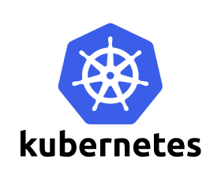
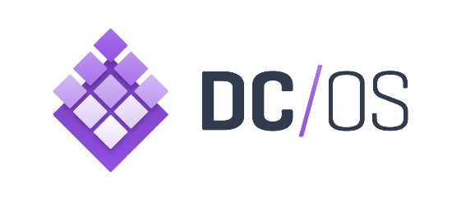
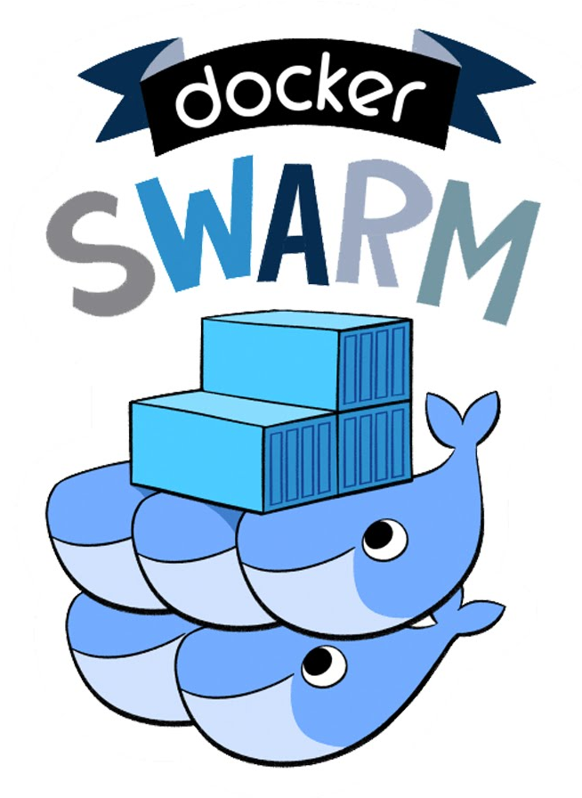
Azure Container Service
Container hosting environment optimized for Azure
Support for the 3 major container orchestration engines
Only pay for the compute and associated storage/networking
Notes:
Native azure networking
integration with ACR
dynamic provisioning of storage volumes and load balancers
Simplifies development and deployment
Poll room, ensure everybody understands before moving to demos

Slide 17
Demo

Slide 18



Resources
Voting App https://github.com/jpoon/voting-app-kubernetes
Kubernetes Project www.github.com/kubernetes
ACS Engine https://github.com/Azure/acs-engine
Getting Started with Kubernetes/ACS https://docs.microsoft.com/azure/container-service/container-service-kubernetes-walkthrough
Kubernetes Design and Architecture https://github.com/kubernetes/community/blob/master/contributors/design-proposals/architecture.md
Jason Poon github.com/jpoon
@jasonthepoon
jason.poon@microsoft.com

