Slide 1
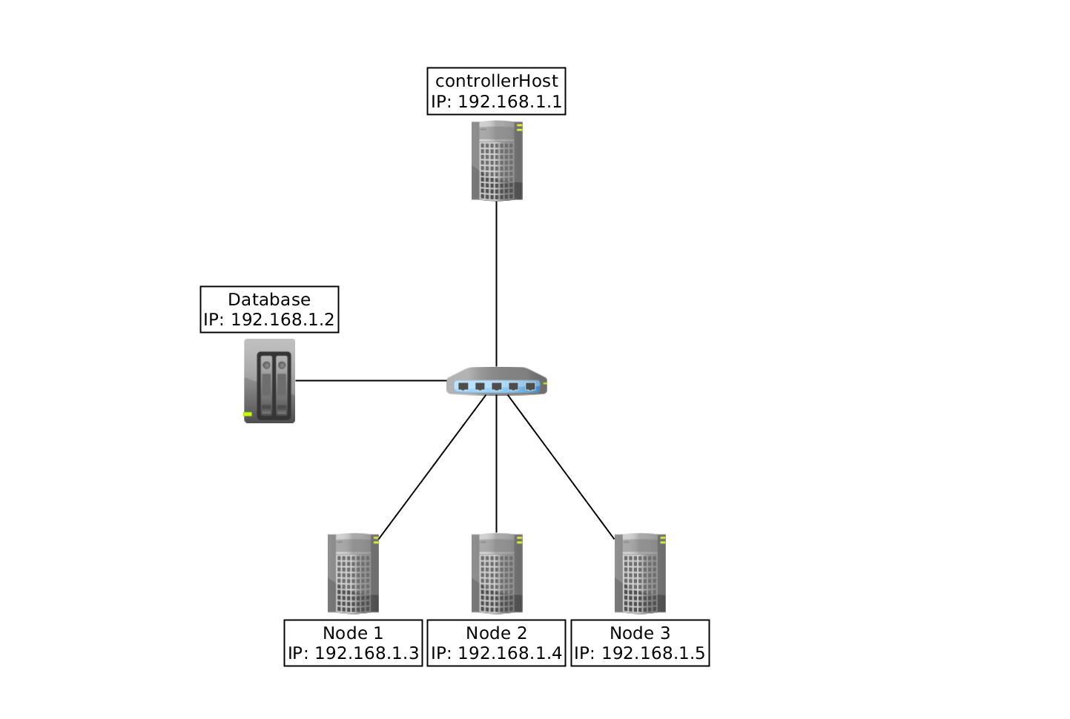
Team Greenfield
GREENFIELD TOPOLOGY
Original Configuration
Greenfield comprises 360 cores and 18TB of memory in three nodes: two HP DL580s and an HP SuperDome X. Each DL580 contains 4 15-core processors and 3TB of memory. The SuperDome X has 16 15-core processors (for a total of 240 cores) and 12TB of memory.
Achievements/Challenges
Setting up NFS/Torque/Env-Mod
Correctly configuring modulefiles
Failed to implement Passwordless-ssh and openMPI

