Slide 1
Darren Brock
Hangman Game

Slide 2
Hangman Game
So the objectives of the game was to:
Make user stories
Make a dummy dictionary

Slide 3
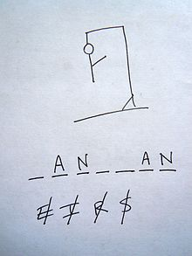
This is an example of what the game should expected to be.

Slide 4
Description of my Riddle man
I know the games idea is to guess a character but my is more of like guessing a word and changed the game because I knew that most of my classmates would have a similar program as me
So my game works more as a riddle.

Slide 5
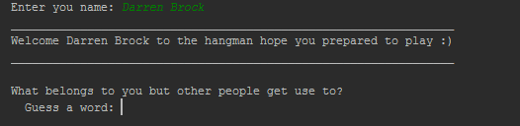
My run code:

