Slide 1
Darren Brock
TRANSLATOR

Slide 2
Translator
So the main objectives was for the program to:
To all the your program to translate 100 common words
To create a dictionary to store the values

Slide 3
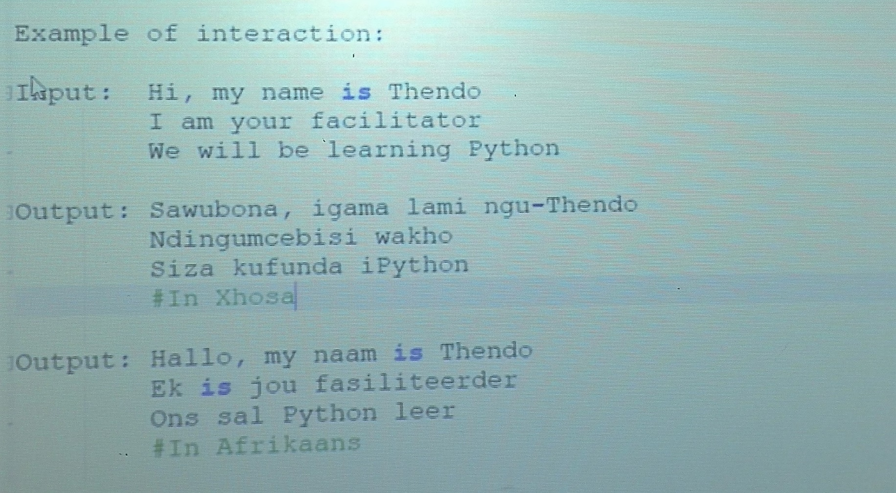
Below is an example of what it should look like:

Slide 4
Description of my code:
The idea or main thing is to make sure you have internet connection to be able to install and import the “googletrans” function to be able to pickup/detect any language you prefer.
So after the googletrans is successfully installed the code will be implemented.

Slide 5
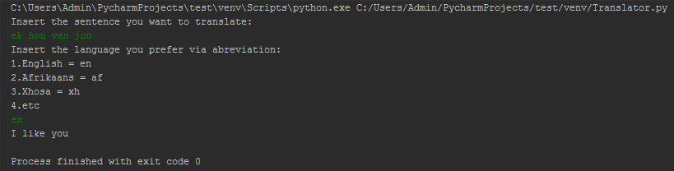
My code when I run it

