Slide 1

Resistor Recognizer
Using computer vision to recognize the value of resistors in real-time.
Team04
b04502031 施力維
b05502048 鄭婷予
b06901188 李宗倫
b07502022 梁皓瑋
日期：2020.01.10

Slide 2
1
Objectives
Overview
2
Method
3
Program
4
Current Result
5
Future Works

Slide 3
1
Objectives
Identifying resistors is no longer a time-wasting task

Slide 4

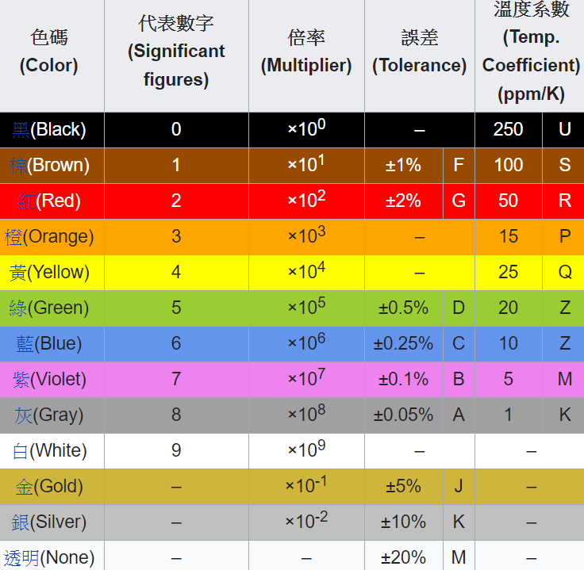
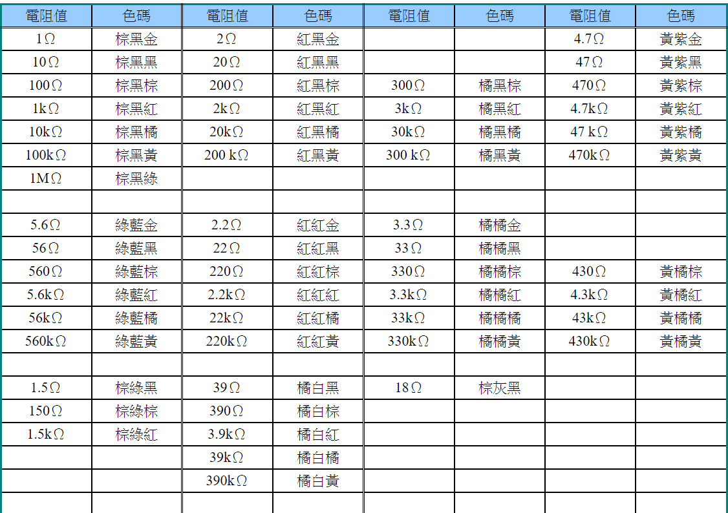
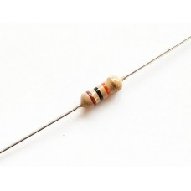
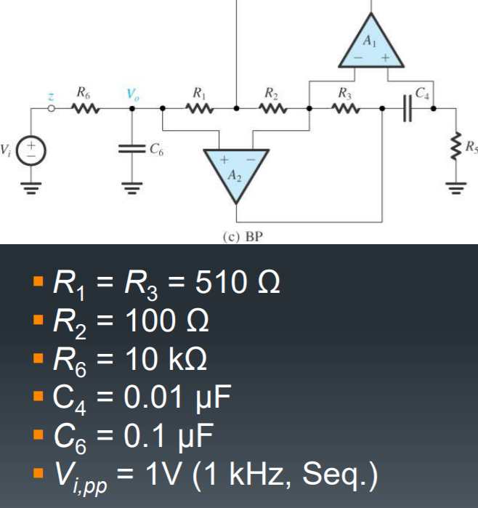
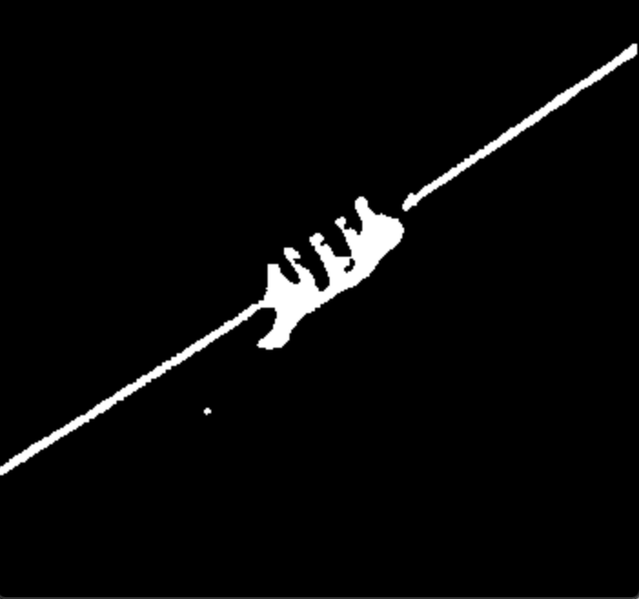
Objectives
Input
Loading
Optimization
Processing
Ouput

Slide 5
Target Audience
1
For those having difficulty identifying the colors on resistors
2
For those having the need to use lots of resistors in their projects
3
Serving as a wonderful tool for circuit debugging

Slide 6
2
Method
Using computer vision
to accurately identify the value of resistors.

Slide 7


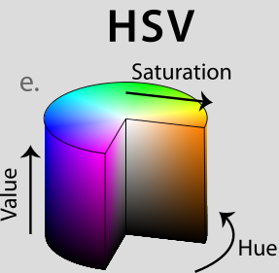
Tools
OpenCV
OpenCV is a library of programming functions mainly aimed at real-time computer vision
HSV
HSV are alternative representations of the RGB color model to more closely align with the way human vision perceives color-making attributes

Slide 8
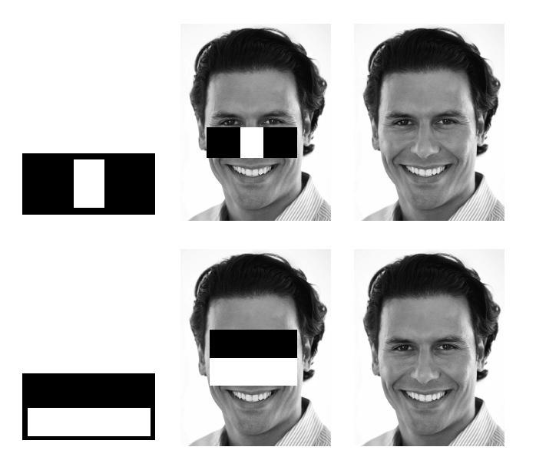
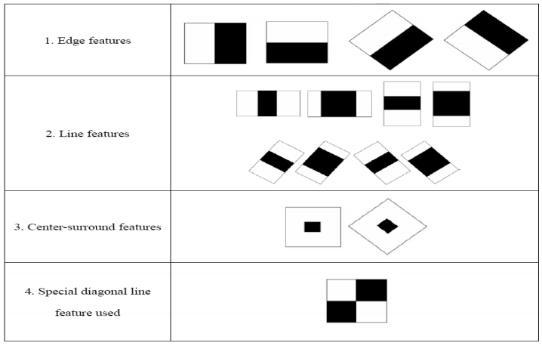
Finding the Resistors
(Using Haar Cascade Classifier)
Notes:
所謂的Haar指的是哈爾特徵（Haar-like features）
HAAR透過各種不同的mask在待檢測的圖片來回的滑動，這個窗口每移動到一個位置就會計算出該區域的特徵值。各個不同的mask即為不同的弱分類器，所有弱分類器產生結果再透過Cascade Classifier（AdaBoost級聯分類器）經過AdaBoost步驟最後組合成強大的分類器。
這些弱分類器使用的masks目的就是為了把圖像特徵量化，例如用以區分人臉當中的眼睛顏色要比兩頰的深（即像素強度較弱近於0）。計算方式是矩形中黑色區塊pixel值總和與白色區塊pixel值總和做相減，所獲取的值即為此分類器在該區域的特徵值。每個窗口的特徵值 = 白色矩形的灰度值總和 – 黑色矩形的灰度值總和

Slide 9
How to find the Resistors
Positive Samples
Negative Samples
Train the Cascade
Using Cascade Classifier to find the resistors

Slide 10
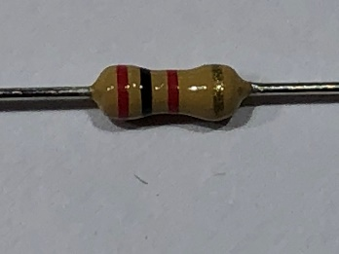


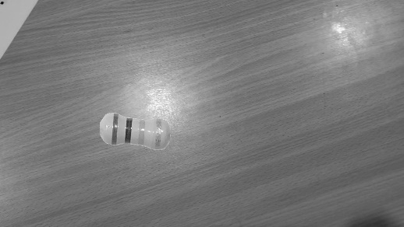
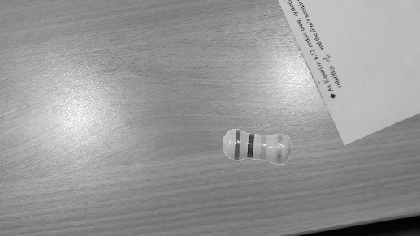

How to find the Resistors
Positive Samples
Negative Samples
Train the Cascade
Using Cascade Classifier to find the resistors
Notes:
數十張原圖

Slide 11
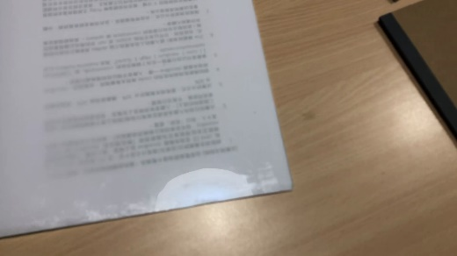
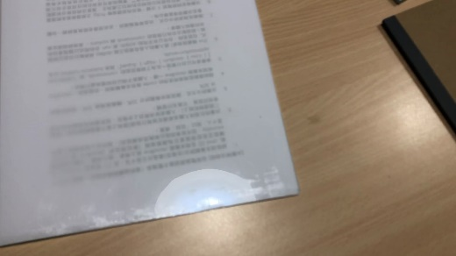


How to find the Resistors
Positive Samples
Negative Samples
Train the Cascade
Using Cascade Classifier to find the resistors
1000+ negative samples are used

Slide 12
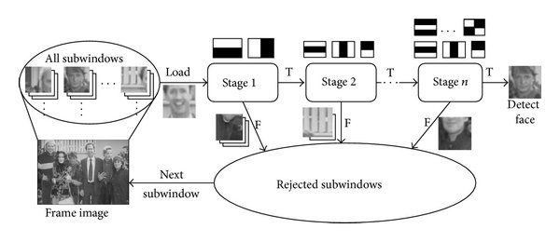
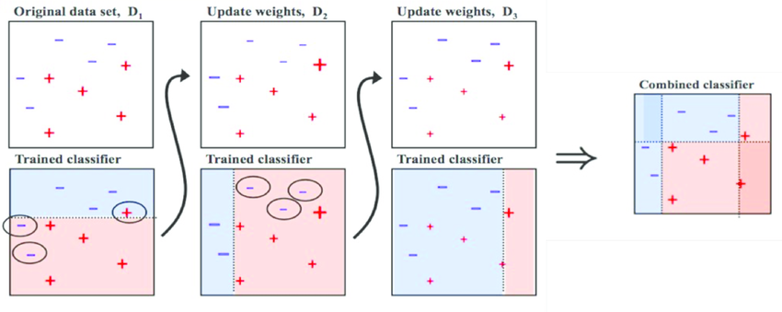
How to find the Resistors
Positive Samples
Negative Samples
Train the Cascade
Using Cascade Classifier to find the resistors
Cascade Classifier –– AdaBoost
Notes:
Adaboost 的物理意义可以表述为：当已经提取的分类器对于某些样本分类正确，那么减小这些样本的权重。当分类错误，增加这些样本的权重。这样，后面训练提取的简单分类器就会更加强化对这些分类错误样本的训练。
D1、D2、D3分別代表三個弱分類器，第一行為原始資料，第二行為分類的結果。
A）首先，D1分類的結果，有一個「正」和二個「負」分類錯誤
B）接著， D2分類器針對D1分類錯誤的部份加強其權重，針對D1的錯誤作出正確的分類。但結果，仍有三個「負」分類錯誤。
D3分類器再將那三個錯誤的負權重提高，結果仍有錯誤
C）最終，雖然每個弱分類皆分類錯誤，但是綜合所有的結果，就能得到正確的分類

Slide 13
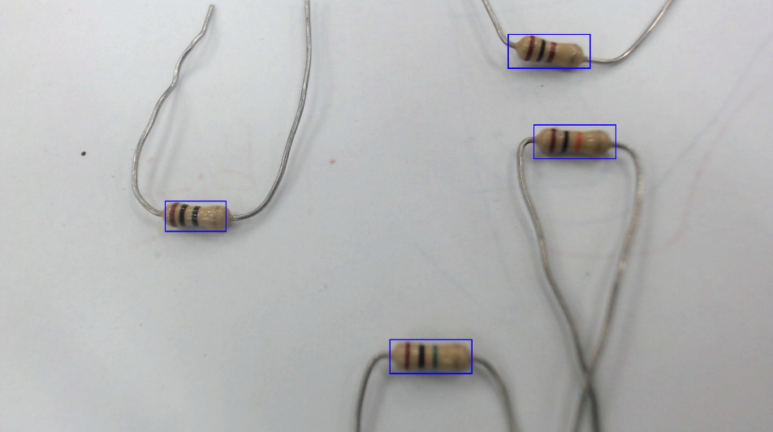
How to find the Resistors
Positive Samples
Negative Samples
Train the Cascade
Using Cascade Classifier to find the resistors
Notes:
Adaboost 的物理意义可以表述为：当已经提取的分类器对于某些样本分类正确，那么减小这些样本的权重。当分类错误，增加这些样本的权重。这样，后面训练提取的简单分类器就会更加强化对这些分类错误样本的训练。
D1、D2、D3分別代表三個弱分類器，第一行為原始資料，第二行為分類的結果。
A）首先，D1分類的結果，有一個「正」和二個「負」分類錯誤
B）接著， D2分類器針對D1分類錯誤的部份加強其權重，針對D1的錯誤作出正確的分類。但結果，仍有三個「負」分類錯誤。
D3分類器再將那三個錯誤的負權重提高，結果仍有錯誤
C）最終，雖然每個弱分類皆分類錯誤，但是綜合所有的結果，就能得到正確的分類

Slide 14
How to identify the value
Image Blurring
Adaptive Threshold
Detecting Colors

Slide 15
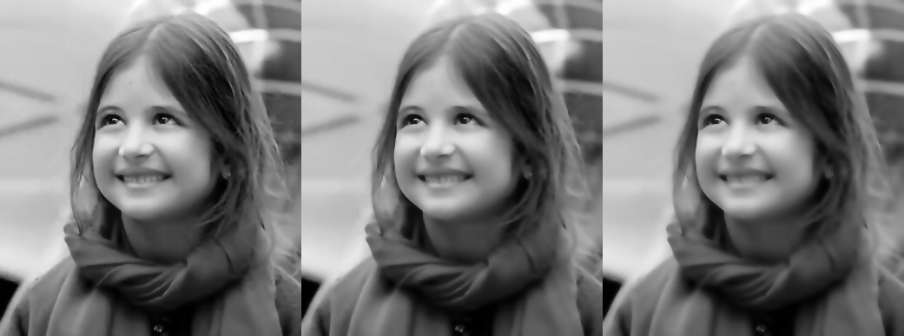
How to idenify the value
Image Blurring
Adaptive Threshold
Detecting Colors

Slide 16
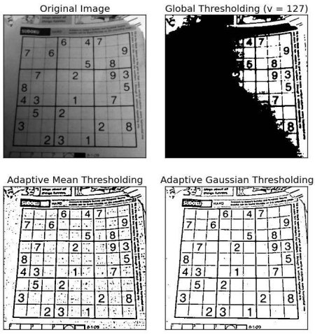
How to idenify the value
Image Blurring
Adaptive Threshold
Detecting Colors

Slide 17
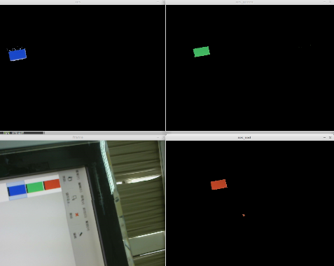
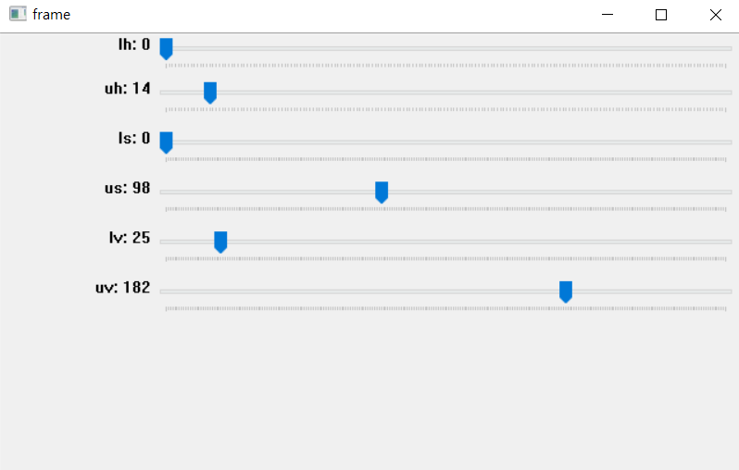
How to idenify the value
Image Blurring
cvtColor()
inRange()
Adaptive Threshold
Detecting Colors

Slide 18

How to idenify the value
Image Blurring
findContours()
Adaptive Threshold
Detecting Colors

Slide 19



Read color
1kΩ
Original image
Thresholding specific color
Find contour
Read color

Slide 20
3
Program
Our code structure

Slide 21
Structure
cv2
numpy
import
top
main.py
class object
resFinder
resReader
class function
read_model()
find()
read_band()
read_value()

Slide 22
Structure
main.py
Capture video
resFinder.read_model()
Load the Haar cascade classifier model
resFinder.find()
Return location of resistor
resReader.read_band()
Find the color of bands with HSV thresholding
resReader.read_value()
Read resistors value according to its color

Slide 23
4
Current Result
Demo

Slide 24
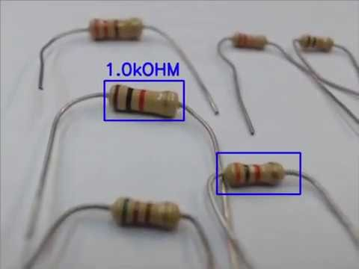
Resistor Recognizer
https://www.youtube.com/watch?v=fuuUqIBVSGw&feature=youtu.be

Slide 25
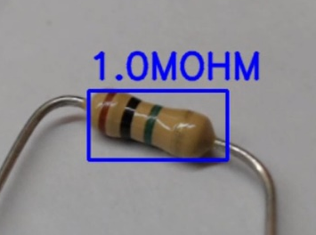
Conclusion––What have we achieved?
A Resistor Recognizer that can…
1
Identify the value of resistors using computer vision.
Resistor rotation angle can up to 20 degrees
84% correctness in our environment
2
Identify multiple resistors at the same time.
3
Identify the value of resistors under different light/background conditions.

Slide 26
5
Future Work
Future applications and further development

Slide 27

Future Work
Other electronic
components
Improve it with mask CNN
Make it a smartphone application

Slide 28
6
Work Division

Slide 29
Work division
施力維：寫程式(找電阻位置)、製作投影片
鄭婷予：寫程式(讀電阻色碼)、製作投影片
李宗倫：寫程式(找電阻位置)、製作投影片
梁皓瑋：寫程式(讀電阻色碼)、製作投影片

Slide 30
References
https://chtseng.wordpress.com/2018/06/15/opencv-cascade-object-detection/
https://blog.csdn.net/anson2004110/article/details/12954541
https://memememememememe.me/post/training-haar-cascades/?fbclid=IwAR1PbCFUmHh1RLlc1NQ0zaoAX-4hOVTEwJjoC3IoyLVf7yk0RSf0clPNYfM

Slide 31
Thank you for listening

