Slide 1
CST336 Internet programming
Practice 5: ajax

Slide 2
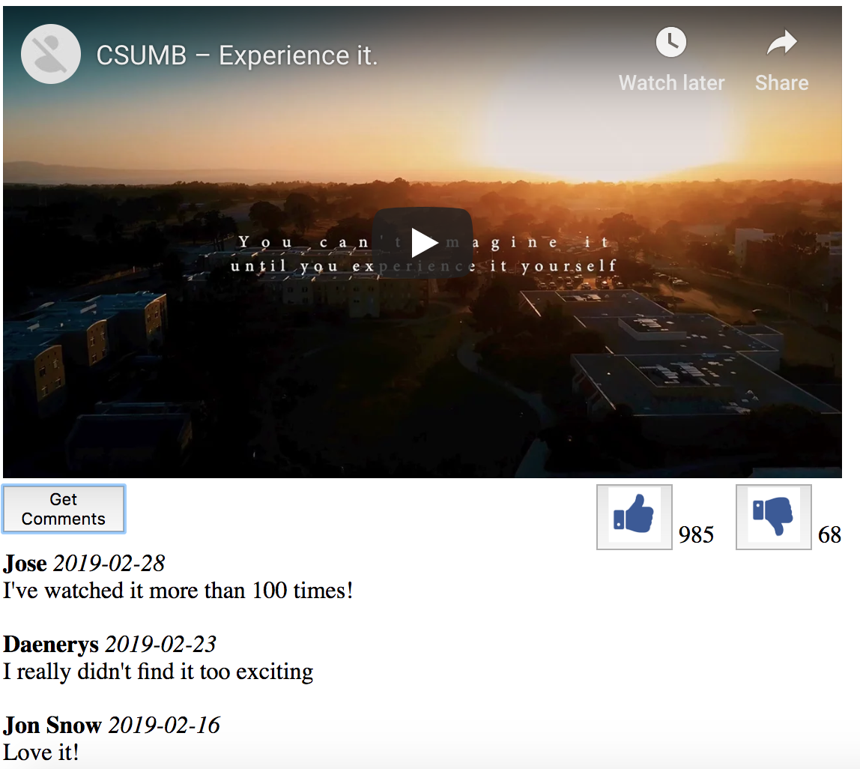
Task: Create a “Like/Dislike” Video App

Slide 3
Directions:
Start working INDIVIDUALLY for 10 minutes.
Individually, do the following:
1) Within the “practice” folder, create a new “p5” folder
2) Upload there the “img” folder and the “index.html” file
3) In the “index.html” embed any YouTube video of your choice.
4) Add the YouTube video Id within the AJAX call
5) Display the Dislike button 6) Display the number of dislikes (from the API) 7) Become familiar with the API (see last slide)

Slide 4
Directions:
Work in pairs for 50 minutes.
In pairs, do the following:
You MUST use ONLY ONE computer
The teammate to the right must start coding for 7 minutes. The other teammate must observe and help.
After every 7 minutes, you MUST switch
BOTH of you must be engaged in the activity
Those who complete the activity in 50 minutes will get extra points in a homework assignment.
A few completers will be selected to show your work via Zoom.

Slide 5
Rubric:
Three Points:
1) When clicking on any “Like” button: Number of likes is updated (using the AJAX call) The clicked button is hidden and the “disabled/enabled” button is displayed
2) When clicking on the “disabled” buttons (grayed out) the last “like” or “dislike” action is reset
3) Layout is similar to the screenshot in slide 2 (“Comments” button to the left, “like” buttons to the right)
Two Bonus Points!
4) When clicking on “Get Comments”, the comments from the API are displayed in the same format as in slide 2.

Slide 6
Web API Documentation:
End Points:
https://cst336.herokuapp.com/projects/api/videoLikesAPI.php?videoId=xyz
Returns an initial random number of likes and dislikes for the video Id Note: It’s not using the values from the actual YouTube video
https://cst336.herokuapp.com/projects/api/videoLikesAPI.php?videoId=xyz&action=like Increases the number of likes and returns the updated value Other values for action are: dislike: Increases the number of dislikes and returns the updated value cancel_like: Decreases the number of likes and returns the updated value cancel_dislike: Decreases the number of dislikes and returns the updated value comments: Return random comments

