Slide 1

CST336 Internet programming
Practice 1: HTML / CSS

Slide 2
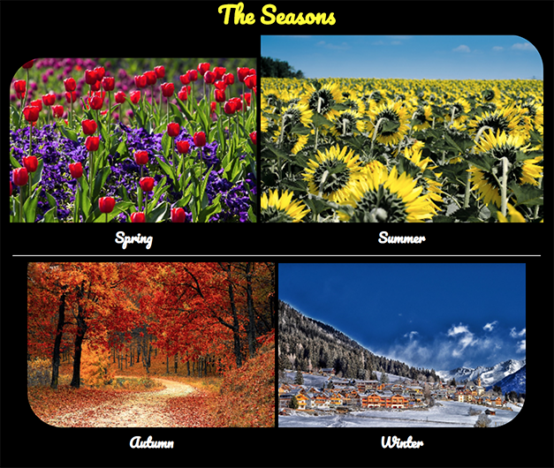
Task: Create a “Seasons” webpage

Slide 3
Directions:
You’ll start working INDIVIDUALLY for 10 minutes.
Individually, do the following:
1) In your C9 workspace, create a folder called “practice” (within your github folder)
2) Within the “practice” folder, create a new folder called “p1”
3) Upload the “seasons/img” folder from your local computer to the “p1” folder (there are only 3 images, google the missing one)
4) Within the “p1” folder, create a new HTML file called “index.html”
5) Start creating the “seasons” webpage! Do as much as you can!

Slide 4
Directions:
Work in pairs for 50 minutes.
In pairs, do the following:
You MUST use ONLY ONE computer
The teammate to the right must start coding for 7 minutes. The other teammate must observe and help.
After every 7 minutes, you MUST switch (the coder becomes the observer and the other way around)
BOTH of you must be engaged in the activity
Those who complete the activity in 50 minutes will get two extra points in a homework assignment.
A few completers will be selected to show your work via Zoom.

Slide 5
Rubric:
1) Layout is similar to the screenshot in slide 2
2) Header uses Web Font with any color (except black)
3) Images have one rounded corner Hint: use something like: border-top-left-radius: 50px
4) Season names use Web Font, any legible color (except black)
5) Each image is a link to external web site
6) Images are slightly bigger when hovering over them
7) CSS rules must use both id’s and classes

