Slide 1

CST336 Challenge activity
NOTE: For Attendance, you must submit the
Google Form by the end of the session
JAVASCRIPT / JQUERY

Slide 2
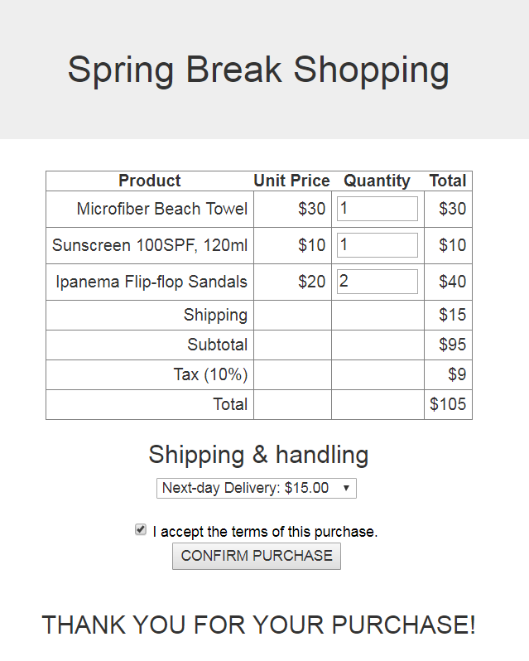
Task: Recalculate Totals in Shopping Cart

Slide 3
Directions:
You’ll start working INDIVIDUALLY for 10 minutes.
Individually, do the following:
1) Within the “practice” folder, create a new folder called “p4”
2) Upload the “index.hml” file from your local computer to the “p4” folder
3) Open the “index.html” and add the missing form elements: The shipping options are: Next-day Delivery: $15.00 Three-day Delivery: $10.00 Regular (5-8 days): $ 5.00
4) Start implementing the Total calculation. Do as much as you can!

Slide 4
Directions:
Work in pairs for 50 minutes.
In pairs, do the following:
You MUST use ONLY ONE computer
The teammate to the right must start coding for 7 minutes. The other teammate must observe and help.
After every 7 minutes, you MUST switch (the coder becomes the observer and the other way around)
BOTH of you must be engaged in the activity
Those who complete the activity in 50 minutes will get three extra points in a homework assignment.
A few completers will be selected to show your work

Slide 5
Rubric:
You MUST use ONLY ONE computer and SWITCH typing every 7 min. Three Points:
Upon updating any product quantity, the cost values for subtotal, tax, and total must be updated. Hint: Use a “change()” event.
Upon updating the shipping method, the cost values for shipping, subtotal, tax, and total must be updated.
Upon clicking on the “Confirm Purchase” button, an error message is displayed in red if no shipping method is selected (see screenshots in next slide)
Two Bonus Points!
Upon clicking on the “Confirm Purchase” button:
The “I Accept the Terms” message changes to red if the checkbox is not checked. Hint: Use something like: if ( !$("#terms").is(':checked') )
If there are no errors, display “Thank you for your Purchase” below the button.
Add 5 CSS rules or use Bootstrap to make the page look nice

Slide 6
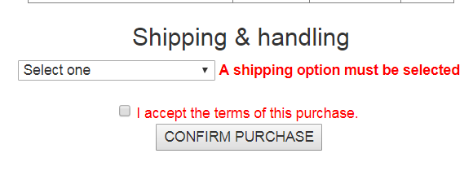
Error Screenshots

