Slide 1
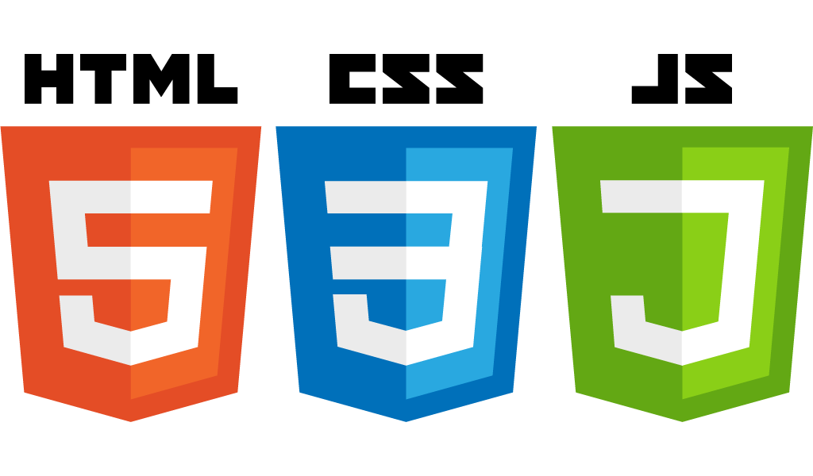
CST336 Internet programming
Practice 3: Javascript

Slide 2
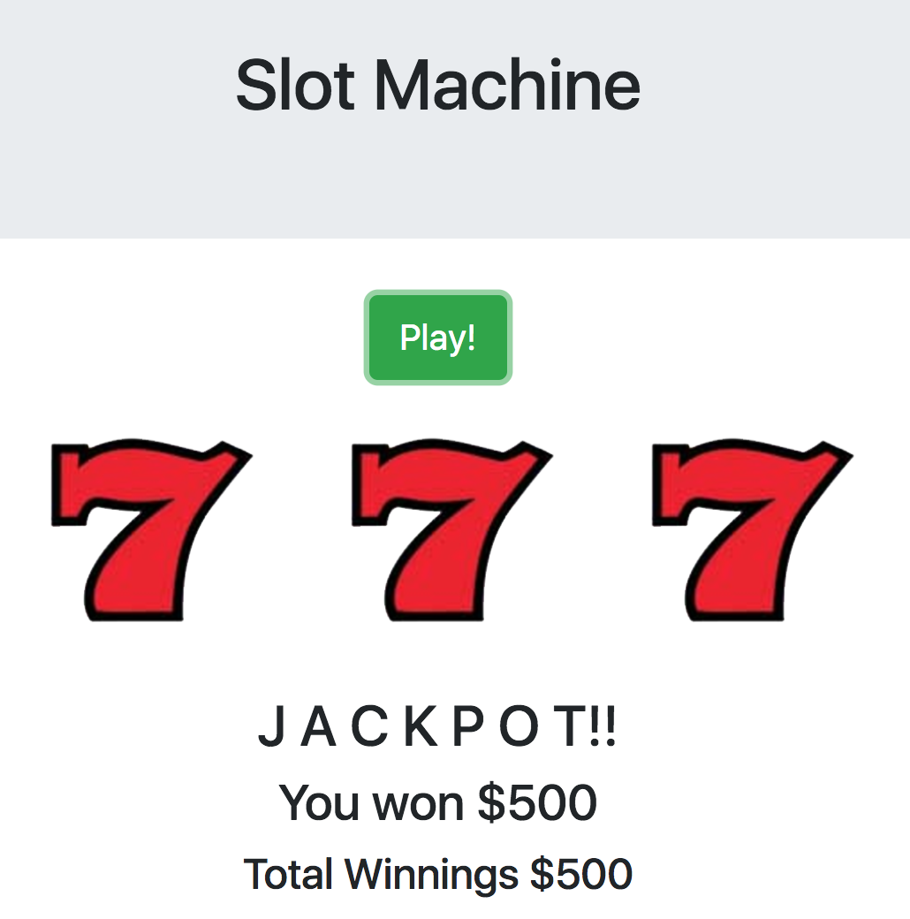
Task: Create a “Slot Machine”

Slide 3
Directions:
Start working INDIVIDUALLY for 10 minutes.
Individually, do the following:
1) Within the “practice” folder, create a new folder called “p3”
2) Upload the “img” and “audio” folders from your local computer to the “p3” folder
3) Within the “p3” folder, create a new HTML file called “index.html”
4) Start creating the “Slot Machine” Do as much as you can!

Slide 4
Directions:
Work in pairs for 50 minutes.
In pairs, do the following:
You MUST use ONLY ONE computer
The teammate to the right must start coding for 7 minutes. The other teammate must observe and help.
After every 7 minutes, you MUST switch (the coder becomes the observer and the other way around)
BOTH of you must be engaged in the activity
Those who complete the activity in 50 minutes will get up to five extra points in a homework assignment.
A few completers will be selected to show your work

Slide 5
Rubric:
Three Points:
1) Layout is similar to the screenshot in slide 2
2) When clicking on the “Play” button, three random images are displayed, next to each other
3) Money is correctly awarded if the three images are the same: Cherries: $100, Grapes: $300, Sevens: $500
4) A “JACKPOT!” message is displayed only for three “sevens”.
5) If the three images are not the same, display “Try Again”
Two Bonus Points!
6) The cumulative Total Winnings is displayed properly, start with $0 (It’s ok if it’s reset back to $0 when refreshing the page)
7) The audio clip plays when getting a Jackpot

