Slide 1
SI 506: Programming I
Winter 2022
Lecture 05
Anthony Whyte <arwhyte@umich.edu>
Lecturer III, School of Information
715 N. University Ave, Ann Arbor, MI 48109
Roumanis Square, 2nd floor (“the loft”)

Slide 2


Whence the name Python?
a snake or . . . ?

Slide 3
And now for a bit of history
Monty Python’s Flying Circus: Spam Sketch (1970)
https://vimeo.com/329001211

Slide 4

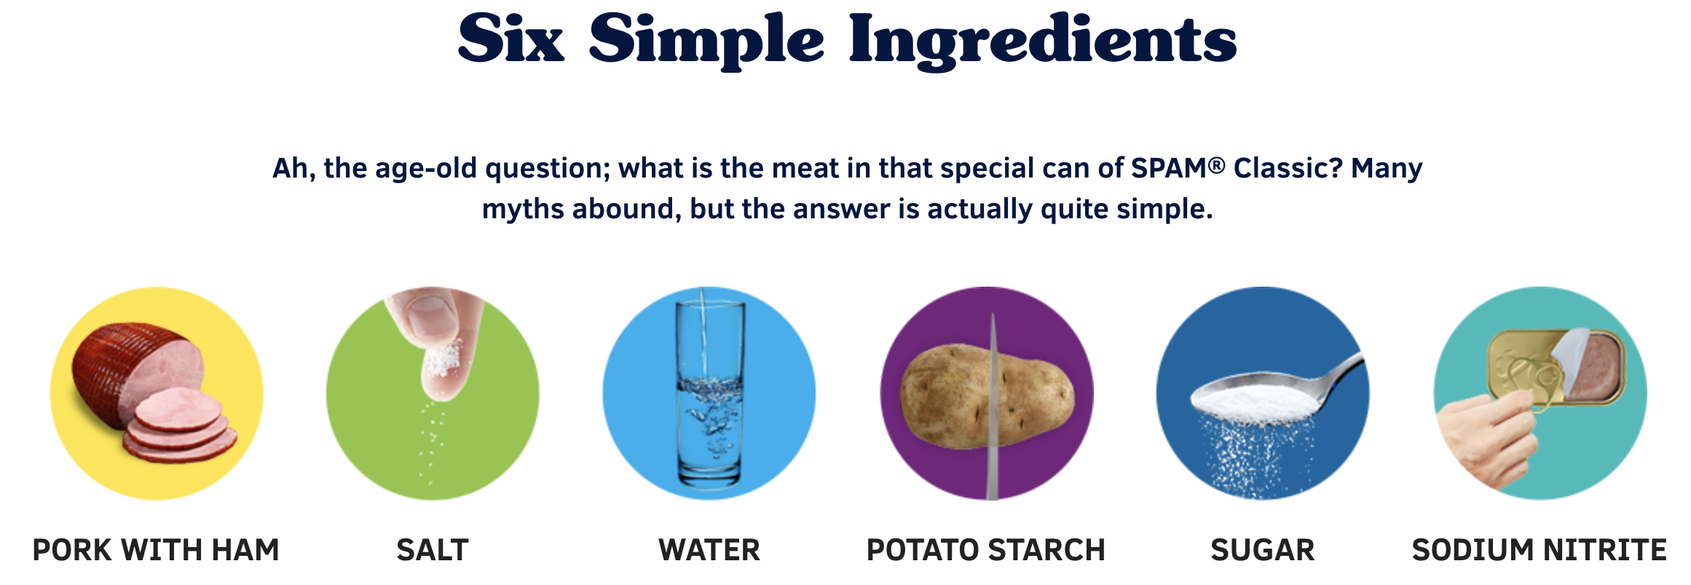
Lecture Theme: Spam
I don’t like Spam

Slide 5
slicing

Slide 6
Sequence: slicing syntax
returns sequence comprising subset of parent list elements
(start at index x)
inclusive
# Slice
new_seq = seq[x:y]
exclusive
(end at index y - 1)

Slide 7
Sequence: slicing syntax
returns sequence comprising subset of parent list elements
(start at index position)
inclusive
# Slice
new_seq = seq[x:]
inclusive
(end at last index position)

Slide 8
Sequence: slicing syntax
returns sequence comprising subset of parent list elements
(start at index 0)
inclusive
# Slice
new_seq = seq[:y]
exclusive
(end at index y - 1)

Slide 9
Sequence: slicing syntax
returns sequence comprising subset of parent list elements
(start at index -x)
inclusive
# Slice
new_seq = seq[-x:]
inclusive
(end at last index position)

Slide 10
Seq: slicing syntax (negative)
returns sequence comprising subset of parent list elements
(start at index -x)
inclusive
# Slice
new_seq = seq[-x:-y]
exclusive
(end at index -y - 1)

Slide 11
finis

Slide 12
Slide deck revisions
errata: corrections and other changes
Slide no(s). | Fix ver. | Description
 | v1p1

