Slide 1
Strategies for
Career Fair Success
ecrc-info@umich.edu ⏐734-647-7160
career.engin.umich.edu

Slide 2
Fall SWE/TBP Engineering Career Fair
Monday, September 13
Tuesday, September 14
Wednesday, September 15
9:00 AM – 9:00 PM ET
Location:
VIRTUAL
230 Chrysler Center ▪ career.engin.umich.edu ▪ ecrc-info@umich.edu

Slide 3
Why Should I Attend?
Search for Full-Time, Internship or Co-op positions from over 230 companies
Gather Information on Companies of Interest
More Information = Customized Application
One on One Virtual Recruiter Interactions
Most Highly Cited Sources for CoE Student Jobs
32.8% Networking
23.5% Career Fair
Network
Practice developing a valuable, life long, skill
230 Chrysler Center ▪ career.engin.umich.edu ▪ ecrc-info@umich.edu

Slide 4
What Can I Learn?
Information about Companies and their Culture
Employer Contact Information
Application Instructions
Current and Future Job Openings
Skills Needed for Specific Positions
230 Chrysler Center ▪ career.engin.umich.edu ▪ ecrc-info@umich.edu

Slide 5

Before the fair…
230 Chrysler Center ▪ career.engin.umich.edu ▪ ecrc-info@umich.edu

Slide 6


How to Prepare
Research companies attending the fair
Set a schedule to visit your top companies in Career Fair Plus
Prepare a 30-second “Elevator Pitch”
Plan what to wear and your location for the fair
Gather the materials you need
230 Chrysler Center ▪ career.engin.umich.edu ▪ ecrc-info@umich.edu

Slide 7
Research the Companies Attending (Engineering Careers, CF+ App)
Company Website
Annual Report
Mission
History
Locations
Current Projects
Current Job Postings
Media Reports
Online search of current events
Other Resources
Engineering Careers
D&B Hoovers (access online through UM library)
Glassdoor.com
LinkedIn
Classmates or others who have worked for the company
230 Chrysler Center ▪ career.engin.umich.edu ▪ ecrc-info@umich.edu

Slide 8
Create your Top 10….and beyond
Identify companies of interest based on your research
Prioritize companies according to importance for YOU
Schedule appointments with companies starting with most important on list
What if all the appointment times are taken?
Check back to CF+ frequently!
Look for Resume Drops – “Unable to schedule an appointment”- Book My Spot Now.
Planning your schedule goes beyond the Career Fair!
Information Sessions
230 Chrysler Center ▪ career.engin.umich.edu ▪ ecrc-info@umich.edu

Slide 9
Career Fair Plus Timeline
Starting NOW | Create your profile in CF+ https://app.careerfairplus.com/ume_mi
Starting NOW | Join the ECRC Peer Advising Piazza forum questions leading up to the fair
Starting NOW | Research companies attending the fair
Sept 8 | Sign up for meetings with recruiters: For all CoE majors and LSA CS and DS Majors Sep 13th Meetings: Open on 9/8 at 8:00 PM ET Sep 14th Meetings: Open on 9/8 at 8:30 PM ET Sep 15th Meetings: Open on 9/8 at 9:00 PM ET For all Majors Sign ups for all days of the fair open on 9/9 at 7 PM ET
Prior to Sept 13 | Determine your wardrobe and location/surroundings for the day of the fair
Sept 13, 14, & 15 | Meet with recruiters on the assigned day/time
230 Chrysler Center ▪ career.engin.umich.edu ▪ ecrc-info@umich.edu

Slide 10
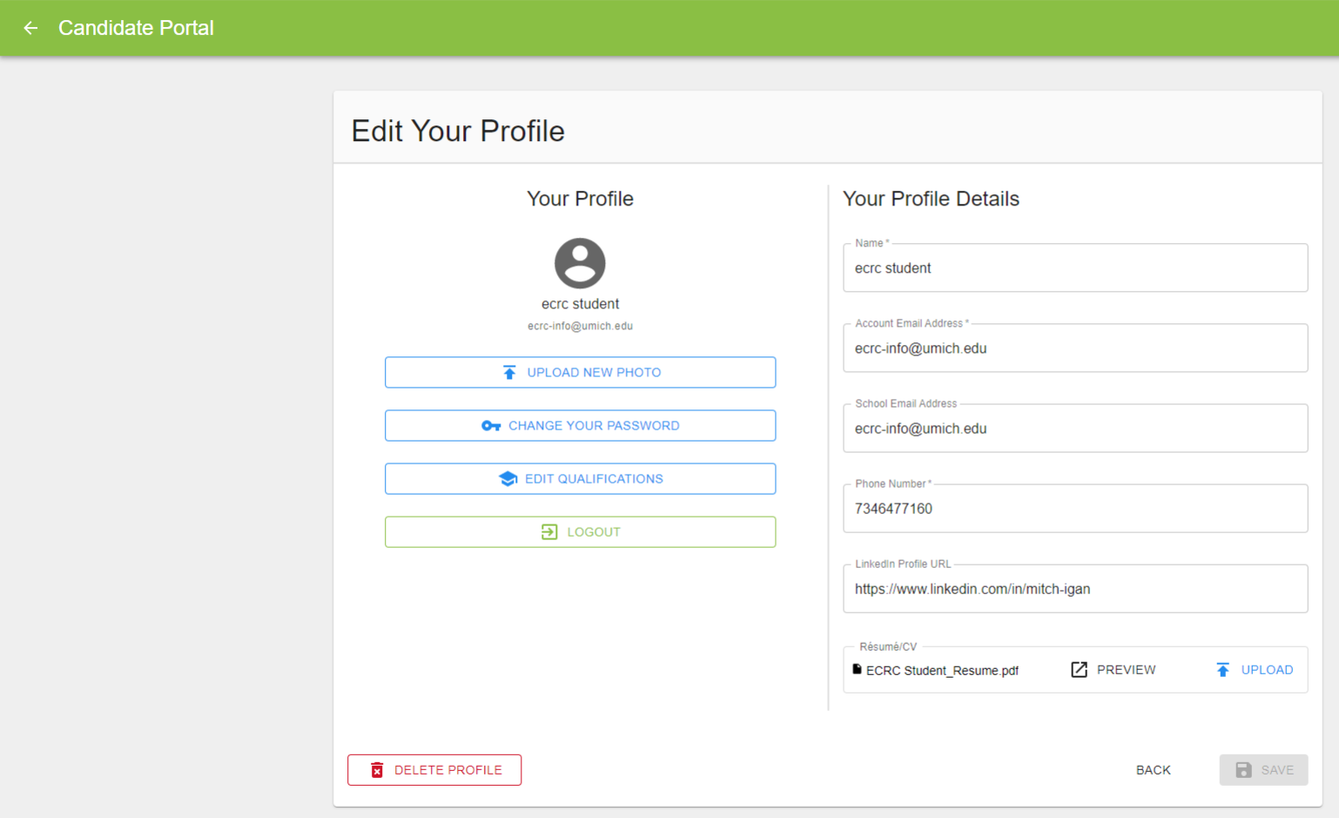
Career Fair Plus
Create your profile on CF+: app.careerfairplus.com/ume_mi
230 Chrysler Center ▪ career.engin.umich.edu ▪ ecrc-info@umich.edu
Notes:
Create Profile on the CF+ Website
Go to app.careerfairplus.com/ume_mi
Click on ‘Fall Engineering Virtual Career Fair hosted by SWE/TBP’ → ‘Login’
Click ‘Sign Up’ and then ‘Student or Candidate’
Complete your Profile
You will need to use your umich email to create your account.
Ensure that your phone number is accurate in case of technical difficulties during the fair. If you do not have a phone number available, please contact eng-careerfair@umich.edu.
Upload your Resume/CV
You can only upload one resume. Make sure you upload the latest version of your resume before the fair begins to ensure recruiters have access to it.
Recruiters will be able to view your resume once you sign up for meetings.
Update your profile/resume any time by going to app.careerfairplus.com/my-fairs and clicking on your name in the top right corner → "Edit Profile"

Slide 11
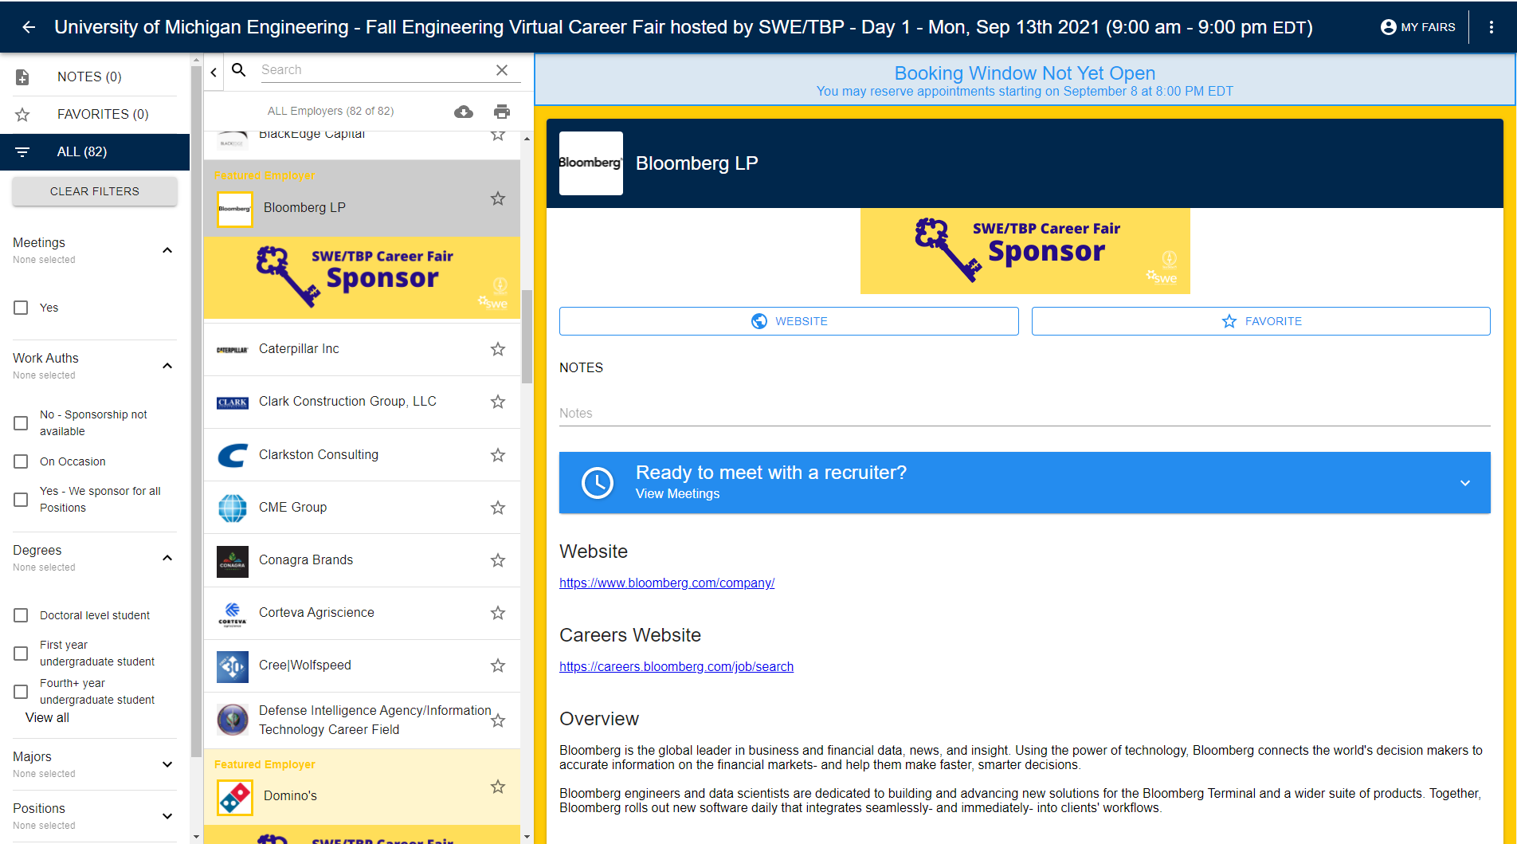
Career Fair Plus
Begin to Schedule 1-on-1 Meetings with Recruiters
Starting on Sept. 8th at 8, 8:30 and 9 PM ET
230 Chrysler Center ▪ career.engin.umich.edu ▪ ecrc-info@umich.edu
Notes:
Schedule Meetings on the CF+ Website
Scheduling opens at different times for each day of the fair. Check each day’s event page for details.
Log into CF+ and navigate to the fair to schedule meetings to meet virtually with recruiters.
Select the employer(s) you would like to meet with and then click ‘Ready to meet with a Recruiter? View Meetings’ to see the schedules they have available.
Companies are able to have 1-on-1 Meetings and/or Group Meetings.

Slide 12
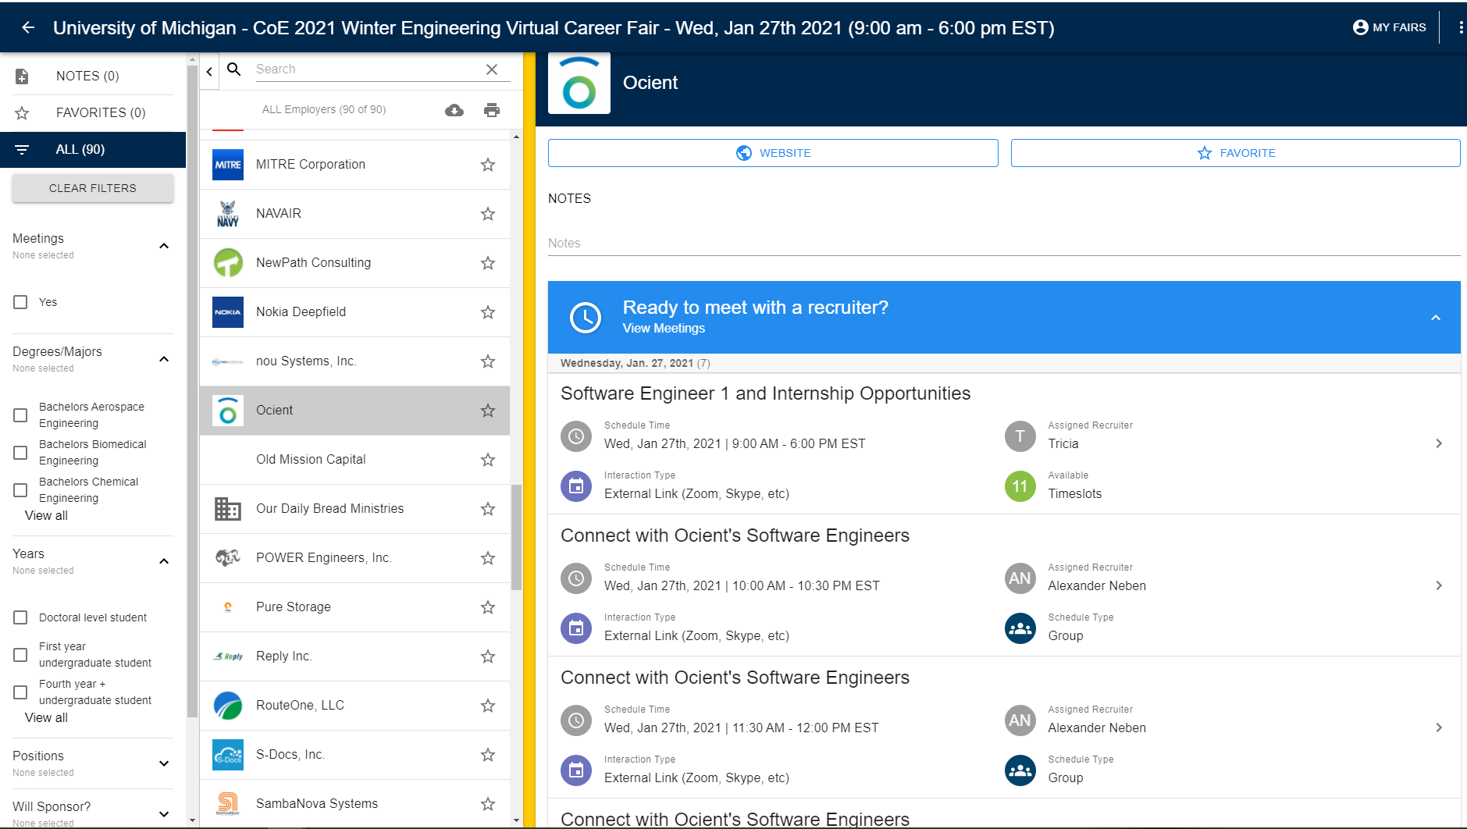
Career Fair Plus
Begin to Schedule 1-on-1 Meetings with Recruiters
Starting on Sept. 8th at 8, 8:30 and 9 PM ET
230 Chrysler Center ▪ career.engin.umich.edu ▪ ecrc-info@umich.edu
Notes:
1-on-1 Meetings are first-come, first-serve.
You must book 1-on-1 meetings by 8:00am ET on each day of the fair
Group Meetings can include multiple candidates at a time. You can join/leave the meeting at any time during the schedule duration. Group Meetings are typically opportunities for you to explore more about the company and ask general questions.
You may book group meetings ahead of time or on the day of the fair.
Select the schedule that you're interested in and review the schedule description for more information
For 1-on-1 Meetings, select a time that works for you, and click 'YES' to book the meeting slot.
For Group Meetings, select “Book My Spot Now”.
Cancel/Change 1-on-1 Meetings by 8:00 am ET on each day of the fair
Click ‘My Fairs’ in the right corner or go to app.careerfairplus.com/my-fairs and click on the fair.
Click on the meeting you would like to cancel, then click “cancel meeting”.
To change your timeslot, you must first cancel your original timeslot. You will have the opportunity to book a new meeting if alternative slots are available.

Slide 13
Career Fair Plus
Test your connection to the CF+ Video Platform!
Desktop functionality is available through Chrome and Firefox.
You can use the desktop version for the video appointments with employers
*Use this link to test your connection: https://careerfairplus.whereby.com/cfplus-drop-in
230 Chrysler Center ▪ career.engin.umich.edu ▪ ecrc-info@umich.edu
Notes:
Make sure you download/test any platforms that you will be using.
For Schedules using the CF+ Video platform
If the interaction type says CF Plus Video Room, you will see a blue ‘Join Meeting’ button.
For Schedules NOT using the CF+ Video platform
If the interaction type says External, click on the top right arrow in the meeting details to see the interaction type and review any additional instructions that are provided.
Set up/prepare your personal space for your meetings and have your professional attire ready to wear.
Test your internet connection from the location you plan to be at during the fair.

Slide 14
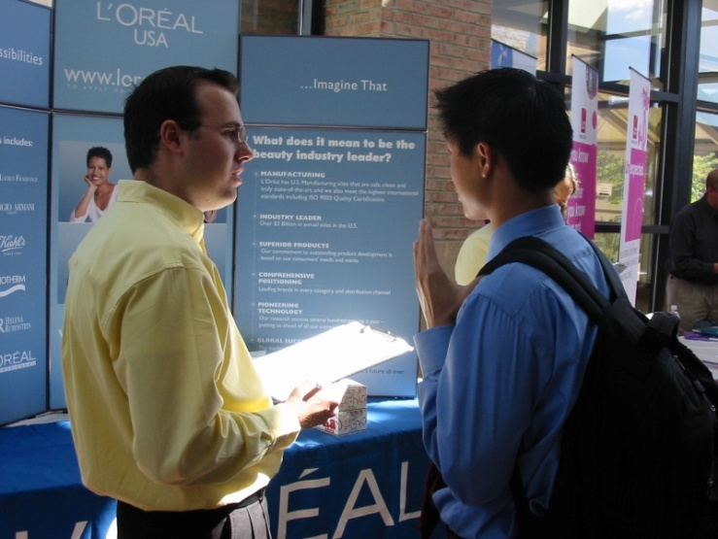
Prepare a 30-second “Elevator Pitch”
What will you say when you log into an appointment?
230 Chrysler Center ▪ career.engin.umich.edu ▪ ecrc-info@umich.edu

Slide 15
Prepare a 30-second “Elevator Pitch”
Include name, major, and grad date or class level
Highlight your skills, strengths, and experiences
Describe what opportunities you are looking for
- Why did you make an appointment with them?
Tailor your pitch to each company!
Make the connection for the employer between your background and their company
230 Chrysler Center ▪ career.engin.umich.edu ▪ ecrc-info@umich.edu

Slide 16
Sample Elevator Pitch Targeting internship in water research
Hello, my name is Michael Thomas. I’m a junior studying environmental engineering seeking an internship position in water research.
For the past two years, I’ve worked on a project with BLUElab aimed at monitoring water quality in the Great Lakes and proposing various water purification methods. This semester, I’m also conducting research on campus where I am overseeing tests for a wastewater treatment project.
I think my experience in water quality and developing effective test procedures would make me a good fit for an internship with your company. Would you be able to tell me more about your internship program?
230 Chrysler Center ▪ career.engin.umich.edu ▪ ecrc-info@umich.edu

Slide 17
Sample Elevator Pitch Targeting full-time product development position
Hello, I’m Bridget Lee and I’m a senior studying materials science and engineering graduating this May. I am seeking a full-time position in product development.
I recently interned at Ford where I led a project to evaluate the mechanical performance of a new material by planning and executing a variety of feasibility tests. On campus, I serve as a student leader in the Michigan Marching Band, where I help band members execute successful performances each week.
I think my passion for technical challenges and leadership have prepared me well for a full-time opportunity at your company. I recently applied for an entry product engineering role on your company’s website. Would you be able to tell me more about the role?
230 Chrysler Center ▪ career.engin.umich.edu ▪ ecrc-info@umich.edu

Slide 18
ECRC Resume Critiques (Sign ups start Sept 1, 12pm)
RESUME CRITIQUES
Wednesday, Sept 8, 2021
9:00 AM – 7:00 PM
VIRTUAL in CF+
RESUME CRITIQUES
Friday, Sept 10, 2021
9:00 AM – 7:00 PM
VIRTUAL in CF+
*Visit https://career.engin.umich.edu/events/workshops/
for all ECRC Virtual Workshops
230 Chrysler Center ▪ career.engin.umich.edu ▪ ecrc-info@umich.edu

Slide 19
Dress for Success…. In a VIRTUAL Setting?
While at an in person Career Fair we suggest wearing professional attire from head to toe; in a virtual space it can be slightly different:
Look professional from the waist up, a suit is not required, but a clean and polished look is. You want to put your best ‘face’ forward. Wear a nice dress shirt or blouse.
Good grooming is essential, don’t just roll out of bed! Uncombed hair or a disheveled appearance create a negative impression.
Find a nice area to have your virtual conversations, avoid distracting backgrounds and harsh lighting. Clean up the space you are in.
Silence distractions such as cellphones, pets, roommates, etc. You want to eliminate as much background noise as you can. Use headphones if needed!
230 Chrysler Center ▪ career.engin.umich.edu ▪ ecrc-info@umich.edu

Slide 20

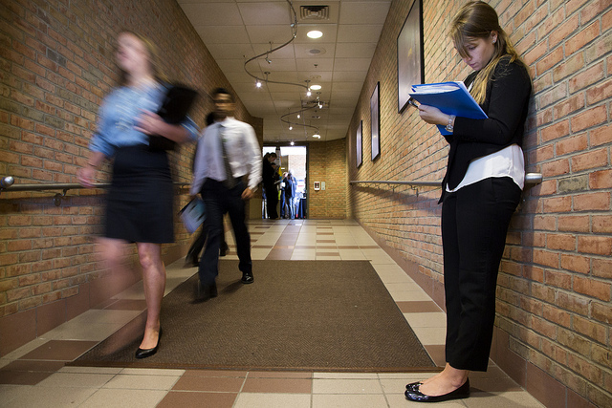
Gather the materials you will need
Notepad and pen
Have your resume up on your computer to reference if needed and a PDF ready to email.
Copies of your elevator pitch
Your Schedule
230 Chrysler Center ▪ career.engin.umich.edu ▪ ecrc-info@umich.edu

Slide 21
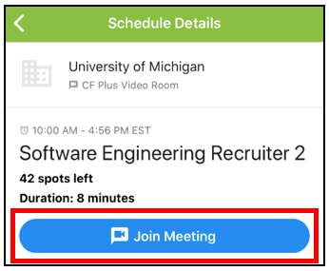
Career Fair Plus
On the Day of the Fair….
*If you have any questions the day of the fair, please email eng-careerfair@umich.edu.
Log into CF+ and make sure you are signed into your account.
You can use the app to help you track your appointments
When joining rooms be punctual but no more than 2 minutes early
230 Chrysler Center ▪ career.engin.umich.edu ▪ ecrc-info@umich.edu
Notes:
If you have any questions the day of the fair, please email eng-careerfair@umich.edu.
Log into CF+ and access your virtual meeting schedule.
To join the virtual rooms for your meetings, click on “Join Meeting” or click on the top right arrow in the meeting details and follow the instructions provided.
Etiquette for Joining Rooms
Be punctual, but not more than 2 minutes early. When you knock to enter a meeting room, the recruiter will be notified. You don’t want to knock too early and interrupt their conversation with another student.
If there are technical difficulties, we’ve instructed the recruiters to call the phone number listed in your profile.
During your conversations with recruiters, inquire about the best way to get in touch with the company to follow up after the fair regarding next steps.
Please note that some recruiters may not share their contact information.

Slide 22
During the Career Fair
Meet with companies according to your schedule
Smile and introduce yourself
Deliver your 30-Second elevator pitch (be flexible)
Ask the recruiter if the have your resume or if you should send it
Practice Active Listening
Display your knowledge of the company
Ask Targeted Questions
Explore Fit
Wrap up: Ask for contact information and thank the recruiter for their time
230 Chrysler Center ▪ career.engin.umich.edu ▪ ecrc-info@umich.edu

Slide 23
Questions employers may ask you
Questions will center on:
Knowledge of company
Knowledge of industry
Your interest in working for their company
Your experience/skills
Your resume - be prepared to answer questions about your GPA or anything listed on your resume
230 Chrysler Center ▪ career.engin.umich.edu ▪ ecrc-info@umich.edu

Slide 24
Questions to ask employers
Questions should center on:
Skills they are seeking
Training opportunities
Career growth and advancement
Organizational culture & environment
Company and industry challenges
Next steps in the application process
230 Chrysler Center ▪ career.engin.umich.edu ▪ ecrc-info@umich.edu

Slide 25
Questions NOT to ask
Avoid asking for information that is easily obtained or too early in the process to ask.
What does your company do?
Does your company have any jobs?
How much does this position pay?
What are the company benefits?
230 Chrysler Center ▪ career.engin.umich.edu ▪ ecrc-info@umich.edu

Slide 26
After the Career Fair
If you obtained contact information you can send a thank you note to recruiters with whom you spoke
Use e-mail
State where you met them (i.e. the Career Fair) and express appreciation for their time
Recap what you discussed and what conclusions you drew from your discussion with him/her
Reiterate what you could bring to the company and/or position
230 Chrysler Center ▪ career.engin.umich.edu ▪ ecrc-info@umich.edu

Slide 27
Sample Follow-up Email General Interest in a Company
Dear Ms. Recruiter,
Thank you for taking the time to speak with me at the University of Michigan Career Fair on September 15th. I appreciated the opportunity to learn more about your company. I am impressed by the recent quality improvements you described at Company X; the training programs you discussed reaffirm my belief Company X is a challenging yet rewarding place to work.
I will follow-up with you at the beginning of my senior year to explore potential employment opportunities available at that time.
Thank you again for your time and consideration.
Sincerely,
Clearly A. Student
(734) 123-4567
230 Chrysler Center ▪ career.engin.umich.edu ▪ ecrc-info@umich.edu

Slide 28
Sample Follow-up Email Interest in a Specific Position
Dear Mr. Recruiter,
Thank you for taking the time to speak with me at the University of Michigan Career Fair on Sept 15th. I appreciate your time and the information you provided.
After speaking with you about Company X’s Engineering Trainee Program, I am even more confident my background and interests are a great fit for this opportunity. My engineering education and experience as President of the Z Club have enhanced my leadership and analytical skills, two qualities I believe would be an asset to Company X.
As you advised, I have submitted my resume through your website. If you need additional information please contact me at (734)123-4567. Thank you again for your time and consideration.
Sincerely,
Clearly A. Student

Slide 29
After the Career Fair
Apply to positions on Engineering Careers
and/or the company’s website.
Do this as soon as you can!
230 Chrysler Center ▪ career.engin.umich.edu ▪ ecrc-info@umich.edu

Slide 30
Final Tips
Maintain a Positive Attitude
Use Eye Contact and a Professional Background
Do not Monopolize a specific company’s time by signing up for multiple appointments with them
Follow through on your commitments and show up for appointments you have scheduled
Check back in the CF+ app a few times a day to see if new appointments have opened up
230 Chrysler Center ▪ career.engin.umich.edu ▪ ecrc-info@umich.edu

Slide 31
Questions?
Engineering Career Resource Center
230 Chrysler Center
Monday through Friday, 8:00 am – 5:00 pm
http://career.engin.umich.edu
ecrc-info@umich.edu
230 Chrysler Center ▪ career.engin.umich.edu ▪ ecrc-info@umich.edu

