Slide 1
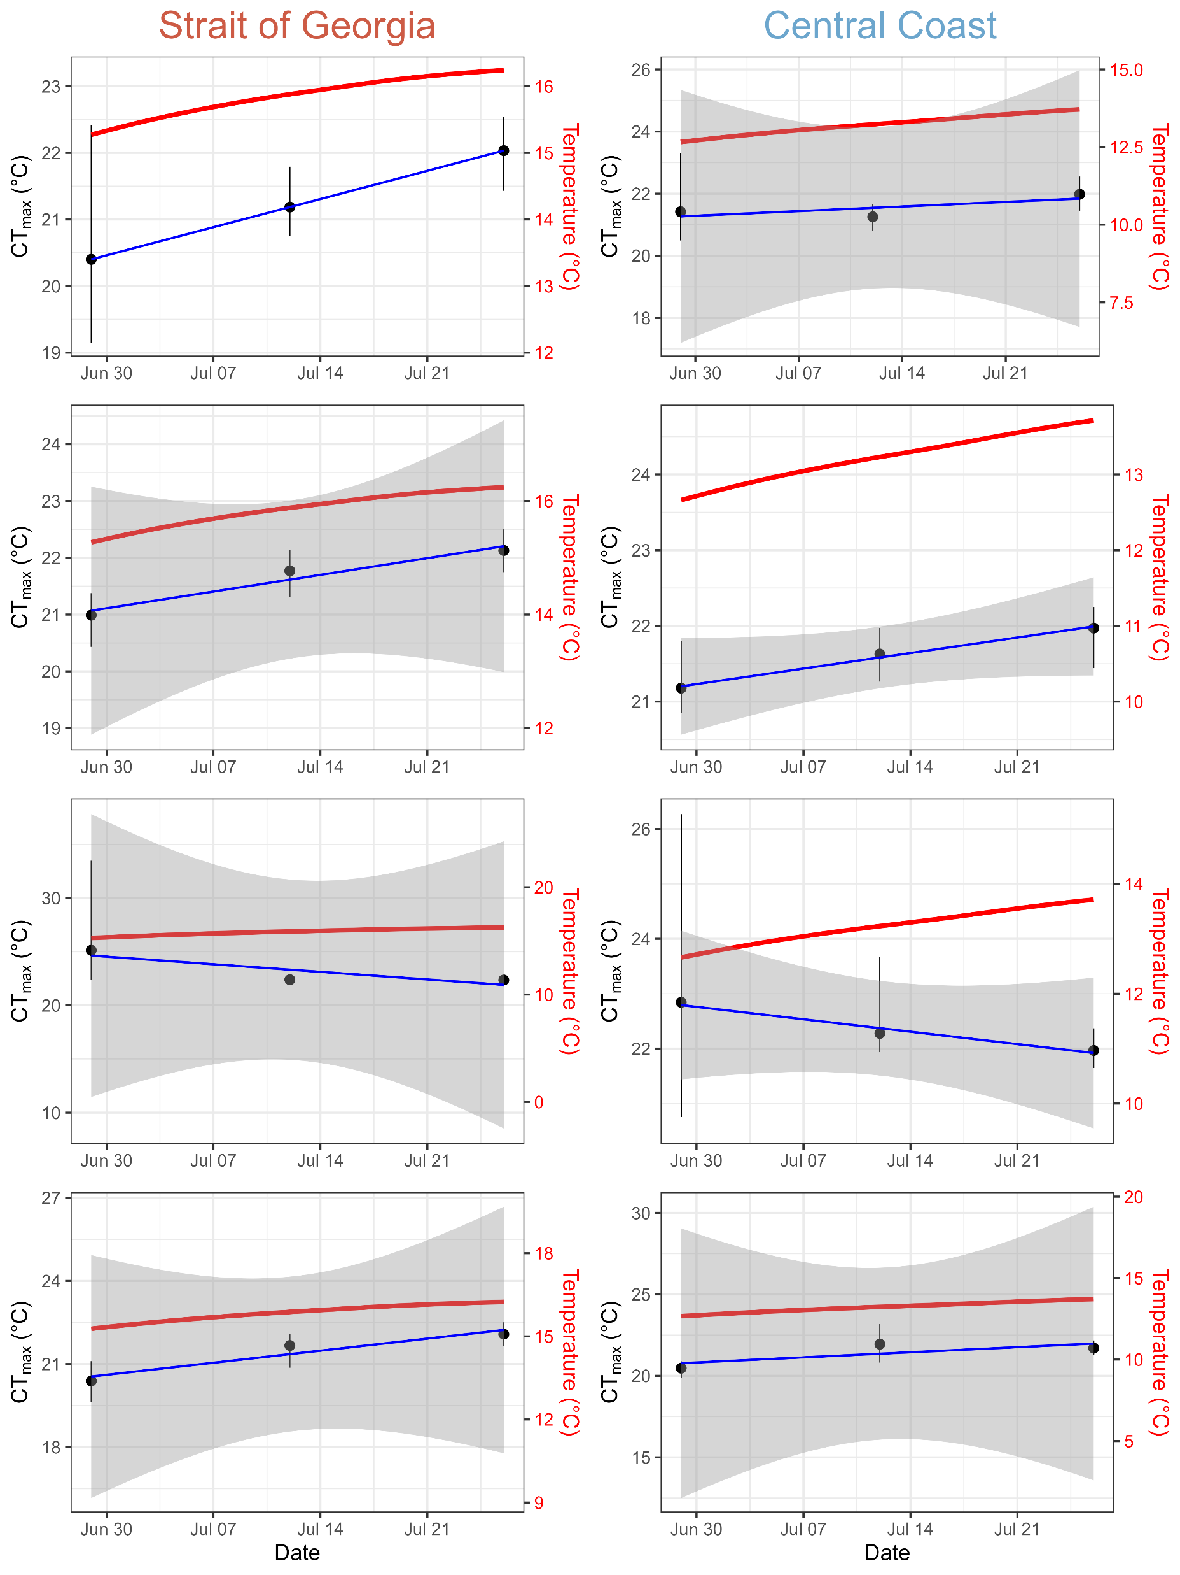
Shell length
Slope = 0.060 °C/day
p-value = 0.0002
Slope = 0.021 °C/day
p-value = 0.456
Slope = 0.029 °C/day
p-value = 0.063
Shell lip
Slope = 0.042 °C/day
p-value = 0.148
Slope = -0.101 °C/day
p-value = 0.341
Slope = -0.032 °C/day
p-value = 0.120
Shell weight
Slope = 0.062 °C/day
p-value = 0.197
Slope = 0.045 °C/day
p-value = 0.445
Tissue weight

