Slide 1
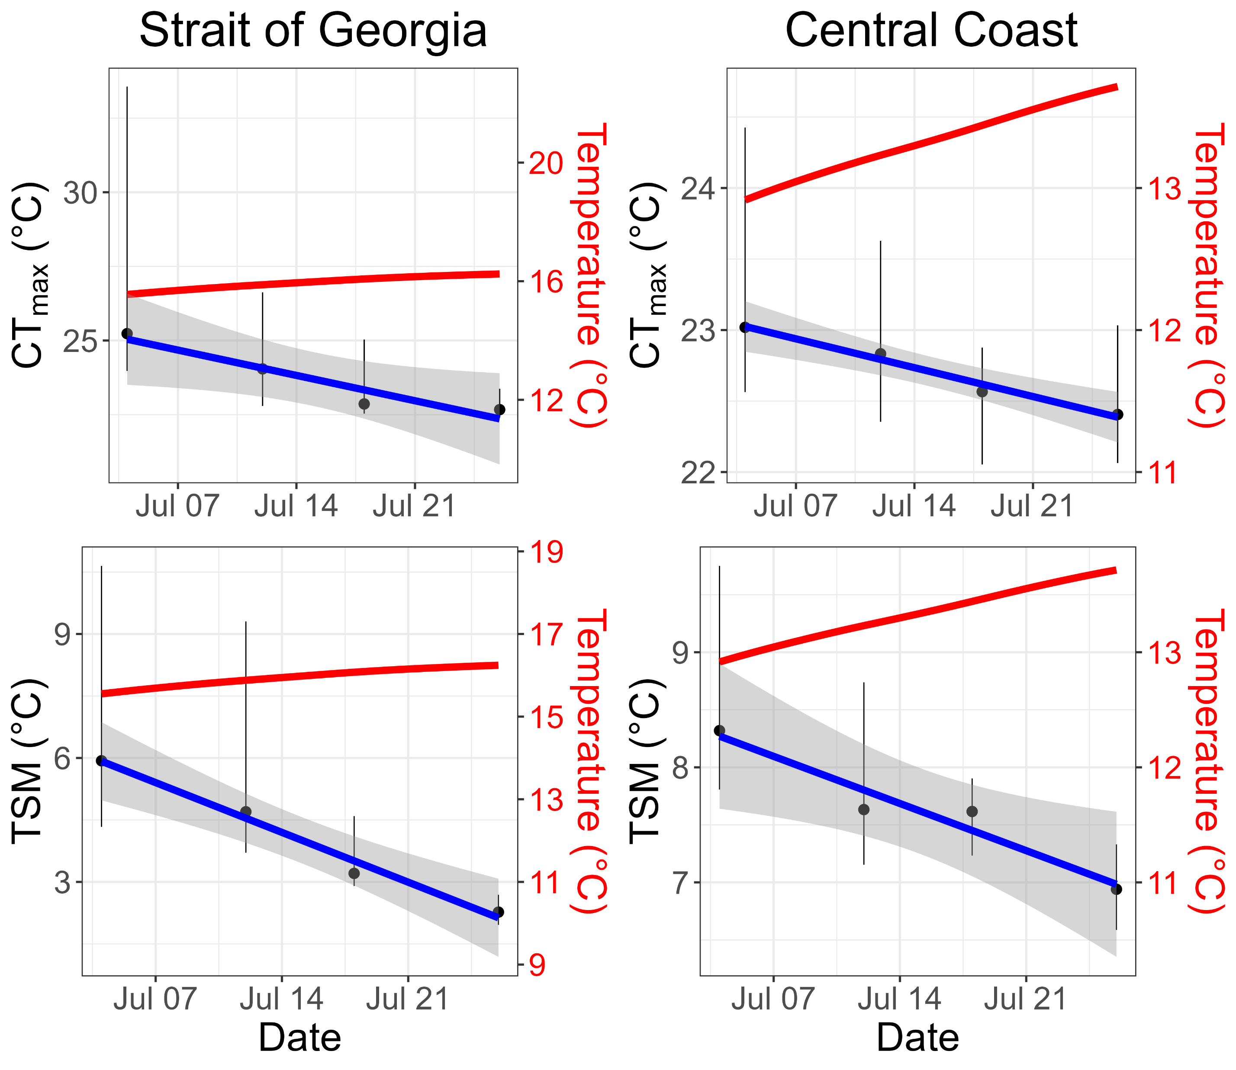
a
b
Slope = -0.122 °C/day
p-value = 0.043
Slope = -0.029 °C/day
p-value = 0.011
c
d
Slope = -0.059 °C/day
p-value = 0.032
Slope = -0.172 °C/day
p-value = 0.009

