Slide 1
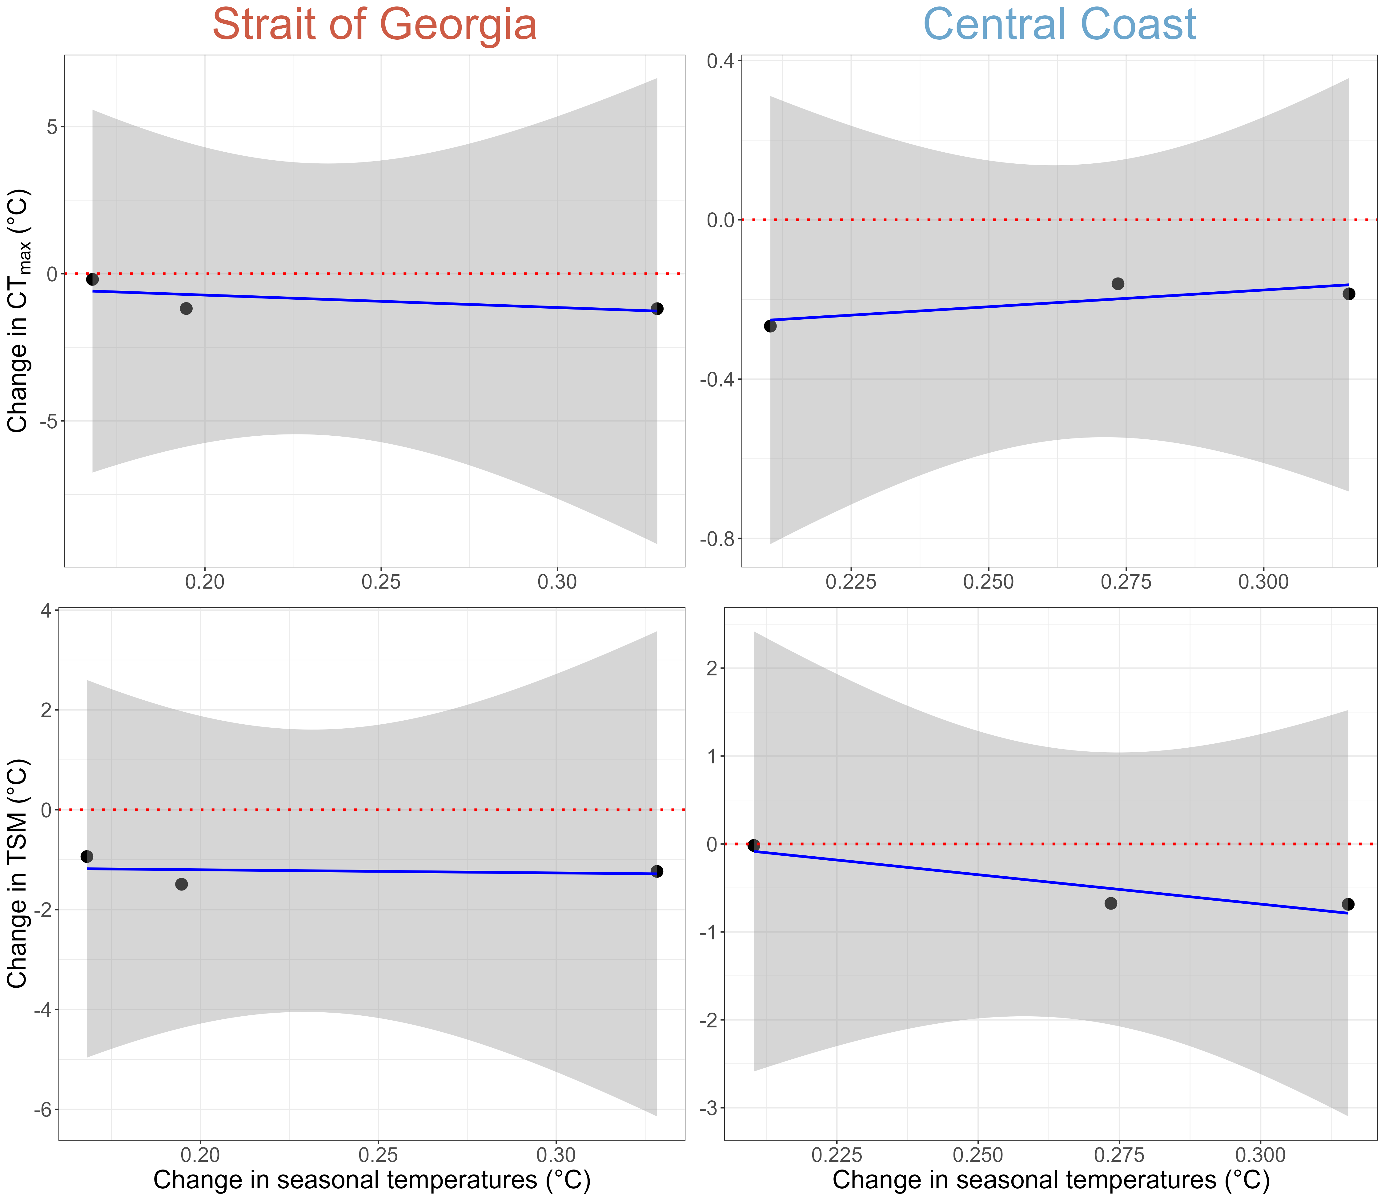
Slope = -4.230
p-value = 0.564
Slope = 0.842
p-value = 0.406
Slope = -0.632
p-value = 0.875
Slope = -6.683
p-value = 0.251

