Slide 1
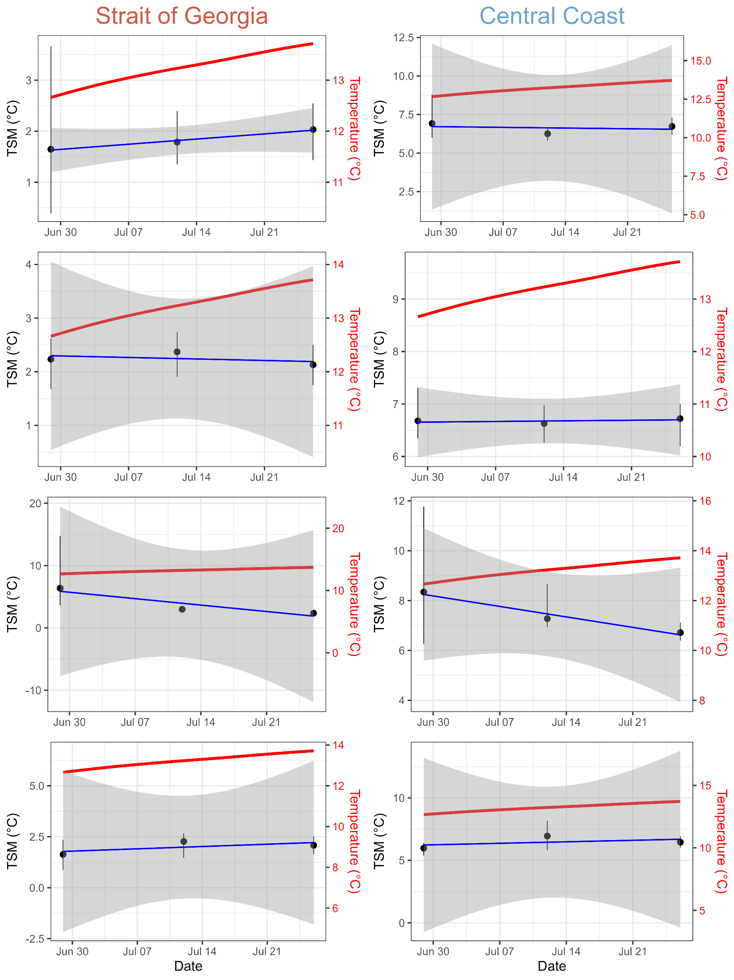
Shell length
Slope = 0.014 °C/day
p-value = 0.086
Slope = -0.006 °C/day
p-value = 0.838
Slope = 0.002 °C/day
p-value = 0.683
Shell lip
Slope = -0.004 °C/day
p-value = 0.703
Slope = -0.147 °C/day
p-value = 0.253
Slope = -0.060 °C/day
p-value = 0.127
Shell weight
Slope = 0.016 °C/day
p-value = 0.533
Slope = 0.017 °C/day
p-value = 0.685
Tissue weight

