Slide 1
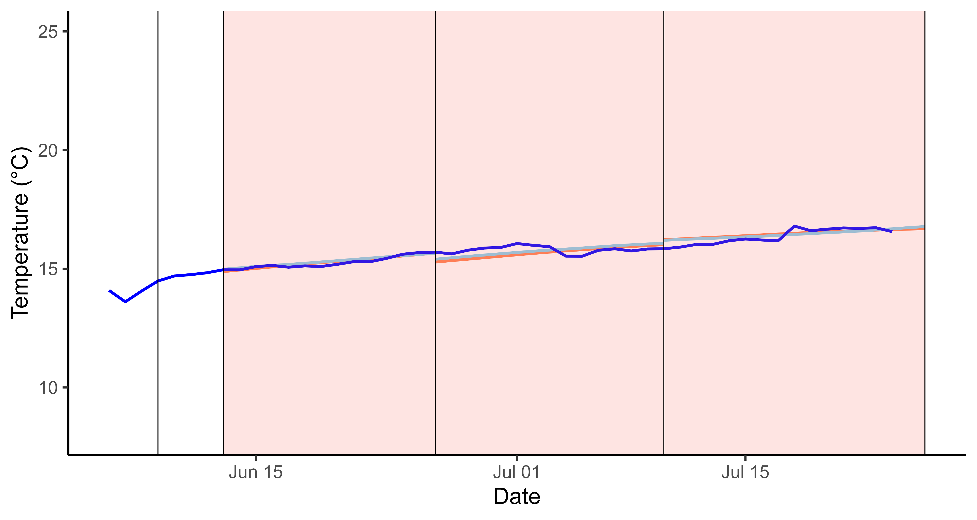
Acclimation period at the severity thresholds
α_{cold} = 2.4
Realised temperature
α_{cold} = 2.3
α_{cold} = 2.5
α_{warm} = 0.2
α_{warm} = 0.1
Cold region severity threshold
α_{warm} = 0.3
Warm region severity threshold

