Slide 1
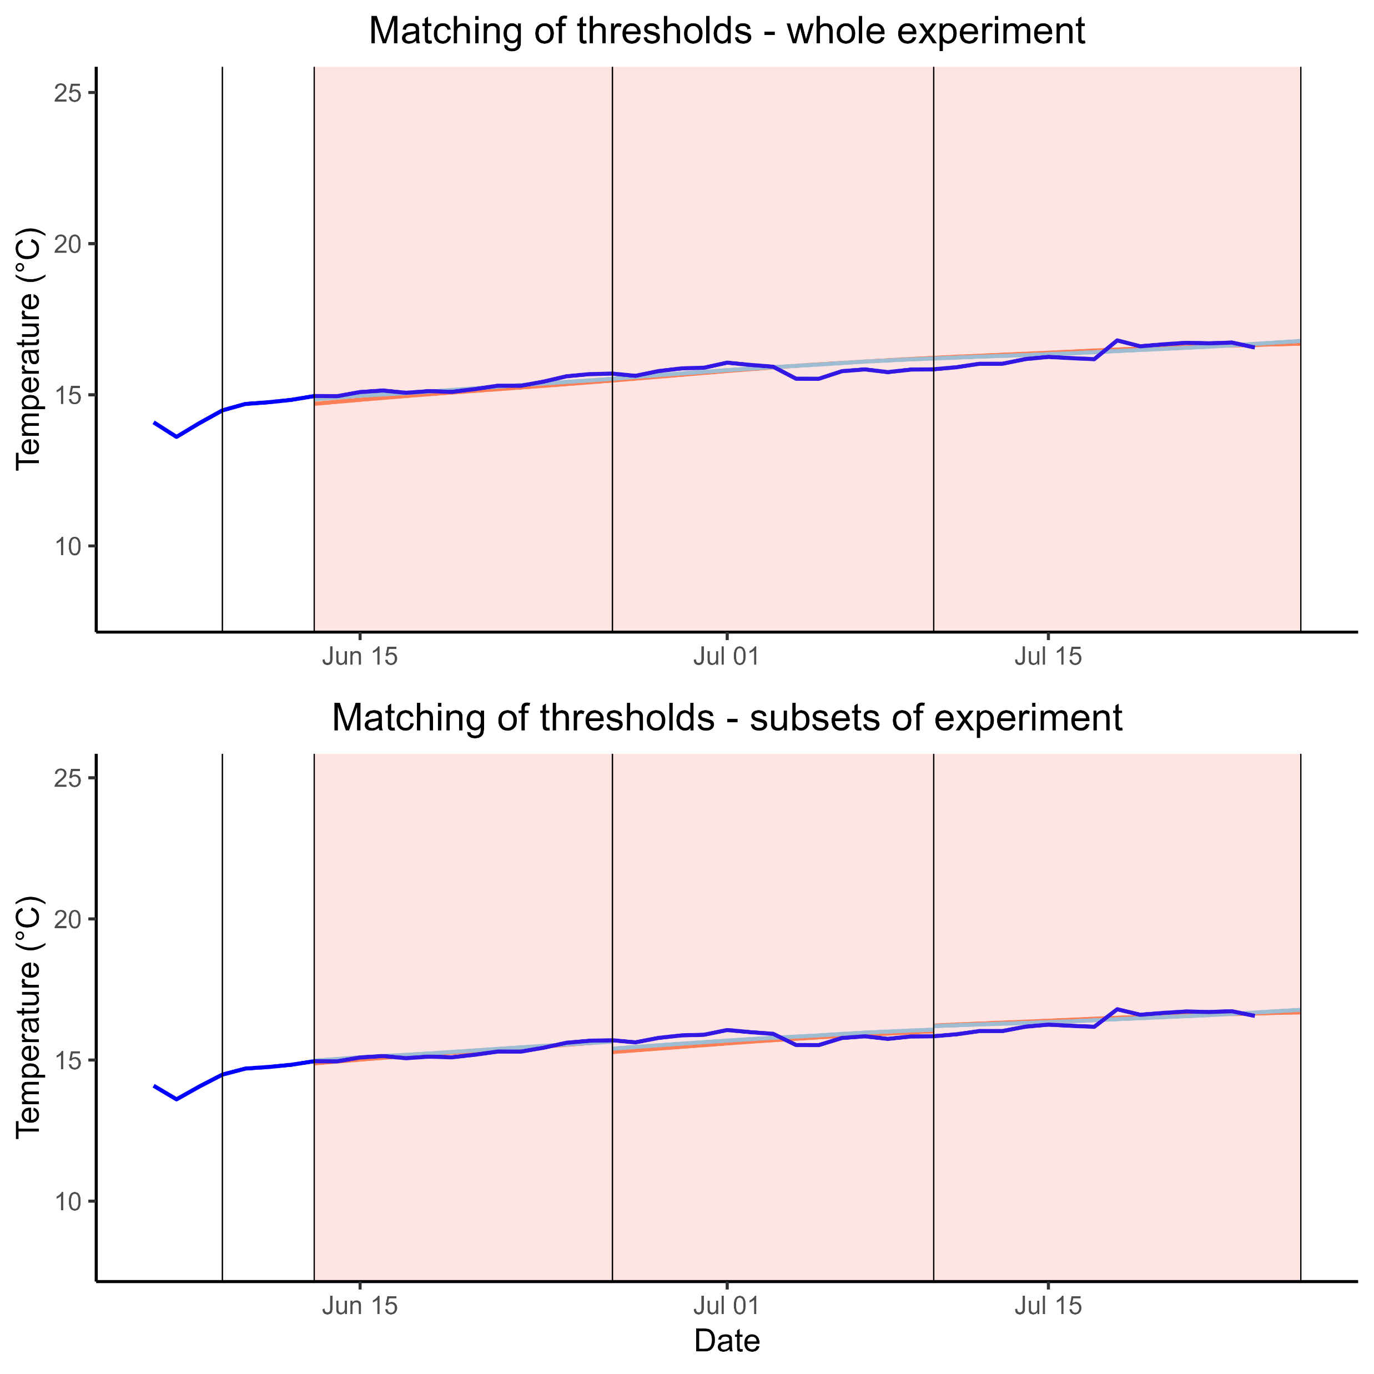
a
Realised temperature
α_{cold} = 2.4
Cold region severity threshold
α_{warm} = 0.2
Warm region severity threshold
b
α_{cold} = 2.5
α_{cold} = 2.3
α_{cold} = 2.4
α_{warm} = 0.1
α_{warm} = 0.2
α_{warm} = 0.3

