Slide 1
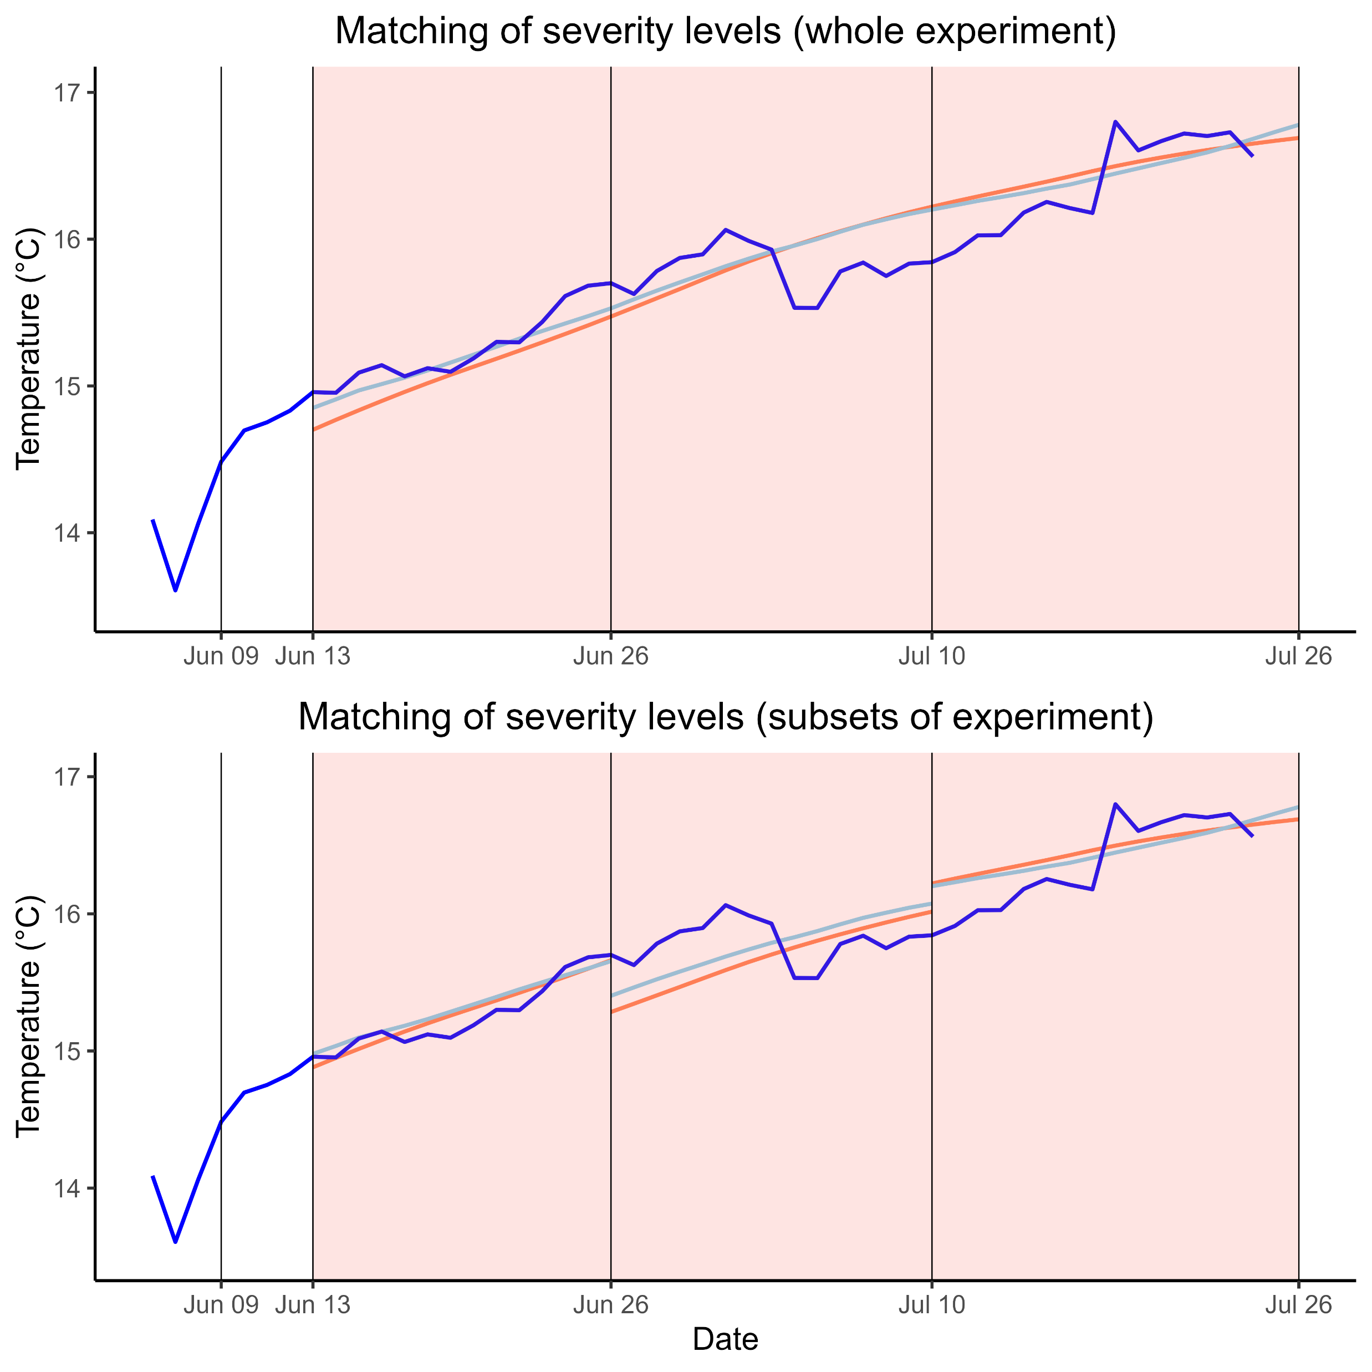
a
Realised temperature
Cold region severity level
Warm region severity level
α_{cold} = 2.4
α_{warm} = 0.2
b
α_{cold} = 2.4
α_{cold} = 2.3
α_{warm} = 0.2
α_{cold} = 2.5
α_{warm} = 0.1
α_{warm} = 0.3

