Slide 1
Project 1: Analysis of Police-Inflicted Fatalities
Darren Pardo
Henry Sanchez
Jakub Tamulewicz
Joshua Marcus

Slide 2
Abstract
Goal: uncover patterns related to US police-inflicted fatalities
Clean data for useful and relevant information
Combine with US Census population data to investigate trends related to fatalities

Slide 3
Sources
Primary source: Individuals Killed by Police in the US from 2000 – 2016
CSV of people killed by police over a 16 year span in the US
Victim data includes: age, gender, location, manner of death, etc.
https://data.world/awram/us-police-involved-fatalities
Secondary source: United States Census Bureau
Used to investigate trends between fatalities and population change
https://www.census.gov/

Slide 4
Questions
What trends can we uncover regarding the frequency of police-involved fatalities from 2000 to 2016?
What state has the highest recorded number of fatalities?
What is the most common manner of death?
Does the month of the year influence the number of fatalities?
Which gender is the most affected?
What age group is most affected?
Combining census info with our dataset, can we show a direct correlation between increase in population and increase in fatalities?

Slide 5
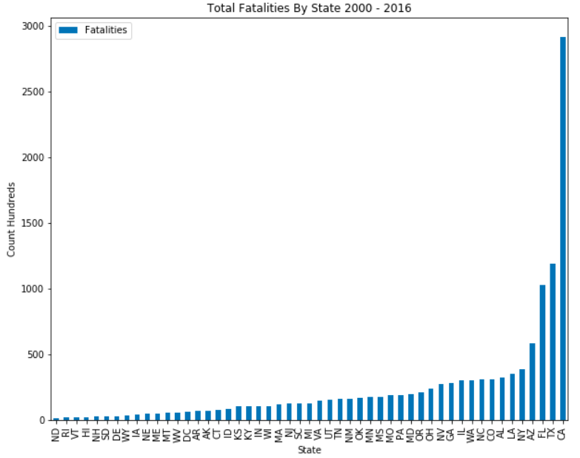
1. We Discovered the Following Trends:
The state with the highest recorded police-inflicted fatalities over the 16 year span is California.

Slide 6
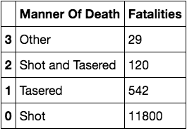
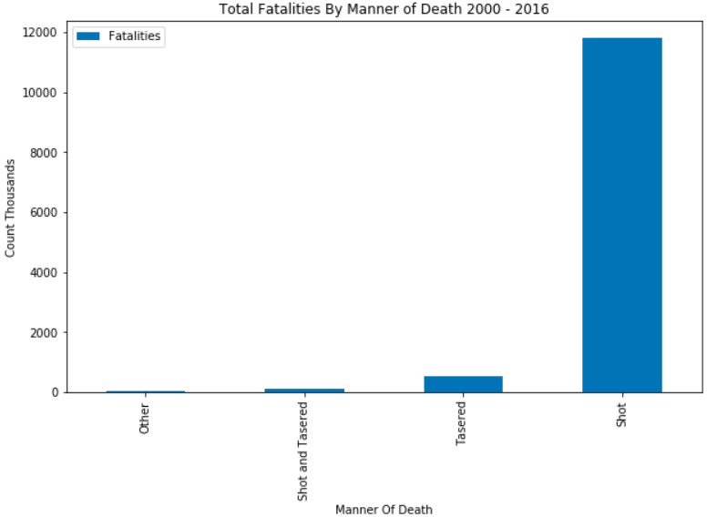
1. We Discovered the Following Trends:
b.
The most common manner of death in these fatalities is by firearm.

Slide 7
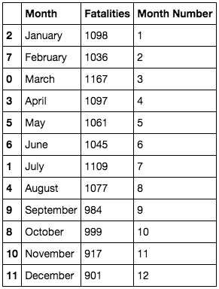
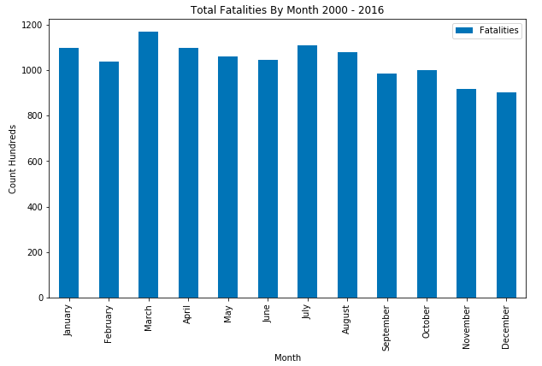
1. We Discovered the Following Trends:
c.
The month with the overall lowest police fatalities was December, with 901 fatalities. The highest was March, with 1167. Our dataset shows a marginal spike for March, and a general decrease throughout the subsequent months.

Slide 8
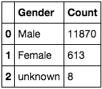
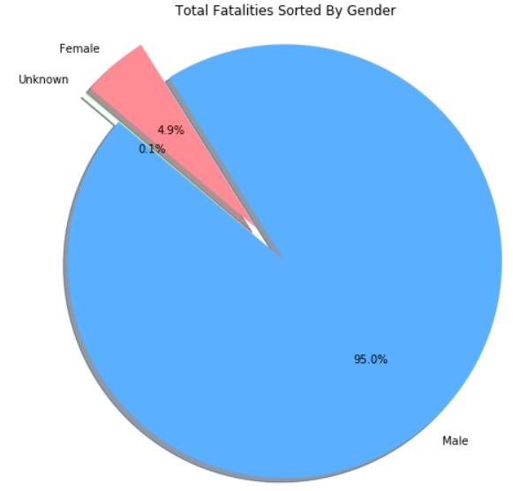
1. We Discovered the Following Trends:
d. The most affected gender, by a significant margin, is male.

Slide 9
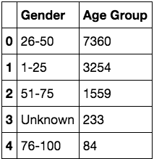
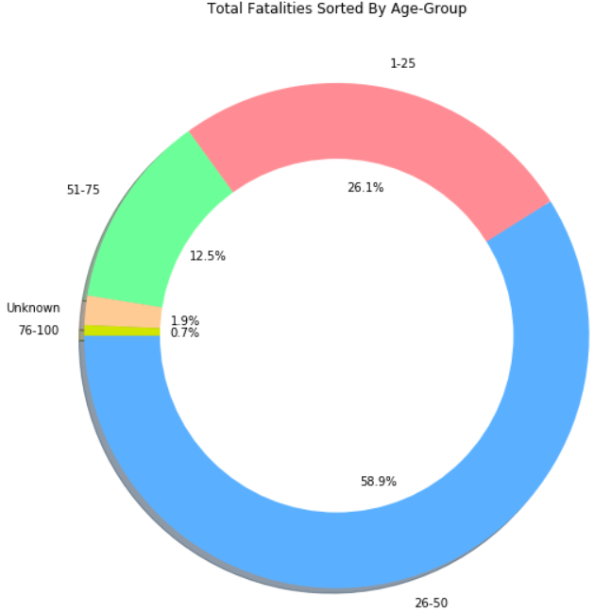
1. We Discovered the Following Trends:
e. The most affected age group is 25 to 50 year-olds. The second highest group was 25 years and younger.

Slide 10
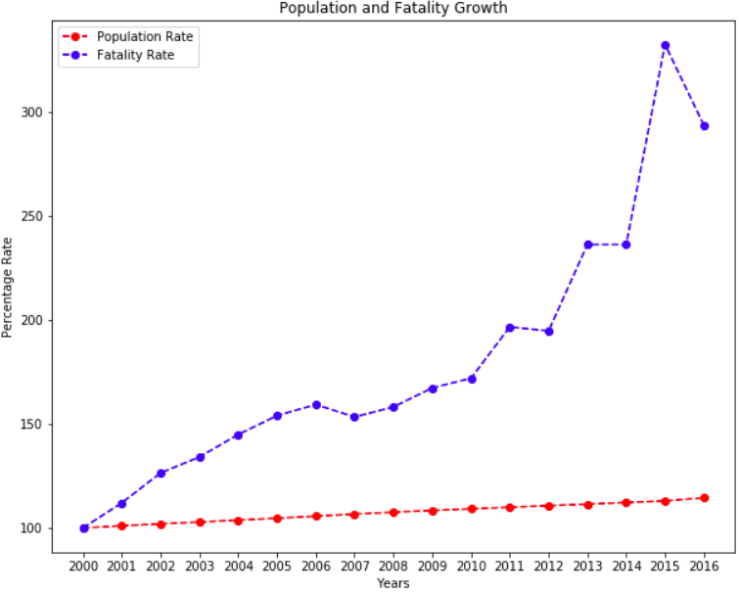
2. Fatality Rate vs. US Population Growth
Recorded police fatalities have, overall, grown at an alarmingly higher rate, as compared to overall US Population growth

Slide 11
Coding Workflow
Planning: Excel and Pivot Tables
Opening our primary data source (Police Fatalities CSV file) in Excel
Planning how to clean CSV files in a formulaic manner
Creating pivot tables to visualize the data quickly and to get a sense of trends
Jupyter Notebook
Read in CSVs
Convert CSVs into data frames and clean data
Plot graphs from data in data frames

Slide 12
Jupyter Notebook Code Breakdown

Slide 13
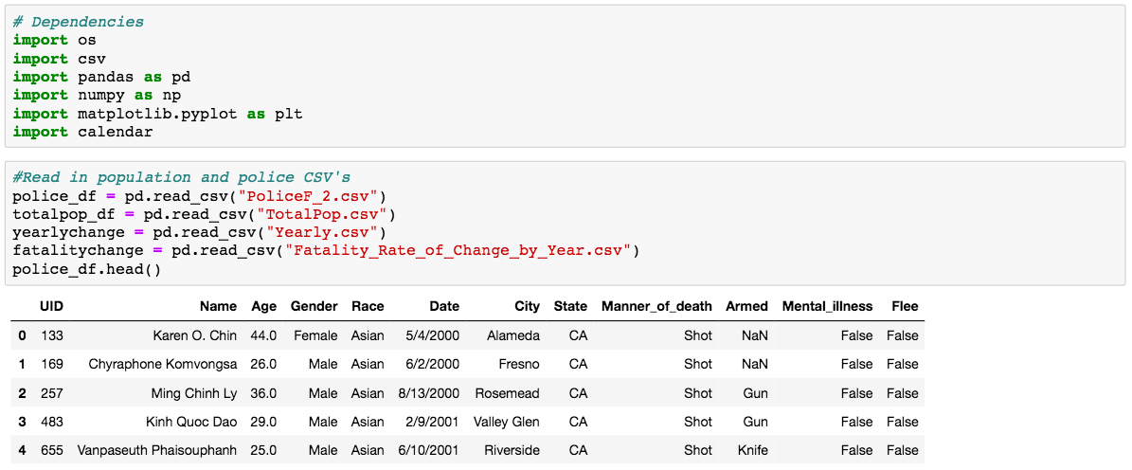

Slide 14
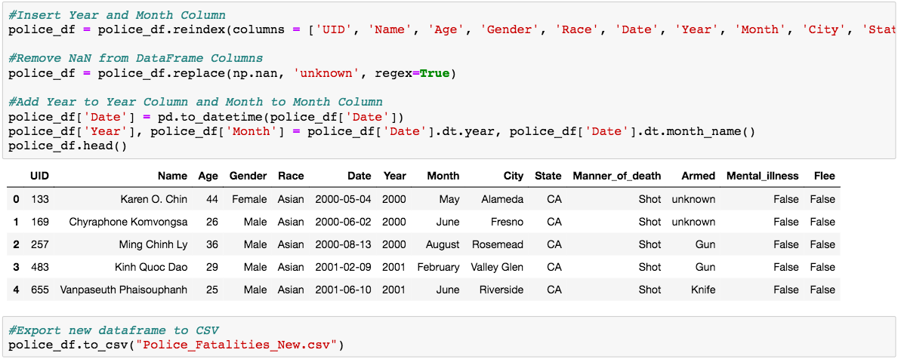

Slide 15
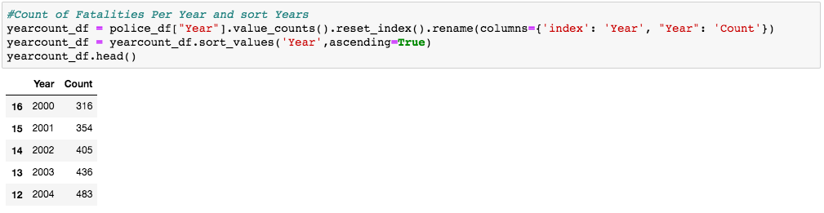

Slide 16
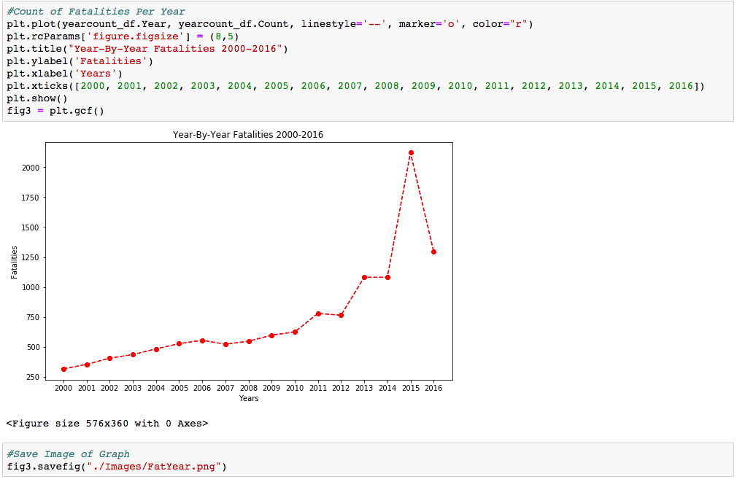

Slide 17
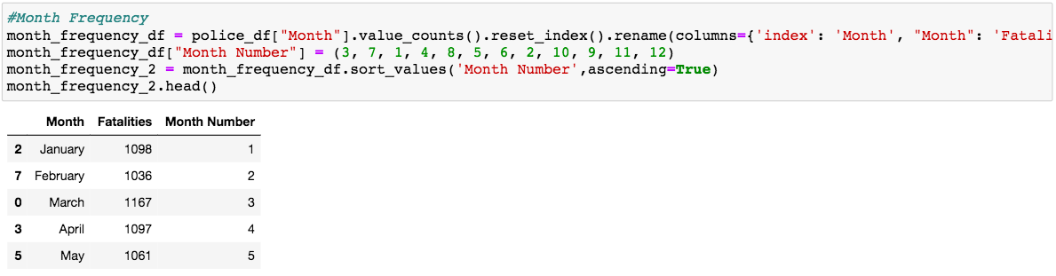

Slide 18
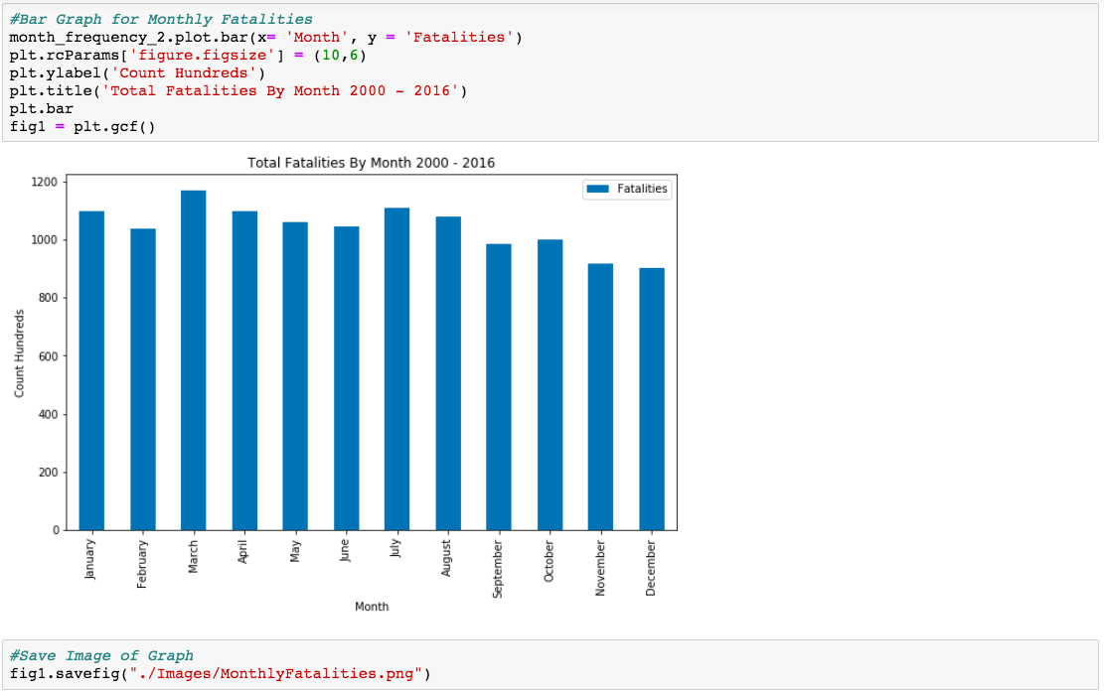

Slide 19
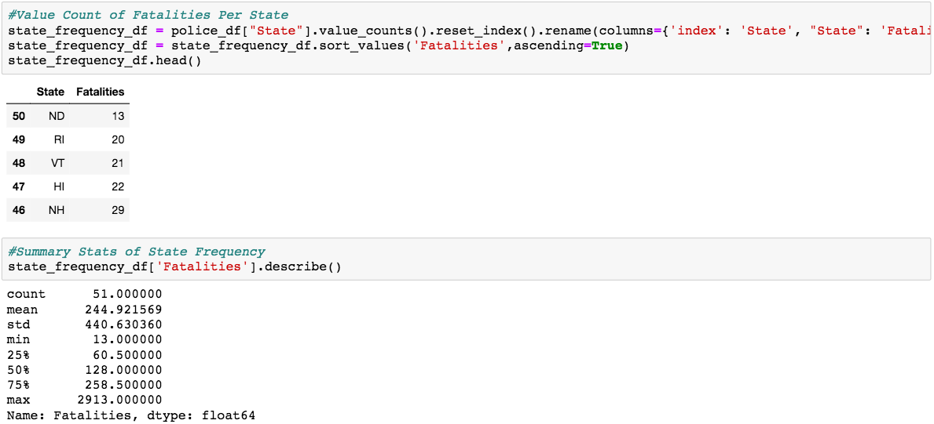

Slide 20
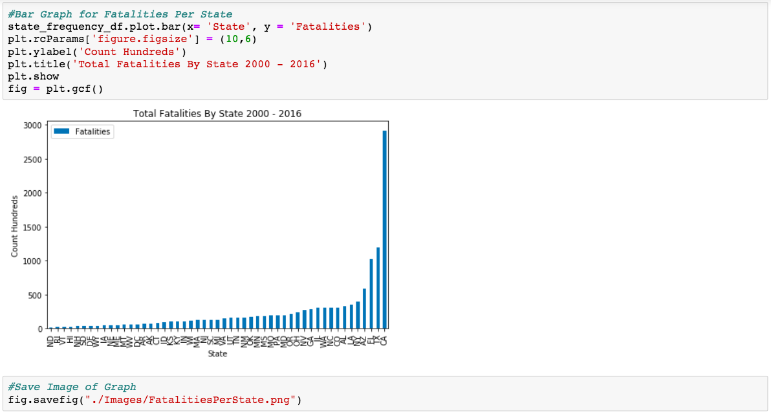

Slide 21
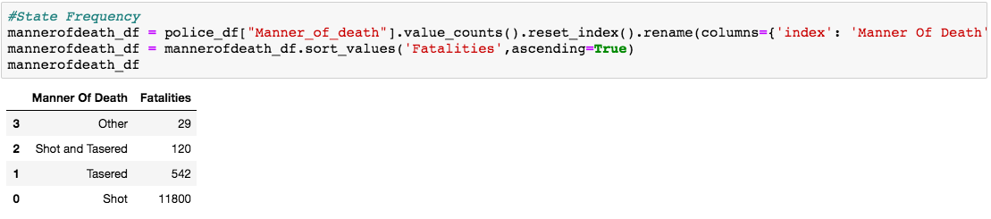

Slide 22
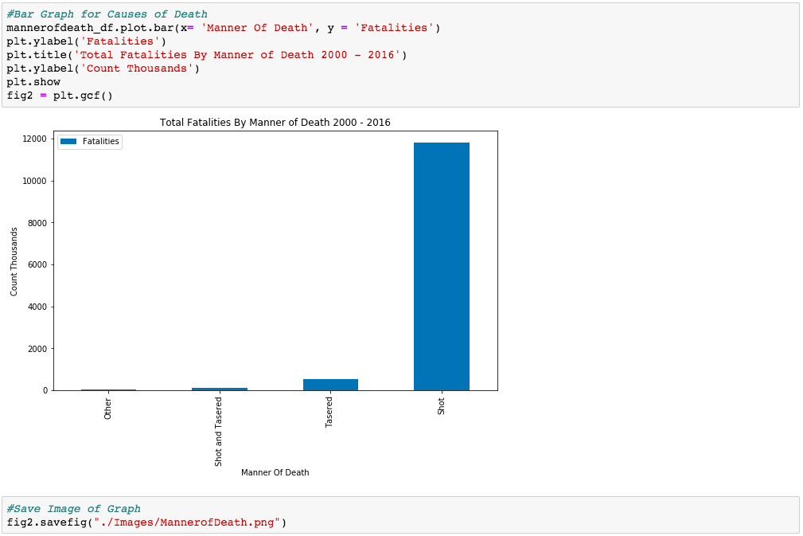

Slide 23
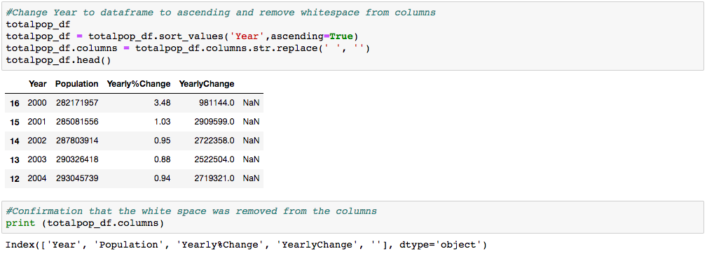

Slide 24
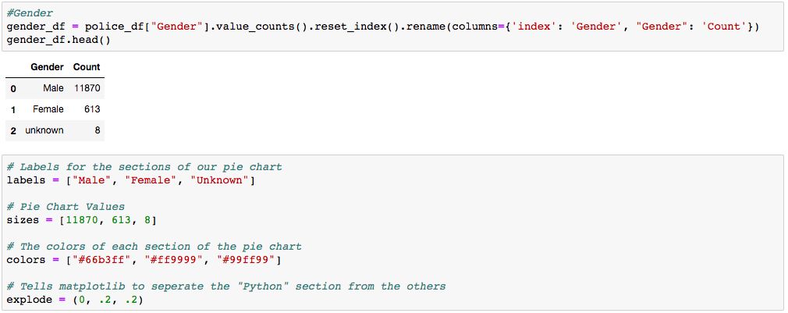

Slide 25
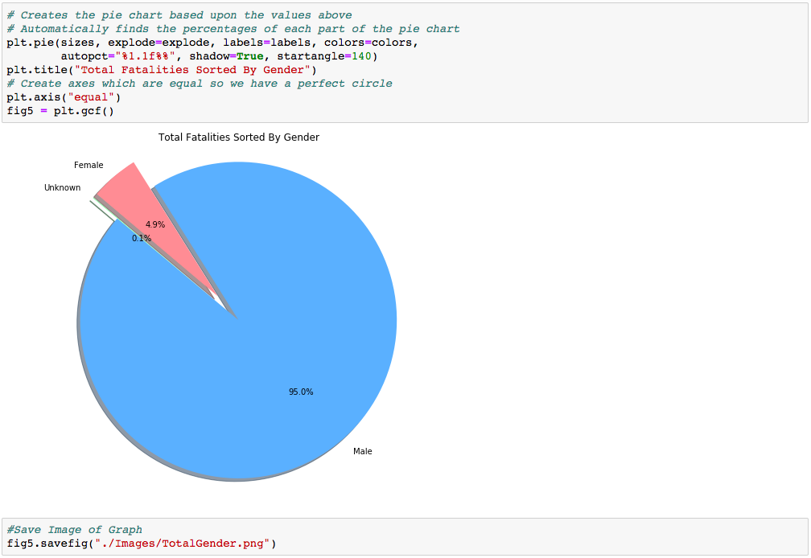

Slide 26
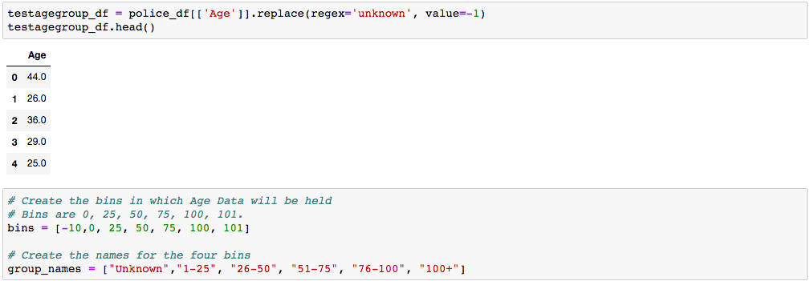

Slide 27
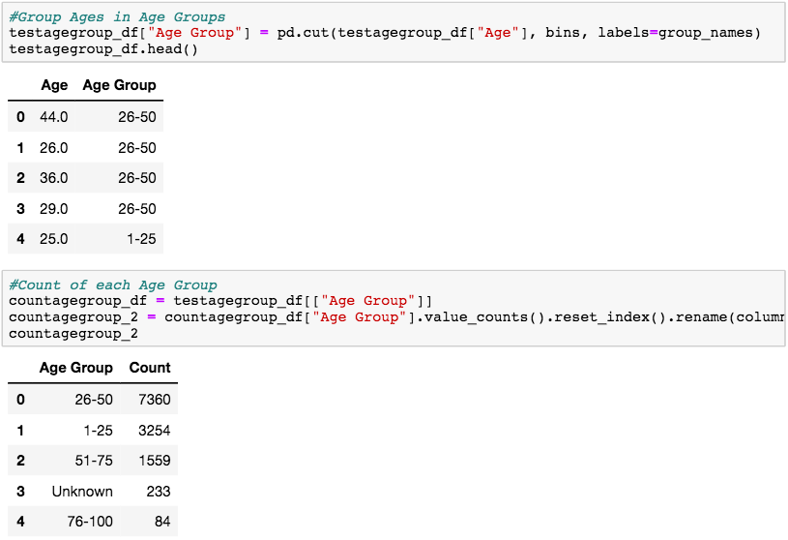

Slide 28
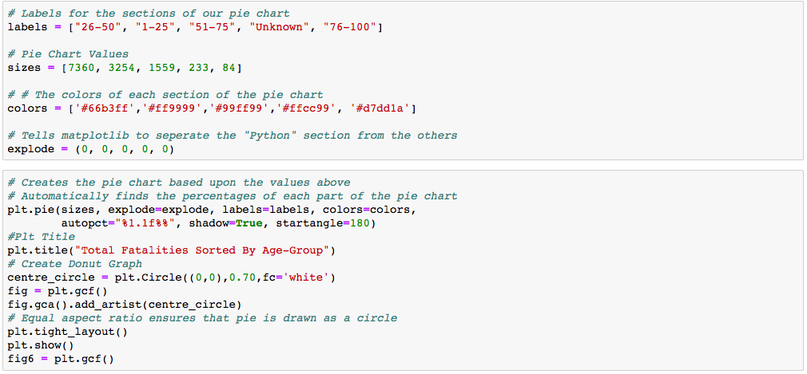

Slide 29
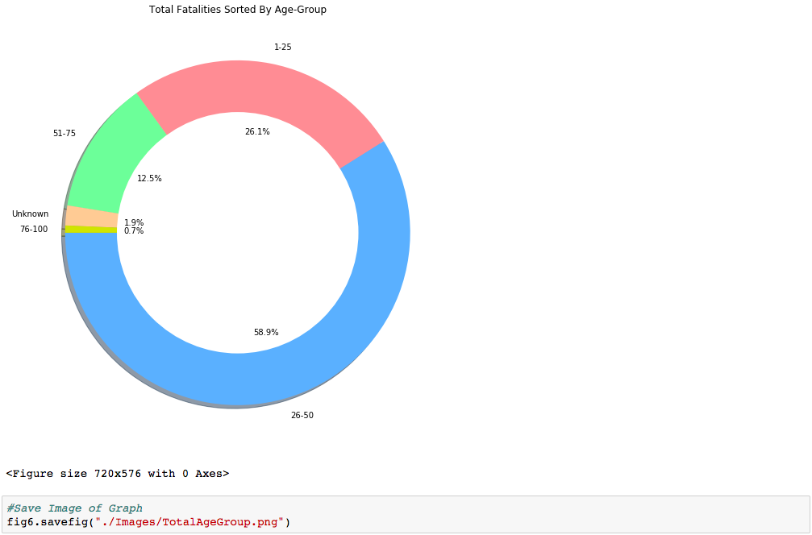

Slide 30
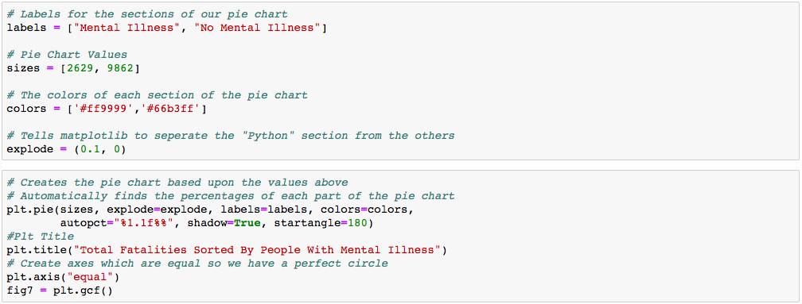

Slide 31
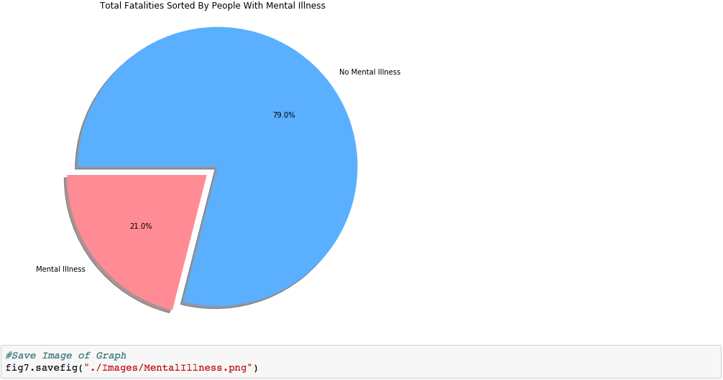

Slide 32
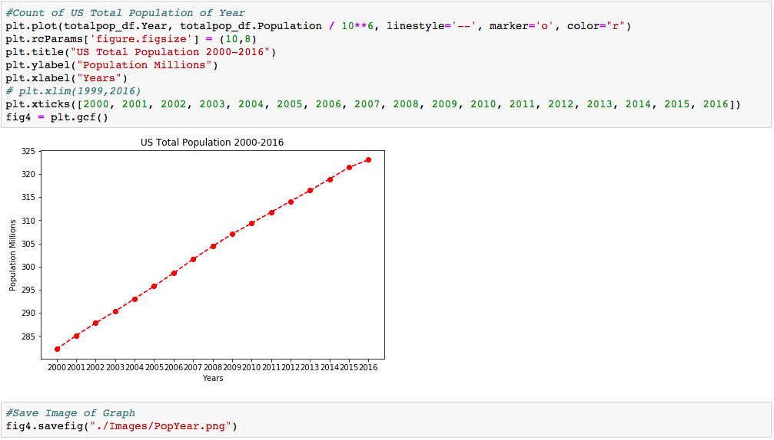

Slide 33
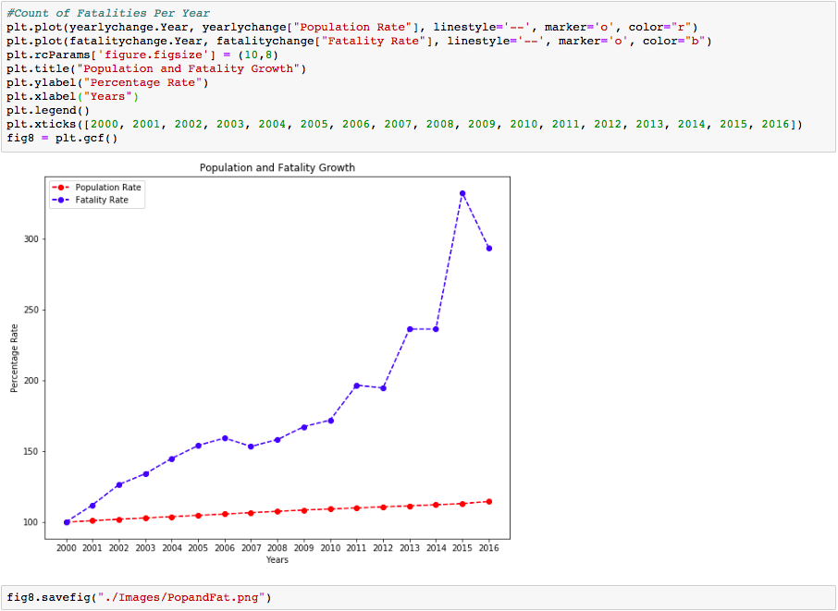

Slide 34
Questions?

