Slide 1
Forecasting
Mainland China Inflation
Forecast accuracy, operational reliability, and Chinese New Year inference
DS607 Statistics for Data Science
Darren TAY Teck Yong | 01084382
Individual course project
Notes:
Opening (about 35 seconds): This project asks a practical question: can parsimonious seasonal models beat a simple operational benchmark when forecasting mainland China headline and core inflation? I also separate forecasting from inference by asking whether Chinese New Year variables improve the explanatory fit of the headline month-on-month model.
[Sources]
- Project-generated visual: outputs/figures/01_cpi_reconstruction_audit.png
- Official requirement: DS607_group_project_guidelines.pdf, presenter section (question, data, methods, main figures, takeaway, limitations)
[/Sources]

Slide 2
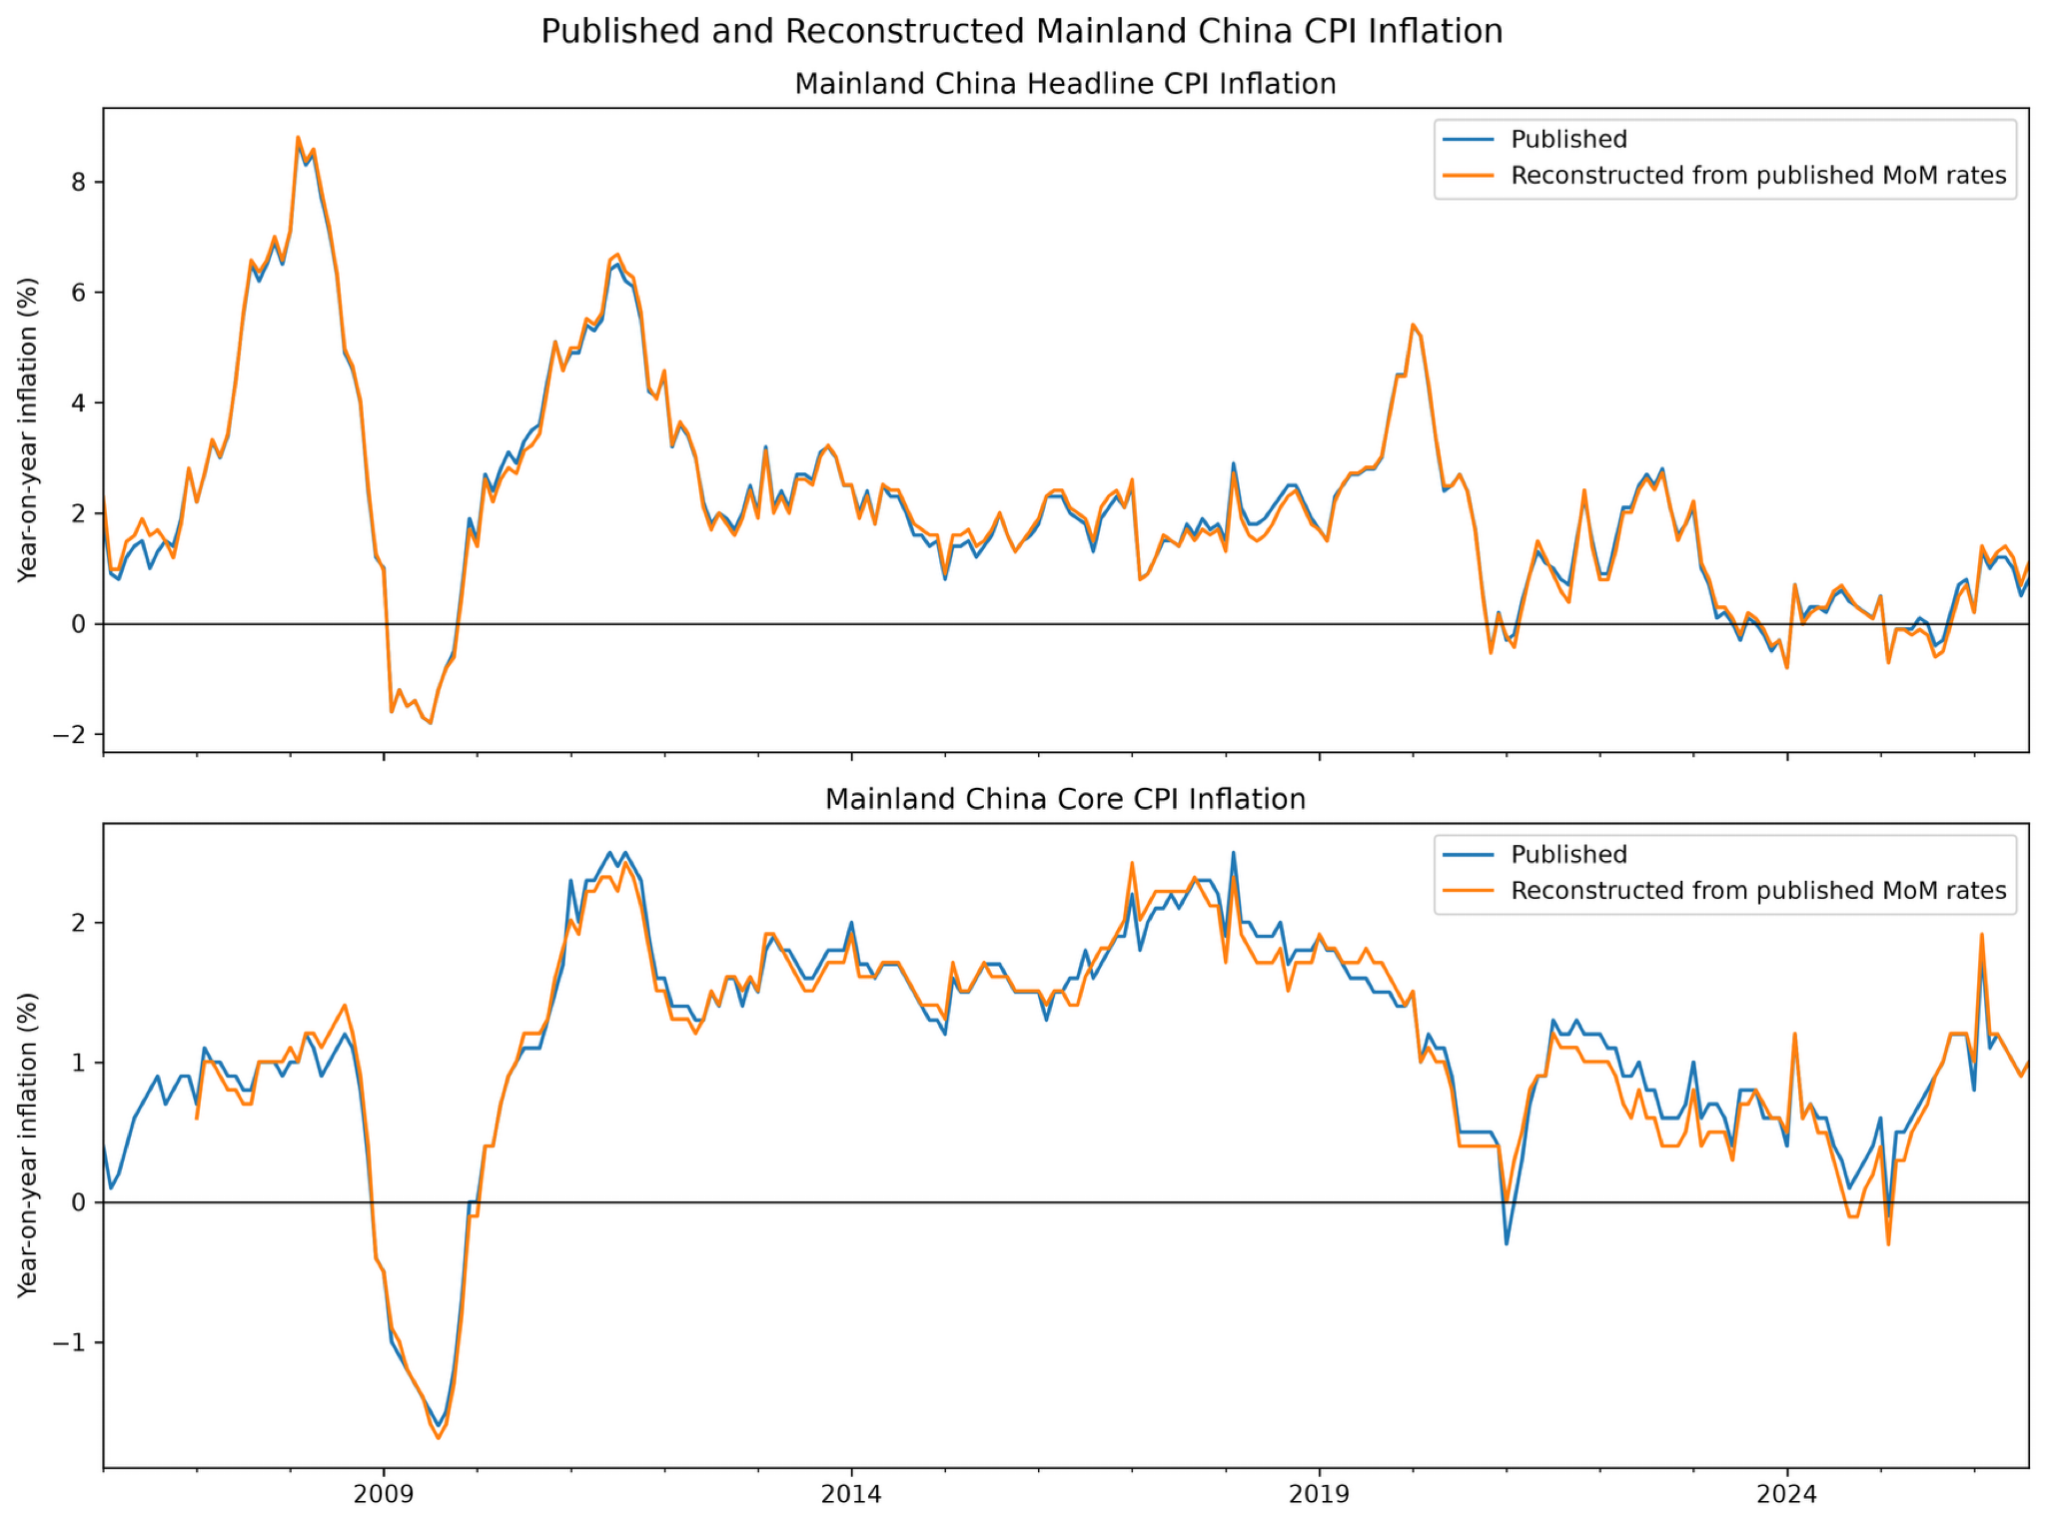
Forecast monthly inflation, evaluate year-on-year outcomes
NBS statistics accessed through CEIC; common headline/core sample starts January 2006
1
Model published
MoM inflation
2
Compound into a
CPI index path
3
Convert to
YoY forecasts
4
Compare with
published YoY
Why this matters
Models forecast monthly rates, but the decision-facing comparison is year-on-year inflation.
The reconstructed series track the published series closely enough for a coherent forecast transformation.
Notes:
About 55 seconds: The models operate on published month-on-month inflation. Each forecast path is compounded into a reconstructed CPI index and converted to year-on-year inflation. The chart shows that reconstructed and published year-on-year inflation move closely together. Small differences are expected because the published monthly rates are rounded. The raw CEIC export remains local; only project-generated outputs are published.
[Sources]
- Project-generated visual: outputs/figures/01_cpi_reconstruction_audit.png
- Project documentation: docs/methodology/DATA_DICTIONARY.md and README.md
[/Sources]

Slide 3
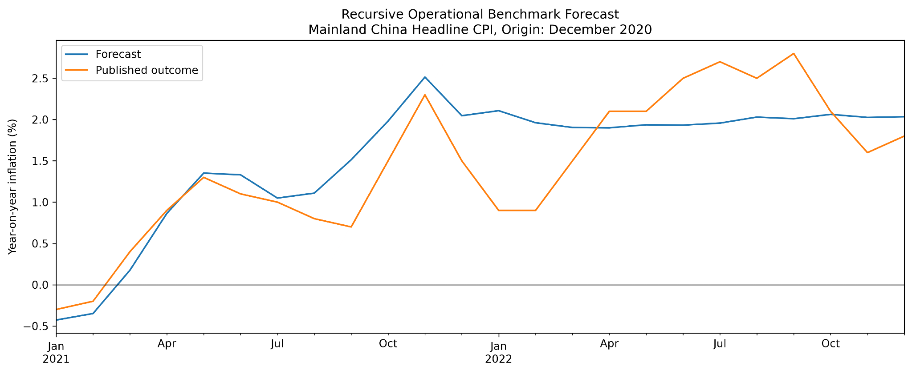
A locked, expanding-window evaluation avoids look-ahead bias
Development decisions end in 2014; final evaluation covers 117 attempted forecast origins
Development
Jan 2006 - Dec 2014
Select and lock models
Final evaluation
Origins: Dec 2014 - Aug 2024
Targets through Aug 2026
24
117
104
max horizon
(months)
attempted
origins
common successful
origins
The benchmark uses the previous five same-calendar-month values and becomes recursive beyond 12 months.
Notes:
About 70 seconds: All model choices were made using data through December 2014. The final expanding-window evaluation then begins at the December 2014 origin, runs through August 2024, and evaluates horizons up to 24 months using realised targets through August 2026. There are 117 attempted origins. Accuracy comparisons use 104 common successful origins so each model is compared on the same observations. The benchmark averages the previous five values for the same calendar month and recursively uses its own forecasts beyond 12 months.
[Sources]
- Project-generated visual: outputs/figures/02_benchmark_forecast_example.png
- Project results: notebooks/04_final_evaluation.ipynb and outputs/tables/04_final_reliability_summary.csv
[/Sources]

Slide 4
The final comparison is deliberately narrow and interpretable
All specifications were locked before final-evaluation outcomes were examined
HEADLINE
CORE
Benchmark
5-year recursive same-month average
Benchmark
5-year recursive same-month average
Conventional
SARIMA (1,0,1)(1,0,1)₁₂
Primary statistical
ARMA(1,1) seasonal ARMA
CNY-aware primary
Seasonal-MA SARIMAX + month + CNY
Reliability robust
MA(2) seasonal ARMA
CNY-aware robust
Seasonal-AR SARIMAX + month + CNY
Selection considered fit, residual diagnostics, valid roots, repeated-origin reliability, and development-stage forecast performance.
The project compares transparent low-complexity models, not a large machine-learning bake-off.
Notes:
About 55 seconds: The final ladder is intentionally small. For headline inflation, I compare the operational benchmark, a conventional CNY-ignorant SARIMA, and two CNY-aware SARIMAX variants. For core, I compare the benchmark with a primary ARMA(1,1) seasonal ARMA and an MA(2) robustness model. Selection used development-period fit, diagnostics, valid stationary and invertible roots, repeated-origin reliability, and forecast performance.
[Sources]
- Project table: outputs/tables/03_locked_model_specifications.csv
[/Sources]

Slide 5
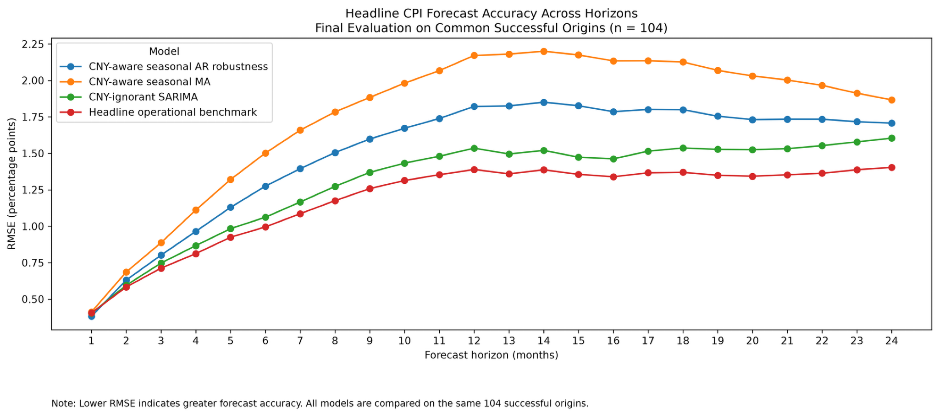
Headline: the benchmark wins beyond one month
Lower RMSE indicates better year-on-year forecast accuracy; n = 104 common successful origins
H1
CNY-aware seasonal AR
has lowest RMSE
H2-24
Operational benchmark
has lowest RMSE
Bias grows with horizon
Negative mean errors indicate systematic overforecasting.
Adding CNY structure improves explanation, but does not deliver general headline forecast superiority.
Notes:
About 70 seconds: The headline result is stark. The CNY-aware seasonal-AR robustness model has the best one-month RMSE, about 0.382 percentage points. From horizons 2 through 24, the simple operational benchmark has the lowest RMSE. At the highlighted horizons, benchmark RMSE is about 0.712 at three months, 0.995 at six months, 1.389 at twelve months, and 1.403 at twenty-four months. Mean errors become more negative at longer horizons, indicating systematic headline overforecasting.
[Sources]
- Project-generated visual: outputs/figures/04_headline_final_rmse.png
- Project table: outputs/tables/04_headline_selected_horizon_metrics.csv
- Project table: outputs/tables/04_best_model_by_horizon.csv
[/Sources]

Slide 6
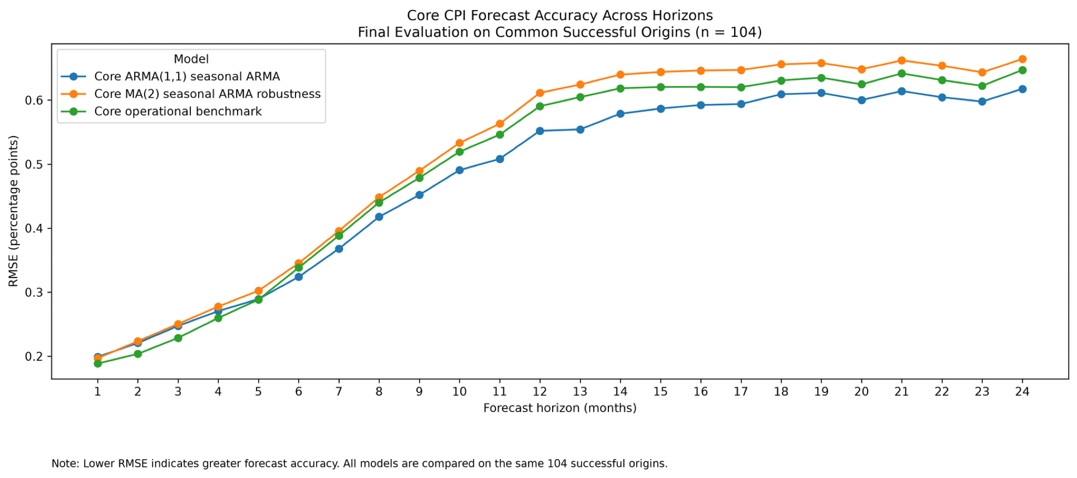
Core: statistical modelling adds value from six months onward
The benchmark leads through H5; the locked ARMA(1,1) seasonal ARMA leads from H6 to H24
H1-5
Operational benchmark
has lowest RMSE
H6-24
Core ARMA(1,1)
has lowest RMSE
H24 RMSE
0.618 statistical
vs 0.647 benchmark
The practical answer differs by target: simple for headline, statistical at longer core horizons.
Notes:
About 60 seconds: Core inflation produces a different answer. The benchmark has the lowest RMSE through horizon five. From horizon six onward, the locked ARMA(1,1) seasonal ARMA is best. At horizon 24, its RMSE is about 0.618 percentage points versus 0.647 for the benchmark. Core bias is also smaller than headline bias. This target-specific result argues against selecting one universal forecasting method.
[Sources]
- Project-generated visual: outputs/figures/04_core_final_rmse.png
- Project table: outputs/tables/04_core_selected_horizon_metrics.csv
- Project table: outputs/tables/04_best_model_by_horizon.csv
[/Sources]

Slide 7
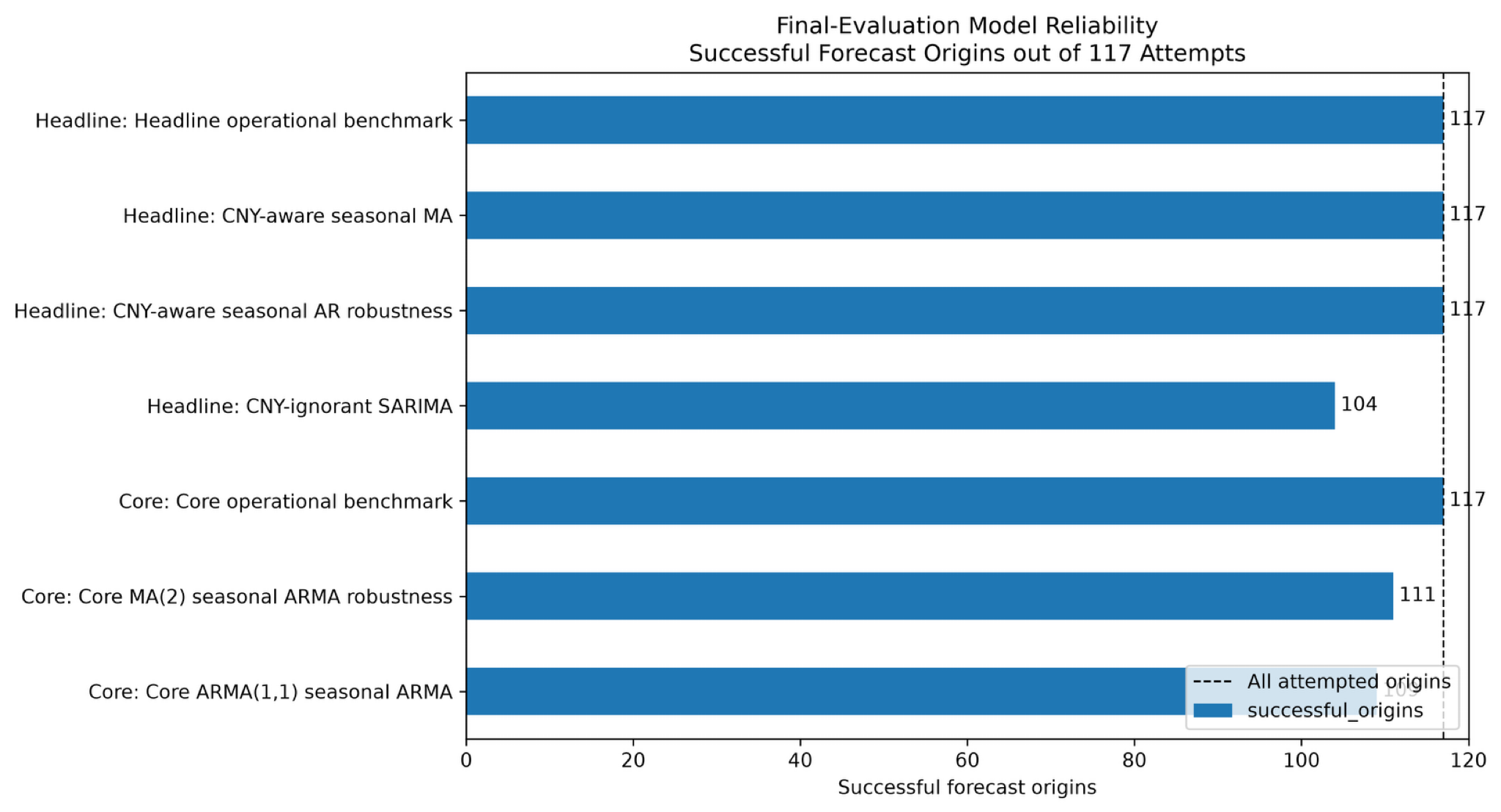
Accuracy is conditional on models producing valid forecasts
Reliability is reported across all 117 attempted origins, separately from paired accuracy
100%
100%
benchmarks
CNY-aware headline
88.9%
93.2%
CNY-ignorant headline
core ARMA(1,1)
Why separate the metrics?
A low RMSE on successful origins does not compensate for frequent fitting failure.
Operational usefulness depends on both loss and the probability of obtaining a valid forecast.
Notes:
About 60 seconds: RMSE alone is incomplete because statistical models can fail to converge or generate invalid paths. Both operational benchmarks succeed at all 117 origins. Both CNY-aware headline models also succeed at all origins. The CNY-ignorant headline SARIMA succeeds at 104, or 88.9 percent. The core ARMA(1,1) model succeeds at 109, or 93.2 percent, and the core MA(2) model at 111, or 94.9 percent. This is why reliability is reported separately.
[Sources]
- Project-generated visual: outputs/figures/04_final_model_reliability.png
- Project table: outputs/tables/04_final_reliability_summary.csv
[/Sources]

Slide 8
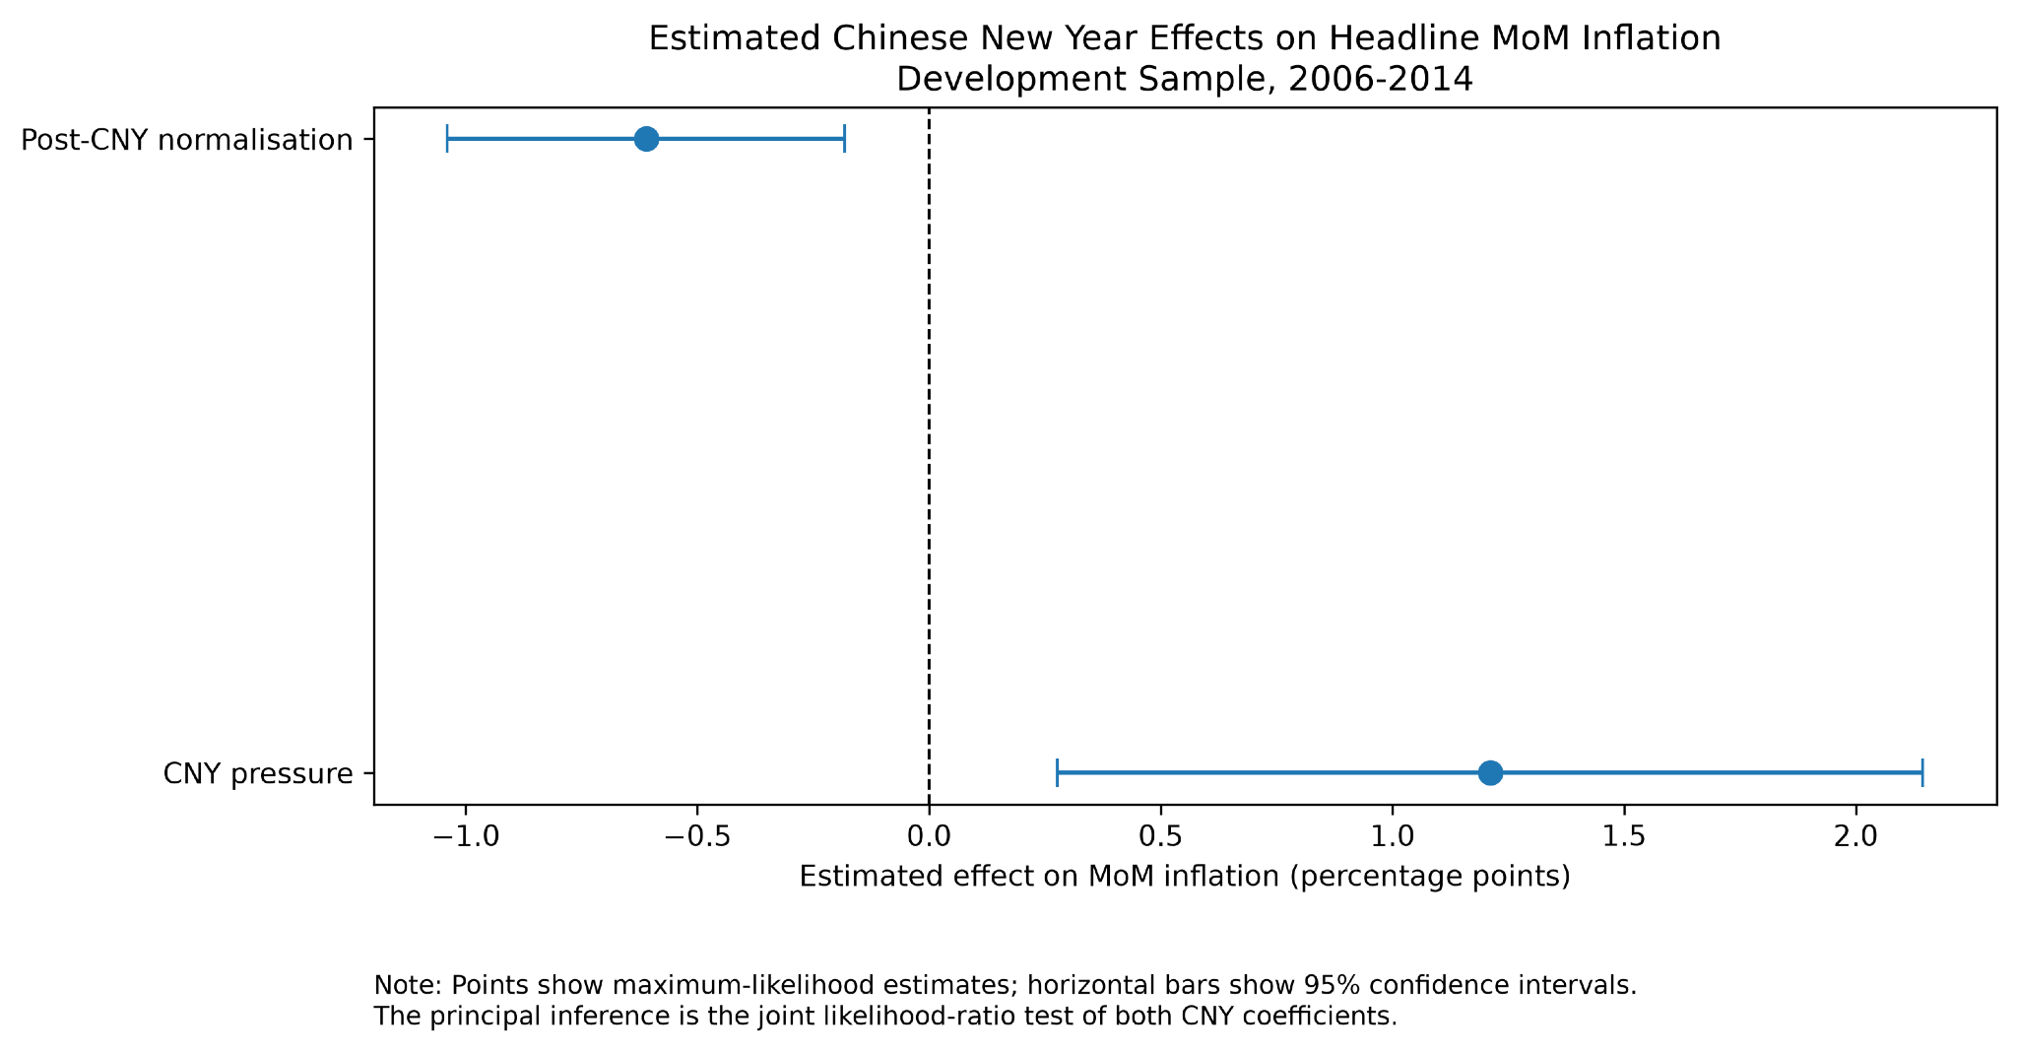
CNY effects are explanatory, not a guarantee of forecast gains
Matched likelihood-ratio test on the 2006-2014 development sample
Joint LR test
LR = 28.985
df = 2
p ≈ 5.08 × 10⁻⁷
Estimated effects
Pressure: +1.211 pp
Normalisation: -0.611 pp
Strong in-sample likelihood evidence coexists with weak medium- and long-horizon headline forecast performance.
Notes:
About 80 seconds: For inference, I compare matched restricted and unrestricted headline models using the same 108 observations, month indicators, and SARIMA error structure. The unrestricted model adds exactly two CNY regressors. The likelihood-ratio statistic is 28.985 with two degrees of freedom and a p-value about 5.08 times ten to the minus seven. CNY pressure is estimated at plus 1.211 percentage points, while post-CNY normalisation is minus 0.611; both 95 percent confidence intervals exclude zero. This is strong explanatory evidence, but the forecast results show it does not guarantee lower multi-step forecast errors.
[Sources]
- Project-generated visual: outputs/figures/05_cny_coefficient_estimates.png
- Project tables: outputs/tables/05_cny_likelihood_ratio_test.csv and outputs/tables/05_cny_coefficient_results.csv
- Higher-precision p-value from notebooks/05_results_and_inference.ipynb
[/Sources]

Slide 9
Decision takeaway: use different tools for different purposes
Forecast accuracy, reliability, and explanatory inference answer distinct questions
HEADLINE
CORE
CNY INFERENCE
Default to the benchmark
Use the statistical model at longer horizons
Use CNY variables for explanation
Best RMSE from H2-H24
Perfect operational reliability
Benchmark through H5
ARMA(1,1) from H6-H24
Strong LR evidence
Not a forecast guarantee
Key limitations
Published rather than real-time vintages • reconstructed index levels • rounded MoM rates • deterministic CNY windows • some near-boundary roots and fitting failures
More structure can improve interpretation without improving operational forecasts.
Notes:
About 55 seconds: The decision takeaway is target-specific. For headline inflation, use the operational benchmark as the default beyond one month. For core inflation, use the benchmark at short horizons and the ARMA(1,1) seasonal model from six months onward. Treat the CNY variables as useful explanatory structure, not as a guarantee of better forecasts. The main limitations are published rather than real-time vintages, reconstructed index levels, rounding in monthly rates, deterministic CNY windows, and some near-boundary roots and fitting failures.
[Sources]
- Project conclusions: README.md, notebooks/04_final_evaluation.ipynb, notebooks/05_results_and_inference.ipynb
- Official requirement: DS607_group_project_guidelines.pdf (decision-maker takeaway and limitations)
[/Sources]

Slide 10
Backup slides
For technical questions on specifications, CNY construction, and development-stage selection
Notes:
Use only if needed during Q&A.
[Sources]
- Project documentation and outputs
[/Sources]

Slide 11
Backup: exact locked specifications
Development-stage choices carried unchanged into final evaluation
Target
Role
Order
Seasonal order
Deterministic terms
Headline
Conventional
(1,0,1)
(1,0,1,12)
Intercept
Headline
CNY-aware MA
(1,0,1)
(0,0,1,12)
Intercept + month + 2 CNY
Headline
CNY-aware AR
(1,0,1)
(1,0,0,12)
Intercept + month + 2 CNY
Core
Primary
(1,0,1)
(1,0,1,12)
Intercept
Core
Robustness
(0,0,2)
(1,0,1,12)
Intercept
No final-evaluation result was used to reopen model selection.
Notes:
Backup: Use this table if asked for the exact nonseasonal, seasonal, and deterministic specifications.
[Sources]
- Project table: outputs/tables/03_locked_model_specifications.csv
[/Sources]

Slide 12
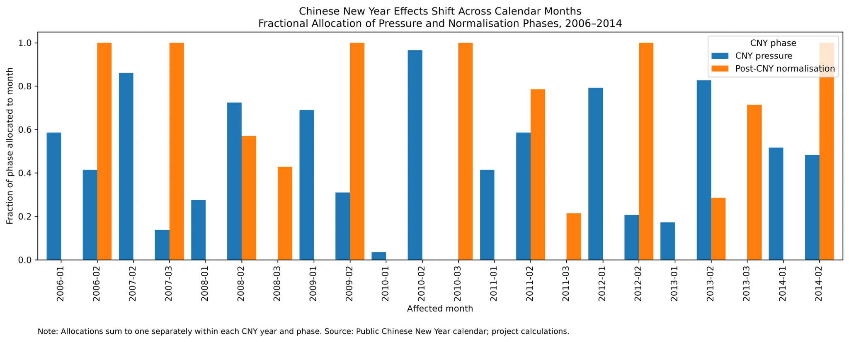
Backup: the CNY phases move across calendar months
Fractional monthly allocation prevents a fixed-February dummy from misclassifying the holiday effect
Pressure and normalisation are allocated by affected days, then each phase sums to one within year.
Notes:
Backup: The lunar holiday shifts between January and February, and the normalisation phase can extend into March. The regressors therefore allocate affected days fractionally across Gregorian months.
[Sources]
- Project-generated visual: outputs/figures/03_cny_monthly_allocations.png
[/Sources]

Slide 13
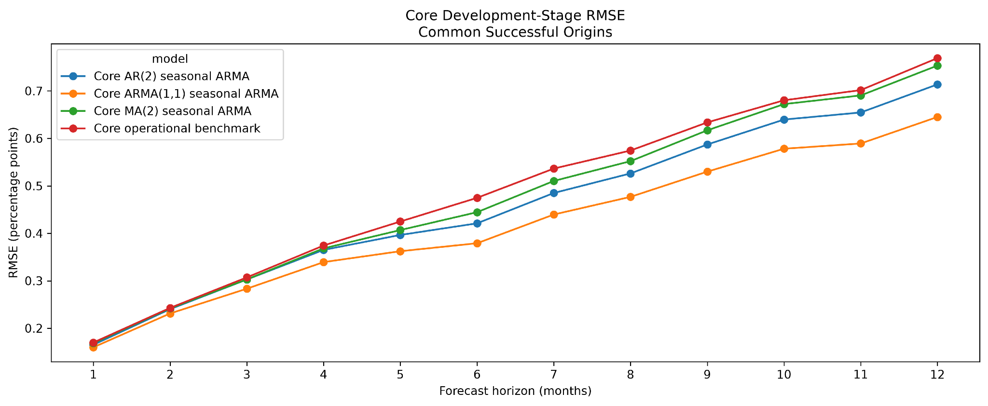
Backup: development-stage evidence selected the core primary model
Internal validation precedes and is separate from the final evaluation
The ARMA(1,1) seasonal ARMA led development-stage RMSE, then also led final RMSE from H6 onward.
Notes:
Backup: This development-stage chart shows why the core ARMA(1,1) seasonal ARMA was locked as the primary statistical model before the final period was examined.
[Sources]
- Project-generated visual: outputs/figures/03_core_development_rmse.png
[/Sources]

