Slide 1
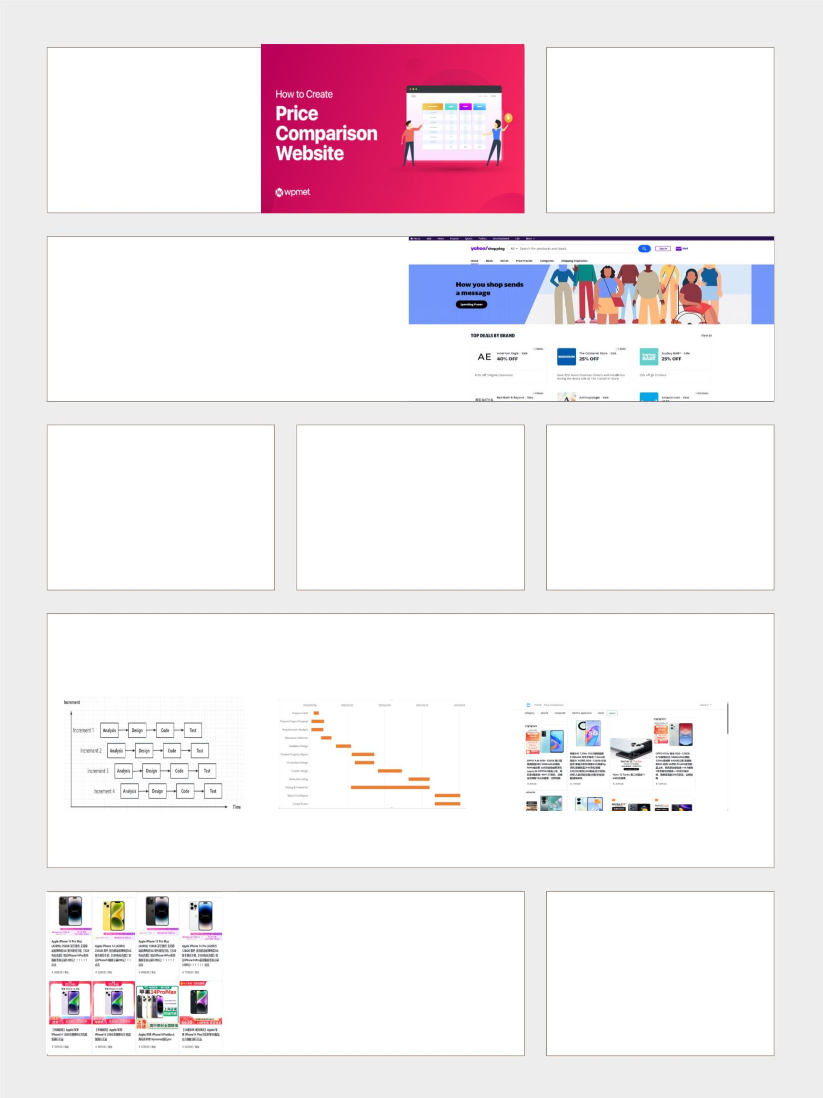
Price
Authors
comparison
system
Darren（Zhu Xunran）
Chengdu University of Technology
School of Computer and Cyber Security
(Oxford Brookes Institute)
poster
Computer Science and Technology
Introduction
With the gradual rise of Internet technology, people's lifestyles and shopping habits
have changed and online shopping has become increasingly popular. People are
keen to compare prices on products when shopping online. A price comparison
system that can display matching products from multiple shopping platforms and
display product information and price comparison results after users enter relevant
search terms would provide great convenience to users. How to implement this price
comparison system to improve the convenience of consumer shopping has become
the focus of the moment.
Objective
Methodology
Results
(1) Define project requirements
In this project, the development model is incremental,
which is a step-by-step development model. Each
phase of the project can be completed independently.
The front-end technology uses html-based Bootstrap
framework, the back-end code uses Python language,
the database uses MySQL, and the crawler is
designed using Beautiful Soup. finally integrated into a
complete system to meet the final project
development requirements.
The project design was tested after completion. In
the test results, users were able to sign in and out,
display products on the home screen and paginate
products, and filter and compare prices. In general,
the system basically fulfilled its function and met the
development requirements, and achieved the
expected purpose.
(2) Background research
(3) Establish project development steps
(4) Database design
(5) Crawler technology design
(6) Front-end UI design
(7) Back-end code design
(8) Testing and Implementation
Analysis
Shows the model of the project development, the time nodes allocated for the development project and the main front-end interface
after the project development is completed.
Incremental model diagrams
show the development steps
Use Gantt charts to refine development time
System main interface display
Conclusion
Related Literature
This project is a web-based price comparison system for online
shopping platforms. In this project, Python is used as the
development language, Beautiful Soup as the crawler framework,
MySQL as the database, Flask as the back-end framework, and
Bootstrap as the front-end framework. Each part is linked by
back-end code on PyCharm compiler to finally form a complete
price comparison system. The requirements of the development
design were met and the intended purpose was achieved.
1. S. Sharma and P. Gupta, “The anatomy of web
crawlers,”in International Conference on Computing,
Communication and Automation, ICCCA 2015,
Institute of Electrical and Electronics Engineers Inc.,
Jul. 2015, pp. 849–853. doi:
10.1109/CCAA.2015.7148493.
an, 2. L. Yang, S. Lan, and X. Tong, “Application of
HTML5 multimedia,” in Proceedings - 2012
International Conference on Computer Science and
Information Processing, CSIP 2012, 2012, pp. 871–
874. doi: 10.1109/CSIP.2012.6308992.

