Slide 1


CIS2348 Final Project
Darrian Woodard
12/4/20

Slide 2
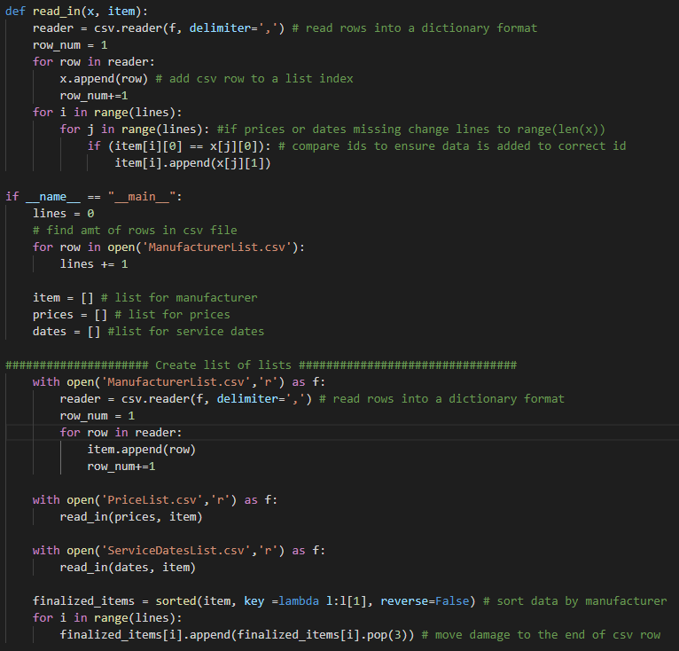
Reading in Data

Slide 3

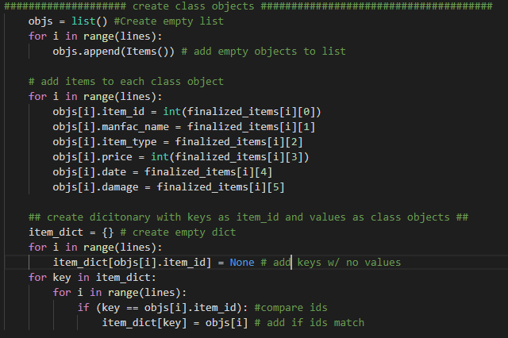
Class

Slide 4
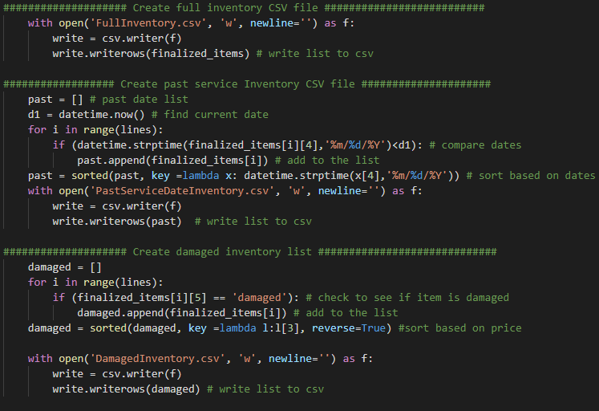
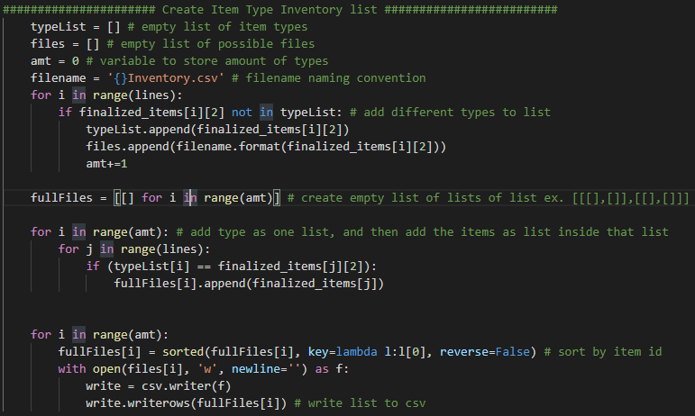
Writing to Files

Slide 5
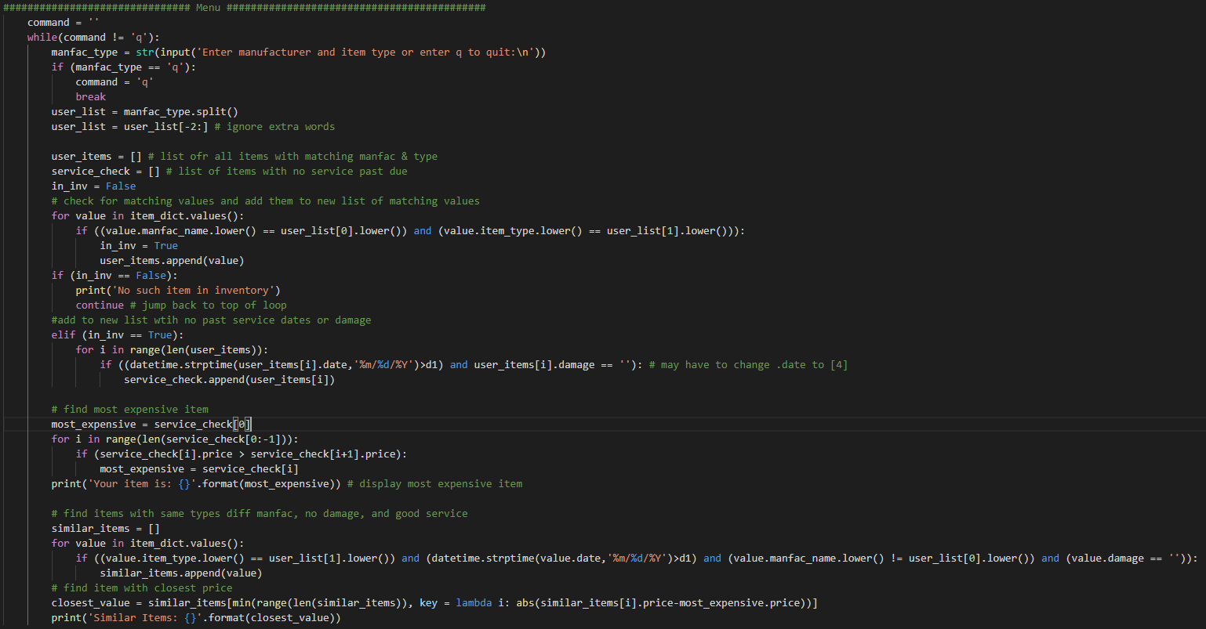
Menu

