Slide 1
Team members
Team no: 20
Subject Code: CS6611 Subject Name: Creative and Innovative project
Project Title: Model generation to identify public opinion towards tourism from tweets
S.No | Name | Register No
1 | Aparna G | 2018103515
2 | Darrshana R | 2018103521
3 | Soumya S | 2018103596

Slide 2
ABSTRACT
Travel and Tourism industry has emerged as one of the largest and fastest growing economic sectors globally.
Its contribution to the global Gross Domestic Product and employment has increased significantly.
Social media has changed every single aspect of human lives, it has become an integral part of our everyday lives.
Their influence is significant, both for personal aspect and for business. The use of social networks is leading individuals and businesses towards a new era for the global economy.
With the growing use of social media in the tourism industry, a substantial amount of user-generated content containing tourism information and sentiment is readily available but a large amount of this data goes unanalyzed.
Our project attempts to address this problem in the context of tweets made in India with the use of natural language processing and machine learning techniques.

Slide 3
INTRODUCTION
Nowadays, the age of Internet has changed the way people express their views and opinions.
Social media has become a part and parcel of our lives today and the emergence of Social media platforms has provided a new dais for communication for both the consumers and marketers.
Twitter is one of such social media platform where common people shares their reviews in short blogs.
Tourism and urban everyday life are deeply connected in a mutually constitutive way.
Tourism industry is probably one of the most affected by the introduction of social media and micro-blogging websites.
These twitter reviews on tourism by family and friends work like electronic word of mouth and become major factors during their buying decision.
Sentiment analysis is the automated process of identifying and classifying subjective information in text data.
In this project, we have performed sentiment analysis on the tweets extracted from the TwitterAPI.
And finally we have classified user opinion as positive or negative and provided a rating score about a tourist spot specified by the user
Specific summaries related to the safety, ambience, cleanliness and transportation are provided.

Slide 4
PROBLEM STATEMENT
Usually when people travel to a particular tourist spot they cast their opinion about the place in twitter in form of tweets.
Most people find twitter to be an effective platform where they can cast their opinion without any hinderance.
These tweets can be effectively analyzed and to deduce a general review about the particular tourist spot.
Hence, given a set of tweets containing multiple features and varied opinions pertaining to various tourist spots across the nation, the objective of our project is to extract expressions of sentiment describing a target feature from the tweets, classify it as positive or negative and further generate general and specific summaries regarding the particular tourist spot.

Slide 5
LITERATURE SURVEY
S.No | Author | Publication | Year | Methodology | Advantages | Limitations
1 | Kazutaka Shimada, Shunsuke Inoue, Hiroshi Maeda and Tsutomu Endo | The First ACIS International Symposium on Software and Network Engineering | 2011 | In this paper they have focused on an supervised machine learning approach, which needs manually annotated training data. It is based on seed words and pseudo training data extracted from a non-tagged corpus. They have used naive bayes method as a means to classify tweets into positive or negative. The naive bayes classifier generates the model from the vector space. | This paper has a good explanation about Vector Space Generation and Naïve Bayes Classification. The same methods are going to be adopted for our model | Data Filtration methods were not very clear. The number of training inputs were not sufficient hence the accuracy of Naïve Bayes classification was low.

Slide 6
2 | Rico Yudha Saputra,Lukito Edi Nugroho,Sri Suning Kusumawardani. | The International Conference on Information and Communications Technology (ICOIACT) | 2019 | The authors have explained about the various criteria to consider while collecting data for the project. The Tourism Contextual Information consists of information about tourists, tour destination, location, time, social, architecture and weather. The problem of how to effectively integrate and distribute heterogeneous data sources were handled in this paper. Before the heterogeneous data were connected, the authors have performed the ETL (Extract Transform Load) phase was conducted. | The paper has explained in detail how to effectively integrate and distribute heterogeneous data sources i.e the data coming from any source and in the various format. It explains about the literature-based study that was conducted by collecting, reviewing and analyzing the topic related to the tourism recommendation system. | The authors have collected data based on six factors only which limits the correctness of the suggestion provided to the users.

Slide 7
3 | Muhammad Afzaal,Muhammad Usman. | The Tenth International Conference on Digital Information Management (ICDIM) | 2015 | The authors have proposed a tourism information analysis system that performs analysis on the tweets and then divides them on the basis of positive and negative sentiments. System firstly takes tweets from the twitter as input. Secondly, extracts the tourism related tweets and discards the remaining ones. Thirdly, apply sentiment analysis on extracted tweets. | The positive aspect of this paper is that the proposed method applies post-processing on the tweets before applying sentiment analysis. As a result tourism related tweets separate to the other remaining tweets. The classification of tweets into positive and negative sentiments related tweets has accuracy of approximately 0.92 that is nearly the human ability. | The limitation of the work is that method extracts some irrelevant sentences from the tourist tweets that have not any relationship with targeted tourist place and this causes noise in tweets classification.

Slide 8
4 | Ananchai Muangon, Sotarat Thammaboosadee,Choochart Haruechaiyasak. | International Conference on Digital Information and Communication Technology and its Applications(DIC TAP) | 2014 | The methodology included in this paper involves data collection from Agoda (www.agoda.com) website and they have used feature-based opinion mining method to extract opinions. The pre-processing are supported by LexToPus and the result of the pre-processing step is a pattern of the segment that contains both features and polar words. They have finally summed up the opinion scores of different features and have build a combination strategy on subjective logic. | The authors have clearly explained about the usage of feature-based opinion mining, where features refer to the categories of opinions and opinion mining is the process of classifying them into different scales. Features and polar words are used as the lexicons and they have extracted these from the opinion text based on syntactic pattern analysis and by calculating the sentiment scores. | They have done opinion mining based on the feedback that a hotel collects from their customer which maybe limited and which may not be true as the customer might not express his/her true opinion.

Slide 9
5 | Ankur Goel,Jyoti Gautam,Sitesh Kumar | The 2nd International Conference on Next Generation Computing Technologies Dehradun | 2016 | The authors have employed Naive Bayes algorithm to perform sentiment analysis on tweets. Training corpus of Sentiment1403 is used as training data for the classification of tweets . | This paper clearly explains the implementation of Naïve Bayes for sentiment analysis. This paper mentions that this method can be extended to any review related website for example product review to understand products popularity , movie review etc . Determining consumer attitudes and trends is one of the major applications of sentiment analysis of data. | This sentiment analysis model has a flaw that it takes a lot of time in fetching data from twitter and in data management.

Slide 10
ISSUE IDENTIFIED
In the base paper 1, by the data filtration methods were not mentioned clearly and the number of training inputs were not sufficient .
In our project, we have done data filtration in multiple steps i.e we have performed Morphological Analysis by breaking each tweet into words
Further for data filtration, the noisy and unwanted data are removed.
The name of the spot might not always refer to a tourist location, for instance Palani might also refer to a person. Such tweets were removed
We have collected a decent no of tweets from the TwitterAPI so that there will be sufficient data for the training and testing datasets.
In the reference papers, the sentiment analysis were performed on the reviews collected from the customers in their official portal.
Oftentimes, these reviews wont be the real reflection of what the customer might feel.
Instead of performing sentiment analysis on reviews collected by a hotel, we have performed them on tweets collected form the Twitter API by considering various features such as transport, cleanliness, safety and local ambience.
To resolve the issue of unwanted tweets that were collected , we done noisy data removal using Regex

Slide 11
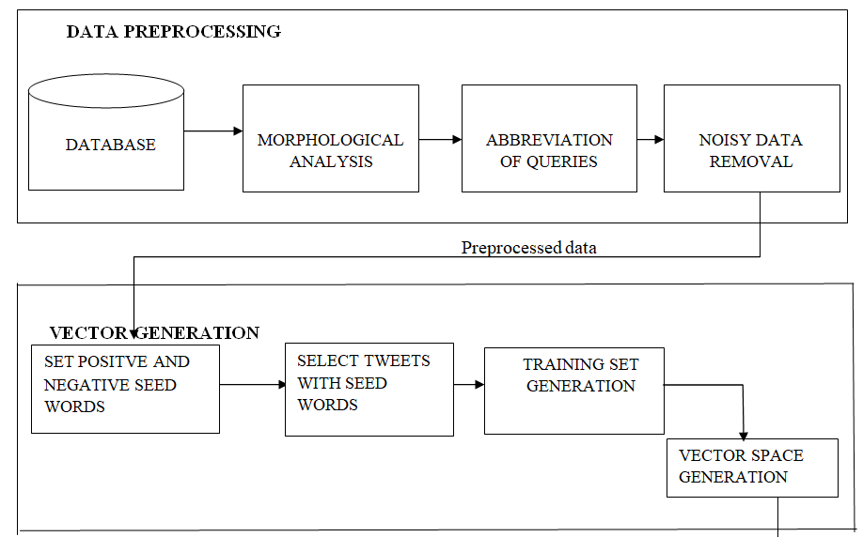
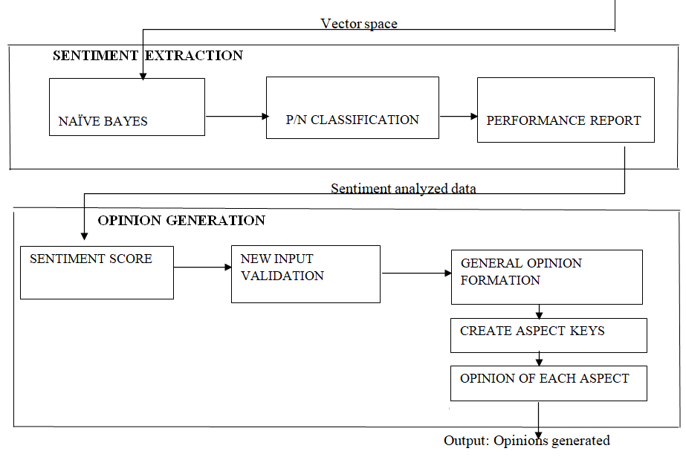
BLOCK DIAGRAM

Slide 12
Module wise input and output
Module | Input | Output
Data Pre-processing | Tweets from twitter API | Pre-processed cleaned tweets
Vector Generation | Pre-Processed Tweets | Vector Space
Sentiment Extraction | Vector Space | Sentiment Analysed data
Opinion Generation | Sentiment Analysed Data | Opinion Generated

Slide 13
Data Description
DATASET NAME | CUSTOM DATASET (TOURISM RELATED TWEETS FROM TWITTER API)
INPUT DATASET COLLECTED | TOURISM RELATED TWEETS FOR THE FOLLOWING TOURIST SPOTS: 1.Mumbai 2.Delhi 3.Kashmir 4.Kerala 5.NorthEast India 6.Ladakh
TYPE OF DATA | TEXT
SIZE OF THE DATA COLLECTED (CSV file size) | 1.Mumbai - 7KB 2.Delhi - 10KB 3.Kashmir – 10KB 4.Kerala – 9 KB 5.Ladakh – 7 KB 6.NorthEast India – 7KB
SOURCE OF DATA | TWEETS EXTRACTED FROM THE TWITTER API

Slide 14
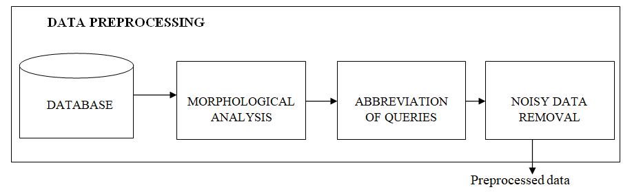
MODULES Module1: Data pre-processing
The Twitter Application Programming Interface (API) allows the user to read and write Twitter data.
Hence, the users can use it to compose tweets, read profiles, and access a high volume of tweets on particular subjects in specific locations.
In the Data pre-processing module we extract tourism related tweets from the Twitter API by using the manually prepared query list.
We then perform morphological analysis on this data by dividing the sentence into words which means to identify, structure and investigate the total set of possible relationships contained in the given dataset.
The next process in data pre-processing module is abbreviation of basic queries. We acquire the related words of the basic query and prepare the final queries.
The final queries for the retrieval are a combination of tourist spots. Tweets often contain unwanted or irrelevant data known as noisy data.
If a tweet contains unwanted information then that tweet is removed from the dataset, through this process we have collected tweets from twitter API for many Tourist spot across India.

Slide 15
Pseudo code
Get tweets:
Input: Tweets from Twitter API( extracted using tweepy)
Output: Cleaned Tweets
Authenticate keys
Get API connection
Get PlaceName from user
Get StartDate from user
Set places list
Ask if want to add spots in PlaceName
If PlaceName.csv exist :
Index = len(PlaceName.csv)
Else
Index = 0 If yes
Ask for number of spots n
Get n spots
Append to places list
Open PlaceName.csv file
for i = index to places.length:
Tweet = Get english tweets with places[i] in it
If tweet is not retweeted:
Append to PlaceName.csv Clean Tweets: function clean_tweets(tweets)
tweets = tweets - urls
tweets = tweets - ‘@’
tweets = tweets = ‘RT’ wordlist.extend(tokenizer.tokenize(tweet))
set stopwords endfunction newFile = “cleaned”+PlaceName.csv
csvFile = open(newfile)
csvWriter = csv.writer(csvFile)
myFile = openRead("example.txt")
while NOT myFile.endOfFile()
csvreader = csv.reader(myFile)
For each row in csvreader:
String clean_tweets(row)
csvWriter.writerow([string])
endwhile
myFile.close()

Slide 16
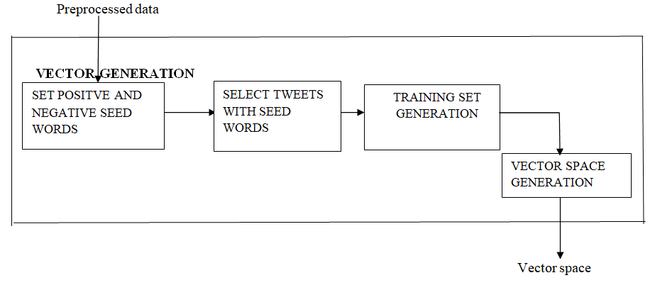
Module 2: Vector Space Generation
The main purpose of this module is to split the dataset into training and testing sets. Based on the training dataset, the vector space will be generated which will be used for future classifications.
We are going to do an supervised machine learning approach, which needs manually annotated training data. It is based on seed words
The proposed method for classifying a place is based on seed words. The words like “excellent” and “poor” can be used and seed words for the positive and negative categories respectively and then compute the semantic orientation of a phrase by using Pointwise Mutual Information (PMI) between the seed word and the phrase. We use “:-)”, “xD” as positive and “:/” , “:-(” as negative because the tweets on Twitter are often informal and contain symbols.
Example: Pseudo positive training dataset: “The view from Ladakh was amazing and breathtaking.” Pseudo negative training dataset: “Palolem beach was very dirty and filled with garbage.” From the training dataset, we get the vector space with seed words classified into positive or negative as follows:
Class ...., amazing, ...., breath taking,...,dirty, ..., garbage...
Pos : ........, 1, ................, 1, ................, 0, ..........., 0, .....
Neg: ........, 0, ................, 0, ................, 1, ..........., 1, .....

Slide 17
Pseudo code
Input: Pre-processed tweets
Output: Vector Space
Set seed words:
Set positive seed array
Set negative seed array
function positive_tweets(tweet):
for i from 0 to positive_seed.length()
if tweet has positive_seed[i]
return tweet
return “ ”
endfunction
Function negative_tweets(tweet):
for i from 0 to negative_seed.length()
if tweet has negative_seed[i]
return tweet
return “ ”
endfunction

Slide 18
Vector space generation:
function vector_space(wordlist)
rows, cols = (2,len(wordlist))
m = [[1 for i in range(cols)] for j in range(rows)]
for i in range(0,int(len(wordlist))):
if( positive_seed has wordlist[i]) :
m[0][i] = 1
m[1][i] = 0
else if ( negative_seed has wordlist[i]):
m[0][i] = 0
m[1][i] = 1
else:
m[0][i]=0.5
m[1][1]=0.5
pd.DataFrame(m, columns=wordlist)
tf = TfidfVectorizer()
m = tf.fit_transform(m).todense()
Print vector space

Slide 19
Separating positive and negative tweets:
Ask for filename
Get input as n
If n>=0
Newfile1 = positive+filename
Else
Newfile1 = negative+filename
csvFile = openRead("Newfile1.csv")
csvWriter = csv.writer(csvFile)
csvreader = csv.reader(csvFile)
row = myFile.readLine()
tokenizer = RegexpTokenizer(r'#?\w+')
wordlist = [ ]
wordlist.extend(tokenizer.tokenize(str(row)))
for w in wordlist :
words.append(w)
vector_space(words)

Slide 20
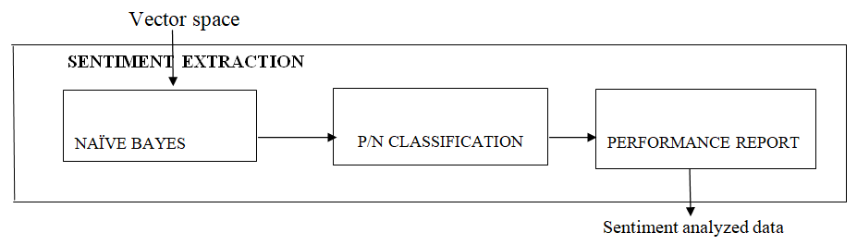
Module 3: Sentiment Extraction
The main purpose of this module is to classify each tweet into the testing set into positive or negative opinion. To do so we are going to use Naive Bayes Algorithm.
The reason for using Naive Bayes is that it is a very straightforward and fast classification algorithm.
It is very suitable in this case because of the large size of the dataset. It performs well even when the size of the training dataset is less.
Naive Bayes rule describes the probability of an event on prior knowledge of the occurrence of another event related to it. Then the probability of occurrence of event A given that event B has already occurred is P(A|B) = P(A)P(B|A)/P(B).
In order to get the probability stats for the words, we will be creating a dictionary of these words and counting the occurrence of each word in positive and negative tweets.
In the Naive Bayes, we will find how each word is contributing to the sentiment, which can be calculated by the ratio of the probability of occurrence of the word for positive and negative class.
The naive bayes classifier generates the model from the vector space.

Slide 21
Pseudo code
Input: Training and testing sets Output: Trained Naive Bayes Classifier(sentiment analyzed data) Combine All tweets for classification: inputs = [list of cleaned and classified dataset names] for i in range(0,len(inputs)): with open(inputs[i], 'r') as f1, open("tweets.csv", 'a') as f2 : line <- f1.readline() line <- f1.readline() write_outfile = csv.writer(f2) while line != "" : if 'positive' in inputs[i]: write_outfile.writerow([line,1]) line = f1.readline() else : write_outfile.writerow([line,-1]) line = f1.readline()

Slide 22
Naive Bayes:
df1 = pd.read_csv('datasets.csv')
X = df1[df1.columns[0]]
y = df1[df1.columns[1]]
Apply TfidfVectorizer
Transform vectorized data
Split into training and testing sets = X_train, X_test, y_train, y_test
#Apply Naive Bayes
model_naive = MultinomialNB().fit(X_train, y_train)
Predict for testing set
#Performance metrics
Print confusion matrix
Print accuracy
Print classification report
Test model for new Tweets:
Input: Tweets in text format
Output: PN classification
df2 = pd.read_csv('testinputs.csv')
X_pred = df2[df2.columns[0]]
temp_X = X_pred
Transform new inputs <= final_vector_data
Predict for final_vector_data <= new_output
For i from 0 to new_output.length
If new_output =1
print(‘Positive’)
Else
print(‘Negative’)

Slide 23
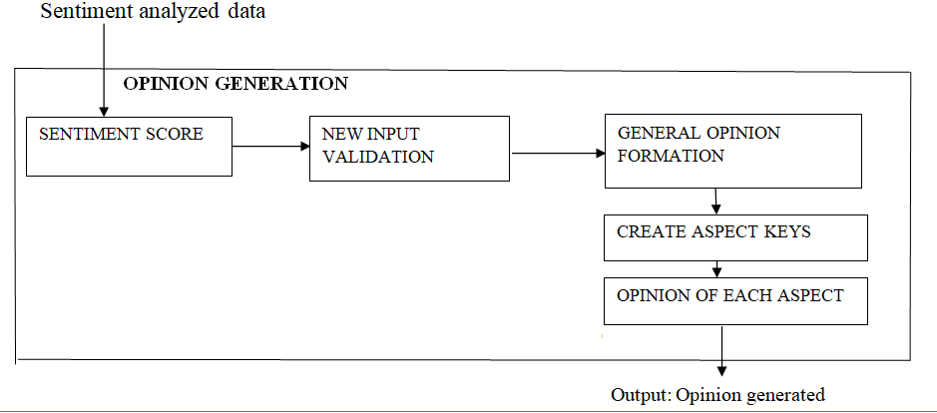
Module 4: Opinion Generation
The goal of this module is to calculate the sentiment score of each tourist spot. Based on the score and the user tweets, the model prints the general opinion of the given spot.
We calculate the sentiment score of each spot by counting the number of positive and negative classifications.
A place has a sentiment score above 8 is considered as a “good(more positive)” tourist spot, else a “bad(more negative)” spot.
The general opinion of a spot is mainly focused on details from the classified class (positive or negative) of tweets.
We have performed the summarizer using T5 summarizer model. We have further extended this idea and have made specific summary of a tourist spot considering four criteria namely safety, cleanliness, local ambience and transportation.
If the user specifies a tourist spot and a criteria, the general opinion about that place related to the criteria is printed.

Slide 24
Pseudo code
Input: Sentiments Analysed data
Output: Sentiment Score and Input Validation
Calculate Sentiment Score:
Toursit_places[0] = mumbai'
Toursit_places[1] = 'northeast'
Tourist_places[2] = ‘kashmir'
Toursit_places[3] = ‘ladakh'
Toursit_places[4] = 'kerala'
Toursit_places[5] = ‘delhi’
For i from 0 to tourist_places.length
df1 = read_csv(tourist_places[i]+'dataset.csv')
X = df1[df1.columns[0]]
y = df1[df1.columns[1]]
pos = 0
for j in range(0, X.length) :
if(y[j]=1) :
pos+=1
senti_score <= (pos/X.length*100)
rating+= senti_score rounded to 2 decimal places
Sort placenames and ratings according to senti_score

Slide 25
Find rating of places: Ask for placename input
Check if valid input
If rating[placename] > 8
Print great tourist spot
Else if rating[placename] > 5
Print average tourist spot
Else
Print poor tourist spot
Validating user input: Function clean_tweets(tweet)
if(tweet has @, # , url)
Remove them
Set stop words
Tokenize tweets and store in wordlist
if wordlist.length<2
Print ‘Tweets are not related to tourism’
Exit
For i from 0 to stopwords.length()
If tweets has stopwords[i]
Print ‘Tweets are not related to tourism’
Exit
Print ‘Thankyou for your opinion’
Return tweet
Endoffunction Set allowed_places
Created a dictionary of allowed places and their tourist spots
Keep placename input
Tweet <=Get input opinion
Validate opinion clean_tweets(tweet)
if(not valid) :
exit(1)
csvFile = openRead("testinput.csv")
csvWriter = csv.writer(csvFile)
csvWriter.write(testinputs.csv)

Slide 26
Input : New Tweet(Text)
Output: Sentiment Analysed text
Predict Sentiment of user input:
Transform user input
Send to naive bayes model
if(sentiment == 1)
Positive opinion
Else
Negative opinion
Add tweet and sentiment in dataset

Slide 27
Input: Tweets
Output: Positive and Negative summary of the given place
General Summary: Get input for PlaceName Collect positive tweets of PlaceName
Create T5 summarizer model
Feed tweets to model
Summary_p = Generate model summary with unwanted symbols Collect negative tweets of PlaceName
Create T5 summarizer model
Feed tweets to model
Summary_ n = Generate model summary with unwanted symbols function remove_unwanted(tweets)
Tweet.remove(‘<extra_id_1>')
tweet.remove(‘<pad>’)
tweet.remove(‘</s>’)
Return tweet Final_p = remove_unwanted(Summary_p)
Print Final_p
Final_n = remove_unwanted(Summary_n)
Print Final_n

Slide 28
Input: Place name and aspect
Output: General summarised opinion
Specific Aspect Summary:
Get PlaceName
Set transport_keys []
Set safety_keys []
Set clean_keys[]
Set local_keys[] Function collect_opinion(PlaceName, arr,flag )
sign = ""
if flag == -1:
sign = "negative"
Else:
sign = "positive"
opinion = ""
with openRead(sign+'cleaned'+PlaceName+'.csv') as csvfile:
csvreader = csv.reader(csvfile)
for each row in csvreader:
for i from 0 to arr.length:
if arr[i] in row[0]
opinion += str(row[0])
opinion += ' '
continue
return opinion
Endoffunction Function generate_summary(tweet_data):
Create T5 summarizer model
Feed tweets to model
Summary = Generate summary with unwanted symbols
Summary = remove_unwanted(summary)

Slide 29
function remove_unwanted(tweets)
Tweet.remove(‘<extra_id_1>')
tweet.remove(‘<pad>’)
tweet.remove(‘</s>’)
Return tweet Endoffunction Input category
Generate (positive_dict[category] )
Generate(neagtive_dict[category]) positive_dict = {
"transport" : collect_opinion(PlaceName,transport_keys,1),
"safety" : collect_opinion(PlaceName,safety_keys,1),
"sight" : collect_opinion(PlaceName, sight_keys,1),
"clean" : collect_opinion(PlaceName, clean_keys,1),
"local" : collect_opinion(PlaceName, local_keys,1)
}
negative_dict = {
"transport" : collect_opinion(PlaceName,transport_keys,-1),
"safety" : collect_opinion(PlaceName,safety_keys,-1),
"sight" : collect_opinion(PlaceName, sight_keys,-1),
"clean" : collect_opinion(PlaceName, clean_keys,-1),
"local" : collect_opinion(PlaceName, local_keys,-1)
}

Slide 30
INNOVATION
Our reference and base papers doesn't have any information about generating reviews.
All papers have dealt upto performing sentiment analysis and as per our base and reference papers, we have classified the tweets extracted from the Twitter API into positive and negative categories.
The projects proposed in the paper have dealt with the sentiment analysis for various spots within a city, but we have extended this idea and have considered multiple tourist spot across India while collecting tweets.
We have calculated a rating for each place by rounding off likeness of a place divided by 10.
Further, we have grouped places as ‘great’, ‘average’ and ‘poor’.
A place is considered ‘great' place if it's sentiment score is between 8-10, it is considered as an 'average' place if it's sentiment score is between 5-8 and it is considered as a ‘poor' place if it's sentiment score is below 5.

Slide 31
As another innovation, we are also getting inputs from the user and appending them to the corresponding spot's CSV data file and classifying them into positive and negative categories.
Based on the sentiment score and the tweets, the model generates an overall opinion for the tourist spot.
So, when an end user enters a tourist spot as an input, they get the general public opinion on it.
Further, we have added a specific review about certain features in the dataset, we have considered cleanliness, safety, local ambience and transportation and if a user specifies a particular feature and a spot, the review is generated.
Our model with all the innovations we have made can be of immense use to the tourism recommendation system.
It'll also help confused people who aren't able to decide on the tourist place to visit to come to a wise conclusion.
These innovations and contributions are incorporated in the fourth module.

Slide 32
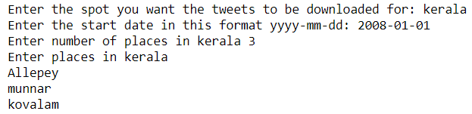
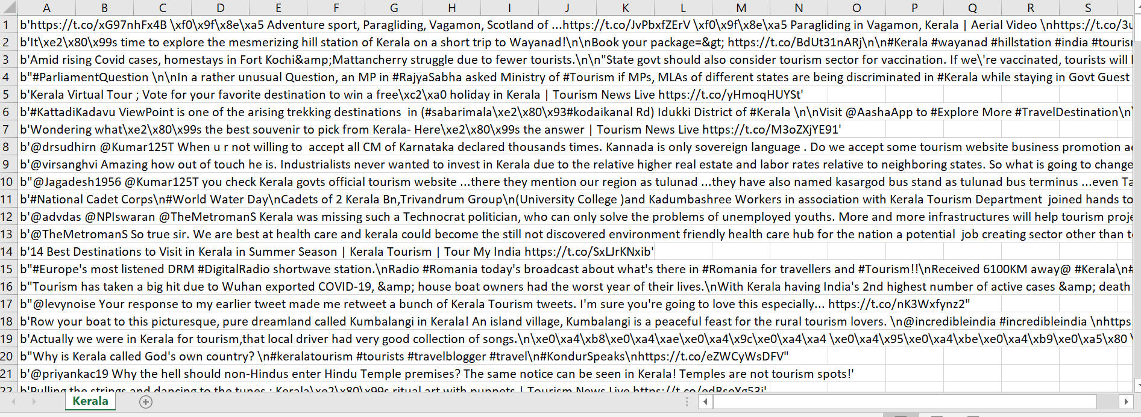
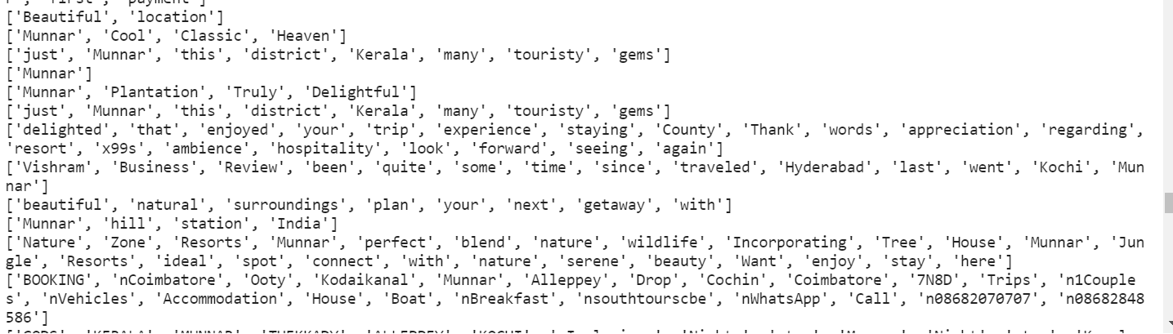
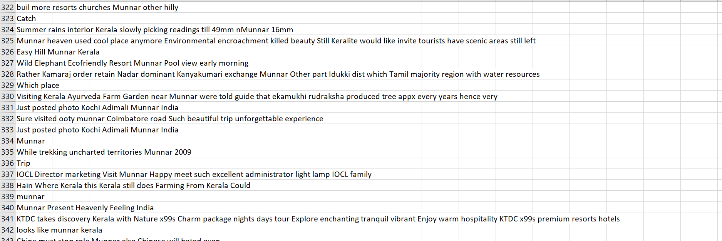
The results of each modules with screenshots
Module 1 Data Preprocessing
Input | Ouput
1. Place details of kerala 2.Noisy data 3.Tokenization 4.Cleaned data

Slide 33
Cleaned data in text format
PlacesName | Cleaned Tweets stored in csv file
Kerala
Really bad day.So sad.Ws disaapointed with boat house stay
your boat this picturesque pure dreamland called Kumbalangi Kerala island village Kumbalangi peaceful feast rural tourism lovers
Beach Tourism Beaches Kerala Beautiful
Kerala is a Overhyped place.

Slide 34
Module 2 Vector Generation
Input table
Enter spot name | Enter any positive number for Positive classification or negative number for negative classification
cleanedkashmir.csv | 1
cleanedkashmir.csv | -1
cleanedladakh.csv | 1
cleanedladakh.csv | -1

Slide 35
KASHMIR
Positive
Negative
gulmarg trekking amazing experience pumped with adrenaline
gulmarg perfect sking loacation
Srinagar is a heaven on earth So beautiful
visited dal lake in srinagar. Such a soothing and calm place. So peaceful
interior kashmir not safe for tourists.
india pok border unsafe
pulwama is filled with terrorists
landslides in gulmarg leave people stranded. No food or water.

Slide 36
LADAKH
Positive
Negative
Amazing view of galwan valley
Snow-biking at zero point. Very much recommended
Solo trip to ladakh. Best experience ever
One of the most beautiful places in the world
Ladakh is overhyped Locals are not friendly and never help Had a horrible experience
There are so many thieves in Ladakh Tourists be careful Still unsafe
Plastic bottles thrown in lakes and rivers. Place is unhygenic Ladakh very poor administration
I went to Ladakh for some alone time. But this place is overcrowded and my trips ruined

Slide 37
Vector Space Generation
Input
Enter spot name
cleanedkashmir.csv
cleanedladakh.csv

Slide 38
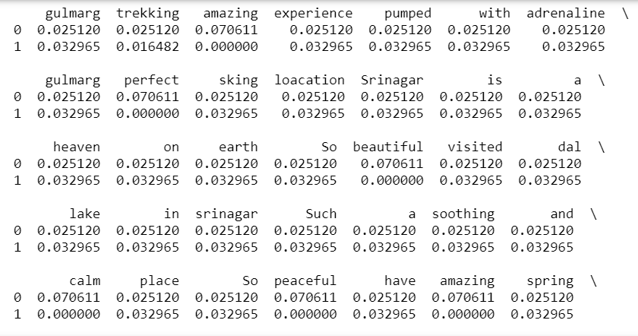
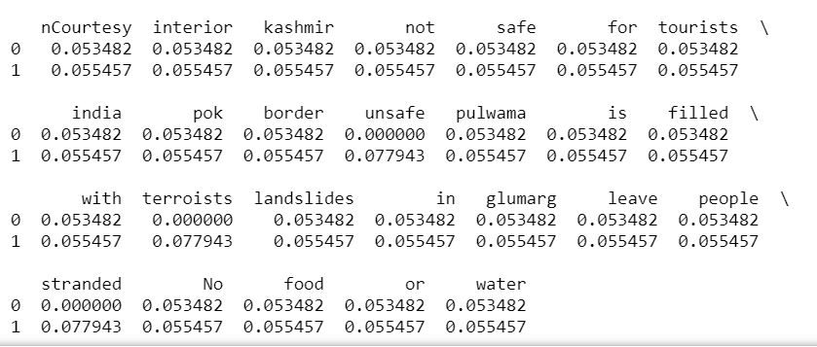
Kashmir

Slide 39
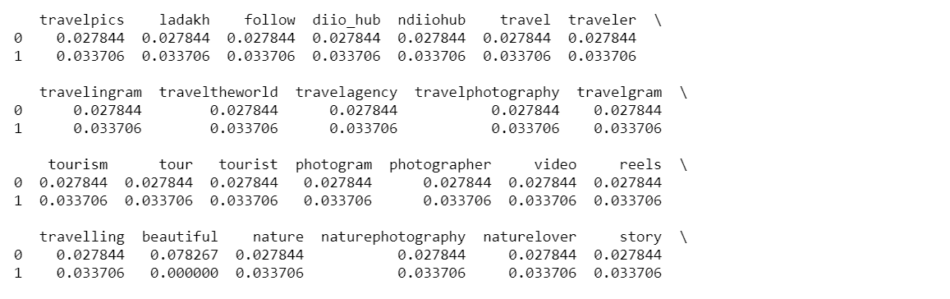
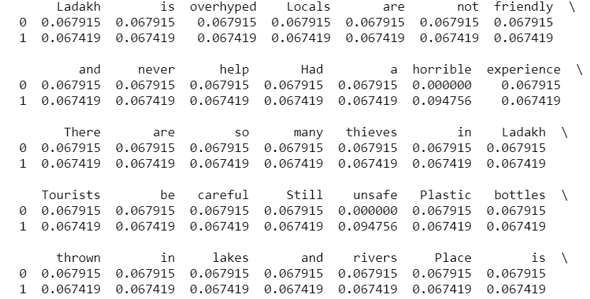
Ladakh

Slide 40
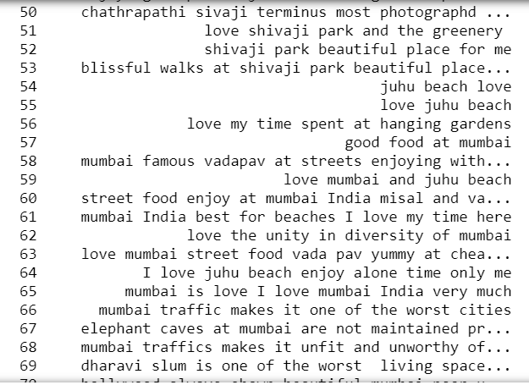
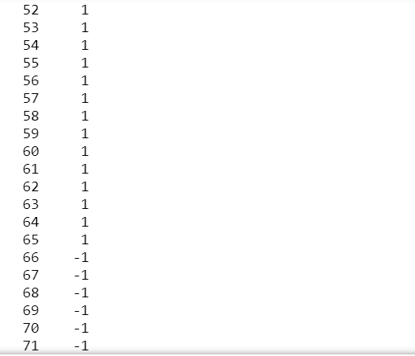
Module 3
PN Classification
Tweets
Sentiments
Here -1 indicates negative sentiment
and 1 indicates positive sentiment

Slide 41
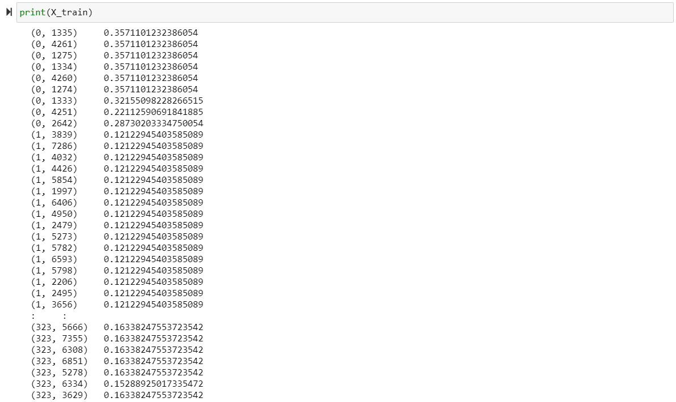
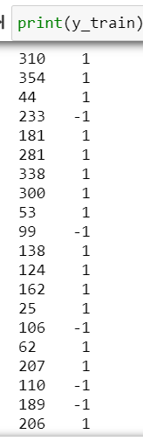
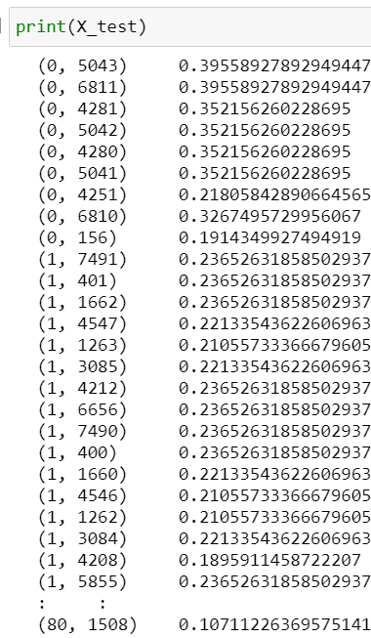
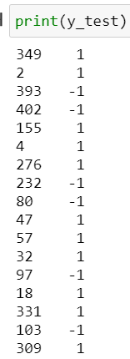

Slide 42
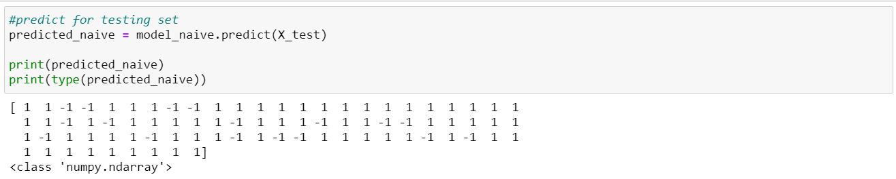
The predicted naïve is as follows

Slide 43
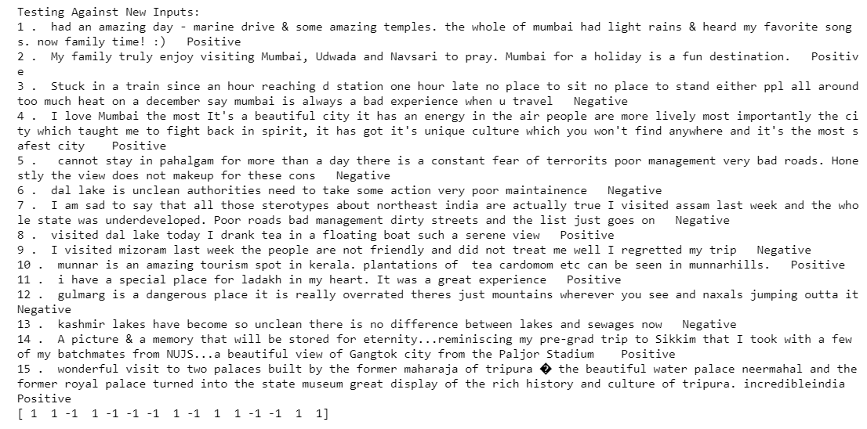
Testing the model against new tweets

Slide 44
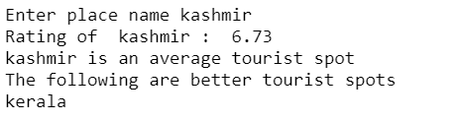
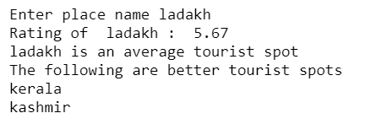
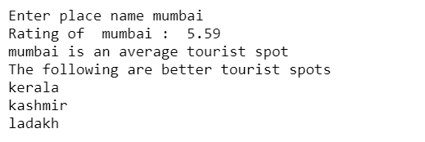
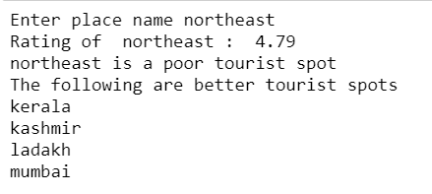
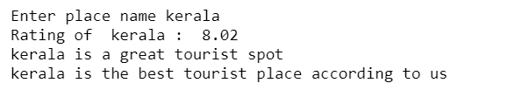
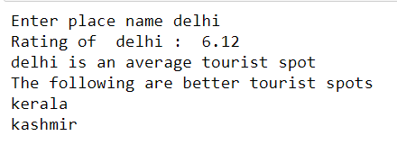
Module 4
Review generation
Input -Spot Name | Output -ratings
Kashmir
Ladakh
Mumbai
NorthEast India
Kerala
Delhi

Slide 45
Summarization of tweets:
Place Name | Input file | Positive and Negative aspects of the place
Kashmir | Positivecleaned Kashmir.csv Negativecleaned Kashmir.csv | Positive Aspects of Kashmir: dal lake in srinagar is a heaven on earth so beautiful visited dal lake in srinagar. dal lake is one of the most beautiful destinations in the world. sanasar has an amazing view of mountain ranges 360degree. sanasar is one of the beautiful hill stations which are famous for picturesque surroundings. sanasar is a beautiful tourist town hosting a mass of adventure activities. Negative Aspects of Kashmir: Kashmir is unsafe for tourists and residents. dal lake is unclean and dirty. dal lake water is dirty and so many mosquitos are budding around sanasar. Kashmir is a dirty place with poor infrastructure and bad transportation. Kashmir is a dangerous place with terrorists naxals cults. a slum in pulwama is filled with terrorists landslides.
Ladakh | Positivecleaned Ladakh.csv Negativecleaned Ladakh.csv | Positive Aspects of Ladakh: ladakh is one of the most beautiful places on earth. with a surplus of attractions to visit, stunning landscapes, amazing people and culture, Ladakh is truly a heaven on earth. teli completed another cycling journey from srinagar covering distance hours minutes. zanskar valley beautiful scenery. ancient forts and monasteries built in the gorges of beautiful Himalayas. secluded villages, rolling sand dunes and shimmering blue lakes. Negative Aspects of Ladakh: ladakh is overhyped and overhyped Locals are not friendly and never help. ladakh is unsafe for tourism with unions destroying bikes and harassing people. the nubra valley is terrible most unsafe, dangerous for tourists.

Slide 46
Final General Review for the Tourist Spots
Place Name | Summary
Kashmir | Transportation: state transport in kashmir is really good. nice improvement over the last few years. srinagar roads are not a problem if you are a good driver. state transport in kashmir is really good. But remember these facts about kashmir before visiting: patnitop roads are in bad condition. stayed 2 days in pahalgam very dirty bad roads concrete everywhere. it is a terrible journey. patnitop fails to attract tourists from all over the country due to bad condition of the road. Safety: Yes it is safe in kashmir kashmir: tourists visiting kashmir need to stay together to be safe. kashmir: tourists visiting kashmir need to stay together to be safe. kashmir: tourists visiting kashmir need to stay together to be safe. But here's why people think it's unsafe: kashmir is unsafe for tourism sullied in political turmoil. walking on icy Dal Lake can be life threatening & can result in slips, falls, fractures & fatal injuries. Local: Here's why you should really visit kashmir gulmarg trekking amazing experience pumped with adrenaline. kashmir is an amazing place shown wrongly in movies. srinagar is a heaven on earth so beautifulvisited dal lake in srinagar. Why you should avoid kashmir kashmir is extremely unsafe and full of terrorists never visit kashmir. kashmiri people really don’t know how to behave with tourists. Cleanliness: The lakes in kasmir are crystal clear,stunning and pristine.The valleys of Kashmir are untamed and unspoilt. But is Kashmir really clean? Kashmir’s iconic Dal lake is dying a slow death.Cleaning drives on the Dal are not new to Kashmir.

Slide 47
Place Name | Summary
Ladakh | Transportation: How good is transportation in ladakh: ladakh bike trip takes enchanting lands most coveted booming destinations indian tourism world most thrilling adventurous bike trip withmazing ladakh roadtrip unforgettable experience. ladakh roadtrip takes enchanting lands most coveted booming destinations indian tourism world most thrilling. But remember these facts about ladakh before visiting: quality of roads in and around Ladakh must be improved. ladakh is unsafe for tourism with unions destroying bikes. there are so many thieves in Ladakh… Safety: Yes it is safe in ladakh ladakh region doesn't require any special permission to visit and it's absolutely safe too. Definitely give it a consideration if you're looking for adventurous bike trip through most beautiful places. But here's why people think it's unsafe: Ladakh is unsafe for tourism with unions destroying bikes, harassing people and forcefully troubling them. Safe trekking trails water stress and intense pressures on a fragile ecosystem are just some of the by-products of Ladakh embrace of unregulated tourism. Local: Here's why you should really visit ladakh ladakh is incredulously beautiful in every season but i have somehow fallen in love with its white expanse more. enjoy the sheer beauty of ladakh and pangong tso lake. Amongst the most starkly beautiful places on earth. Why you should avoid ladakh ladakh is overhyped Locals are not friendly and never help. had a horrible experience. nubra valley highways terrible most unsafe dangerous for tourists. for anyone the nubra Valley an unsafe place to go alone. rain ruined my ladakh trip. Cleanliness: Markha Valley is very clean With no contact with the outer world Markha Valley is very pure. Clean air. Fresh water in small lakes. Leh is very clean. Clean air. Clean water in small lakes. But isladakh really clean? pangong lake and its surroudings where 3 idiots was shot have become so unclean. there is no difference between the lake and sewages now public facilities in ladakh are extremly unhygienic garbage everywhere.

Slide 48
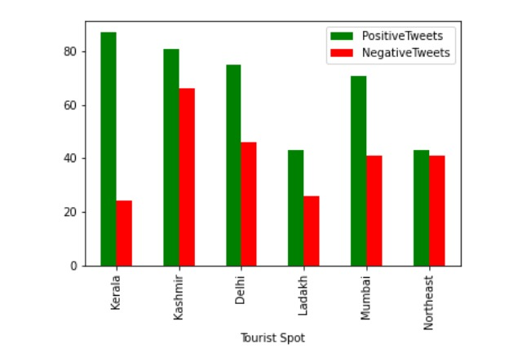
EVALUATION METRICS
Bar graph representation of the no of positive and negative tweets related to each tourist spot

Slide 49
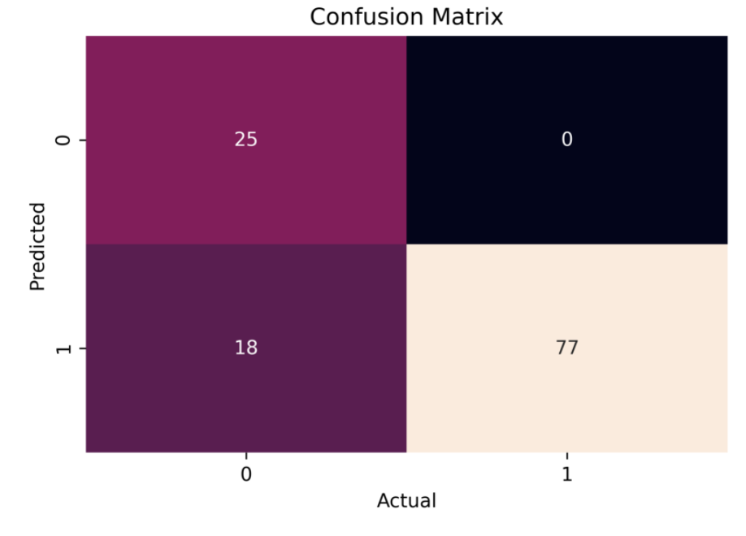
The confusion matrix obtained after executing the third module is as follows
The model has correctly predicted 77 inputs as positive and 25 inputs as negative. The model has not predicted any positive input as negative but it has predicted 18 negative inputs as positive.

Slide 50
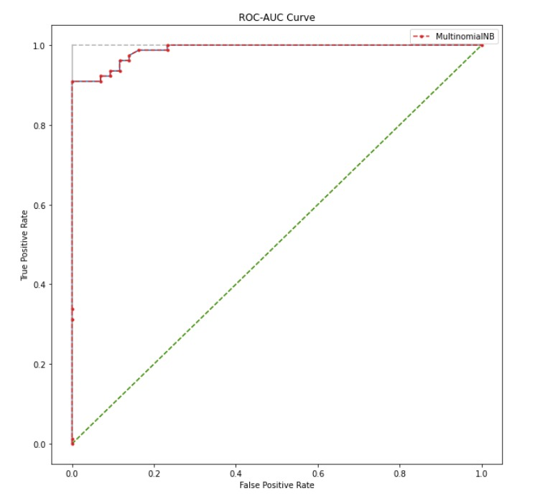
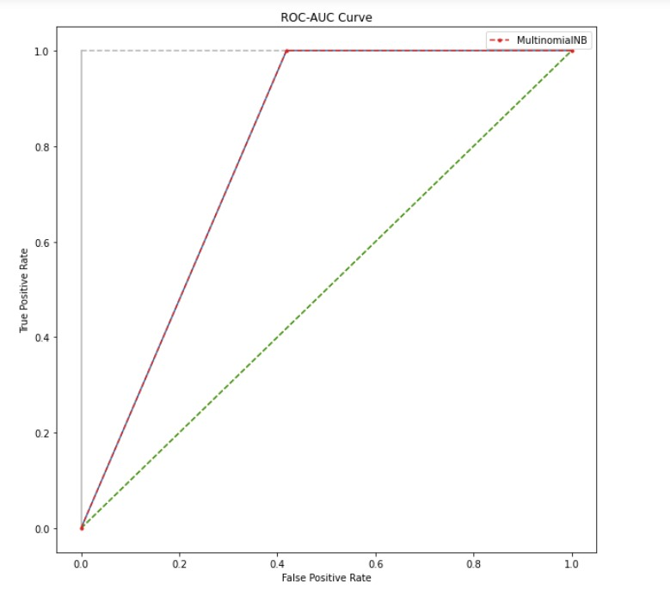
ROC curves for the multinomialNB classifier for the training set:

Slide 51
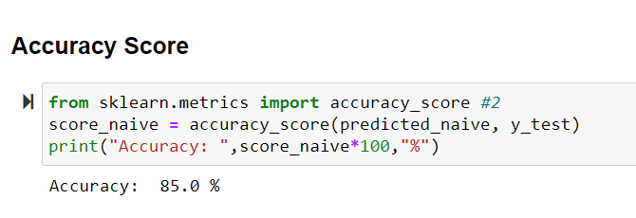
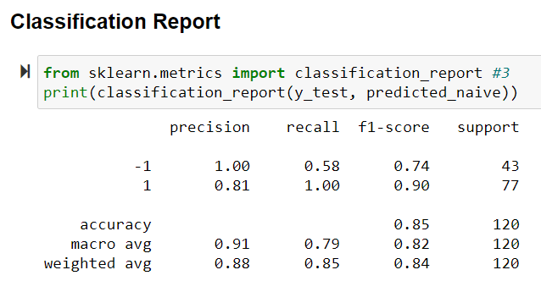
We were able to get an accuracy of 85.0% using the custom prepared dataset
The classification report obtained is as follows

Slide 52
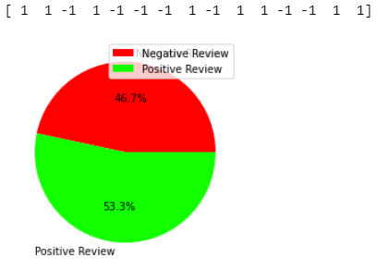
A visual representation of the no of positive and negative tweets in test inputs dataset obtained while testing the model

Slide 53
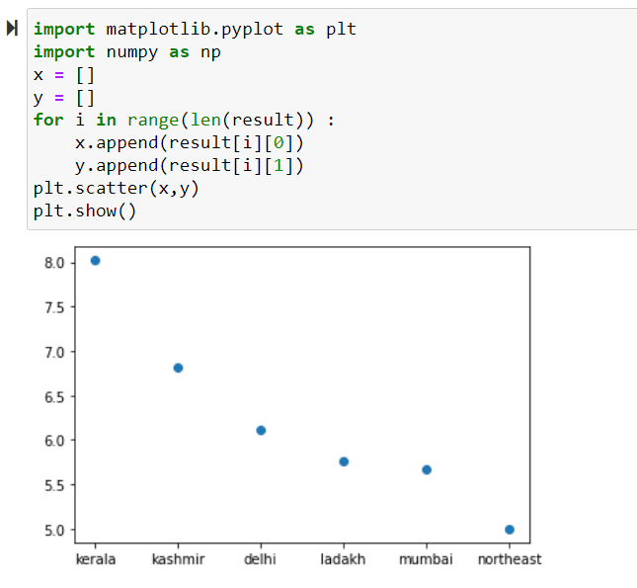
Rating graph using sentiment score

Slide 54
CONCLUSION AND FUTURE DIRECTION
We have completed all the 4 modules in our project block diagram, successfully extracted tweets pertaining to various tourist spot across India from the Twitter API and have successfully performed sentiment analysis on them using Naïve Bayes classifier.
We have calculated the sentiment score and validated the user inputs for the tourist spots. We have also generated a general opinion or review about the particular tourist spot based on the user input.
The general review provides information regarding the safety, cleanliness, transportation and local places of the tourist spots.
Further more our model can be extended to work for many other tourist spots as well. It can also be made into a website with a good user interface for ease of use for the layman.
Thus our model can be of immense use to the tourism recommendation system and for confused people who are not able to decide a good tourist place to visit to come to a wise conclusion.

Slide 55
REFERENCES
Kazutaka Shimada, Shunsuke Inoue, Hiroshi Maeda and Tsutomu Endo. “Analyzing Tourism Information on Twitter for a Local City.” In The First ACIS International Symposium on Software and Network Engineering,pages 61-66,2011.
Rico Yudha Saputra,Lukito Edi Nugroho,Sri Suning Kusumawardani. “Collecting the Tourism Contextual Information data to support the tourism recommendation system.” In The International Conference on Information and Communications Technology (ICOIACT),pages 79-84,2019.
Muhammad Afzaal,Muhammad Usman. “A Novel Framework for Aspect-based Opinion Classification for Tourist Places.” In The Tenth International Conference on Digital Information Management (ICDIM) ,pages 1-9,2015.
Ananchai Muangon, Sotarat Thammaboosadee,Choochart Haruechaiyasak. “A Lexiconizing Framework of Feature-based Opinion Mining in Tourism Industry.” In International Conference on Digital Information and Communication Technology and its Applications(DIC TAP),pages 169-173,2014.
Ankur Goel,Jyoti Gautam,Sitesh Kumar. “Real Time Sentiment Analysis of Tweets Using Naive Bayes.” In The 2nd International Conference on Next Generation Computing Technologies Dehradun, India, pages 257-261,2016.

